Slide 2
Reemployment Services and Eligibility Assessment Program (RESEA)
November 21, 2019
Implementing Requirements for Conducting Evaluations and Building Evidence

Slide 3
Lawrence Burns-Moderator
Reemployment Coordinator
Office of Unemployment Insurance
ETA/USDOL

Slide 4
Gay M. Gilbert
Administrator
Office of Unemployment Insurance
ETA/ USDOL
Megan Lizik
Senior Evaluation Specialist
Chief Evaluation Office
USDOL

Slide 5
Overview of Expectations and Program Requirements for Conducting Evaluations and Building Program Evidence
UIPL 1-20 and TEGL 6-19, Published October 31, 2019
Causal Evidence Ratings
Standards for causal evidence ratings for RESEA interventions
Implications for state-led RESEA evaluations
Tips for Conducting High Quality Evaluations
Evaluation Technical Assistance and Other Resources

Slide 6
Background
Bipartisan Budget Act of 2018 (BBA) enacted new Section 306 of the Social Security Act (SSA)
Establishes a permanent authorization for the RESEA program.
Introduces a tiered evidence approach to promote states’ use of effective interventions and service delivery strategies
It’s no longer a fully prescriptive program - it promotes and rewards new and innovative service delivery strategies and interventions that improve employment outcomes and reduce duration

Slide 7
Social Security Act (SSA) Section 306
RESEA Goals
“To improve employment outcomes and reduce benefit duration, or that the intervention or service delivery strategy are being evaluated to determine their effectiveness in achieving these goals.
To strengthen program integrity and reduce improper payments of unemployment compensation.
To promote integration with the vision of the Workforce Innovation and Opportunity Act.
Establish RESEA as an entry point to other workforce system partners

Slide 8
How would you rate your knowledge of evaluations?
I don’t know a lot about evaluations – but I’m ready to learn!
I know some general evaluation concepts, but have not planned or conducted an evaluation.
I’ve planned some evaluation activities, but have never played a role in conducting an evaluation.
I’ve planned and conducted an evaluation.

Slide 9
RESEA Evidence and Evaluation Requirements
Funds must be used for interventions or strategies demonstrated to reduce claim duration by improving employment outcomes.
Interventions and strategies not backed by evidence must be under evaluation.
Up to 10 percent of a state’s RESEA funds may be used for evaluations.

Slide 10
What is a Tiered Evidence Approach?
Requires use of strategies that work
Ties funding availability to strategies with evidence
Provides incentives to build new evidence around innovative strategies
Requires evaluations of strategies without evidence

Slide 11
RESEA Funding and Evaluation
Beginning in FY 2023, States must use a minimum percentage of their funds on interventions with high or moderate causal evidence ratings
This requirement increases over time as follows:

Slide 12
Expectations for State RESEA Evaluations
States are expected to begin evaluations of RESEA interventions/service delivery strategies no later than during FY 2020
RESEA is a new program
Expanded causal evidence is needed to support funding requirements
Rigorous impact evaluations are multi-year efforts
RESEA state plan requires a description of how the state is meeting/plans to meet the evidence and evaluation requirements

Slide 13
Evaluation Parameters
To align with RESEA defined goals, RESEA impact evaluations must include the following two outcomes:
Unemployment Compensations Duration; and
Employment
States may propose additional outcomes such, as participation and/or completion rates
Expectation that evaluations be made available to public and to USDOL, regardless of outcomes
Coordinate RESEA evaluations with WIOA-mandated evaluation projects, when feasible.
Other types of evidence building may be appropriate places to start, to ensure conditions are right for an impact study

Slide 14
The Need for Expanded Evaluations of Interventions
Intervention is “a service delivery strategy for the provision of State reemployment service and eligibility assessment activities.” 306(i)(3), SSA
For RESEA evaluations an intervention may be a whole program or any component of it.
Examples of RESEA components in need of evidence include but are not limited to:
Reemployment Service Delivery Strategies
Intensive services and case management
Methods for providing career guidance
Support for developing a reemployment plan
Activities that Support Work Search Compliance
Claimant Selection
Impact of Multiple Sessions

Slide 15
What is your top concern about conducting evaluations?
Building our capacity to conduct evaluations.
Coming up with research questions about what we want to learn from an evaluation.
Incorporating evaluation procedures like random assignment into existing program operations.
Accessing necessary data and related resources (data systems, technology) to conduct evaluations.
Developing internal and external partnerships to facilitate evaluations.
Understanding, communicating, and using evaluation results.

Slide 16
Causal Evidence Ratings

Slide 17
Clearinghouse for Labor Evaluation and Research (CLEAR)
CLEAR’s mission: to make research on labor topics more accessible to practitioners, policymakers, researchers, and the public so that it can inform decisions about labor policies and programs
CLEAR does this by conducting systematic evidence reviews of research and evaluation reports on labor topics
How much research is out there? What does it say? Where are the gaps?
All studies in CLEAR have:
Profiles with summaries of study design and findings
Links to original publications
Causal studies are rated based on the strength of the methods used and study quality: high, moderate, and low
Syntheses provide an overall look at the state of the evidence
CLEAR will house the RESEA evidence review
https://clear.dol.gov/
https://clear.dol.gov/reemployment-services-and-eligibility-assessments-resea

Slide 18
RESEA Interventions’ Causal Evidence Ratings
RESEA intervention ratings indicate how much good-quality evidence is available showing that an intervention is effective
An “intervention” may be either
A whole RESEA program
Some component of that program
Interventions’ evidence of casual effectiveness is rated as:
High
Moderate
Potentially promising
No rating
Will be assigned by CLEAR during evidence review process

Slide 19
Looking forward: CLEAR’s RESEA topic area will have two types of evidence ratings
CLEAR’s causal evidence ratings:
are given only to impact studies
pertain to the study (not the intervention studied)
describe the strength of the methods used and how well the study was carried out
reflect CLEAR’s level of confidence in the study’s ability to estimate causal impacts
do not change once assigned
RESEA intervention causal evidence ratings:
only apply to the RESEA topic area
pertain to the intervention studied (not the study)
describe how much good-quality, credible evidence is available showing that an intervention is effective (ie, relies on CLEAR’s causal evidence ratings for studies)
will be assigned by CLEAR following a periodic evidence review
can change as more evidence is available

Slide 20
Standards for RESEA Intervention Ratings
High Causal Evidence
At least 2 credible impact studies each have found…
Favorable impacts on employment and UI duration…
With a strong degree of statistical significance (p<.05).
Moderate Causal Evidence
At least 1 credible impact study has found…
Favorable impacts on employment and (either that same study or another study has found) favorable impacts on UI duration…
With a modest degree of statistical significance (p<.10).

Slide 21
Standards for RESEA Intervention Ratings (con’t)
Interventions that do not qualify for a High or Moderate rating receive one of the following ratings:
Potentially Promising Evidence
At least 1 credible impact study…
Found favorable impacts on employment or UI duration…
With a modest degree of statistical significance (p<.10)
No Rating
No credible impact studies of the intervention exist (yet), or
Credible impact studies exist, but none show statistically significant favorable impacts on the specified outcomes (…more research is needed).

Slide 22
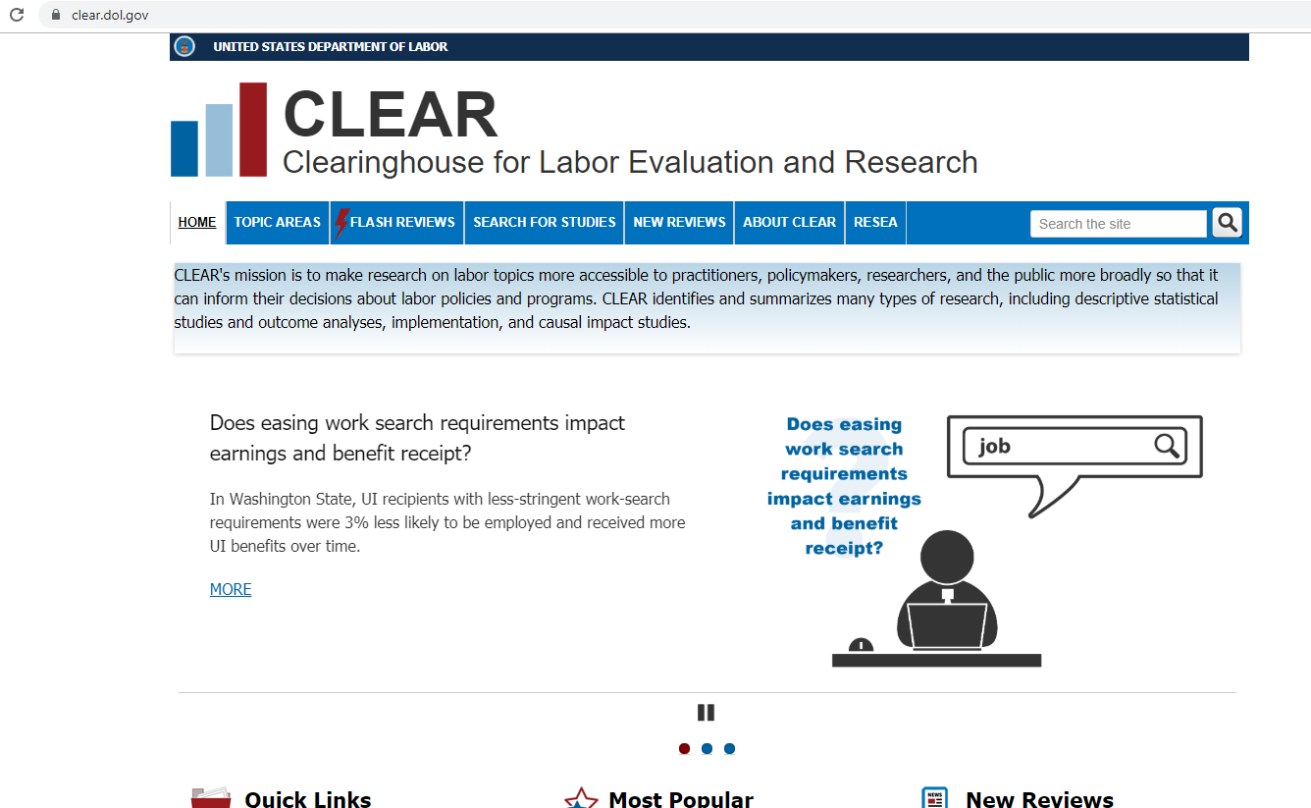

Slide 23
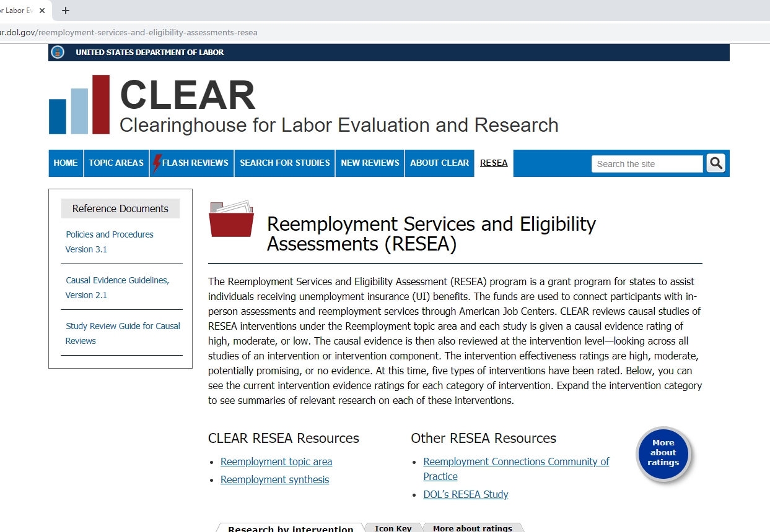

Slide 24
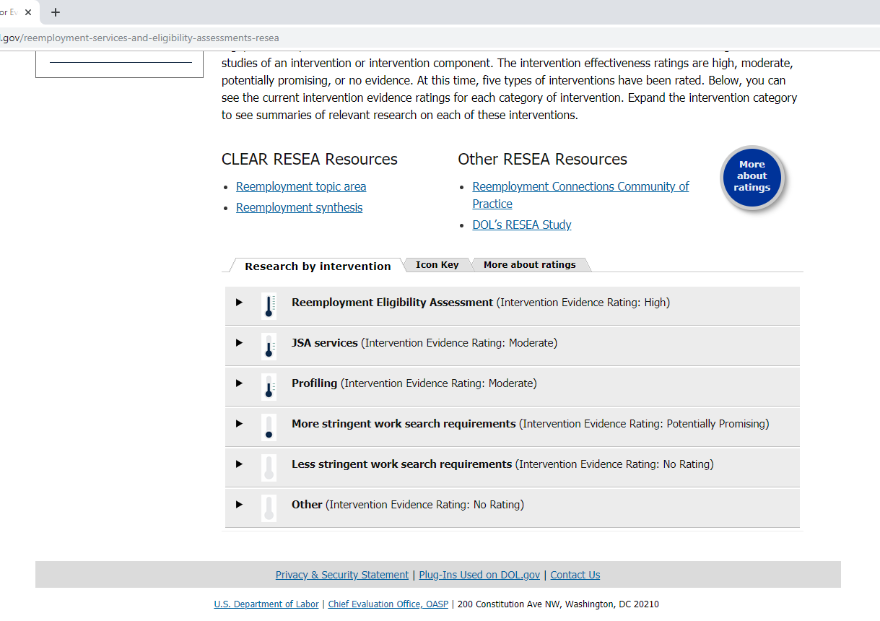

Slide 26
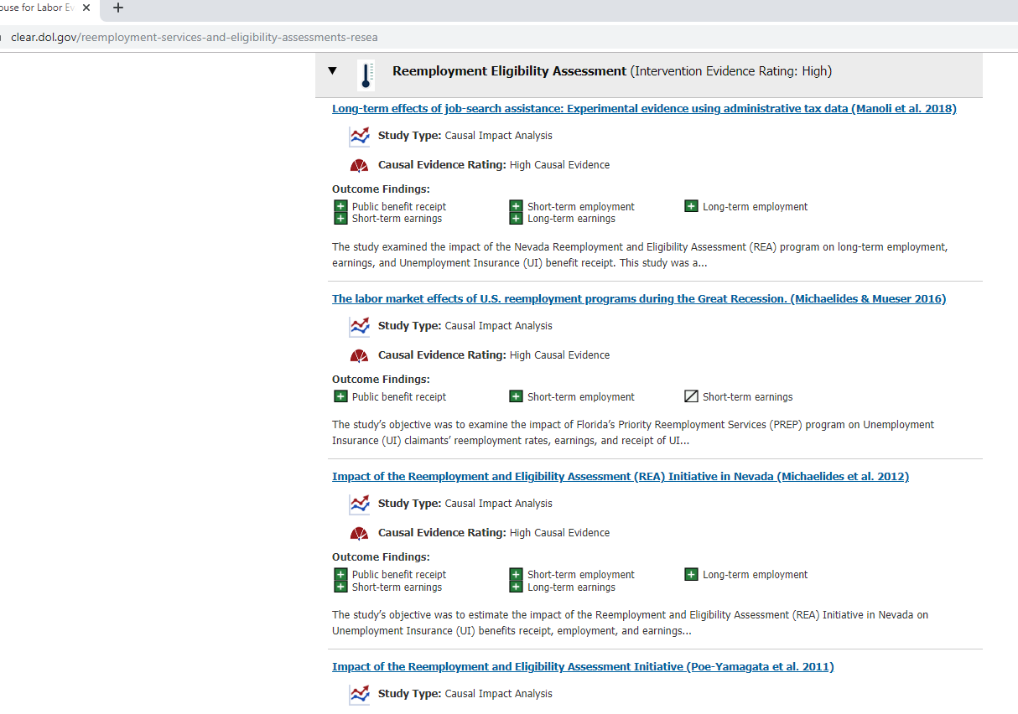

Slide 27
Profile summary of 1 study
Outcomes at a glance
Profile summary of 1 study
Outcomes at a glance
Profile summary of 1 study
Outcomes at a glance
Scroll down for more…

Slide 28
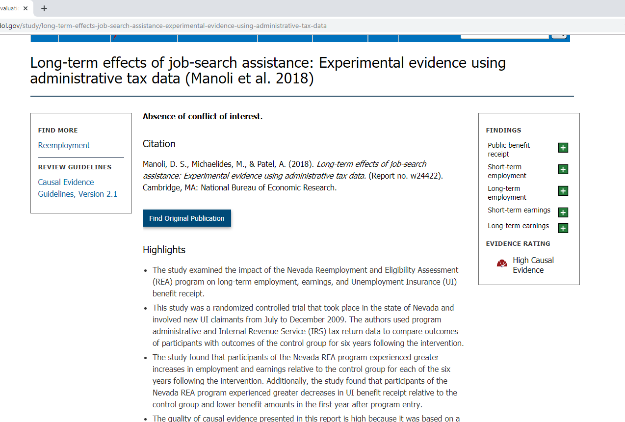
Click on the study title to read more about the study and the intervention it evaluated
See EvalTA Webinar: Using the Clearinghouse for Labor Evaluation and Research (CLEAR) - A Demonstration

Slide 29
Implications for RESEA Programs
RESEA is a new program with a modest evidence base; little high quality evidence exists
Over time, it is vital that more RESEA interventions qualify for high or moderate ratings
To meet statutory requirements
To provide states with reliable information in ongoing efforts to strengthen their RESEA programs
States have a central role in building evidence
Ability to use 10% of RESEA funds for evaluation
DOL is providing evaluation TA to states to support states’ efforts to conduct high quality evaluations of RESEA programs

Slide 30
Tips for Conducting High Quality Evaluations

Slide 31
Where to start…
Q: How can I increase the likelihood of my RESEA intervention getting a high or moderate rating?
A: Getting a high or moderate rating for your evaluation is the first step toward your RESEA intervention being able to be rated high or moderate.

Slide 32
Where to start…
Q: What can I do to increase the likelihood of my RESEA evaluation receiving a high or moderate causal evidence rating?
A: There are three things states can do to help your RESEA impact evaluation meet standards for a moderate or high rating in CLEAR:
Have an experienced, independent evaluator (with no responsibility for program administration or operations) conduct your evaluation.
Make sure your impact evaluation uses an academically rigorous design with comparison groups, like random assignment.
Have a large enough sample, so the results are statistically significant (which could mean partnering with other states to pool samples if your own state has small numbers).

Slide 33
1) Have an experienced, independent evaluator conduct your evaluation.
Ways to verify an evaluator’s qualifications:
Descriptions of previous evaluation work
Biographies and CVs of proposed staff
Descriptions of company’s institutional capacity
Other information required by your state
Request and check references!
See: EvalTA Webinar – Procuring and Selecting an Independent Evaluator

Slide 34
2) Make sure your impact evaluation uses an academically rigorous design with comparison groups, like random assignment.
Impact is different from outcomes
Outcomes = what happened
Impact = What difference my RESEA intervention made to those outcomes (vs. what would have been without the intervention)
Impact study = A study that estimates the difference that an intervention makes
Credibility = Confidence that the impact study’s findings reflect the impact of the intervention, not something else
See: CLEAR’s study ratings

Slide 35
More on CLEAR’s Study Rating Levels
Confident the effects are solely attributable to intervention
Analysis meets methodological standards & results are credible
High
Greater quality and increased credibility
Somewhat confident that effects are attributable to intervention, though other factors may contribute
Factors not accounted for might have contributed to effects
Moderate
Cannot be confident that effects are attributable to intervention
Interpret study findings with caution
Low

Slide 36
What kinds of impact study designs can achieve a high or moderate rating in CLEAR?
CLEAR rates the effectiveness of various types of study designs
Random assignment (or RCT)
Quasi-experimental (QED)
Either of the designs can achieve at least moderate rating…
But QEDs require especially high levels of expertise and care in order to succeed
Work with your experienced evaluator
See EvalTA Webinars:
What Evaluation Designs are Right for My State?
De-Mystifying Random Assignment
Evaluations Using Your Existing Administrative Data: Quasi-Experimental Designs
Overview of Reemployment Study Ratings by Design Type
 |  | Causal Evidence Rating
 | N | High/Mod | Low
RCT | 36 | 83% | 17%
QED | 9 | 11% | 89%
RCT—Randomized Control Trial (random assignment design)
QED—Quasi-experimental design

Slide 37
3) Have a large enough sample, so the results are statistically significant.
Q: How large of a sample does an impact evaluation need?
A: It depends on:
Your research question
What intervention are you evaluating (whole program or component)?
What outcomes are looking at?
Your impact evaluation design
Required sample sizes can be larger than you might expect
Before starting a study, make sure you understand how large a sample is needed to answer your research questions
Work with your experienced evaluator
More EvalTA is coming…

Slide 38
Evaluation Technical Assistance and Other Resources

Slide 39
About the RESEA Evaluation
Contract from DOL/CEO to Abt Associates-led team (w/Urban Institute, Capital Research Corporation)
Working in close collaboration with OUI and OPDR
Supporting DOL and states by:
Developing options for evidence standards and building the evidence base
Conducting an implementation study describing states’ current RESEA programs
Providing evaluation technical assistance to states
Next up:
More evaluation TA
Surveys and some site visits for the implementation study

Slide 40
Evaluation TA Resources – Generalized
RESEA Evaluation TA webinar series
Topics include: Evaluation planning, Procurement, CLEAR, Assessing data, Random assignment, QEDs, Implementation studies
Available on the RESEA Evaluation and Evidence Resources page on WorkforceGPS: https://rc.workforcegps.org/resources/2019/07/30/17/32/RESEA_Evaluation_Evidence_Resources
RESEA Evaluation TA office hours and written products (forthcoming), including the RESEA evaluation toolkit, tip sheets, and more…

Slide 41
Evaluation TA Resources—Customized
Immediate assistance is available through the RESEA Evaluation TA Helpline (RESEA@abtassoc.com)
Answers to basic evaluation questions
Suggestions for options to address challenges
Customized Evaluation TA
Intensive, ongoing assistance is available for a subset of individual states or state evaluation consortia that are ready for and committed to high quality impact evaluation
Provides evaluation TA at key points in the evaluation life cycle – e.g., feedback on evaluation designs, logistical and analytic challenges, reporting, etc.
Supports (does not supplant) the work of an independent evaluator
Further details on forthcoming…

Slide 42
More Evaluation Resources
CLEAR (https://clear.dol.gov):
RESEA Topic Area Tab: https://clear.dol.gov/reemployment-services-and-eligibility-assessments-resea
Reemployment synthesis: https://clear.dol.gov/sites/default/files/ResearchSynthesis_Reemployment.pdf
Reemployment Synthesis Supplement: https://clear.dol.gov/sites/default/files/ResearchSynthesis_Reemploy_Sup.pdf
Causal Evidence Guidelines, Ver. 2.1
Guidelines for rating the strength of causal evidence presented in causal impact studies.
https://clear.dol.gov/reference-documents/causal-evidence-guidelines-version-21
DOL/CEO Guidelines for Randomized Control Trial (RCT) Designs This checklist lists the topics that should be addressed in an evaluation plan using a Random Assignment design.
https://www.dol.gov/asp/evaluation/resources
OMB Guidance for Providing and Using Administrative Data
This memo provides advice and tips for sharing and using administrative data based on OMB guidelines
https://www.whitehouse.gov/sites/whitehouse.gov/files/omb/memoranda/2014/m-14-06.pdf
Federal State Unemployment Compensation (UC); Confidentiality and Disclosure of State UI Information
Confidentiality of UC data is governed by 20 CFR Part 603 and any disclosure or redisclosure of confidential UC data must comply with 603 requirements.
https://www.ecfr.gov/cgi-bin/retrieveECFR?gp=1&SID=e1a7783dda0ecb182e8d6234f1f64613&h=L&mc=true&r=PART&n=pt20.3.603

Slide 43
RESEA Landing Page: https://rc.workforcegps.org/

Slide 44
Summary: Potential Challenges in Meeting Evaluation Requirements
Impact evaluations need to be rigorous in order to achieve a high or moderate causal rating to enable the evaluation to be the basis of supporting state service delivery strategies/interventions.
Rigorous impact evaluations are multi-year projects – usually at least 3 – 4 years.
Rigorous impact evaluations require large sample sizes
Need to consider the availability of data to support the evaluation.
States are limited to 10% evaluation set-aside

Slide 45
Strategies to Meet RESEA Requirements
Strongly Recommend working with experienced evaluators.
Consider how to implement tips provided today into your strategy
Take advantage of DOL’s previous and ongoing TA
Consider conducting pooled evaluations with other states:
Combines limited funding
Allows for larger sample sizes
Can potentially detect effects and demonstrate effectiveness within a more reasonable timeframe.
Current opportunity for additional technical assistance to consortium

Slide 46
Upcoming Events, Deadlines and RESEA Milestones
RESEA Evaluation Office Hours
Wednesday, December 4th 2PM ET
Send Questions to RESEA@abtassoc.com
Technical Assistance Opportunity-Consortiums
E-blast sent to statesTuesday, November 19th
Letters of interest due Wednesday, December 11th
Office Hours will be held the week of December 16th

Slide 48
Lawrence Burns
Reemployment Coordinator
U.S. DOL, Office of Unemployment Insurance
Burns.Lawrence@dol.gov
Megan E. Lizik
Senior Evaluation Specialist and Project Officer for RESEA Evaluation
U.S. DOL, Chief Evaluation Office
Lizik.megan@dol.gov
RESEA Evaluation Technical Assistance Helpline
RESEA@abtassoc.com

