Slide 1
What is your level of experience with Incumbent Worker Training?
High
Some
Low
None

Slide 3
Business Engagement Series:
Incumbent Worker Training As A Business Service

Slide 4
Jeff Ryan
Business Solutions Specialist
US DOL/ETA

Slide 5
Wendi Secrist
Executive Director
Idaho Workforce Development Council
Patrick Crow
Human Resources Manager
Aviation Specialties Unlimited, Inc.
Adrian Kaplan
Workforce Analyst
Office of Workforce Investment/ETA

Slide 6
Introduction/Overview

Slide 7
Does your organization use resources for incumbent worker training?
Yes, we use WIOA funds
Yes, we use funds non-WIOA funds
Yes, we use both WIOA and non-WIOA funds
No
Not sure

Slide 8
Purpose of today’s webinar
We are kicking off our business engagement webinar series with a 3-pack of sessions focused on incumbent worker training as a business service
Today we are thrilled to be joined by the Idaho Workforce Council to talk about how they utilize state resources to provide incumbent worker training as a business service

Slide 9
What is business engagement?
A comprehensive, value-added set of strategies, activities, and partnerships designed to support and promote economic prosperity by providing valuable solutions to address the needs of businesses
The purpose of business engagement programs is to promote long-term economic stability, competitiveness, and growth
Business engagement is about more than just workforce services!

Slide 10
Value of Business Engagement
Successful, thriving businesses are a vital component of economic prosperity
Economic prosperity is of course an outcome that benefits workers and their communities as well as businesses
Whether we represent workforce development, economic development, education or any other government programs, ensuring business success through strong business engagement programs is critical

Slide 11
IWT as a Business Service
Business engagement is a big topic, so today we wanted to start with a discussion about a specific part
In future webinars we’ll broaden our focus, but today we are talking about using incumbent worker training as a business service

Slide 12
IWT Overview
Increases both participants’ and companies’ competitiveness so that businesses can prosper
Two primary reasons to use IWT:
It builds worker skills, so they can be promoted within the company and create backfill opportunities for the employers;
Helps avert potential layoffs of employees;
Many possible sources of funding for IWT, including WIOA
Adult & Dislocated Worker formula (limited to 20%)
Rapid Response funds (activities must be part of a layoff aversion strategy or activity)

Slide 13
Idaho Workforce Development Council
The Workforce Development Training Fund – an employer driven investment strategy.

Slide 14
History of the WDTF
Established in 1996.
3% “offset” of unemployment insurance tax.
$4-6m annually.
Economic development incentive.
Director’s of Labor and Commerce awarded grants.

Slide 15
Use of the WDTF
Idaho Code 72.1203
To provide training and retraining for skills necessary for specific economic opportunities and industrial expansion initiatives;
To provide innovative training solutions to meet industry-specific workforce needs or local workforce challenges; and
For all administrative expenses incurred by the council, including those expenses associated with the collection of the training tax and any other administrative expenses associated with the training fund.

Slide 16
2017 Reset
Governor’s Workforce Development Task Force.
Decision making shifted to Council.
Outreach added to uses of fund:
“To provide public information and outreach on career education and workforce training opportunities, including existing education and training programs and services not funded by the training fund”
Goals for WDTF established:
Increase the economic mobility of Idahoans through training that leads to wage gains and retention.
Provide timely assistance to businesses while shifting focus to broader talent pipeline development strategies that serve multiple employers.
Support growth of the economy by assisting employers with job creation and integration of technology, specifically through the development of skills in their existing and/or new employees.
Provide a return on investment to Idahoans as evidenced by increased wages, job creation, capital investment, retention of Idaho’s workforce, credential attainment and/or customer satisfaction (employer and trainee).
Promote innovation in talent development.
Encourage replication of best practices in talent pipeline development.

Slide 17
2017 Reset

Slide 18
Return on Investment – Employer Grants
Existing metrics:
Did training result in a wage increase?
Did training enhance retention?
Additional economic impact.
New metrics:
Investments in “project” by employer.
How does the training align to in-demand occupations?
Did the individual “go-on” for further degrees/certificates?

Slide 19
Today’s Workforce Development Training Fund
FY19 Awards
12 Employer Grants - $2,835,600
6 Industry Sector - $1,913,200
4 Innovation – $63,800
11 Outreach - $365,500
Over 3,900 trainees and 85 employer partners
Approximately $1,215 invested per trainee

Slide 20
Today’s Workforce Development Training Fund
4 grant programs:
Employer Grants
Industry Sector Grants
Innovation Grants
Outreach Projects

Slide 21
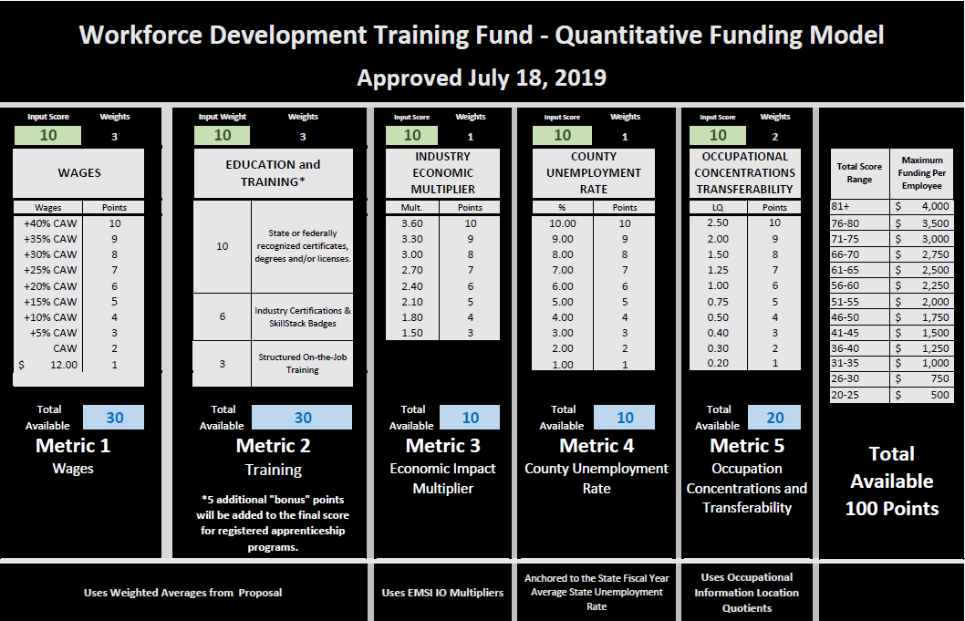
Scoring Model for Employer Grants

Slide 22
Today’s Workforce Development Training Fund
Industry Sector Examples:
Cybersecurity
Welding
Nursing
Co-op education model implementation
K-12 Teacher Certification
Outreach Examples
Teacher Externship
Bussing for Career Fair
Next Steps Idaho

Slide 23
Today’s Workforce Development Training Fund
Employer Grant – Aviation Specialties Unlimited

Slide 24
|| Aviation Specialties Unlimited||

Slide 25
What we do:
NVG Sales
L3
Harris
ASU – E3 – Idaho built NVG platform 30% weight reduction
Aviation lighting filtration for NVG use
NVG Training
NVG flight requires certification (We are a flight school)
Initial and recurrent training
NVG/STC Service
Modification of aircraft lighting systems
FAA collaboration
NVG servicing – calibration – 180 day
NVG Training
NVG/STC Service
NVG Sales

Slide 26
The E-3 Goggle – Idaho made:
NVG – Goggle sales – Current State
90-180 day lead time for other manufacturers
E-3 Goggle, made in Boise – after full FAA approval, ready and in stock.
Why E-3?
30% lighter weight
Fewer moving parts, simpler and easier to maintain.
Who are we hiring?
Manufacturing technicians
Project managers
NVG Training
NVG/STC Service
NVG Sales

Slide 27
What we do – part 2:
Scenic
Field Operation – Aviation Service
Provide Pilots and Mechanics
Tour customers aboard Scenic Eclipse
to amazing sites all over the world.
Only company in the world doing this today
NVG Training
NVG/STC Service
NVG Sales
Scenic Operations

Slide 28
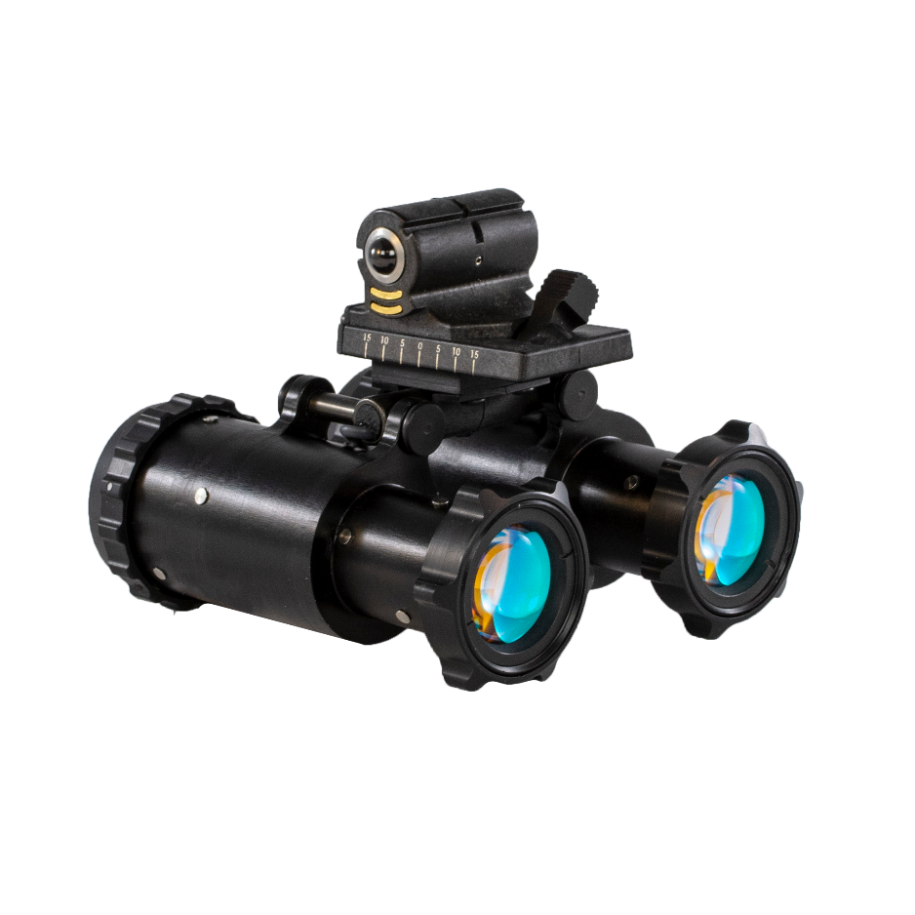
Training Requirements for our expansions:
E-3
Project Management
Lean Manufacturing
3D Printing
Advanced materials
Scenic Operation
Airbus Operation
Airbus Maintenance
Helicopter Underwater Escape
Maritime Safety

Slide 29
Incumbent Worker Training Toolkit
Under construction, share comments

Slide 30
IWT Resources
ETA is currently developing a Tool Kit for incumbent worker training resources
The IWT Tool Kit will contain the following documents:
Policy and Procedures Manual
IWT Training Program
IWT Work Plan
IWT Registration Form
IWT Training Needs Assessment
Please let us know in the comments if there are additional areas you’d like the Tool Kit to address

Slide 31
IWT Resources
The Tool Kit will live on the Incumbent Worker Training resource page on ION, which is part of Workforce GPS
Existing resources on this site include a desk aid and other materials on work-based-learning models.
https://ion.workforcegps.org/resources/2019/05/08/15/08/Incumbent-Worker-Training-IWT

Slide 32
Wrap Up
Thanks to today’s presenters!
Please reach out to them if you have any additional questions
Keep an eye out for additional webinars on various business engagement topics
Let us know in the comments if you have any particular topics that interest you!

Slide 34
Wendi Secrist
Executive Director
Idaho Workforce Development Council
Wendi.secrist@wdc.Idaho.gov
208-488-7561

