Slide 1
Read Before You Proceed: Instructions for Use & Legal Compliance
Legal Accessibility Requirements: 508 Compliance
Only use tables when standard content delivery is insufficient, and never merge table cells.
Do not use screenshots or images of text items. All text must be editable and not blur when the screen is zoomed in.
Avoid using “Smart Art” or the “Design Ideas” tool.
Do not repurpose slide title boxes for any other use.
Do not use multiple spaces, empty paragraphs, or strings of tabs to visually adjust your content, as every such repeated character must then be manually stripped from all slides before posting. Instead:
Use soft returns to bump content to the next line in lieu of spaces (Shift + Enter)
Manage paragraph spacing and tabs in the “Paragraph” panel.
Every image or visual element used must either have alternative “alt” text applied or be marked as “decorative”.
Alt text translates visual information into verbal information, which is read aloud in screen readers, while items marked “decorative” are skipped.
This step is required to deliver the full message provided by any graphics.
The person who laid out the content should also provide that alternate information to ensure their message stays intact.
Learn about the new innovative features!
Please watch this webcast before using this template.
https://vimeo.com/370983870/2afa9e8306
(Ctrl + Click to open link)
Duration: 6 minutes

Slide 2
TAA Financial Overview
Grants, Reporting, Common Issues, and Cost Allocation

Slide 3
Today’s Speakers
Robert Hoekstra
Program Analyst, PMDR Technical Expert
Office of Trade Adjustment Assistance
Timothy Theberge
Program Analyst, PDU Technical Expert
Office of Trade Adjustment Assistance

Slide 4
Who is on the call?
What is your role?
TAA State Program Staff
TAA Reporting Staff
Financial
Unemployment Insurance
US DOL
Other
Please click on the most appropriate answer in the poll.

Slide 5
Today’s Objectives
Discuss TAA Grant Types
Understand the 9130(M)
Address Common Reporting Issues
Review Cost Allocation Principles
Discuss non-Traditional Uses of Case Management Funds

Slide 6
TAA Grant Basics

Slide 7
Grant Basics
Types of TAA Grants
Training and Other Activities (TaOA) Grants
Training Funds
Case Management Funds
Administration Funds
Job Search and Relocation Allowances
Trade Readjustment Allowance (TRA) Grants
Reemployment Trade Adjustment Assistance (RTAA) Grants
Also covers Alternative Trade Adjustment Assistance (ATAA)

Slide 8
Grant Basics
Training and Other Activities
TRA and A/RTAA Grants
Three Year Grant Funds
Includes Administrative Costs
Allocated to States by Formula
Subcomponent Expenditures
Reported on TAA-specific ETA-9130(M)
One Year Grant Funds
Administration Funded Separately
Allocated to States as Needed
No Subcomponents
Reported on General ETA-9130

Slide 9
Grant Basics
TRA and A/RTAA Grants
Governed by UI Grant Processes
Only one Active Grant at a Time
Grant period specified in the UI annual funding agreement
Closeout period for accounting for all funds obligated in the period, not new expenditures
Reported as Total Cumulative Expenditures
TAA Data Integrity (TAADI)
Compares quarterly to PIRL

Slide 10
Grant Basics
Training and Other Activity (TaOA) Grants
Up to Three Grants Active at One Time
First In First Out (FIFO)
Reported as Total Cumulative Expenditures
Includes Subcomponents
Training
Case Management
Administration
Job Search and Relocation
Total TaOA Expenditures
Training
Case Management
Administration
Job Search and Relocation

Slide 11
Grant Basics
TaOA Grants Reported on ETA-9130(M)

Slide 12
Grant Basics
TaOA Subcomponents
Training (includes indirect costs) – Line 11d
Generally just over 50% of expended funds
No cap or minimum expenditures
Case Management – Line 11b
Required minimum expenditure of not less than 5%
Generally around 30-35% of expended funds
Administration – Line 10f
Capped at 10%
Job Search and Relocation – Line 11c
Total TaOA Expenditures
Training
Case Management
Administration
Job Search and Relocation

Slide 13
Grant Basics
Due Dates
Quarterly Reporting Due 45 Days After Quarter Ends
3/31 -> 5/15 6/30 -> 8/14 9/30 -> 11/14 12/31 -> 2/14
First Quarterly Report Based on Notice of Award (NOA) Effective Date
Two (2) Reports Due after the End of the Grant
Final 9130 Due at Normal 45 Days After (Reporting Line 6)
Closeout 9130 Due 90 Days After Final Quarter (in Closeout System)

Slide 14
Any Questions?
Type any questions into the chat and we will respond to as many as we can.

Slide 15
TaOA Grant Deep Dive
Common ETA-9130(M) Reporting Issues and Complexities

Slide 16
TaOA Deep Dive
Administration Expenditures Over Expenditure
TAARA 2015 stipulates up to 10% of Allocation can be spent on Administration
Admin Cap is Calculated based on Allocation, not Expenditures
Reported on line 10f of the 9130(M)
Cap requires special handling for Out of Order Spending*
*Addressed further on Slide 18

Slide 17
TaOA Deep Dive
Case Management Under-Expenditure
TAARA 2015 stipulates at least 5% of Allocation must be spent on Employment and Case Management
NO Maximum
Case Management defined in Section 235, a broad definition
Reported on line 11b of the 9130(M)

Slide 18
TaOA Deep Dive
Out of Order Spending
Oldest available TaOA grant funds should be used first
FIFO = First In, First Out
For example, in FY 2020, a state should not be spending FY 2019 grant funds until FY 2018 grant funds are expended
If FY 2018 is not fully expended:
Training, Case Management, and Job Search should always be $0 on FY 2019 grant
Total Expenditures (10e) should always match Admin Expenditures (10f)
Administration Cap may require roll-over of admin expenditures before older grant is fully expended

Slide 19
TaOA Deep Dive
TaOA Subcomponents Don’t Add
Rule:
10e = 10f + 11b + 11c + 11d
No edit check enforces this logic
Training (11d) added in 2016. Previously calculated training amount.
11d = 10e – (11f + 11b + 11c)
Total Expenditures
(10e)
Training (11d)
Case Management (11b)
Administration (10f)
Job Search & Relocation (11c)

Slide 20
TaOA Deep Dive
TaOA Subcomponents and TAA Data Integrity (TAADI)
Training, line 11d, added in 2016. Previously calculated training amount as: 11d = 10e – (11f + 11b + 11c)
TAADI still uses this logic as a way of enforcing the relationship
TAADI calculates quarterly amount across all three grants
Quarterly = take current quarter cumulative amounts and subtract last quarter cumulative amounts
Across grants = calculate the training amount and add up for all active grants.
Training (11d)
10e
Case Management (11b)
Administration (10f)
Job Search & Relocation (11c)

Slide 21
TaOA Deep Dive
TAADI Logic Expanded
Step 1: Ignore 11d and Calculate Training
Step 2: Subtract Prior Quarter Calculated Amount
Active Grant 1
Current Qtr
Grant 1
Previous Qtr
Active Grant 1
Qtrly Amount
Calculated Training
10e –
(11b +
11c + 10f)
Calculated Training
10e –
(11b +
11c + 10f)
Calculated Training
10e –
(11b +
11c + 10f)
Minus
CM (11b)
CM (11b)
CM (11b)
Admin (10f)
Admin (10f)
Admin (10f)
JS&R (11c)
JS&R (11c)
JS&R (11c)

Slide 22
TaOA Deep Dive
TAADI Logic Expanded
Step 1: Ignore 11d and Calculate Training
Step 2: Subtract Prior Quarter Calculated Amount
Step 3: Add all Active Grants
Quarterly Amount not Right?
Resubmission of old 9130 Not Required, but Can Correct Quarterly Amounts
Active Grant 1
Qtrly Amount
Active Grant 2
Qtrly Amount
Active Grant 3
Qtrly Amount
Calculated Training
10e –
(11b +
11c + 10f)
Calculated Training
10e –
(11b +
11c + 10f)
Calculated Training
10e –
(11b +
11c + 10f)
CM (11b)
CM (11b)
CM (11b)
Admin (10f)
Admin (10f)
Admin (10f)
JS&R (11c)
JS&R (11c)
JS&R (11c)

Slide 23
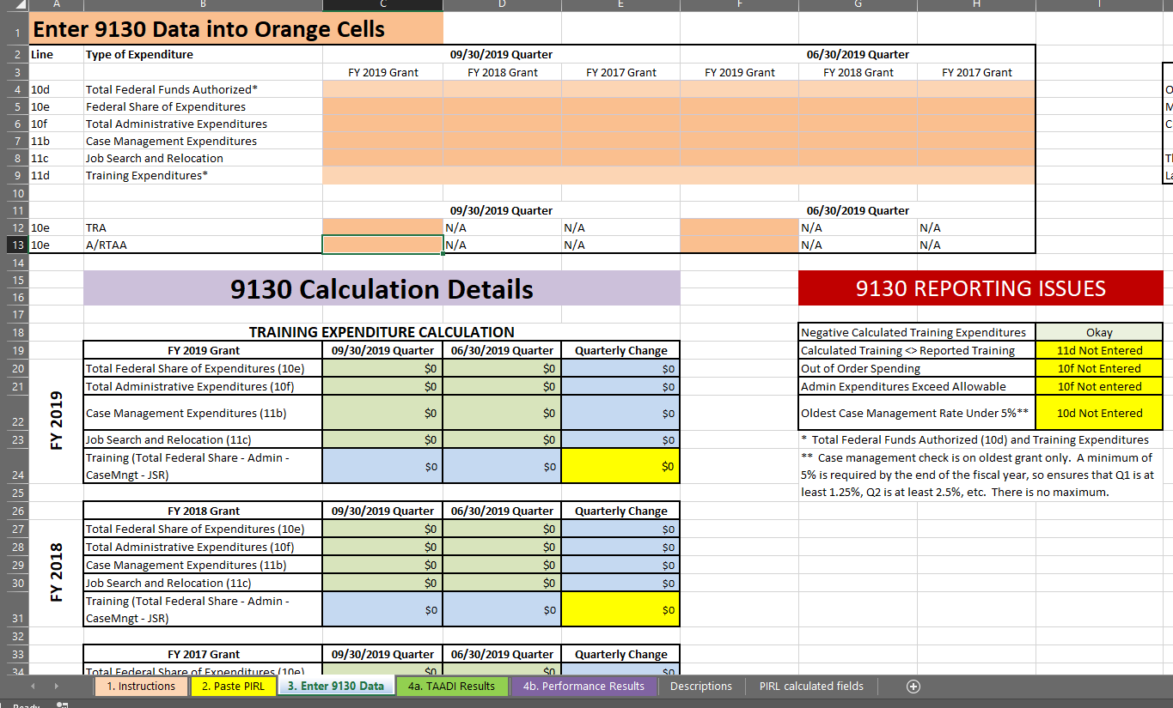
TaOA Deep Dive
Use the TAADI Self-Check!
For TAADI, DOL has provided an excel tool to calculate results.
The Fiscal Worksheet
Calculates Quarterly Amounts
Calculates Training Amounts
Flags Admin Over-Expenditures
Flags Case Mgmt Under-Expenditures
Flags Out of Order Spending
Flags Subcomponents not Adding

Slide 24
Any Questions?
Type any questions into the chat and we will respond to as many as we can.

Slide 25
Grant Timing Issues

Slide 26
Grant Timing Issues
Accrual vs. Cash Accounting
Debt Created
(Accrual)
What is the Difference?
Accrual Basis = When the Debt is Owed
Cash Basis = When the Debt is Paid
All ETA-9130 Reporting is Accrual Basis
DOL Exception to Uniform Guidance at 2 CFR 2900.14
Current Accounting Systems on Cash Basis are not required to convert their systems, but must report best estimate of accruals
Billed
Paid
(Cash)

Slide 27
Grant Timing Issues
Documentation Timing
Debt Created
(Accrual)
TAADI Checks that Participant Data (PIRL) and 9130 Quarterly Amounts Match
When does the expenditure get recorded in your participant system?
When does the expenditure get recorded in the financial system?
Are there major delays?
Is the same date recorded in both systems?
Are both reports generated off the same date?
Billed
Paid
(Cash)

Slide 28
Grant Timing Issues
Expenditures During Closeout
The Grant Period of Performance (PoP) restricts which Expenditures can accrue to the grant
Must be on a grant that is active at the time of the accrual
Grant Years all End on 9/30
Expenditures that accrue after 9/30 may not be on the grant that closed as of 9/30
Expenditures in the First Quarter of the Fiscal Year must not be on the recently expired grant unless it accrued during the prior Fiscal Year.

Slide 29
Any Questions?
Type any questions into the chat and we will respond to as many as we can.

Slide 30
Cost Allocation

Slide 31
Cost Allocation
Cost Categories*
Training
Tuition and related expenses
Books
Tools
Academic fees
Travel or Transportation
Subsistence expenses
Materials Required through Course Curriculum
Licensures / Certification Exams
Equipment Rental / Purchases
Computers
Case Management
The list of 8 CM services as referenced in Sec. 235 (1) – (8)
Maintenance and enhancement of electronic case management systems to allow for improved case management services
Any other staff costs related to case management.
TEGL 22-08 Sec. G(2) and G(3)
Administration
Salaries for Admin related Staff Functions
Collecting, Validating, and Reporting Required Information
Processing Waivers
Administering RTAA Benefits
More information available in Grant Management TEGL 13-18, Attachment III, Section H.2**
Job Search and Relocation
*Lists not intended to be all inclusive.
**TEGL 13-18, Attachment III can be found here:
https://wdr.doleta.gov/directives/attach/TEGL/TEGL_13-18_Attachment-3_Acc.pdf

Slide 32
Cost Allocation
Shared Costs
TAA is a Required Partner under WIOA
TAA Must Share in Costs of One-Stop
Operating Costs
Infrastructure Costs
TAA May Share in Costs of Career Services
TAA Must be Included in Indirect Costs Allocation Plan

Slide 33
Cost Allocation
Federal Cost Principles
Specified in Uniform Guidance
2 CFR Part 200, 2 CFR Part 2900
Consistent Treatment
Partners
Programs
Reporting Periods
Based on Benefit Received
Not Based on Budgets
Reasonable and Necessary

Slide 34
Cost Allocation
Case Management Systems
Collecting Validating and Reporting Data is Charged to Administration
Case Management Funds May be used for Upgrading and Maintaining Electronic Case Management Systems
TEGL 5-15, Change 1, Sec. G(2)
Components of Electronic Case Management Systems
Serve Report Functions May be Charged to Case Management Funds
Exclusive to Reporting Functions Must be Charged to Administration

Slide 35
Cost Allocation
Other Uses of Case Management Funds
Services Provided by Case Managers (Currently State Merit Staff)
Training for Case Managers
Conferences
Round-Tables
Development of Materials

Slide 36
Any Questions?
Type any questions into the chat and we will respond to as many as we can.

Slide 37
Closing Notes
When TaOA funds are initially allocated in a grant year, two TEGLs are issued:
On the Initial Allocation and Grant Requirements
On the Grants Management Requirements
FY 2019 TEGLs are TEGL 12-18 and 13-18
FY 2020 TEGLs coming soon
Need additional TaOA funds?
Forms can be found on the TAA Financial Reporting Page:
https://www.doleta.gov/tradeact/taa-data/financial-reporting/
Check out the recent webinar on high quality reserve requests:
https://taa.workforcegps.org/sitecore/content/global/events/2019/06/26/18/36/Seven-Tips-for-Preparing-Approvable-TAA-Program-Reserve-Funding-Requests

Slide 38
Resources:
ETA-9130 Resources Guide
Quick reference for deadlines and important links.
https://www.doleta.gov/grants/pdf/ETA-9130_Financial_Reporting_Resources.pdf
ETA Financial Reporting Page
Financial Reporting homepage.
https://www.doleta.gov/grants/financial_reporting.cfm
ETA-9130(M)
Training and Other Activities 9130 form.
https://www.doleta.gov/grants/pdf/ETA-9130-M.pdf
TAA Financial Reporting Page
Basics on TAA Financial Reporting
https://www.doleta.gov/tradeact/taa-data/financial-reporting/
TAA Participant Reporting Page
Tons of information on participant reporting including TAADI resources.
https://www.doleta.gov/tradeact/taa-data/participant-reporting/
Upcoming Webinars on our TAA Community Page
WorkforceGPS TAA community page lists upcoming webinars and events.
https://taa.workforcegps.org/events

Slide 39
Contact Us
Robert Hoekstra
Program Analyst, PMDR Technical Expert
Office of Trade Adjustment Assistance
hoekstra.robert@dol.gov
Tim Theberge
Program Analyst, PDU Technical Expert
Office of Trade Adjustment Assistance
theberge.timothy@dol.gov

Slide 40
Thank You!
Need help? Email: Support@workforceGPS.org

