Slide 1
Read Before You Proceed: Instructions for Use & Legal Compliance
Legal Accessibility Requirements: 508 Compliance
Only use tables when standard content delivery is insufficient, and never merge table cells.
Do not use screenshots or images of text items. All text must be editable and not blur when the screen is zoomed in.
Avoid using “Smart Art” or the “Design Ideas” tool.
Do not repurpose slide title boxes for any other use.
Do not use multiple spaces, empty paragraphs, or strings of tabs to visually adjust your content, as every such repeated character must then be manually stripped from all slides before posting. Instead:
Use soft returns to bump content to the next line in lieu of spaces (Shift + Enter)
Manage paragraph spacing and tabs in the “Paragraph” panel.
Every image or visual element used must either have alternative “alt” text applied or be marked as “decorative”.
Alt text translates visual information into verbal information, which is read aloud in screen readers, while items marked “decorative” are skipped.
This step is required to deliver the full message provided by any graphics.
The person who laid out the content should also provide that alternate information to ensure their message stays intact.
Learn about the new innovative features!
Please watch this webcast before using this template.
https://vimeo.com/370983870/2afa9e8306
(Ctrl + Click to open link)
Duration: 6 minutes

Slide 2
Where Are You?
Enter your location in the chat window

Slide 3
H-1B Performance Reporting Orientation 3.0
For Scaling Apprenticeship Grantees

Slide 4
Today’s Moderator
Gregory Scheib
Workforce Analyst
U.S. Department of Labor, Employment and Training Administration

Slide 5
Your Speakers
Kristen Milstead
Performance Lead, Scaling Apprenticeship
U.S. Department of Labor, Employment and Training Administration
Timmy Dudley
Senior Technical Project Management Analyst
ICF

Slide 6
Polling Question
Using the poll, select the role that you play in your H-1B Scaling Apprenticeship grant. For this grant initiative I am the:
Authorized Representative
Program Director/Manager
IT/Data Manager or staff
Training Partner
Employer Partner
Service Provider
Other (case manager, job developer or employment specialist)

Slide 7
Today’s Agenda Items
General SA Performance Reporting Policy Guidance and Announcements
Data File structure
WIPS submission process for data files
Review the aggregation rules used to generate the QPR

Slide 8
SA Performance Reporting Overview and Policy Guidance
Webinar Objectives
Quarterly Progress Reporting Requirements
Guidance for the Quarter Ending 12/31/2019

Slide 9
Webinar Objectives:
Understand the technical aspects of turning a data file into a QPR:
Creating data files with participant data
Navigating the upload process for data files in WIPS
Resolving file errors that can arise when WIPS validates your data
How WIPS calculates your aggregate participant data for the QPR; and
How to compare your outcome targets against the QPR aggregate counts

Slide 10
H-1B Reporting Requirements
Quarterly Progress Reports
H-1B grantees are required to submit two reports in DOL ETA’s Workforce Integrated Performance System, or WIPS:
Quarterly Narrative Report (QNR)
Qualitative summary of grant activities through the reporting quarter
Generated by WIPS after grantee enters information directly into the reporting system
Quarterly Performance Report (QPR)
Quantitative performance outcomes for all participants served
Generated by WIPS from a participant data file uploaded by grantees
Both reports are due 45 days after the end of each quarter.

Slide 11
Reporting Guidance for the Quarter Ending 12/31/2019
Grantees will submit both a Quarterly Narrative Report (QNR) and a participant data file on participants.
Don’t forget to include the Section B program outputs in your QNR
Data file should include cumulative data for all participants served since the start of the grant (7/15/2019)
Grantees will review, certify and submit the QPR generated by WIPS from the uploaded data file (as well as the QNR information)

Slide 12
Reminder: Section B Outcome Reporting in the QNR
Scaling Apprenticeship grantees were required to provide targets on three output measures related to expanding apprenticeship [Section B – B1, B2, B3]
These are not participant outcomes, but program outcomes so are not reported in your data file
These output measures should be reported in Section XI.A of the QNR

Slide 13
Suggested Format for Reporting Scaling Apprenticeship Output Measures

Slide 14
Note about QNR Attachments
Examples of Attachments
Full QNR Document (to extend past 2000 character section limit)
Flyers
Graphs and Charts
News Stories

Slide 15
PIRL 2109-2117 Clarification: Types of Training
PIRL 2109-2117 are used by H-1B programs to specify types of training
For SA grantees, PIRL 2109-2117 are optional
If PIRL 2109-2117 are not used, they must be left blank in the data file.

Slide 16
SA Performance Reporting Handbook 2.0 and Updated PIRL Available Now!
Updated charts and appendices
Clarifications on reporting definitions for some terms
Approved logic and aggregation rules
https://www.workforcegps.org/events/2019/08/29/17/30/H-1B-Scaling-Apprenticeship-Performance-Reporting-Orientation-Webinar-1-0

Slide 17
Any Questions?
Enter your questions in the chat window

Slide 18
Creating a Data File
Data File Format and Technical Requirements
Case Management

Slide 19
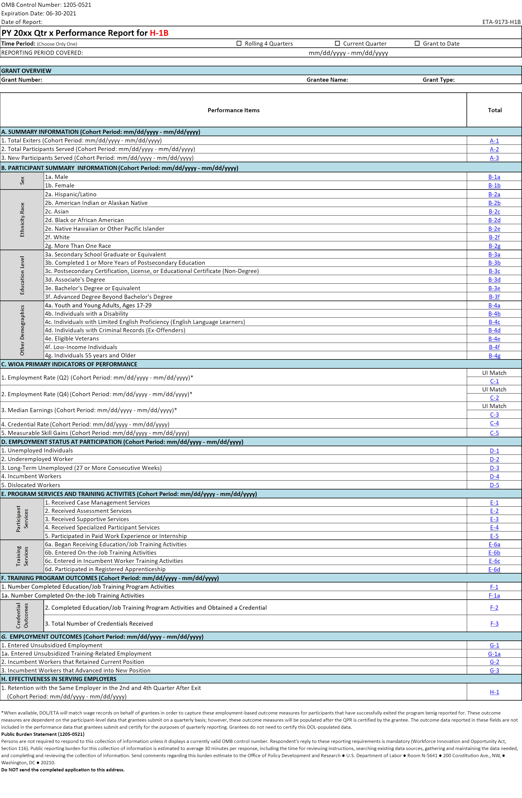
From a Data File to a QPR
Pre-award: Grantees submitted real-time aggregate performance targets on participants (Webinar 2.0 Review)
WIPS generates a QPR of aggregate data and grantee certifies it
Grantee’s QPR data can be used to assess progress on the targets
Post Qtr 2: Grantee develops a data file on participants using PIRL data elements
(Webinar 2.0 Review)
Grantee uploads participant data file to WIPS and resolves file errors
100000000001 | MA | SARAP11 |  |  | 1 | 1 | 0
100000000002 | FL | SAUAP22 |  |  | 2 | 1 | 1
100000000003 | CA | SAPRE33 |  |  | 9 | 0 | 9
100000000004 | AZ | SANONE4 |  |  | 2 | 9 | 1

Slide 20
What is a Data File?
Grantees will upload a data file that includes 89 Participant Individual Record Layout (PIRL) data elements.
PIRL data elements are the required pieces of information that must be reported for each participant served in your program.
The data file includes code values for each PIRL data element for each participant.

Slide 21
Sample Case Management and CSV Data File
Sample Case Management and CSV Data File
Hyperlink

Slide 22
Data File Format
100000000001 | MA | SARAP11 |  |  | 1 | 1 | 0
100000000002 | FL | SAUAP22 |  |  | 2 | 1 | 1
100000000003 | CA | SAPRE33 |  |  | 9 | 0 | 9
100000000004 | AZ | SANONE4 |  |  | 2 | 9 | 1
Each ROW
represents
one participant record
COLUMNS represent code values for data elements on each participant

Slide 23
Data File Technical Requirements
File must be in CSV format in only one file for your grant as a whole
File must include every data element as a data field entry
Participant records must have a corresponding code value for each data element
Cannot contain:
participant names
data element headers
additional rows
blank entries when code values are required
null values instead of a blank or a space.
Note that in some cases, leaving the data field blank is an option if the data element does not apply to the participant. Spaces are counted as a code value.

Slide 24
Polling Question
What systems are you using to track and report your grant’s participant-level data?
Existing MIS System
Third-Party Vendor
Excel Spreadsheet
Access Database
Other

Slide 25
Any Questions?
Enter your questions in the chat window

Slide 26
WIPS and Data Files
Accessing WIPS
Uploading a Data File
Generating an Error Report
Generating a QPR Form
Certifying a Report

Slide 27
WIPS Access
Username and Passwords
The ONLY way to access WIPS is with a WIPS-generated username and password.
Both username and password are sent via email to the Grant’s Authorized Representative from the following email address: admin@dol.appiancloud.com.

Slide 28
Reset Password in WIPS
Select the Reset Your Password link on the WIPS login screen. Then enter your email address in the Username field and select Request Password Reset.
You will receive an email with a temporary password that you will have to change the next time you log in. Your new password must be at least eight (8) characters and have at least one (1) of each of the following:
Uppercase letter
Special character
Lowercase letter
Number
AFTER CHANGING YOUR PASSWORD, YOU MUST LOG OUT AND LOG IN AGAIN.

Slide 29
Change Authorized Representative
Any Authorized Representative change needs to go through the grant modification process, assisted by your FPO.
The modification, signed by the Grant Officer, is the formal approval of the Authorized Representative change.
Please note that after submitting the request to your FPO, it could take 1-2 weeks for the modification to be signed by the Grant Officer and transmitted to you.

Slide 30
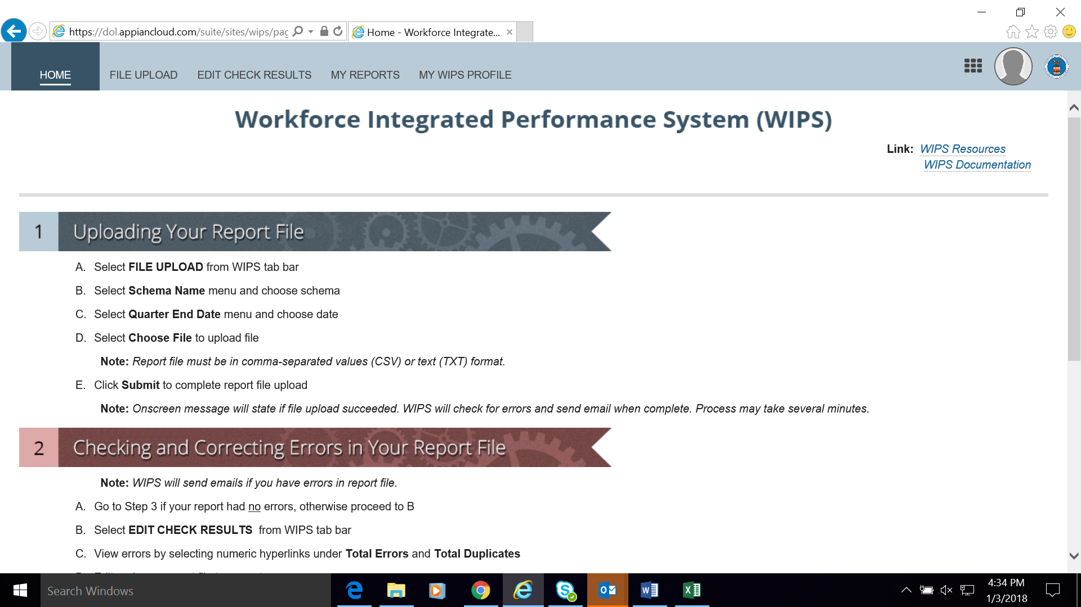
H-1B WIPS Homepage (First Tab)
Once the username and password is entered, the WIPS homepage will display.
Instructions for “Uploading your QPR File” and “Checking and Correcting Errors in Your QPR” will be listed below on the homepage.

Slide 31
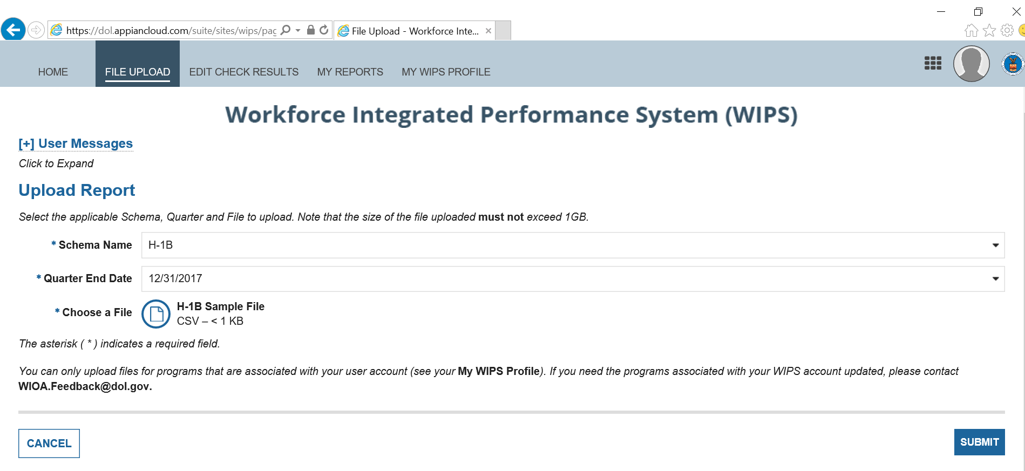
Edit Check Results (Third Tab)
Uploading Your QPR File
Select FILE UPLOAD from WIPS tab bar.
Select Program Name menu and choose program.
Select Quarter End Date menu and choose program.
Select Choose File to upload file.
Click Submit to complete report file upload.
File Upload (Successful Upload Notice)

Slide 32
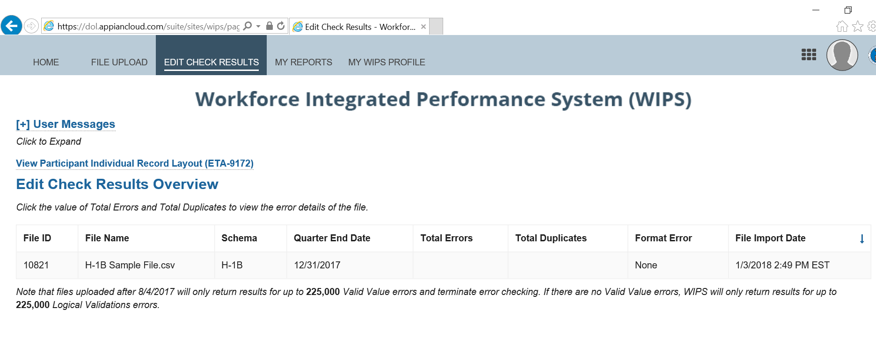
Edit Check Results (Third Tab)
Checking and Correcting Errors in Your Data File
Forgo if your report had no errors.
Select EDIT CHECK RESULTS from WIPS tab Bar
View errors by selecting numeric hyperlinks under Total Errors and Total Duplicates
Edit and save CSV file to correct Errors
Return to Upload your CSV File

Slide 33
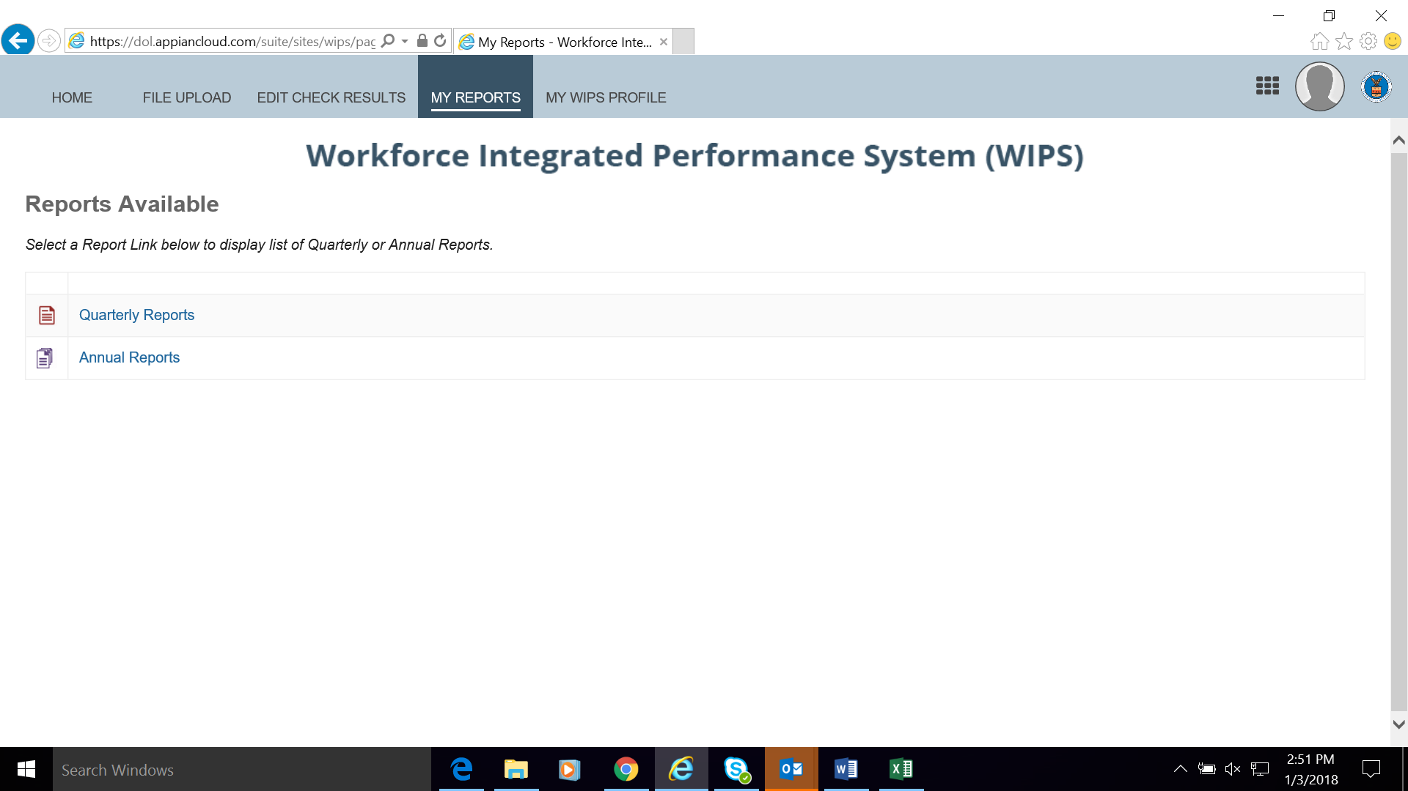
Reviewing Your Uploaded QPR (Fourth Tab)
Select QUARTERLY REPORTS from WIPS tab bar
Find recent report uploaded under Current Quarter section
Open report by clicking hyperlink under Status and Current Quarter(s) section
Confirm accuracy of QPR Information
Contact the Scaling Apprenticeship mailbox if you find discrepancies with your outcomes that you don’t understand
Certify the QPR

Slide 34
Knowledge Check!
Which of the following is not a task that WIPS can help grantees perform within the system?
Resetting a password
Checking whether errors in a data file exist
Correcting errors in a data file
Generating a QPR

Slide 35
Any Questions?
Enter your questions in the chat window

Slide 36
Data Validation and Resolving Data File Errors
Steps for Data Validation
Common Data File Errors

Slide 37
Steps for Data Validation
Step One: Formatting Check Errors
Verify that the format of data file is correct
Appears under format errors hyperlink in WIPS
Step Two: Valid Values Errors
Verify that the code values entered match with the options available
Appears under total errors hyperlink in WIPS

Slide 38
Steps for Data Validation
Step Three: Duplicate Errors
Verifies that duplicative participant records are not in the uploaded file
Appears under duplicate errors hyperlink
Step Four: Logic Rule Errors
Validation check related to the rules assigned to each code value for all data elements to verify internal logic of participant records
Appears under total errors hyperlink
Steps three and four are run at same time

Slide 39
Edit Check Results (Third Tab)
Checking and Correcting Errors in Your Data File
Forgo if your report had no errors.
Select EDIT CHECK RESULTS from WIPS tab Bar
View errors by selecting numeric hyperlinks under
Total Errors and Total Duplicates
Edit and save CSV file to correct Errors
Return to Upload your CSV File

Slide 40
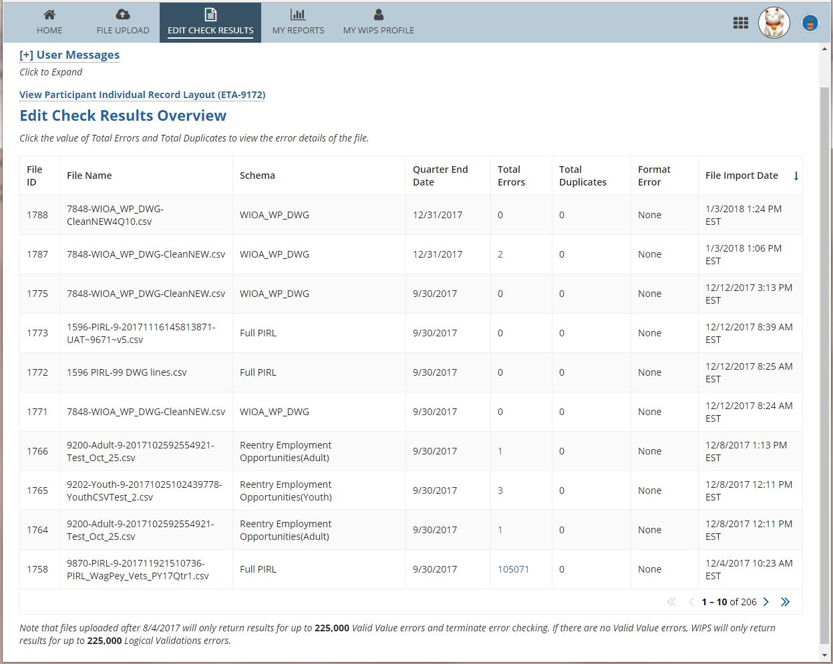

Slide 41
Data Validation Error Report Resolution
Consult error report
Identify error in data file
Verify accurate code value and consult logic rules and valid values
Make corrections to data file
Re-submit data file for the next round of your data validation process

Slide 42
Common Format & Valid Value Errors
Data File Structure
Code values in between commas or a null value
A space in between commas could be an error! A value that contains a space for a null value could be an error!
Do you have headings and data element numbers in your data file?
This will result in a data file error!
PIRL code values that require # digits
Example: PIRL 938 H-1B Grants requires 13 or 14 digits.
Including only 10 digits will result in an error!
Dates in the correct format
Format must be 19771110.
November 10, 1977 or “10111977” will result in an error!

Slide 43
Logic Validation Rule Samples
Logic Validation Rules
Rely on a variety of PIRL data elements to verify your data
PIRL 2101 Reporting Underemployed Workers
IF … | Then …
PIRL 907 (Recipient of Incumbent Worker Training) is 4, H-1B Funded Grant | PIRL 2101 (Underemployed Worker) must be 0, No.

Slide 44
Logic Validation Rule Samples
PIRL 1800 Series | Reporting Credentials
IF … | Then …
PIRL 1800 (Type of Recognized Credential) is 1, 2, 3, 4, 5, 6, or 7, | PIRL 1801 (Date Attained Recognized Credential) must contain a valid date.
PIRL 2118 | Reporting Entered Employment
PIRL 2118 (Date Entered Employment) | must be equal to or after PIRL 900 (Date of Program Entry).

Slide 45
WIPS Tips
Make arrangements with your Authorized Representative for access.
Determine your strategy for how you will receive and validate participant data from your partners.
Start the process of submission early!

Slide 46
Knowledge Check!
Which of the following is an example of a logic validation rule error?
A participant has a date of program entry that comes after a date of program exit
A participant ID number and date of entry are duplicated in the data file
A two-digit number has been entered in a field that requires a date
An extra space was added to a field

Slide 47
Any Questions?
Enter your questions in the chat window

Slide 48
Quarterly Performance Report (QPR) Form
How a QPR is Generated in WIPS
QPR Aggregation Rules

Slide 49
Reviewing Your Uploaded QPR (Fourth Tab)
Select QUARTERLY REPORTS from WIPS tab bar
Find recent report uploaded under Current Quarter section
Open report by clicking hyperlink under Status and Current Quarter(s) section
Confirm accuracy of QPR Information
Contact the Scaling Apprenticeship mailbox if you find discrepancies with your outcomes that you don’t understand
Certify the QPR

Slide 50
QPR Overview: One File—One QPR
User uploads file to WIPS
WIPS checks for errors and processes file
WIPS Generates QPR
User certifies data
Users choose a dropdown option, quarter end date, and file to upload.
Users can view their edit checks and correct files with errors.
Users can view their generated QPR. Only one QPR will be generated per file upload.
User certifies the data represented in the QPR. This data is then recorded in the data warehouse.

Slide 51
H-1B QPR Aggregation Rules
Grantee Database System
CSV Data File Upload in WIPS
QPR Generated
Data File
Data Elements And Edit Checks
Aggregation Rules
Overview of Aggregation Rules
Business rules to aggregate performance data into H-1B Real-time Outcome Measures
Total Participants Served, Began and Completed Training, including types of services, types of training, and credential and employment outcomes
Ensure H-1B aggregation rules are applied to grantee’s internal systems for calculating H-1B Outcome Measures

Slide 52
H-1B WIOA Primary Indicators of Performance on QPR
CSV Data File
DEs used to aggregate:
SSNs used to aggregate:
Measurable Skills Gains
Credential Attainment
Employment Rate – 2nd Quarter After Exit
Employment Rate – 4th Quarter After Exit
Median Earnings – 2nd Quarter After Exit
Effectiveness in Serving Employers

Slide 53
Guidance for Collecting Social Security Numbers
Grantees must ask for SSNs
However, if an individual chooses not to disclose their SSN, services cannot be denied
PIRL 2700 → 999999999
DATA ELEMENT NO. | DATA ELEMENT NAME | DATA TYPE/ FIELD LENGTH | DATA ELEMENT DEFINITIONS/INSTRUCTIONS | CODE VALUE
2700 | Social Security Number | IN 9 | Record the Social Security Number (SSN) assigned to the participant. | XXXXXXXXX

Slide 54
H-1B “Real-time” Measures on QPR
Total apprentices served, including participants served in pre-apprenticeship and apprenticeship programs
Total apprentices who are hired by an employer and enrolled in an apprenticeship education/training program
Total apprentices who complete an apprenticeship education/training program
Total apprentices who complete an apprenticeship education/training program and receive an industry-recognized degree or credential
(Measure is separate from and in addition to the WIOA primary indicators of performance “Credential Attainment”)
Total number of unemployed and underemployed apprentices who complete an apprenticeship education/training program and maintain their employment status with a current or new employer
(Measure is separate from and in addition to the WIOA primary indicators of performance “Employment Rate”)
Total number of incumbent worker apprentices who complete an apprenticeship education/training program and advance into a new position

Slide 55
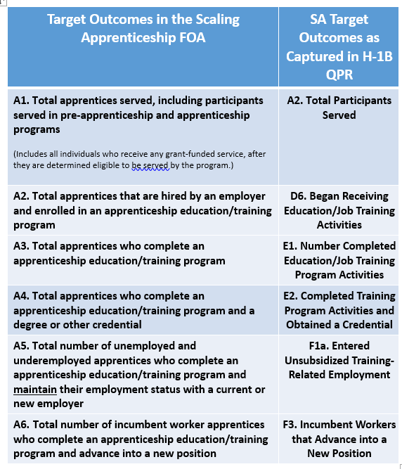
Crosswalk: SA Performance Outcomes with H-1B QPR

Slide 56
H-1B Quarterly Performance Report Aggregations
Aggregation rules depend on:
That PIRL 938 (H-1B) is not blank
Grant Summary Information
Participant Summary Information
Employment Status at Participation
Program Services and Training Activities
Training Program Outcomes
Employment Outcomes
WIOA Primary Indicators of Performance

Slide 57
H-1B QPR Aggregation Rules: Sections A-D
Total Participants Served (A2)
PIRL 900 Date of Program Entry (WIOA)
Total Participants Unemployed at Program Participation (C1)
PIRL 400 Employment Status is 0, Unemployed or 2, Employed, but Received Notice of Termination; and PIRL 900 Date of Program Entry (WIOA)
Total Participants Began Training (D6)
PIRL 900 Date of Program Entry and PIRL 1302 Date Entered Training #1

Slide 58
H-1B QPR Aggregation Rules: Sections E-G
Number Completed Education/Job Training (E1)
PIRL 1307/1312/1317 Training Completed #1/#2/#3 is 1 *and* PIRL 1813 Date Completed [only one of PIRL 1307/1312/1317 is necessary]
Total Participants Entered Employment (F1)
PIRL 2118 Date Entered Employment
Incumbent Workers that Advance into New Position (F3)
PIRL 1813 Date Completed *and* PIRL 907 Receipt of Incumbent Worker Training is 4 *and* PIRL 2120/2122/2124 Incumbent Worker Advance into New Position in 1st/2nd/3rd Quarter after Completion is 1 [only one of PIRL 2120/2122/2124 is necessary]

Slide 59
Knowledge Check!
True or False:
WIPS uses Social Security Numbers to aggregate all of the WIOA Primary Indicators of Performance.
True
False

Slide 60
Any Questions?
Enter your questions in the chat window

Slide 61
Next Steps: Your Action Items
What should we do …

Slide 62
Quarter Ending: H-1B Reporting Reminders
Reporting Deadline: February 14, 2020
Next steps for grantees
Review new performance reporting handbook (and other technical assistance materials—see next slide)
Attend H-1B SA Performance Reporting Office Hours
Wednesday January 22, 2020 1:00PM to 2:00 PM EST
Tuesday, January 28, 2020 1:00PM to 2:00 PM EST
Tuesday, February 4, 2020 1:00PM to 2:00 PM EST
Submit and certify your grant’s QNR and data file in WIPS
Don’t forget Section B in the QNR
Start early!
Contact the Scaling Apprenticeship mailbox (ScalingApprenticeship@dol.gov for performance reporting technical assistance. Please make sure to cc your FPO.

Slide 63
Current Scaling Apprenticeship Performance Resources
H-1B Grants Scaling Apprenticeship Performance Reporting Handbook 2.0 – new!
DOL PIRL for SA Grants – updated!
Joint Quarterly Narrative Performance Report Template (ETA -9179)
H-1B SA Sample Case Management File and Data File
H-1B SA Performance Reporting Toolkit
SA Performance Reporting Webinars 1.0 and 2.0
https://www.workforcegps.org/events/2019/08/29/17/30/H-1B-Scaling-Apprenticeship-Performance-Reporting-Orientation-Webinar-1-0

Slide 64
Polling Question
How prepared are you to submit your CSV data file in WIPS??
Eeks! WIPS What?! We’re not ready.
Um…We are still collecting participant data.
Whew, almost there! We have participant data in our MIS data base.
Feeling great! We’re ready to upload a csv data file in WIPS.

Slide 65
Thank you for all your hard work!

