Slide 1
Wagner-Peyser Act Employment Service
Staffing Flexibility under the 2020 Final Rule

Slide 2
Today’s Moderator
Kim Vitelli
Acting Administrator
ETA – Office of Workforce Investment

Slide 3
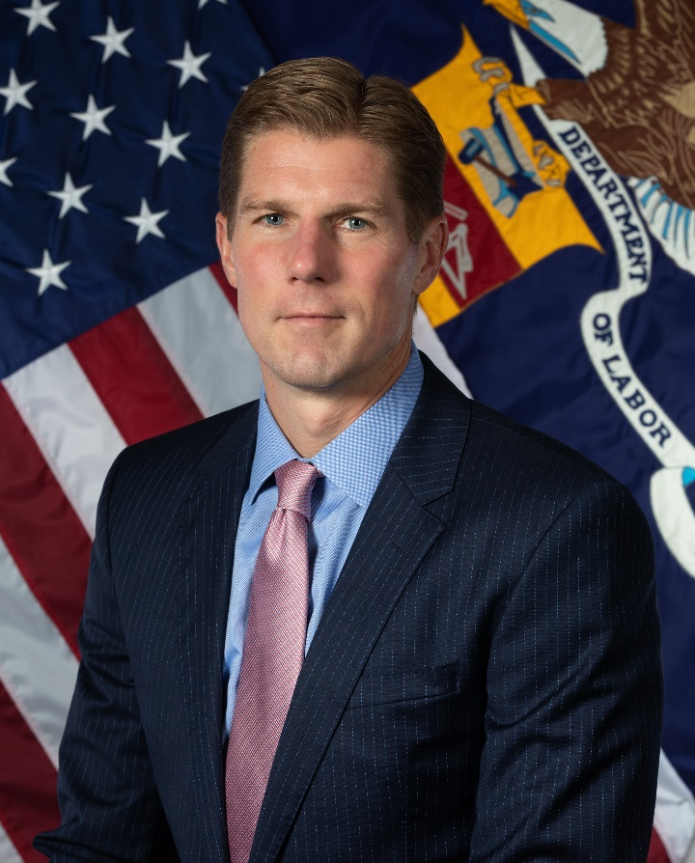
Opening Message from ETA’s Assistant Secretary
John Pallasch
Assistant Secretary
Employment and Training Administration (ETA)

Slide 4
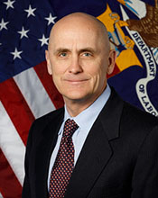
Opening Message from VETS’ Assistant Secretary
John Lowry
Assistant Secretary
Veterans’ Employment and Training Service (VETS)

Slide 5
Today’s Speakers
Andy Ridgeway
Unit Chief – Adult Services
OWI – Div. of Adult Services and Governance
Juan Regalado
National Monitor Advocate
OWI – Div. of National Programs, Tools, and Technical Assistance
Maria Temiquel
Director – Grants and Training
Veterans’ Employment and Training Service

Slide 6
Today’s Objectives
Describe changes the 2020 final rule created to allow states flexibility in the delivery of Wagner-Peyser Act-funded services

Slide 7
Under the 2020 Final Rule, States are no longer required to use state merit staff for Employment Services provided under the Wagner-Peyser Act
This increased flexibility means States can provide Wagner-Peyser Act-funded services through a variety of staffing arrangements

Slide 8
Key Differences
Previously
States were required to provide Wagner-Peyser Act-funded services through State merit staff, with limited exceptions granted for three States.
Under the final rule
States can provide most Wagner-Peyser Act-funded services through State merit staff, other State staff, subawards to local governments or private entities, a combination of these arrangements, or other allowable staffing solutions under the Uniform Guidance.

Slide 9
General Changes to Wagner-Peyser Staffing
Definitions
The final rule adds or amends several definitions found within 20 CFR Part 651.
Additions and changes were made in order to facilitate the flexibility provided under the final rule that allows staffing beyond just state merit staff. The changes also clarify when the final rule allows for additional flexibility and when state staffing must remain in use.

Slide 10
General Changes to Wagner-Peyser Staffing
Definitions (continued)
For example, the following definitions are used in the final rule to clarify when certain tasks or services may be delivered using more flexible staffing and when they must be delivered using state staff.
Employment Service (ES) staff – means individuals, including but not limited to state employees and staff of a subrecipient, who are funded, in whole or in part, by Wagner-Peyser Act funds to carry out activities authorized under the Wagner-Peyser Act.
State Workforce Agency (SWA) official means an individual employed by the State Workforce Agency or any of its subdivisions.

Slide 11
General Changes to Wagner-Peyser Staffing
Subawards
Consistent with the Uniform Guidance, staffing arrangements other than the use of State staff are considered subawards, and non-State entities performing services will be considered subrecipients
States, as Wagner-Peyser Act grantees, are required to oversee all operation under the Wagner-Peyser Act consistent with 20 CFR 683 Subpart D – Oversight and Resolution of Findings
All subrecipients are subject to the Uniform Guidance and the Salary Bonus Limitations
Consistent with 20 CFR 683.400, the Department will continue to conduct monitoring to ensure States are in compliance.

Slide 12
Related Changes to the State Plan ICR
The questions in the State Plan to which states must respond = the “information collection request” or ICR. The W-P regulation updated the State Plan ICR.
The primary State Plan ICR change asks states how they plan to staff the provision of labor exchange services under the Wagner-Peyser Act.
States seeking to utilize the flexibility in the rule need to describe how these services will be provided, such as through a subrecipient arrangement, or a combination of state merit-staff, other state staff, and/or subrecipients.
The Department also made changes to the Agricultural Outreach Plan (AOP) section of the State Plan ICR. As part of their State Plan submissions, states must address the AOP requirements found in that section.
The Department made a change to the Assurances section of the Wagner-Peyser Act part of the State Plan ICR. It removes the assurance that Wagner-Peyser Act-funded staff be state merit-staff employees. This was replaced with an assurance addressing services to migrant and seasonal farmworkers.

Slide 13
Early Implementation
States seeking to implement the Final Rule’s flexibility for the beginning of PY 2020 need to describe their planned implementation activities in the PY 2020-2023 State Plan submission.
At least 45 calendar days before submitting its final Agricultural Outreach Plan (AOP) to the Department, the SWA must provide the proposed AOP to NFJP grantees, public agencies, agricultural employer organizations, and other organizations expressing an interest and allow at least 30 calendar days for review and comment.

Slide 14
Implementation after July 1, 2020
States wishing to implement the flexibility later than the beginning of PY 2020 or subsequent to the approval of their PY 2020-2023 WIOA Unified or Combined State Plan may submit a State Plan modification any time after they receive such notification of approval.

Slide 15
States Opting to Not Use Flexibility
Under the final rule, states may continue to use state merit staff as they have previously done.
States not seeking to change their staffing will still need to provide responses that address the changes made to the State Plan ICR, and can notify ETA that the state will continue to use state merit-staffing in question (a)(1) under the Wagner Peyser Act section in the state plan.

Slide 16
Key Differences (Monitor Advocate)
Staffing Flexibility
Outreach Staff
Significant MSFW One Stop Centers
SMA must be SWA official
Definitions
ES Staff definition applies
Added Definition of Outreach Staff
Added Definition for SWA Official
Clarifying Language
Added clarifying language re: informal resolution of complaints

Slide 17
Monitor Advocate-Specific Changes
New Definitions:
Outreach staff means ES staff with the responsibilities described in 20 CFR § 653.107(b).
State Workforce Agency (SWA) Official means an individual employed by the State Workforce Agency or any of its subdivisions.

Slide 18
Monitor Advocate-Specific Changes
Staffing Flexibility: Outreach Staff
SWAs must seek qualified candidates who speak the language of a significant proportion of the State MSFW population; and
(i) Who are from MSFW backgrounds; or
(ii) Who have substantial work experience in farmworker activities.

Slide 19
Monitor Advocate-Specific Changes
Staffing Flexibility (Cont.): ES Staff at Significant MSFW One Stop Centers
Provide ES staff in a manner facilitating the delivery of employment services tailored to the special needs of MSFWs, including by seeking ES staff that meet the criteria in 20 CFR § 653.107(a)(3)
§ 653.107(a)(3) states: “…candidate who speak the language of a significant proportion of the State MSFW population; and
(i) Who are from MSFW backgrounds; or
(ii) Who have substantial work experience in farmworker activities.”

Slide 20
Monitor Advocate-Specific Changes
Staffing Flexibility (Cont.): State Monitor Advocate
The State Administrator must appoint a State Monitor Advocate who must be a SWA official.
The SWAs must seek persons:
(1) Who are from MSFW backgrounds; or
(2) Who speak the languages of a significant proportion of the State MSFW population; or
(3) Who have substantial work experience in farmworker activities.

Slide 21
Monitor Advocate-Specific Changes
Informal Resolution of Complaints
The State Administrator must have overall responsibility for the operation of the Complaint System; this includes responsibility for the informal resolution of complaints.
Central complaint log must contain: The action taken, and whether the complaint has been resolved, including informally. The complaint log also must include action taken on apparent violations.

Slide 22
JVSG Consolidated Positions
Consolidated Position of Disabled Veterans’ Outreach Program (DVOP) specialist and Local Veterans’ Employment Representative (LVER) staff positions were authorized in Fiscal Year 2012. On January 29, 2020 the policy was updated.
VPL 02-16
States were required to use these positions sparingly and in areas currently underserved or where the assignment of only full-time DVOP specialists and full-time LVER staff would be impractical.
The Consolidated Position should be the exception and not likely to exceed 10 percent of the total JVSG funded staff positions.
VPL 01-20
Grant recipients have the ability to consider their unique situations and allocate staff accordingly, providing a brief narrative to explain how the consolidated positions will promote a more efficient administration of services to veterans.

Slide 23
Summary
Will this impact the quality of career and labor exchange services delivered through AJCs?
No. The new flexibility will allow states, which know their workforce system best, to determine what staffing structure best meets their needs without sacrificing quality of services.
Can States continue to use merit staff that meet the merit-personnel criteria in Federal law to deliver ES services?
Yes. The final rule does not require states to end the use of merit-staffing.

Slide 24
Resources:
Wagner-Peyser Act Staffing Flexibility Final Rule
85 FR 592
https://www.federalregister.gov/documents/2020/01/06/2019-27260/wagner-peyser-act-staffing-flexibility
TEN 13-19
Announcing the Release of the Wagner-Peyser Act Staffing Flexibility Final Rule and Amended Information Collections Associated with this Rulemaking
https://wdr.doleta.gov/directives/corr_doc.cfm?DOCN=6994
State Plan ICR
Required Elements for Submission of the Unified or Combined State Plan and Plan Modifications under the Workforce Innovation and Opportunity Act
https://www.doleta.gov/wioa/docs/State-Plan-ICR.pdf

Slide 25
Any Questions?

Slide 26
Contact Us
WIOA Mailbox
DOL.WIOA@dol.gov

Slide 27
Thank You!
Need help? Email: Support@workforceGPS.org

