Slide 1
Where Are You?
Please enter your location in the chat window
  (lower left of screen)
Please include your name, state, and agency.

Slide 2
Fiscal Year 2020 Reemployment Services and Eligibility Assessment Grants (RESEA)
Funding Allotments, Operating Guidance, and State Plan Requirements

Slide 3

Today’s Moderator
Lawrence Burns
  Reemployment Coordinator
    Office of Unemployment Insurance
    U.S. DOL/ETA

Slide 4
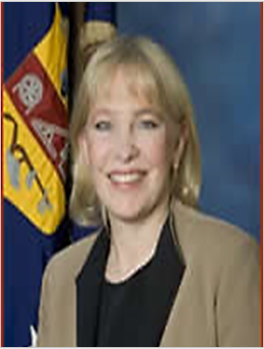


Today’s Speakers
Gay Gilbert
  Administrator
    Office of Unemployment Insurance, U.S. DOL/ETA
Andrew Ridgeway
  Unit Chief, Adult Services
  Office of Workforce Investment, U.S. DOL/ETA
Chanta Ferrell
  Grants Management Specialist
    Office of Grant Management, U.S. DOL/ETA

Slide 5
Today’s Objectives
Background, New Features, and Impact
Funding Allotments and FY 2021 Transition to Formula
Walk-through of FY 2020 RESEA Operating Guidance
RESEA State Plan Process
  Required Elements
  Submission Process
  Timeline
Q&A

Slide 6

Opening Message
Gay Gilbert
Administrator
Office of Unemployment Insurance
Employment & Training Administration
U.S. Department of Labor

Slide 7
Background
Implementing the Permanent RESEA Program

Slide 8
Section 306 of the Social Security Act (SSA)
Enacted by the Bipartisan Budget Act of 2018
  Establishes a permanent authorization for the RESEA program
  Maintains RESEA as a voluntary program
  Phased implementation
    FY 2019 Evidence-based Requirements
    FY 2020 State Plan
    FY 2021 Formula Funding
    FY 2023 Evidence-based Funding Restrictions
Note: the Consolidated Appropriations Act of 2018 postponed RESEA implementation until FY 2019

Slide 9
Section 306(b), SSA
Establishes Four Purposes (goals) for RESEA
To improve employment outcomes of individuals that receive unemployment compensation and reduce benefit duration through employment.
To strengthen program integrity and reduce improper payments of unemployment compensation.
To promote alignment with the broader vision of the Workforce Innovation and Opportunity Act (WIOA).
Establish RESEA as an entry point to other workforce system partner programs.
Note: the Consolidated Appropriations Act of 2018 postponed RESEA implementation until FY 2019

Slide 10
Important New Features of RESEA
It’s permanent and growing dramatically (if all goes well)
It permits flexible targeting of UI claimants
It’s no longer a fully prescriptive program - it promotes and rewards new and innovative service delivery strategies and interventions that improve employment outcomes and reduce duration
It makes RESEA a mandatory one-stop partner under WIOA

Slide 11
How Does this Shift the RESEA Paradigm
Officially makes UI a reemployment program
The funding permits enhanced reemployment services that are more staff intensive – so more thorough assessments, more individualized career counseling, more case management
There is no longer a limitation on “number of visits” – it’s about a continuum of reemployment service delivery that connects claimants to the services they need through American Job Centers and gets them reemployed in good jobs at the earliest possible time

Slide 12
New Requirements Timetable
FY 2019
Evidence-based requirement
Flexibility in targeting
ETA received input on base funding formula allocation
Formula published August 8, 2019
FY 2020
RESEA State Plan implemented
FY 2021
Formula allocation begins
DOL reports to Congress on promising reemployment practices
FY 2023
Evidence-based funding restriction
  25% FYs 2023 and 2024
  40% FYs 2025 and 2025
  50% FY 2027 and later

Slide 13
FY 2020 RESEA Funding Allocations
Maximum Grant Awards for FY 2020 and Factors to Consider for FY 2021

Slide 14
FY 2020 Funding Allocations and FY 2021 Formula
FY 2020
FY 2021
Appropriation is $175 million
Award limits are based on each state’s proportionate share of projected FY 2020 UI first payments
  “Up to” amounts
Minimum increase of 10% and Maximum increase of 20% from FY 19
RESEA implementation funds, not included in FY 19 base.
Authorized Level: $200 million
Formula Factors (1) insured unemployment rate (IUR) and (2) CLF
  See 84 Fed. Reg. 39,018
Distribution:
  89% Base ($178 m)
  10% Outcome Payments ($20 m)
  1% Technical Assistance ($2 m)
Carry Over Limit- 30%

Slide 15
FY 2020 Operating Guidance
Summary of Significant Changes and Program Requirements

Slide 16
FY 2020 RESEA Operating Guidance
The RESEA operating guidance was published on January 30th, as both a Training and Employment Guidance Letter (TEGL 09-19) and Unemployment Insurance Program Letter (UIPL 8-20).
This joint publication reflects the shared responsibilities across the UI and workforce programs in conducting RESEA activities.
The guidance documents are identical other than non-substantive changes to formatting.

Slide 17
RESEA: Changes and Overview of Requirements
New Flexibilities and Other Program Changes
Review of Significant Program Requirements
New Definitions
Revised Program Cost Limits
  Administrative
  Initial and Subsequent RESEAs
Flexibility to Serve Previously Excluded Populations
Recommendations for Self-scheduling and Claimant Participation Policies
RESEAs Funds: Supplement not Supplant
Continued Flexibility in Targeting of RESEA Services
RESEA and Worker Profiling and Reemployment Services (WPRS)
RESEA and WIOA Integration
  Co-enrollment
  Flexible staffing
  Performance reporting

Slide 18
RESEA Definitions
1
RESEA is a new program that provides greater flexibility in program design and service delivery.
For planning and reporting purposes and to promote greater consistency across programs new RESEA specific definitions were introduced.
These definitions reflect the minimum levels of service-delivery and states may include additional services in their program design.
Initial RESEA
2
Subsequent RESEA
3
Reemployment Services
4
Training

Slide 19
RESEA Definitions: Minimum Requirements
Initial RESEA
Official Notification
Eligibility Review/Work Search
Customized Labor Market Info.
Enrollment in Employment Service
Support with Reemployment Plan
Information/Referral to Services
Subsequent RESEA
Follow-on meeting to initial RESEA
Eligibility Review
Review of work search to determine if additional services are needed.
Reemployment Services
Includes but not limited to WIOA Career Services
WIOA Section 134(c)(2)
20 CFR 678.430
Training
Training Services as defined by WIOA Section 134(c)(3) and 20 CFR 680.200
UI approved training

Slide 20
New Flexibilities and Other Program Changes
Revised Cost Limits
Previously Excluded Populations
Administrative costs limited to 15%
  All states may request to use $100,000 above admin limit for IT and other costs associated with implementation of RESEA program.
Cost Per Initial and Subsequent RESEA
  No longer capped
  Information about projected costs must continue to be provided in state plan.
Previously states were required to exempt the following claimant populations from RESEA participation:
  Have definite return-to-work date
  Secure work through union hiring hall
  In approved training
States now have discretion to align RESEA participation policies with state work search requirements.

Slide 21
Section 7c: Claimant Participation in RESEA Services and Rescheduling
“Many states are developing or have already implemented self-scheduling of RESEA sessions….states utilizing this strategy need to develop policies that prevent excessive rescheduling that substantially delays or allows a claimant to circumvent participation in RESEA activities, which is a condition of UI eligibility.”-
Potential Policies:
  Unlimited self-reschedules within a certain time period- must contact RESEA staff to schedule beyond time period
  Limit number of self-service reschedules before claimant must contact RESEA staff.
Be cautious of potential duplication on RESEA activity reports
  Rescheduled sessions not resulting in a disqualification must not be counted in “Total number of RESEAs scheduled” (9128, item 2)

Slide 22
Section 306(h), SSA- Supplement not Supplant
During the development of your RESEA state plan, be mindful of the following provision, especially, when partnering with or leveraging preexisting programs.
“Funds made available to carry out this section shall be used to supplement the level of Federal, State, and local public funds that, in the absence of such availability, would be expended to provide reemployment services and eligibility assessments to individuals receiving unemployment compensation, and in no case to supplant such Federal, State, or local public funds.”

Slide 23
RESEA Participant Selection & Worker Profiling and Reemploy Services (WPRS)
Flexible Targeting of RESEA Services
Intersection with WPRS
FY 2020 Federal Appropriations allow states to identify target groups from recipients of regular UI benefits.
Flexibility to target claimants from a variety of backgrounds or lengths of time receiving UI benefits.
Targeted claimant population must be supported by local labor market information, economic trends, and other available data.
WPRS remains a separate stand-alone program (Section 303(j),SSA).
RESEA States are subject to WPRS, if
  RESEA services are not provided statewide; or
  Method other than profiling is used for selection
States may serve a combination of target populations while still satisfying WPRS

Slide 24
Integration with Workforce Innovation and Opportunity Act
By applying for RESEA funding, states agree to integrate the RESEA program with WIOA, the Wagner-Peyser Act, and the workforce system broadly.
RESEA participants must be co-enrolled in the State’s Wagner-Peyser Act-funded employment service
  Co-enrollment in other programs should be considered, where appropriate
WIOA data will be used to assess the performance of the RESEA program.
  Additional guidance on RESEA performance/outcome payments is forthcoming
  RESEA participants must be identified in WIOA reports (PIRL element 401)
There is no merit-staffing requirements for RESEA service delivery staff
  Eligibility determinations/redeterminations handled by UI merit staff
  States are encouraged to review ES staffing flexibilities (85 FR 592)

Slide 25
RESEA State Plan
Summary of New Elements and Submission Instructions

Slide 26
RESEA State Plan: Overview
DUE: Monday, March 16, 2020
Submission of an RESEA state plan is required by Section 306(e), SSA
To streamline process a fillable template was developed:
  Attachment II of FY 2020 operating guidance
  www.grants.gov Funding Opportunity Number “ETA-UIPL-08-20”
Template is based on previous “RESEA Grant Proposal Summary”
DOL will notify states by April 15, 2020 regarding status of state plan
  States that are disapproved will be informed of the reasons for the disapproval and be provided an opportunity to submit a revised plan.

Slide 27
RESEA State Plan: New Elements
Notification and Scheduling
Activities Supporting Statutory Purposes
Element 24: Proper Notification
  Must be in clear and simple language
  Include warnings to ensure individuals are fully aware of potential consequences
Element 25: Reasonable Scheduling Accommodations
  Intended to maximize participation
  Ex. Self-scheduling, alternative locations, multiple appointment options, etc.
Element 27a- Improve employment outcomes/reduce duration through employment
Element 27b- Strengthen Program Integrity
Element 27c- Alignment with vision of WIOA)
Element 27d- Establish RESEA as an Entry-Point to Workforce System

Slide 28

RESEA State Plan: New Elements
Evidence-based Standards and Evaluation Requirements
Element 28(a): How is the state satisfying the requirement to use grant funds only for interventions and service delivery strategies designed to reduce duration and improve employment outcomes?
  Current evidence-base
Element 28(b): Are RESEA interventions or service delivery strategies used to implement the program without a high or moderate causal rating under evaluation?
  Planned evaluation activities
Element 28(c): Total funds that will be set aside for evaluations
  Up to 10 percent of total grant award.
Element 28(d): Insert a description of any reemployment activities and evaluations of reemployment interventions and service delivery strategies conducted in the prior Fiscal Year.

Slide 29
RESEA State Plan
Submission using Grants.gov

Slide 30
Application Submission Process
  Grants.gov Funding Opportunity Number: ETA-UIPL-08-20
  Applicant’s registration with the System for Award Management (SAM) must be active before an application can be submitted in Grants.gov.
  Applicants must register with Grants.gov to submit the required application package. https://www.grants.gov/web/grants/applicants/appy-for-grants.html.
  Please register early!
  Registration is a one time process, and applicants who already have a Grants.gov account do not need to register again.

Slide 31
RESEA State Plan Requirements
A complete RESEA state plan package includes:
1. SF-424 Application for Federal Assistance
(OMB No. 4040-0004 – Expiration Date 12/31/2022)
2. SF-424A Budget Information- Non-Construction Programs
(OMB No. 4040-0006 – Expiration Date 02/28/2022)
3. Current Indirect Cost Rate Agreement
  4. “Elements of an Unemployment Insurance (UI) Reemployment Services and Eligibility Assessment (RESEA) Grant State Plan” (Fillable PDF)

Slide 32
Common Errors
SF-424: Application for Federal Assistance:
Do not submit expired forms—Check dates!
  Applicant must supply their Data Universal Numbering System
  (D-U-N-S) on line 8c.
  Include the announcement number “ETA-UIPL-08-20” on line 12
  Funding Opportunity Number.
  Provide the ENTIRE award amount on line 18.

Slide 33
Any Questions?
Please use chat feature to submit questions.
  (We will address questions not answered today via a follow-up webinar or FAQ)

Slide 34
Closing Thoughts
Gay Gilbert
Administrator
Office of Unemployment Insurance
Employment & Training Administration
U.S. Department of Labor

Slide 35
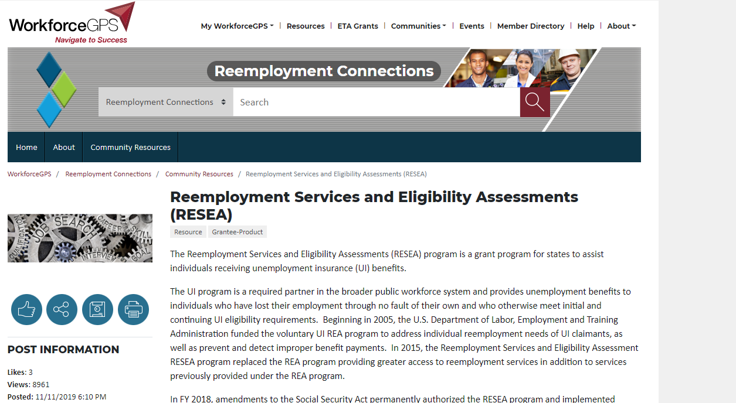
Resources: RESEA Landing Page
The new “RESEA Landing Page” is hosted on the Reemployment Connections Resource Page (https://rc.workforcegps.org/ ) and serves as a comprehensive location for information to support states with all components of the RESEA program.
The landing page can be accessed directly at: https://rc.workforcegps.org/resources/RESEA
Please visit, bookmark, and check often for new resources!

Slide 36
Resources: RESEA Evaluations
Joint Guidance: Expectations for States Implementing the RESEA Program Requirements for Conducting Evaluations and Building Program Evidence
  TEGL 06-19 and UIPL 01-20 Published October 31, 2019
  Webinar recording:
  https://www.workforcegps.org/events/2019/10/22/15/22/RESEA-Overview-of-Evaluation-and-Evidence-Requirements
  WIOA Evaluation Toolkit: Key Elements for State Workforce Agencies
  This toolkit is provides a basic overview of evaluation elements for WIOA program management purposes and a two-part quick action planner to assess evaluation readiness.
    https://evalhub.workforcegps.org/-/media/Global-Site/Content/ETA-Webinars/2018/10---October/20181002_An_Evaluation_Readiness_Assessment/WIOA-Evaluation-Toolkit-for-States-as-of-July-2018.ashx
WorkforceGPS Evaluation and Research Hub
  This page provides links to a broader set of more general evaluation resources.
    https://evalhub.workforcegps.org/about

Slide 37
Resources: Clearinghouse for Labor Evaluation and Research (CLEAR)
CLEAR RESEA Tab
  This page lists RESEA-related evidence resources, including RESEA intervention ratings.
    https://clear.dol.gov/reemployment-services-and-eligibility-assessments-resea
CLEAR Reemployment Synthesis
  This document describes reemployment interventions whose impacts have been evaluated, and the findings of those impact studies.
    https://clear.dol.gov/reemployment-services-and-eligibility-assessments-resea
CLEAR Causal Evidence Guidelines, Version 2.1
  This document describes the Clearinghouse for Labor Evaluation and Research (CLEAR) guidelines for rating the strength of causal evidence presented in causal studies.
    https://clear.dol.gov/sites/default/files/CLEAR_EvidenceGuidelines_V2.1_0.pdf
CLEAR Guidelines for Reviewing Implementation Studies
  This document describes the Clearinghouse for Labor Evaluation and Research (CLEAR) guidelines for reviewing the technical qualities of and findings from implementation studies.
    https://clear.dol.gov/reference-documents/clearinghouse-labor-evaluation-and-research-clear-guidelines-reviewing-0

Slide 38
Evaluation Resources: Technical Assistance Webinar Series
Evaluating RESEA: How Does it Help My State and Where Do We Start?
What Evaluation Designs are Right for My State?
What Evaluation Details Do I Need for a Plan and How Long will it Take?
Procuring and Selecting an Independent Evaluator.
Using the Clearinghouse for Labor Evaluation and Research (CLEAR) - A Demonstration.
Assessing Data for Evaluation.
De-Mystifying Random Assignment.
Evaluations Using Your Existing Administrative Data: Quasi-Experimental Designs.
Implementation Studies.
Forming Consortia to Evaluate RESEA Programs
Evaluation Information and Resources for RESEA Programs

Slide 39
Contact Us
Lawrence Burns
  Reemployment Coordinator
    Office of Unemployment Insurance
      Burns.Lawrence@dol.gov
Chanta Ferrell
  Grants Management Specialist
    Office of Grants Management
      Ferrell.chanta@dol.gov
RESEA Eval-TA Inbox
      RESEA@abtassoc.com

Slide 40
Thank You!
Need help? Email: Support@workforceGPS.org

