Slide 1
Where Are You?
Please enter your location in the chat window
  (lower left of screen)

Slide 2
Model Unemployment Insurance (UI) State
Work Search Legislation
Training and Employment Notice (TEN) 17-19 released February 10, 2020

Slide 3
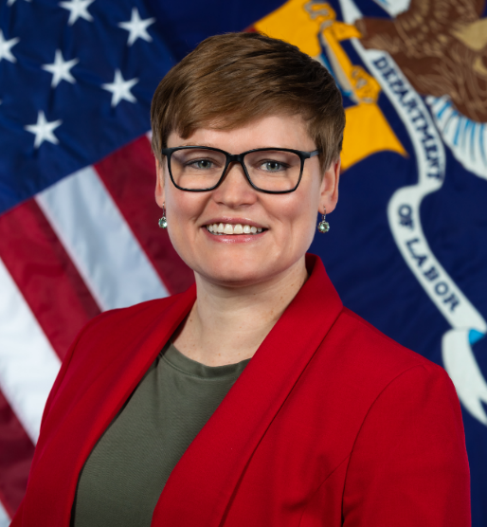
Today’s Moderator
Michelle Beebe
  Division Chief, Legislation
  Office of Unemployment Insurance
    Employment and Training Administration
    US Department of Labor

Slide 4
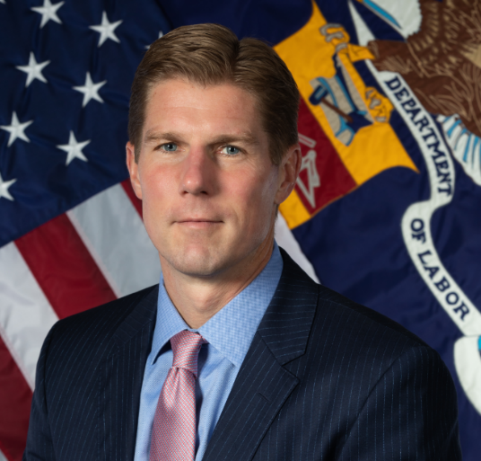
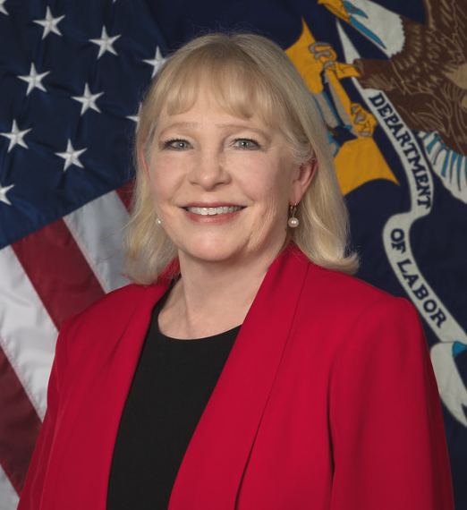
Today’s Speakers
John Pallasch
  Assistant Secretary
    Employment and Training Administration
    US Department of Labor
Gay Gilbert
  Administrator
  Office of Unemployment Insurance
    Employment and Training Administration
    US Department of Labor

Slide 5
Today’s Objective
To encourage you to work with your legislature and UI stakeholders to adopt a framework for work search requirements that:
  Proactively refers claimants to suitable work;
  Defines activities that focus on rapid reemployment
  Supports claimant compliance and documentation; and
  Provides fair notice to claimants.

Slide 6
Agenda
Foundation for Work Search Requirement
Requirement to be “Actively Seeking Work”
Definition of “Actively Seeking Work”
  Proactive Referrals to Suitable Work
  Comprehensive & Results-Oriented Activities
  Work Search Documentation Requirements
Notification to Claimants of Requirement
Conclusion

Slide 7
Foundation for Work Search Requirement
42 U.S.C. 503(a)(12) Provision for State Laws
A requirement that, as a condition of eligibility for regular compensation for any week, a claimant must be able to work, available to work, and actively seeking work.
Amended with The Middle Class Tax Relief and Job Creation Act of 2012 (Pub. L. 112-96)

Slide 8
Requirement to be “Actively Seeking Work”
Proposed Language Section 100
As a condition of eligibility for unemployment compensation in any week, a claimant must be able to work, available to work, and actively seeking work, unless exempted under [reference state and federal law for work search exemptions].
States may wish to consider whether to include statutory and/or regulatory requirements for the “able to work” and “available to work” clauses separately.

Slide 9
Requirement to be “Actively Seeking Work”
Discussion
UI claimants are important customers of the workforce system, beyond the Reemployment Services and Eligibility Assessment (RESEA) program.
  UI is a mandatory one-stop partner under the Workforce Innovation and Opportunity Act (WIOA).
  UI claimants are specifically named as potential customers of multiple workforce programs, including the Wagner-Peyser Employment Service program, the WIOA Dislocated Worker program, and the Trade Adjustment Assistance program.
Consider reinforcing the requirement to complete work search activities throughout the claims cycle. Use technology tools such as an online application, emails, or texts to “nudge” claimants to comply.

Slide 10
Definition Part 1: Proactive Referrals to Suitable Work
Proposed Language Section 101(1)
A claimant must meet the following requirements to be actively seeking work:
A claimant who receives referrals from [the department] to a job or jobs considered to be suitable, as otherwise defined in state law, must apply for such job(s) within one week of receiving the referral and accept employment in suitable work if offered.
State laws that establish suitability requirements must, at a minimum, meet the labor standards in Section 3304(a)(5), FUTA

Slide 11
Definition Part 1 Cont’d.
Discussion
States and American Job Centers should have business processes in place to proactively refer all suitable jobs to claimants throughout the life of the claim.
To support this proactive approach to job referrals and to promote rapid reemployment to reduce benefit duration, states should:
  Improve claimants’ ability to use job banks, and the wide array of private job banks, as tools to identify suitable jobs for claimants;
  Identify suitable jobs, in accordance with the state’s definition of “suitable jobs,” to which individual claimants are referred; and
  Have processes in place to adjudicate a claimant’s failure to accept suitable work in accordance with Federal and state laws.

Slide 12
Definition Part 2: Comprehensive & Results-Oriented Activities
Proposed Language Section 101(2)
A claimant must meet the following requirements to be actively seeking work:
The claimant has performed at least the required number of acceptable work search activities in the week for which benefits are claimed, as established in state [regulation and/or policy]. Acceptable work search activities include:
  Creating a reemployment plan;
  Creating a resume;
  Uploading resume to online job boards;
  Registering for work with the state’s labor exchange system . . . ; or
  Any other work search activities prescribed by the state in [regulation and/or policy]

Slide 13
Definition Part 2 Cont’d.
Discussion
Adopt aggressive work search policies to support the claimant’s rapid reemployment.
Utilize the list of acceptable work search activities that was developed by Federal/State workgroup.
Include a broad range of work search activities that supports finding suitable employment. The quality of the work search activity is critical.
Incorporate flexibility to adapt through regulation and policy with shifts in the economy and the evolving technology.

Slide 14
Definition Part 3: Work Search Documentation Requirements
Proposed Language Section 101(3)
A claimant must meet the following requirements to be actively seeking work:
The claimant has maintained a work search activity log and submitted weekly work search activity logs to the state UI agency using the method prescribed in state [regulation and/or policy].

Slide 15
Definition Part 3 Cont’d.
Discussion
Consider integrating the capture of work search activities in the state’s online weekly certification. This enables the state to immediately know whether the claimant has completed the correct number of activities prior to payment of benefits.
Encourage active use of the state’s job bank to search for work and integrate UI and Employment Service/Workforce Program technology to provide a seamless method for documenting work search activities.
If automation of work search documentation at the time of weekly certification is not an option right now, consider developing tools and templates to support claimants maintaining their work search documentation.

Slide 16
Notification to Claimants of Requirement
Proposed Language Section 102
The [State UI Agency] shall notify claimants, using the delivery method selected by the claimant [or in accordance with existing section of state law], of the requirement to actively seek work at the time an initial claim is filed and at any other time during the benefit year that the requirement for actively seeking work substantially changes. Delivery methods may include U.S. mail, email, online mailbox, or text. This notification should include the types of acceptable work search activities; the number of work search activities required in any week; the state requirement for documentation of work search activities; and the requirement to apply to, and accept if offered, suitable jobs referred by the agency.

Slide 17
Notification to Claimants of Requirement
Discussion
Ensure that the claimant understands work search requirements, both the acceptable activities and documentation requirements.
Communicate at the time the initial claim is filed and any other time during the benefit year when the requirements substantially change (e.g., when a work search exemption expires and claimant continues to certify).
Reinforce actively seeking work requirements through the lifecycle of the claim using RESEA services, pop-up messages when claimants file for and certify for benefits, and through emails and text messages.

Slide 18
Conclusion
The advantages of requiring claimants to actively search for work include:
Rapidly restores the individual’s ability to have self-sustaining employment;
Maintains the individual’s participation in the labor force, which is good for the economy; and
Reduces benefit duration, saving UI trust fund dollars.

Slide 19
Partnership Acknowledgement
Thank you!
States participating in development and implementation of the Reemployment Framework
States innovating and sharing their experiences with peers
States working closely with their Workforce colleagues to strengthen reemployment strategies
States tackling improper payments and partnering with the National UI Integrity Center

Slide 20
What’s Next?
Review your existing work search laws and policies in light of the model language and framework.
Engage your state legislature and UI stakeholders.
Reach out for Technical Assistance.

Slide 21
Resources
TEN 17-19
  Model Unemployment Insurance State Work Search Legislation
    https://wdr.doleta.gov/directives/corr_doc.cfm?DOCN=4227
National UI Integrity Center
  Contact your state liaison
    https://integrity.naswa.org/services
Documentation and Validation
  What can and should be validated? Is self-attestation enough?
    https://rc.workforcegps.org/-/media/Communities/rc/Files/MRP/UI-Documentation-and-Validation-White-Paper_FINAL_20160502.ashx
Pathway to Reemployment Framework
  Re-envisioned approach to work search
    https://rc.workforcegps.org/resources/2016/10/03/05/36/Pathway_to_Reemployment_Framework
My Reemployment Plan
  Interactive job search guide that can be adopted to specific requirements and various economies
    https://rc.workforcegps.org/resources/2016/10/03/05/28/My_Reemployment_Plan
Behavioral Analytics with New Mexico
  Using data for decision-making
    https://www.pewtrusts.org/en/research-and-analysis/issue-briefs/2016/10/behavioral-analytics-help-save-unemployment-insurance-funds

Slide 22
Thank You!
Need help? Email: Support@workforceGPS.org

Slide 23
Any Questions?
Please type your question into the chat window.

