Slide 1
National Dislocated Worker Grants
Updated Program Guidance (TEGL 12-19)

Slide 2
Today’s Presenters
Moderator:
  Amy Ambrose, Office of Workforce Investment/ETA
Presenters:
  Robert Kight, Office of Workforce Investment/ETA
  Kim Powell, Office of Workforce Investment/ETA
  Jeff Ryan, Office of Workforce Investment/ETA
  Lynn Fraga, Office of Grants Management/ETA

Slide 3
Today’s Agenda
Overview and Purpose of DWG Program
Performance Resources
DWG Policy and Programmatic Highlights
Application Procedures

Slide 4
Enter title of polling slide here.
What type of organization do you represent?
State or Outlying Area Workforce Agency
Local Workforce Development Board
Indian Tribal Entity or WIOA 166 grantee
Federal Agency
Other (answer in comments)
Choose the one option that best answers the question.

Slide 5
Welcome Message
Robert Kight
Chief, Division of Adult Services and Governance
Office of Workforce Investment/ETA

Slide 6
National Dislocated Worker Grants
Program Purpose

Slide 7
DWG Program Overview
DWGs are supplemental resources that provide flexibility responding and recovering from qualifying events (disasters and layoff events)
ETA expects these grants will be aligned with existing state/local priorities, resources, and programs
DWGs should not be seen as stand-alone programs
Design and carry out projects in coordination with existing efforts through Rapid Response/layoff aversion, formula-funded activities, business engagement efforts, and more
Expectation that projects demonstrate intent to maximize positive outcomes for participants

Slide 8
DWG Performance Resources

Slide 9

Training and Employment Guidance Letter 14-18
Describes performance accountability requirements for the DWG program
  Main body of TEGL 14-18 also applies to DWG
  Attachments for each individual program (11 total)
Attachment 6 dedicated to DWG performance

Slide 10
Performance Guidance References
Training and Employment Guidance Letter 14-18
  Aligning Performance Accountability Reporting, Definitions, and Policies Across Workforce Employment and Training Programs Administered by the U.S. Department of Labor (DOL)
  https://wdr.doleta.gov/directives/corr_doc.cfm?docn=7611
Attachment 6 National Dislocated Worker Grant Program
  Attachment 6 of TEGL 14-18:
  https://wdr.doleta.gov/directives/attach/TEGL/TEGL_14-18_Attachment-6_Acc.pdf

Slide 11
Performance Indicators
Measure | Description
1.Employment Rate Second Quarter After Exit | Percentage of participants who are in unsubsidized employment during the second quarter after exit.
2. Employment Rate Fourth Quarter After Exit | Percentage of participants who are in unsubsidized employment during the fourth quarter after exit.
3. Median Earnings Second Quarter After Exit | Median earnings of participants who are in unsubsidized employment during the second quarter after exit.
4. Credential Attainment | Percentage of participants enrolled in an education or training program who attain a recognized postsecondary credential or a secondary school diploma during participation or within one year after exit.
5. Measurable Skill Gains | Percentage of participants during a program year who are in an education or training program that leads to a recognized postsecondary credential or employment and who are achieving measurable skill gains.
6. Effectiveness in Serving Employers | Retention with the same employer in the 2nd and 4th quarter after exit.

Slide 12
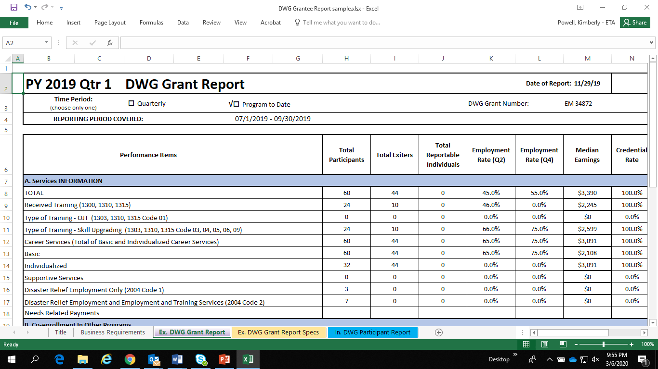
Sample Report

Slide 13
Workforce Integrated Performance System
WIPS
QNR
QPR
REPORTS!

Slide 14
Reporting System
Workforce Integrated Performance System (WIPS) https://dol.appiancloud.com/suite/

Slide 15
Resource
DWG Performance Web Page
  Reporting Technical Assistance Guide
    www.doleta.gov/DWGs/Performance-and-Reporting-Resources

Slide 16
Resource
DWG Performance Web Cast
  Available on Workforce GPS!
    https://performancereporting.workforcegps.org/resources/2019/05/17/19/06/TEGL-14-18-Performance-Alignment-Webcast-Series-and-Resource-Page-Pt-2

Slide 17
TEGL 12-19 vs TEGL 2-15
Highlights, Changes, Revisions, Updates and Policy Clarifications

Slide 18
Types of DWGs
TEGL 2-15: 4 Types
  DWGs for Layoffs
  DWGs for Dislocated Service Members
  DWGs for Trade Impacted Workers
  DWGs for Emergencies and Disasters
TEGL 12-19: 2 Types
  Disaster Recovery DWG
  Employment Recovery DWG

Slide 19
Disaster Recovery DWGs

Slide 20
Disaster Recovery DWGs: Purpose and Limitation
Disaster Recovery DWGs provide disaster-relief and humanitarian assistance employment, as well as employment and training services, as appropriate, to minimize the employment and economic impact of declared disasters and emergency situations, in disaster-declared areas
  All activities must directly address the impacts of the current disaster and not be designed to prevent the impacts of future disasters
DWG funds may also provide employment and training services to dislocated workers and other eligible participants
  Employment and training activities should be designed to ensure participants can obtain unsubsidized, sustainable employment following their participation in the grant

Slide 21
Disaster Recovery DWGs: Eligible Applicants
Eligible applicants for Disaster Recovery DWGs are:
States
Outlying areas,
Indian tribal governments as defined by the Stafford Act, 42 U.S.C. 5122(6)
States may sub-grant funds to local boards and/or may expend such funds through public and private agencies and organizations engaged in disaster relief projects

Slide 22
Disaster Recovery DWGs: Eligible Participants
Eligibility has not changed from TEGL 2-15
However, we want to clarify that grantees are responsible for setting appropriate policies and procedures for determining participant eligibility
  The state has the authority to provide exceptions to its policies regarding the acceptable documentation local areas must collect to document participant eligibility
  Such exceptions may rely on self-attestation, but states eventually must collect all documentation necessary to demonstrate that each participant is eligible

Slide 23
Disaster Recovery DWGs: Non-FEMA Declared
Emergency or Disaster of National Significance as declared or otherwise recognized by federal agency other than FEMA
Not all Federally-declared emergency or disaster events will qualify for DWG funding
Applicants must demonstrate that the emergency or disaster could result in a potentially large loss of employment
ETA defines this as the potential loss of at least 50 jobs
Applicants must include rationale for how they project the loss of at least 50 jobs
FEMA-declared emergencies or disasters do not require demonstration of potential large loss of employment

Slide 24
Disaster Recovery DWGs: Grants for Relocated Individuals
May be requested when a “substantial” number of individuals have relocated or been evacuated from a disaster area to another area
“Substantial”: Applicants must be able to demonstrate that at least 50 individuals (note: not “workers”) have relocated or evacuated
The relocation/evacuation of 50 or more to a non-impacted area is a qualifying event for DWG application; it does not restrict who may participate in the grant
Any eligible individuals in the area covered by the grant may be enrolled.

Slide 25
Disaster Recovery DWGs: Grant Activities
Disaster Recovery DWGs provide 2 types of activities
Must* provide: Disaster-relief employment
  Clean-up and recovery efforts for facilities and lands and offshore areas related to the emergency or disaster
  Delivery of appropriate humanitarian assistance in immediate aftermath of the disaster or emergency
May provide: Employment and training activities
Supportive services allowed for participants receiving either
* There are 2 exceptions to the requirement to provide disaster-relief employment

Slide 26
Disaster Recovery DWGs: Exceptions to DRE Requirement
ETA may permit Disaster Recovery DWGs that only offer employment and training activities in the following situations:
For Disaster Recovery DWGs awarded in response to non-Stafford Act disaster or emergency declarations, where the circumstances and nature of the disaster do not allow for the clean-up and humanitarian temporary employment opportunities
For Disaster Recovery DWGs that are awarded due to an influx of individuals relocated from a disaster area, where the grantee is not responding to the actual disaster.
  However, these grants may also offer participants disaster relief employment where appropriate.

Slide 27
Disaster Recovery DWGs: Disaster-Relief Employment
Disaster Recovery DWGs provide disaster-relief and humanitarian assistance employment, as well as employment and training services, as appropriate, to minimize the employment and economic impact of declared disasters and emergency situations, in disaster-declared areas
Clean-up and recovery efforts including demolition, repair, renovation and reconstruction of damaged and destroyed structures, facilities and lands located within the disaster area and in offshore areas related to the emergency or disaster
Employment related to the delivery of appropriate humanitarian assistance in the immediate aftermath of the disaster or emergency

Slide 28
Disaster Recovery DWGs: Humanitarian Assistance
Humanitarian assistance generally includes actions designed to save lives, alleviate suffering, and maintain human dignity in the immediate aftermath of disasters.
This assistance includes activities such as the provision of food, clothing, and shelter.
As with cleanup work, any humanitarian assistance provided by disaster-relief workers must relate directly to immediate response to the disaster situation

Slide 29
Disaster Recovery DWGs: Private Property
Grantees should give highest priority to public facilities, lands, etc
Work on private property may be approved under the following circumstances:
  Must be intended to remove health and safety hazards to the larger community or to address or alleviate specific economic or employment-related impacts of the disaster (such as clean-up work needed for disaster-affected employers to resume operation);
  The activities necessary to remove health and safety hazards on private lands or around homes or other structures may only return the land or structure(s) to a safe and habitable level, and not improve them;
  The project prioritizes service to older individuals and individuals with disabilities; and
  Grantees must not use Disaster Recovery DWG funds to cover the cost of materials to do repairs
Grantees must request prior approval from the grant officer before conducting such work

Slide 30
Disaster Recovery DWGs: Other Policies
Disaster Relief Employment Limitation
  Temporary employment limited to 12 months or 2,080 hours per individual
  Additional 12 months may be approved through modification
Participant Wages
  Wages are paid by the “worksite employer” (formerly known as “employer of record”)
  No limitation on the type of organization that may serve this role
  Must pay the higher of Federal, state or local minimum wage
  Or comparable rates of pay for other individuals employed in similar occupations by that employer (permanent and temporary employees included)
Emergency Application
  Limited information required when submitted within 15 days of qualifying declaration
  For COVID-19: ETA will accept all applications as emergency applications without additional justification
Full Application
  Required within 60 business days of initial award and includes full information related to the application (budget, implementation plan, and a list of worksites, as well as addressing any initial special terms of award)

Slide 31
Disaster Recovery DWGs: Timing of Services
Grantees may enroll participants in services as best meets their needs and the needs of the project as follows:
Disaster-relief employment only
Employment and training activities only; or
Both disaster-relief employment and employment and training activities
These activities may occur concurrently, or one may occur prior to the other.

Slide 32
Employment Recovery DWGs

Slide 33
Employment Recovery DWGs: Overview
Employment Recovery DWGs provide resources to states and other eligible applicants to respond to major economic dislocations, such as large, unexpected layoff events that cause significant job losses
The Secretary of Labor has the discretion to award DWGs to eligible entities where the eligible entity can demonstrate the need for additional funds to provide employment and training assistance to workers affected by major economic dislocations, such as plant closures and mass layoffs
This also could include closures and realignments of military installations
ETA will examine each application on a case-by-case basis to determine if the applicant has demonstrated need
Employment Recovery DWGs provide employment and training assistance to dislocated workers and other eligible participants

Slide 34
Employment Recovery DWGs: Qualifying Events
There are three primary types of qualifying events for Employment Recovery DWGs
Mass Layoff or Plant Closure
Industry-Wide Layoffs
Community Impact
There is also another qualifying event: For dislocated service members
  DWGs may provide assistance to areas where there is a higher-than-average demand for employment and training activities from dislocated military service members and dislocated military spouses that exceeds state and local resources for providing such activities
The TEGL refers to these as “special populations” DWG, though services available are the same as under Employment Recovery DWGs

Slide 35
Employment Recovery DWGs: Eligible Applicants
Applicants eligible to apply for Employment Recovery DWGs are as follows (please note the changes here from TEGL 2-15)
States or outlying areas, or a consortium of these
Local Workforce Development Boards (WDBs) or a consortium of WDBs
Indian and Native American program grantees (WIOA Section 166(c))
The following categories require additional documentation as described on page 9 of the TEGL
Entities determined to be appropriate by the governor of the state or outlying area involved
And entities that demonstrate to the Secretary of Labor their capability to effectively respond to circumstances related to particular dislocations

Slide 36
Employment Recovery DWGs: Eligible Participants
Eligible participants remain the same from TEGL 2-15
Employment recovery DWGs are intended to provide supplemental funding to eligible applicants to address the increased burden faced by the workforce system resulting from a qualifying layoff or layoffs
While the TEGL encourages grantees to prioritize services to individuals impacted by the qualifying layoff events where possible, any eligible participants may be included

Slide 37
Employment Recovery DWGs: Co-Enrollment with TAA
ETA no longer requires a separate DWG application to cover trade-affected workers;
Trade affected workers may be served under Employment Recovery DWGs
ETA strongly encourages co-enrollment with appropriate programs for eligible individuals, including those who are trade-affected
Employment Recovery DWGs may provide DWG participants who are trade-affected with allowable services not otherwise provided by the TAA Program
The TEGL also provides some examples of how to work with trade-affected participants in an Employment Recovery DWG

Slide 38
Employment Recovery DWGs: Timing of Applications
Applications should be submitted within 120 days of a qualifying layoff event
  The target group of workers is eligible for assistance upon notification of layoff (receipt of an individual layoff notice or the date of the company’s layoff announcement) or the date of the layoff itself
Most Employment Recovery DWG applications will be submitted as full applications
However, in cases of sudden or unexpected mass layoff events, such as an unannounced facility closure or the destruction of a place of employment due to a fire, emergency applications may be accepted

Slide 39
Employment Recovery DWGs: Award Factors
Employment Recovery DWGs are awarded at the Secretary’s discretion to assist grant recipients in dealing with dislocation events, such as layoffs and plant closures that cannot be handled through the local workforce development system’s normal capacity.
ETA will determine whether the dislocation exceeds the normal capacity of the local workforce system on a case-by-case basis
ETA sets no firm requirements that applicants must meet to demonstrate this demand beyond the normal capacity of the local workforce system
  We no longer require applicants to have spent 70% of prior year DW formula funds
Among other factors, ETA may consider the level of expenditure of the applicant’s prior program year total available DW formula funds (including Rapid Response and carry-in).
Other factors ETA will consider include including the quality of the proposed project, the severity of job loss qualifying event, and the applicant’s past performance in administering the WIOA Title I Dislocated Worker program or prior DWG awards.
ETA may use quarterly financial reports (ETA-9130 form) to verify expenditures and transfers to the Adult program, and may use disbursement reports to verify the fund usage between quarterly reporting periods

Slide 40
DWG Application Procedures

Slide 41

DWG Application Procedures: Where are they?
Grants.gov – TEGL 12-19 Announcement:
https://www.grants.gov/web/grants/view-opportunity.html?oppId=325616
Contains How to Apply Instructions and Suggested Application/Mod Forms
Office of Grants Management Website:
https://www.dol.gov/agencies/eta/feature-grants
Contains How to Apply Instructions and link to two DWG funding announcements: TEGL 12-19 (Employment and Disaster Recovery DWGs) and TEGL 4-18 (National Health Emergency DWGs serving the opioid crisis).

Slide 42
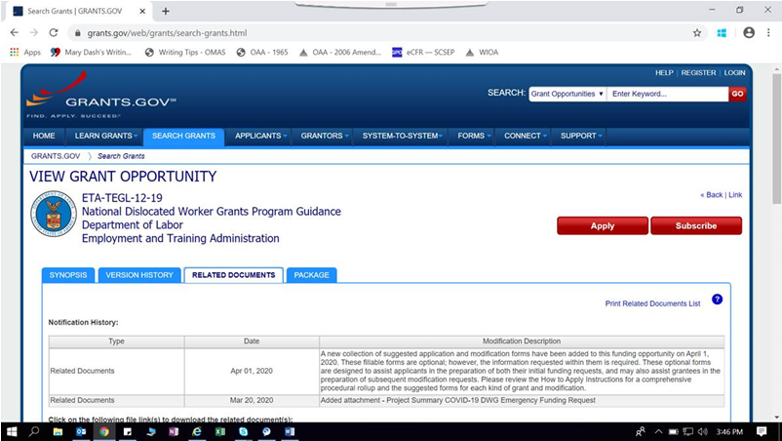
DWG Application Procedures: Subscribe to TEGL Announcement
Subscribe to the TEGL 12-19 Grants.gov announcement to receive real-time updates on changes to the funding opportunity.

Slide 43

DWG Application Procedures: Updated How to Apply Instructions
It’s a transparent summary of the process, written for all DWG stakeholders: applicants, grantees, Regional and National Office Staff
What remains the same for DWG applicants and grantees:
  All new funding requests must be submitted through Grants.gov announcement (TEGL 12-19 and TEGL 4-18)
  To modify DWGs first submitted via the e-System: use the e-system to submit modifications
  To modify DWGs submitted via Grants.gov: email the mod to your Federal Project Officer/Regional Office
Quick Notes on the Updated How to Apply Instructions:

Slide 44

DWG Application Procedures: Updated How to Apply Instructions
Conference Calls Between Applicants/Grantees, Regional, and National Office Staff
Offered when a funding request is returned for revision
Generally held within 5 days of the return
Recommended that applicants/grantees resubmit revisions within 10 days of return
What’s New in the Updated How to Apply Instructions?

Slide 45

DWG Application Procedures: Suggested Application/Modification Forms
A new collection of OPTIONAL/SUGGESTED forms is available for DWG applications and modifications
Fillable pdf format
Applicants may use their own formats to submit required information

Slide 46
DWG Application Procedures: Suggested Forms for Funding Requests
COVID-19 Emergency Application | Disaster Recovery: New Grant Request via an Emergency Application | Disaster Recovery: New Grant Request via a Full (NOT Emergency) Application | Employment Recovery: New Grant Request | Incremental or Supplemental Funding Requests for Both Disaster and Employment Recovery DWGs
SF-424 | SF-424 | SF-424 | SF-424 | SF-424
COVID-19 DWG – Suggested Project Summary for New Grant Request | Disaster Recovery DWG – Suggested Project Summary for New Grant Request | SF-424A | SF-424A | SF-424A
 |  | Budget Narrative | Budget Narrative | Budget Narrative
 |  | Disaster Recovery DWG – Suggested Project Summary for New Grant Request | Employment Recovery DWG – Suggested Project Summary for New Grant Request | Disaster Recovery or Employment Recovery DWG – Suggested Modification Summary and Narrative
 |  | Disaster Recovery DWG – Suggested Modification Summary and Narrative (Required to collect the additional information normally submitted in Modification 1, following an emergency application.) | Employment Recovery DWG – Suggested Enrollment and Expenditure Worksheet | Disaster Recovery or Employment Recovery DWG – Suggested Enrollment and Expenditure Worksheet
 |  | Disaster Recovery DWG – Suggested Enrollment and Expenditure Worksheet | Employment Recovery DWG – Suggested Employer Data Worksheet | Employment Recovery DWG – Suggested Employer Data Worksheet (if an Employment Recovery DWG and updates required)
 |  | Disaster Recovery DWG – Suggested Project Operator Worksite Information | Employment Recovery DWG – Suggested Project Operator Information
This table is located in the How to Apply Instructions

Slide 47
DWG Application Procedures: Suggested Forms for Mod Requests
Budget Realignment | Period of Performance Extension Request | Disaster Recovery: Full Application | Statement of Work | Equipment Request | Responding to Terms and Conditions
Cover Letter Summarizing Modification Request, Signed by Authorized Representative | Cover Letter Summarizing Modification Request, Signed by Authorized Representative | Cover Letter Summarizing Modification Request, Signed by Authorized Representative | Cover Letter Summarizing Modification Request, Signed by Authorized Representative | Cover Letter Summarizing Modification Request, Signed by Authorized Representative | Cover Letter Summarizing Modification Request, Signed by Authorized Representative
Disaster Recovery or Employment Recovery DWG – Suggested Modification Summary and Narrative | Disaster Recovery or Employment Recovery DWG – Suggested Modification Summary and Narrative | Disaster Recovery DWG – Suggested Modification Summary and Narrative | Disaster Recovery or Employment Recovery DWG – Suggested Modification Summary and Narrative | Disaster Recovery or Employment Recovery DWG – Suggested Modification Summary and Narrative | Disaster Recovery or Employment Recovery DWG – Suggested Modification Summary and Narrative
SF-424A |  | SF-424 |  | SF-424A | Required forms for modifications responding to special conditions will vary, depending on the components to be addressed. Please consult with your FPO regarding modification request requirements.
Budget Narrative |  | SF-424A |  | Budget Narrative
 |  | Budget Narrative
 |  | Disaster Recovery DWG – Suggested Enrollment and Expenditure Worksheet
 |  | Disaster Recovery DWG – Suggested Project Operator Worksite Information
This table also located in the How to Apply Instructions

Slide 48
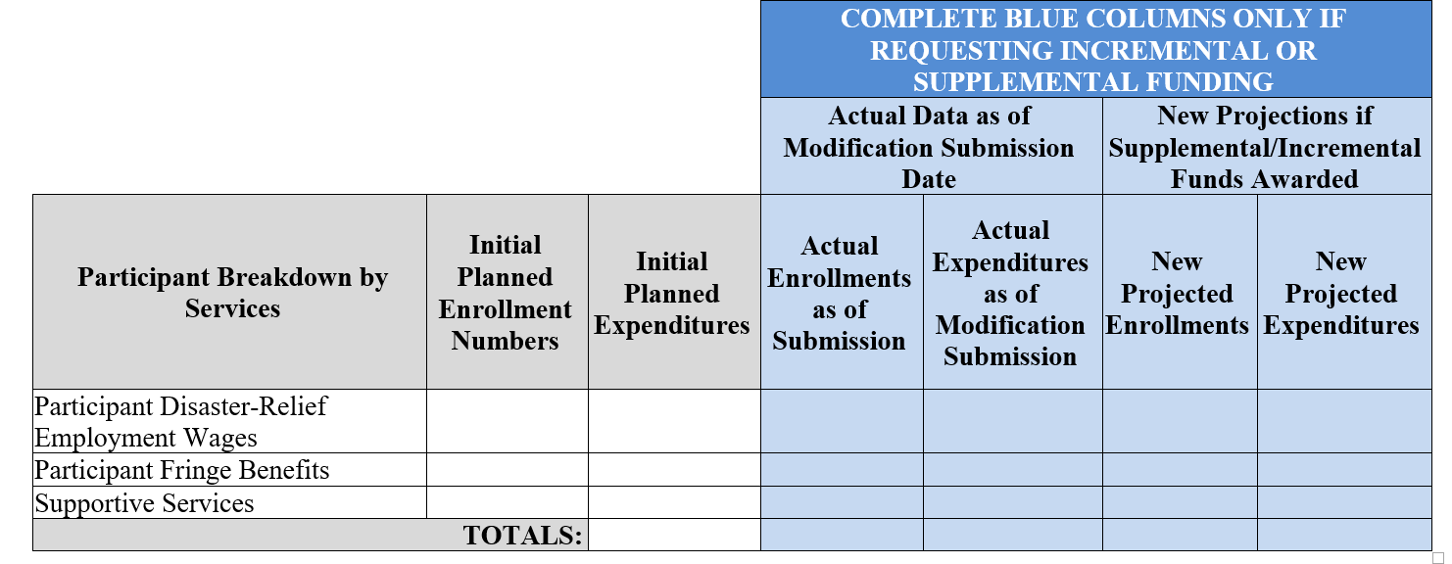
A Change to the Suggested Modification Forms: Highlights
DISASTER RECOVERY NATIONAL DISLOCATED WORKER GRANT (DWG)
SUGGESTED ENROLLMENT AND EXPENDITURE WORKSHEET
Disaster-Relief Employment Component

Slide 49
A Change to the Suggested Modification Forms: Highlights
GENERAL INFORMATION
Project Operator Name:
Address:
Project Counties Covered by Project Operator:
Total Number of Participants to be Enrolled in Disaster-Relief: | Project Operator Funding Level:
Worksite Location | County | Description of the Primary Work to be Performed | Number of Participants at this Worksite | Enter Percentage of Work Complete (or Enter NEW)

Slide 50
A Change to the Suggested Modification Forms: Highlights
Modification Summary Form
One form for submitting the bulk of mod information
Check the types of modification requests for the particular submission
Enrollment and Expenditure Summary
Narrative section to provide the required details of each request

Slide 51

DWG Application Procedures: Timeframes
DWG Funding Requests
45 Days for Application Approval
10 days for Grant Execution

Slide 52

Don’t hesitate to provide feedback…
Share your thoughts with us:
Email comments/suggestions on suggested forms and procedures to: dol-eta-dwg@dol.gov
-or-
share feedback during one of our conference calls
-or-
share with your FPO

Slide 53
Any Questions?
Please enter any questions you have in the chat box.
  (As a reminder we may not be able to answer COVID-19 specific questions at this time but please still submit.)

Slide 54
Contact Us
For any questions you may have following this webinar, please reach out to the Federal Project Officer for your state and we will get answers back to you as quickly as possible.
Thank you!

Slide 55
Thank You!
Need help? Email: Support@workforceGPS.org

