Slide 1
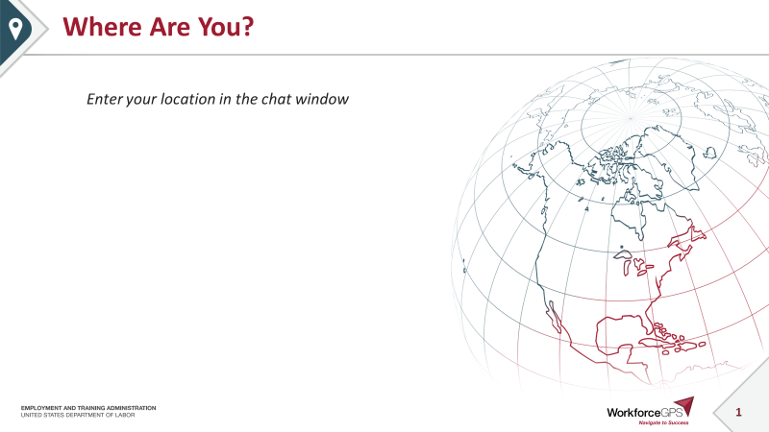

Slide 2
Reporting Apprenticeship Training Activities for
H-1B Scaling Apprenticeship Grants

Slide 3

Today’s Moderator
Zodie Makonnen
  Workforce Analyst
    U.S. Department of Labor, Employment and Training Administration

Slide 4


Your Speakers
Kristen Milstead
  Workforce Analyst
    U.S. Department of Labor, Employment and Training Administration
Timmy Dudley
  Senior Technical Project Management Analyst
    ICF

Slide 5
Webinar Objectives:
Know the difference between a participant, a pre-apprentice, and an apprentice for your grant reporting purposes
Know when you can report that a participant is an apprentice and what data elements you must report at that time
Understand how a participant’s employment status at entry determines how to report apprenticeship training
Learn how to check your QPR to ensure you have reported data elements accurately for apprenticeship training
Understand what you should and should not be counting in Section B outcomes in the QNR

Slide 6
ETA Grants and COVID-19
Commitment to support grantees during this unprecedented time
Prioritize the health and well-being of yourselves, your families and colleagues, and individuals that you serve.
ETA’s Frequently Asked Questions on COVID-19’s impact to grant programs:
https://www.workforcegps.org/resources/2020/03/18/23/35/Coronavirus-COVID-19-Resources
Remote continuity of operations, and virtual training and delivery of services.
Visit the Centers for Disease Control and Prevention (CDC) for information on Covid-19 and community resources. OSHA has also published information on keeping workplaces safe at https://www.dol.gov/coronavirus.

Slide 7
Share any strategies you are using now to minimize the impacts of COVID-19, or any concerns or questions you may have in the chat window.
Let’s CHAT

Slide 8
Participants, Apprentices, and Pre-Apprentices: Oh My!
What is Apprenticeship Training?

Slide 9

Becoming a Grant Participant
An individual becomes a grant participant when he or she is deemed eligible by your grant to participate and receives a grant-funded service, including (but not limited to):
  Assessments
  Drug-testing
  Case management services
  Apprenticeship training
  Pre-apprenticeship training
Follow the money!

Slide 10
Let’s Differentiate Between Key Terms We’ll Use
Two key components of a high quality apprenticeship where reporting are concerned are 1) the on-the job learning component and 2) the instructional training component.
On-the-job Training (OJT): A well-designed and highly structured work experience that is a component of the apprenticeship. OJT is one of the five hallmarks of program quality in the Scaling Apprenticeship (SA) FOA.
Instructional training: A shortened version of the term “educational and instructional component” which is another of the five hallmarks of program quality, and which is often referred to as “classroom” training. Other terms used for this include Related Technical Instruction (RTI) in Registered Apprenticeship Programs (RAPs) and Related Instruction in Industry-Recognized Apprenticeship Programs (IRAPs).

Slide 11
Reporting a Participant as an Apprentice
What is an apprentice?
  A participant is counted as an apprentice when they have:
    been hired by an employer and started on-the-job training, and
    started instructional training.
Participants who do not do both of these things cannot be counted as apprentices until both have taken place.
The program into which a participant is enrolled can be a Registered Apprenticeship Program (RAP) or an unregistered apprenticeship program
  Five Hallmarks of Program Quality
        Paid Work-Based Component
        OJT Training and Mentorship
        Educational and instructional Component
        Industry-Recognized Credentials Earned
        Safety, Supervision, and Equal Employment Opportunity

Slide 12
What About Pre-Apprentices?
Pre-apprenticeships provide career-specific training and readiness skills needed to enter an apprenticeship.
For Scaling Apprenticeship grants, pre-apprenticeship is considered a grant-funded service.
The instructional training that pre-apprentices receive is not reported in PIRL training data elements.

Slide 13
Knowledge Check!
Which of the following is may be considered a grant-funded service?
Pre-apprenticeship training
Instructional/classroom training
Being hired by an employer into an apprenticeship
Drug testing for employment
All may be considered grant-funded services

Slide 14
Any Questions?
Enter your questions in the chat window

Slide 15
Reporting Apprenticeship Training:
It’s All About Timing
When and how should apprenticeship training be recorded in WIPS?

Slide 16
Dates Are Key to Understanding How to Report Training Activities
Date of Program Entry (PIRL 900)
  Entry into Your Grant Program
Date Entered Training #1 (PIRL 1302)
  Entry into Apprenticeship Training
Date Entered Employment (PIRL 2118)
  Hired by an Employer into an Apprenticeship
Date Completed Training (PIRL 1813)
  Completed all Components of Apprenticeship

Slide 17
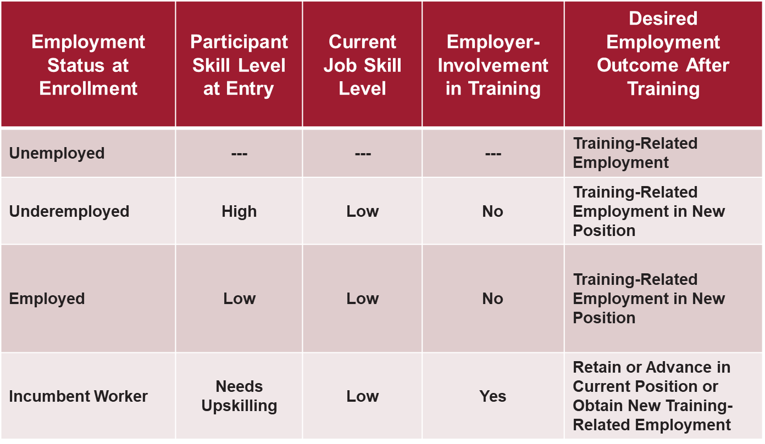
Participant Status at Entry is Also Key

Slide 18
The Path to Reporting Apprenticeship Training Activities for Underemployed/Unemployed/Employed Participants
PIRL 900 Date of Program Entry
  The date an individual has received a grant funded service after they have been determined eligible by the grantee.
  The Date of Program Entry may be the same as the date a participant begins apprenticeship training.

Slide 19
When is a Participant Enrolled in an Apprenticeship?
A Tale of Three Scenarios
PIRL 1302 Date Entered Training #1 and PIRL 2118 Date Entered Employment are linked together for reporting apprenticeship training.
  Scenario 1:
  Tom starts the instructional training, or classroom, component of his apprenticeship on January 15, 2020. On April 10, 2020, he is hired by an employer and starts the on-the-job training component of his apprenticeship.
  To report this in WIPS:
  PIRL 1302 Date Entered Training #1 is January 15,2020.
  PIRL 2118 Date Entered Employment is April 10, 2020.
  Both dates will be reported after the quarter ending June 30, 2020.

Slide 20
When is a Participant Enrolled in an Apprenticeship?
A Tale of Three Scenarios
PIRL 1302 Date Entered Training #1 and PIRL 2118 Date Entered Employment are linked together for reporting apprenticeship training.
  Scenario 2:
  Bob is hired by an employer and starts on-the-job apprenticeship training on December 1, 2019. When the semester starts on January 22, 2020, he starts the instructional training component of his apprenticeship.
  To report this in WIPS:
  PIRL 2118 Date Entered Employment and PIRL 1302 Date Entered Training #1 are both reported as December 1, 2019.
  The instructional training for his apprenticeship may be reported in PIRL 1309 Date Entered Training #2 as January 22, 2020.
  Dates for all three data elements are reported after the quarter ending March 31, 2020.

Slide 21
When is a Participant Enrolled in an Apprenticeship?
A Tale of Three Scenarios
PIRL 1302 Date Entered Training #1 and PIRL 2118 Date Entered Employment are linked together for reporting apprenticeship training.
  Scenario 3: Linda is hired and begins her apprenticeship on-the job training through her employer on March 1, 2020. A couple of weeks later, on March 15, 2020, she starts the instructional training (classroom) component of the apprenticeship.
  To report this in WIPS:
  PIRL 1302 Date Entered Training #1 is March 1, 2020.
  PIRL 2118 Date Entered Employment is March 1, 2020.
  The RTI for her apprenticeship is reported in PIRL 1309 Date Entered Training #2 as March 15, 2020.
  Dates for all three data elements can be immediately reported after the same reporting quarter (March 31, 2020).

Slide 22
PIRL Data Elements for Reporting “Entering Apprenticeship Training”
When the participant has been both hired by an employer into an apprenticeship and begun the instructional training (or classroom), report:
  PIRL 1302 Date Entered Training #1
    The date the participant started the on-the-job component of the apprenticeship with the employer or the date the participant started the instructional training – whichever occurs first
  PIRL 2118 Date Entered Employment
    The date the employer hired the participant
  PIRL 105 Type of Apprenticeship*
    SARAP11: Registered Apprenticeship Program
    SAUAP22: Unregistered Apprenticeship
All three data elements must be entered within the same reporting quarter – for PIRL 105, this includes the apprenticeship code values only!
If a participant is not an apprentice or a pre-apprentice, but has received a grant-funded service or one of the two components of apprenticeship training, in PIRL 105, enter SANONE4 for None.
*NOTE: Ignore the words “at the time of program entry” in code value definition (not applicable to this employment status)

Slide 23
Knowledge Check!
Terry starts instructional training in an apprenticeship program in Quarter 1 of your grant. In Quarter 2, she is hired by an employer into a Registered Apprenticeship Program.
Which of the following is not correct?
After Quarter 1, Terry is reported as “None” in PIRL 105 to indicate she is not yet an apprentice.
After Quarter 1, the date Terry started instructional training is reported in PIRL 1302.
After Quarter 2, the date Terry started working as an apprentice is reported in PIRL 2118.
After Quarter 2, Terry is reported as a being in a Registered Apprenticeship Program in PIRL 105.

Slide 24
Reporting Training Types – It’s Based on PIRL 105
PIRL 1303 Type of Training Service #1
  Two Options:
    Registered Apprenticeship Program (09)
    Occupational Skills Training (06)
PIRL 2109 Type of Training #1 (for PIRL 1303)
  Registered Apprenticeship Program Option (8)
  Or multiple options for unregistered apprenticeship
    1 = On-the-job Training
    2 = Classroom Occupational Training
    3 = Contextualized Learning
    4 = Distanced Learning
    5 = Customized Learning
    6 = Incumbent Worker Training
    7 = Other Occupational Skills Training

Slide 25
Reporting Completion and the Related Employment Outcome
PIRL 1813 – Date Completed an Education or Training Program Leading to a Recognized Postsecondary Credential or Employment
  Participants must complete all training components of the apprenticeship program
  This includes the instructional training component and the on-the-job training component
PIRL 2126 Entered Training-Related Employment
  Participants who completed the training components of their apprenticeships who remained in their positions or obtained new positions

Slide 26
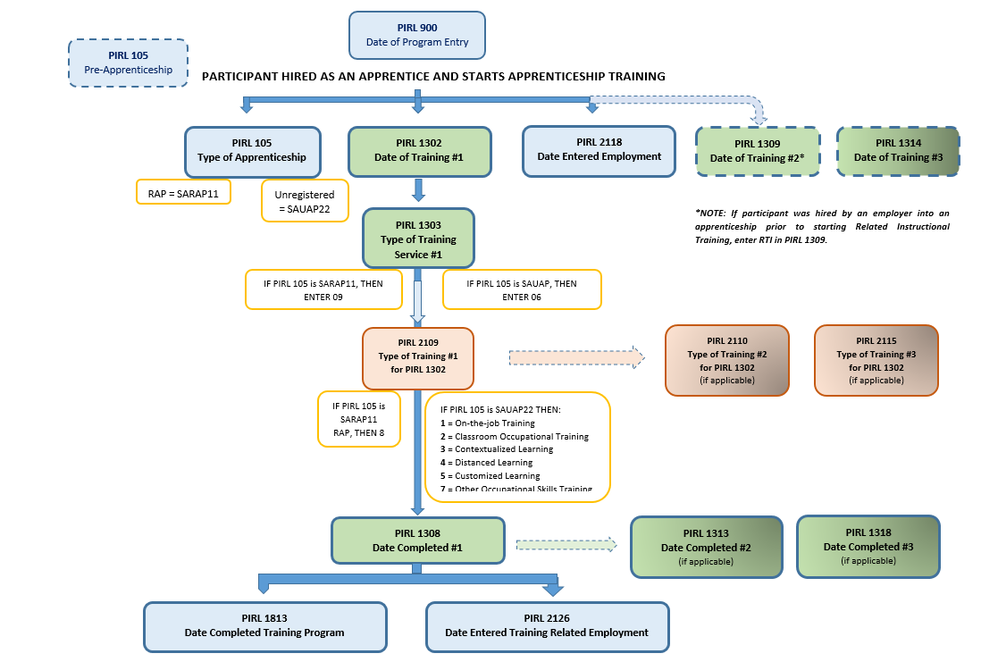
Figure 1. Flow Chart: How to Report Apprenticeship Training Activities for Underemployed/Unemployed/Employed Participants

Slide 27
Reporting Apprenticeship Training for Incumbent Workers
What are the differences between how apprenticeship training is reported for underemployed/ unemployed/employed participants and for incumbent worker participants?

Slide 28
Incumbent Workers Are Different
Incumbent workers must meet the same criteria as underemployed, unemployed and employed workers to be considered apprentices. They must:
    Be employed by the employer offering the apprenticeship; and
    Have started their instructional training (or classroom) component.
By definition, you will not report “hire by an employer” in WIPS when reporting apprenticeship training for incumbent worker participants.
  Their apprenticeship is developed in conjunction with their employer before they become participants in your program

Slide 29
PIRL Data Elements for Reporting “Entering Apprenticeship Training” (Incumbent Workers)
When the incumbent worker participant has both started the apprenticeship with the employer and has begun instructional training, report:
  PIRL 1302 Date Entered Training #1
    The date the participant started the on-the-job component of the apprenticeship with the employer or the date the participant started the instructional training – whichever occurs first
  PIRL 105 Type of Apprenticeship
    SARAP11: Registered Apprenticeship Program
    SARAP22: Unregistered Apprenticeship
PIRL 2118, Date Entered Employment, is never a required data element for incumbent workers.
  You must document separately that your participant has begun the apprenticeship training with their employer, however.

Slide 30
Incumbent Worker Training Scenario
  Scenario:
  Donna is an incumbent worker who starts on-the-job apprenticeship training with her employer on February 1, 2020. She starts the instructional training component of her apprenticeship on April 1, 2020.
  To report this in WIPS:
  PIRL 1302 Date Entered Training #1 is February 1, 2020 and will be reported after the quarter ending June 30, 2020.
  Instructional training may be reported in PIRL 1309 Date Entered Training #2 after the quarter ending June 30, 2020.

Slide 31
Reporting Training Types: Incumbent Workers
PIRL 1303 Type of Training Service #1
  Two Options:
    Registered Apprenticeship Program (09)
    Unregistered Apprenticeship (06)
PIRL 2109 Type of Training #1 (for PIRL 1303)
  6 = Incumbent Worker Training

Slide 32
Reporting Completion and the Related Employment Outcome (Incumbent Workers)
PIRL 1813 – Date Completed an Education or Training Program Leading to a Recognized Postsecondary Credential or Employment
  Participants must complete all training components of the apprenticeship program
PIRL 2120 Advanced to New Employment
  Participants who were incumbent workers at program entry who completed the training components of their apprenticeships who advanced to new positions with their current employer or with a new employer.
    Participants must complete the on-the-job components of their apprenticeships to be counted in this data element.
    Often the job title and description are different, but not always.
      As long as the competency is applied in the new position, it can be counted as advancement.

Slide 33
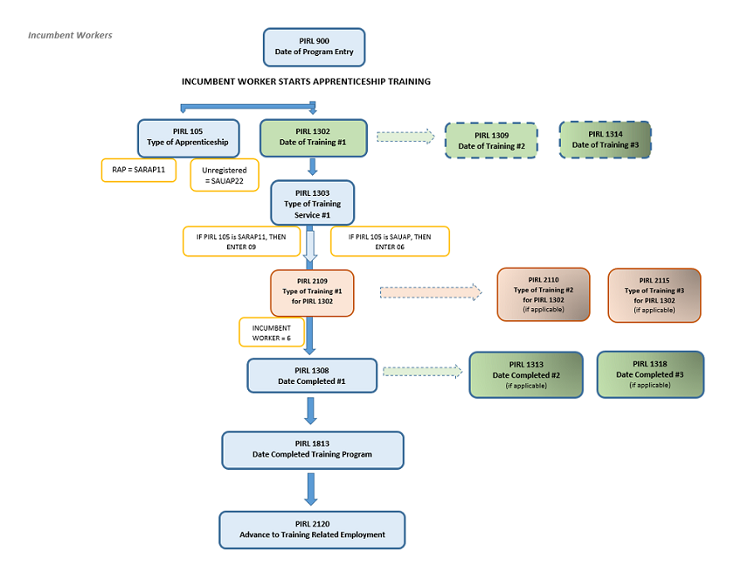
Figure 2. Flow Chart: How to Report Apprenticeship Training Activities for Incumbent Workers

Slide 34
Any Questions?
Enter your questions in the chat window

Slide 35
Apprenticeship Training and Your QPR
Where does apprenticeship training aggregate (show up) on the QPR?

Slide 36
Program Entry and Starting Training
FOA Outcome | QPR Outcome | Summary of WIPS Data Elements You Must Report
A1. Total Apprentices Served | A2. Total Participants Served | PIRL 900 Date of Program Entry
A2. Total Apprentices Hired by an Employer and Enrolled in an Apprenticeship Education/Training Program | E6a. Began Receiving Education/Job Training Activities | PIRL 105 Type of Apprenticeship (RAP or unregistered apprenticeship only) PIRL 1302 Date Received Training #1 PIRL 2118 Date Entered Employment¹
1 Underemployed/unemployed/employed only

Slide 37
Completion and Credential Achievement
FOA Outcome | QPR Outcome | Summary of WIPS Data Elements You Must Report
A3. Total Apprentices Who Complete an Apprenticeship Education/Training Program | F1. Number Completed Education/Job Training Program Activities | PIRL 1813 Date of Program Completion
A4. Total Apprentices Who Complete an Apprenticeship Education/Training Program and Receive a Degree or Other Credential | F2. Completed Training Program Activities and Obtained a Credential | PIRL 1813 Date of Program Completion PIRL 1800 Type of Recognized Credential #1

Slide 38
Employment Outcomes
FOA Outcome | QPR Outcome | Summary of WIPS Data Elements You Must Report
A5. Total Number of Unemployed and Underemployed Apprentices Who Complete an Apprenticeship Education/Training Program and Maintain Their Employment Status with a Current or New Employer | G1a. Entered Unsubsidized Training-Related Employment | PIRL 1813 Date of Program Completion PIRL 2118 Date Entered Employment¹ PIRL 2126 Entered Training-Related Employment¹
A6. Total Number of Incumbent Worker Apprentices Who Complete an Apprenticeship Education/Training Program That Advance into a New Position | G3. Incumbent Workers that Advance into New Employment | PIRL 907 Receipt of Incumbent Worker Training² PIRL 1813 Date of Program Completion PIRL 2120 Incumbent Workers Advance into New Position²
1 Underemployed/unemployed/employed only
2 Incumbent workers only

Slide 39
Section B Outcomes: Programs not Participants
How is reporting apprenticeship training in the data file different from reporting on apprenticeship programs in your QNR (your Section B target outcomes)?

Slide 40
Section B Program Outcomes
Scaling Apprenticeship grantees were required to provide targets on three output measures related to expanding apprenticeship [Section B]
These are not participant outcomes, but program outcomes so are not reported in your data file.

Slide 41
How to Report Section B Outcome Measures
These output measures should be reported in Section XI.A of the QNR.
Suggested Format:

Slide 42
TIPS for Reporting Section B Outcomes
List and report on each of the three Section B outcomes each quarter.
Report on each outcome even if you have nothing to report. Report 0 if you have no data to report yet.
Clearly label the numbers you include. Examples may include, “Quarter Only,” “Cumulative-to-Date,” “Annual Target,” or “Total Target.”

Slide 43
Counting Programs and Employers: What Do We Count?
Remember the five hallmarks of quality
Counting Programs (B1 and B3)
  Programs can be counted only one time in either B1 or B3 during the period of performance.
  The definition of new vs. expanded programs depends upon whether the program existed prior to the start of the grant.
  A program cannot count as both new and expanded.
  Each expanded program can count one time during the period of performance and cannot be duplicated in B3.
Counting Employers (B2)
  B2 cannot contain duplicated counts of employers. Each employer can be counted only once in this output measure.

Slide 44
Any Questions
Enter your questions in the chat window

Slide 45

Preview: Changes Coming to PIRL Reporting!
Pre-Apprenticeship is Currently Reported in PIRL 105

Slide 46
Changes Coming Soon!
Pre-Apprenticeship will be removed from PIRL 105 and a distinct place to report pre-apprenticeship will be included
Allows Scaling Apprenticeship grantees to report participants as both pre-apprentices and apprentices as appropriate
Changes will go into effect after June 30, 2020. For this quarter, report pre-apprentices using the current PIRL.

Slide 47
Scaling Apprenticeship Reporting Reminders
  Reporting Deadline: May 15, 2020
May 15: Reporting Deadline!
April 23: Office Hours #1
May 11: Office Hours #3
NOW! Start Early
April 20: Peer-sharing Call (COVID-19 Strategies)
May 5: Office Hours #2
April 15
May 15
  Scaling Apprenticeship Performance Reporting Resources Page
  Questions? ScalingApprenticeship@dol.gov
  (don’t forget to copy your FPO)

Slide 48
Thank you for all your hard work!

