Slide 1









Industry-Recognized Apprenticeship Programs
Information for Prospective Standards Recognition Entities
Thursday, April 16, 2020 3:00PM-4:00PM EDT
Office of Apprenticeship

Slide 2

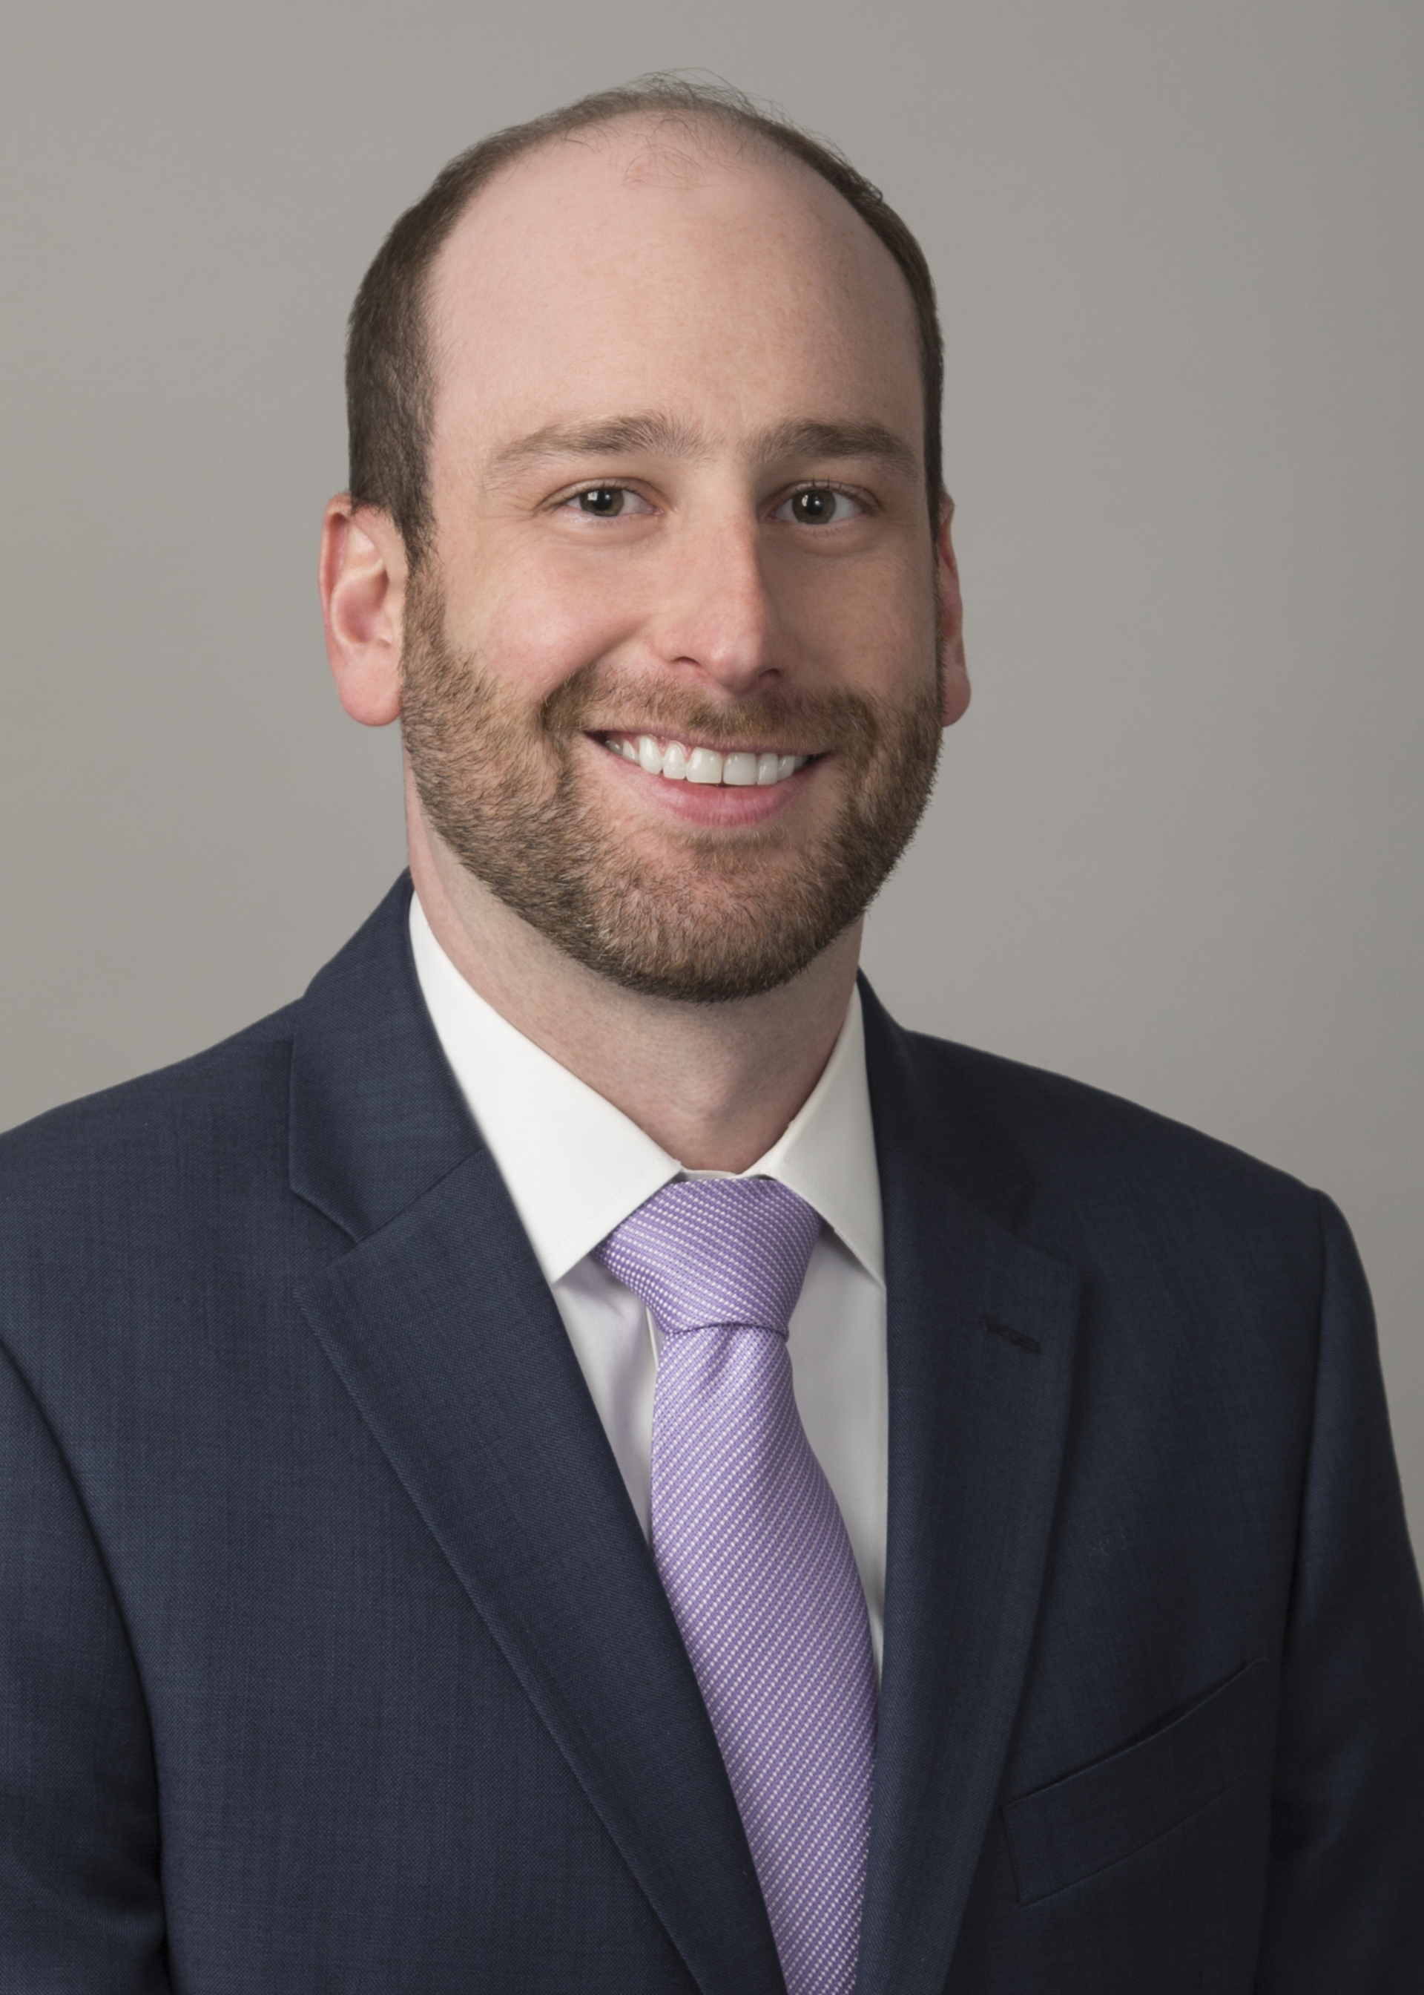
Welcome
Andrew Kilberg
Counselor to the Secretary
U.S. Department of Labor

Slide 3


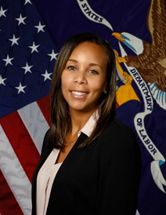
Today’s Presenters
John V. Ladd
Administrator, Office of Apprenticeship
Cierra Mitchell
IRAP Division Chief, Office of Apprenticeship

Slide 4
Today’s Objectives
Learn about the criteria to become a Standards Recognition Entity (SRE).
Learn about the roles and responsibilities of an SRE.
Learn about the Application Process for becoming an SRE.

Slide 5
IRAP Implementation Timeline
IRAP Final Rule
May 11, 2020 IRAP Final Rule goes into effect
SRE Application Review
June 9, 2020 OA begins review of first round of SRE Applications
March 2020
May 2020
June 2020
September 2020
May 2020–June 2020
SRE Application Portal
May 11, 2020 SRE Application portal launch
SREs Announced
Fall 2020 first SREs announced and posted online
IRAP Final Rule
March 11, 2020 IRAP Final Rule published

Slide 6
Standards Recognition Entities (SREs)
An SRE is a third-party entity, recognized by the Department as qualified to recognize apprenticeship programs as IRAPs. The types of entities that can become SREs include, but are not limited to:
Trade, industry, and employer groups
or associations;
Corporations and other organized entities;
Educational institutions, such as universities or community colleges;
State and local government
agencies or entities;
Non-profit organizations;
Unions;
Joint labor-management organizations;
Certification and accreditation bodies or entities for a profession or industry; Or
A consortium or partnership of entities such as those above.
The U.S. Department of Labor will not recognize SREs that intend to recognize programs that train apprentices to perform construction activities.

Slide 7
Why Become a Standards Recognition Entity(SRE)?
Serve as an Industry Leader and provide direction to the apprenticeship programs in your industry to ensure quality and relevancy to employer’s needs.
Set the Standard for apprenticeships, ensuring more flexibility to meet the needs of industry, to help Close the Skills Gap and improve our economy when our Country needs it most.
Help the economy and companies scale back up and redeploy their workforces to new economic realities and pressures.

Slide 8

What are IRAPs ?
IRAPs are high-quality apprenticeship programs that provide individuals with opportunities to obtain workplace-relevant knowledge and progressively advancing skills.
The final rule establishes a process for the Department of Labor’s Office of Apprenticeship to recognize qualified third party entities, known as Standards Recognition Entities (SREs), which will, in turn, evaluate and recognize IRAPs consistent with the Department’s standards.

Slide 9
IRAP Requirements
Paid Work
Written Apprenticeship Agreement
Specialized Knowledge & Experience
Credit for Prior Learning
Written Training Plan
Industry- Recognized Credential
Equal Employment Opportunity
Mentorship
Disclosure of Costs & Fees
Safety

Slide 10

Why IRAPs ?
For Business Leaders, IRAPs:
Provide an additional pathway to assist career seekers and job creators;
Serve the needs of business by expanding apprenticeships across more industries;
Use innovative, industry-driven approaches to scale a proven workforce education model;
Allow more flexibility to design apprenticeship programs that meet business needs;
Supply an immediate pool of workers for today and skilled talent for tomorrow;
Create potential to access tools and products to help businesses develop and launch programs quickly.

Slide 11

IRAP Sponsor
An IRAP Sponsor is the entity responsible for administering the IRAP, much like a Registered Apprenticeship Program (RAP) sponsor. IRAP Sponsors are entities such as:
Trade and industry groups;
Corporations;
Non-profit organizations;
Educational institutions;
Unions; and
Joint labor-management organizations

Slide 12
Difference Between SREs and IRAP Sponsor
 | SREs | IRAP Sponsor
Role of entity | A third-party entity, recognized by the Department as qualified to recognize apprenticeship programs as IRAPs. | The entity responsible for administering the IRAP, much like a RAP sponsor.
Who is eligible for the role? | Third party entities such as trade, industry and employer groups and associations, corporations, educational institutions, state and local government, nonprofits, unions, Certification and accreditation bodies or entities for a profession and joint labor-management organizations. | Typically an employer or consortia of employers but can include other entities including trade and industry groups, corporations, non-profit organizations, educational institutions, unions, and joint labor-management organizations.
Level of recognition and oversight | Recognized and overseen by the DOL’s Office of Apprenticeship Administrator or any person designated by the Administrator. | Recognized and overseen by an SRE, who will maintain a quality assurance role with the IRAP Sponsor.

Slide 13
Key Responsibilities of SREs
Recognize High-Quality IRAPs.
Notify the Office of Apprenticeship within 30 days when they have recognized, suspended, or derecognized an IRAP.
Provide program and performance data to OA in a timely manner.
Develop policies and procedures that require IRAPs’ adherence to applicable Federal, State, and local laws pertaining to EEO and reflect comprehensive outreach strategies to reach diverse populations.
Establish policies and procedures for recognizing, and validating compliance of, programs that ensure that SRE decisions are impartial, consistent, and based on objective and merit-based criteria.

Slide 14

SRE Reporting Requirements
Up-to-date contact information for each IRAP;
The total number of new and continuing apprentices annually training in each IRAP under an apprenticeship agreement;
The total number of apprentices who successfully completed the IRAP annually;
The annual completion rate for apprentices.
The median length of time for IRAP completion;
The post-apprenticeship employment retention rate, calculated 6 and 12 months after program completion;
The industry-recognized credentials attained by apprentices in an IRAP, and the annual number of such credentials attained;
The annualized average earnings of an IRAP's former apprentices, calculated over the 6 month period after IRAP completion;
Training cost per apprentice; and
Basic demographic information on participants.

Slide 15
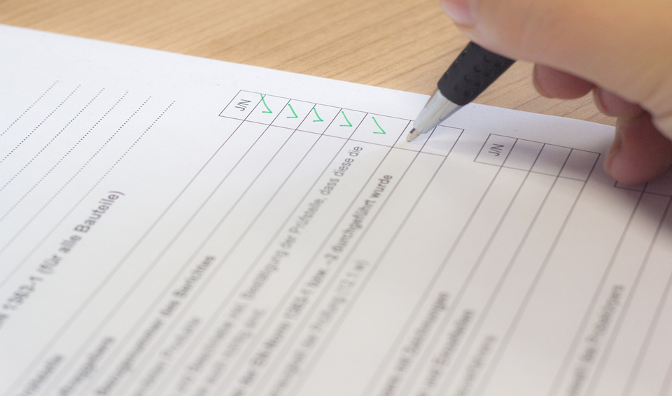
How to Become an SRE
Prospective SREs that intend to recognize IRAPs must first apply for recognition by submitting the information requested in the application to the Administrator. Organizations interested in serving as SREs will be able to submit their applications online once the Final Rule goes into effect on May 11, 2020.
Before the rule goes into effect, entities will be able to consult with and receive technical assistance from DOL about how to prepare their applications.
Applications should be submitted electronically using the Department’s online application form on our website. The application must include all required policies and procedures.

Slide 16
Criteria to become an SRE: An SRE Must…
Have the expertise to set competency-based standards through a consensus-based process involving industry experts.
Have the capacity and quality assurance processes and procedures to ensure IRAPs comply with DOL standards, including safety, compensation, and quality.
Have resources to operate as an SRE for a 5-year period.
Demonstrate impartiality.
Be in good standing with the U.S. Federal Government; cannot be suspended or debarred.
Have the appropriate industry and occupational expertise and resources in place to recognize IRAPs in their selected geographical area.

Slide 17
Filing a Complaint Against an IRAP
An SRE must have policies and procedures for addressing complaints filed by apprentices, prospective apprentices, an apprentice’s authorized representative, a personnel certification body, or an employer against each IRAP the SRE recognizes.
An SRE must notify the public about the right of an apprentice, a prospective apprentice, the apprentice’s authorized representative, a personnel certification body, or an employer, to file a complaint with the SRE against an IRAP the complainant is associated with, and the requirements for filing a complaint.

Slide 18
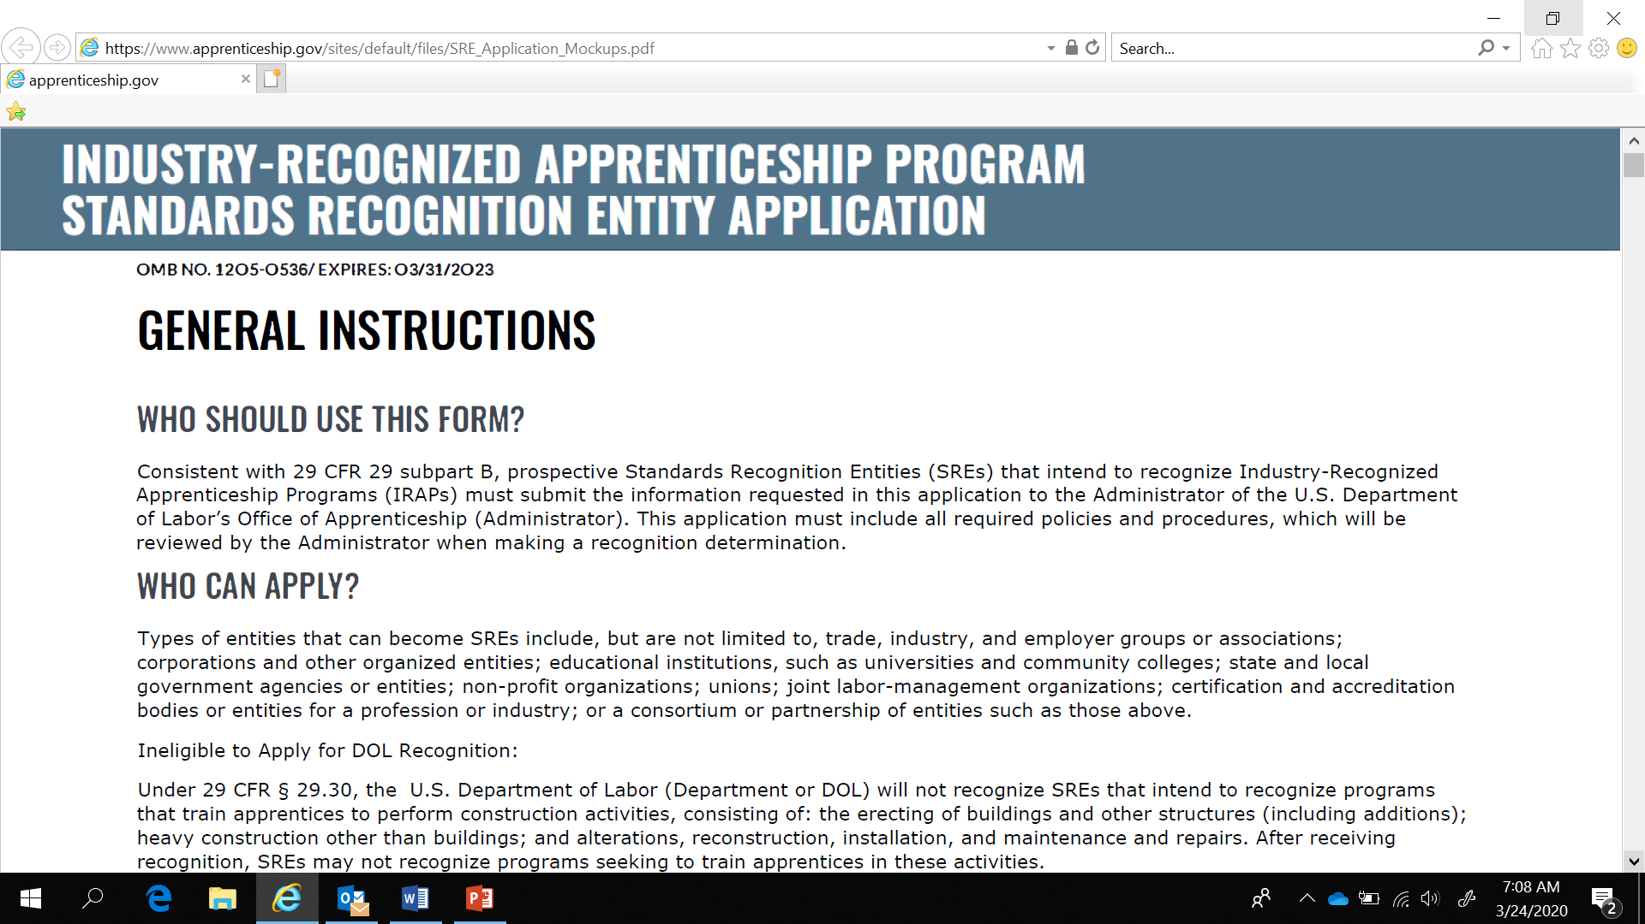
The Application
SRE Applicant Information
Capabilities and Experience
Evaluating and Monitoring High Quality Programs
Policies and Procedures
Attestation
Application Mockups found here: https://www.apprenticeship.gov/sites/default/files/SRE_Application_Mockups.pdf

Slide 19
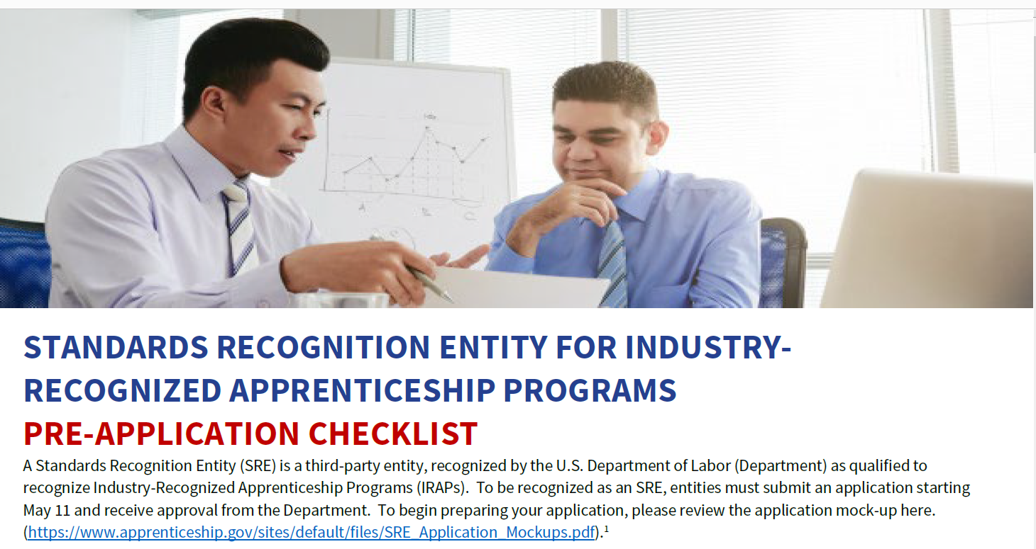
What You’ll Need to Apply

Slide 20
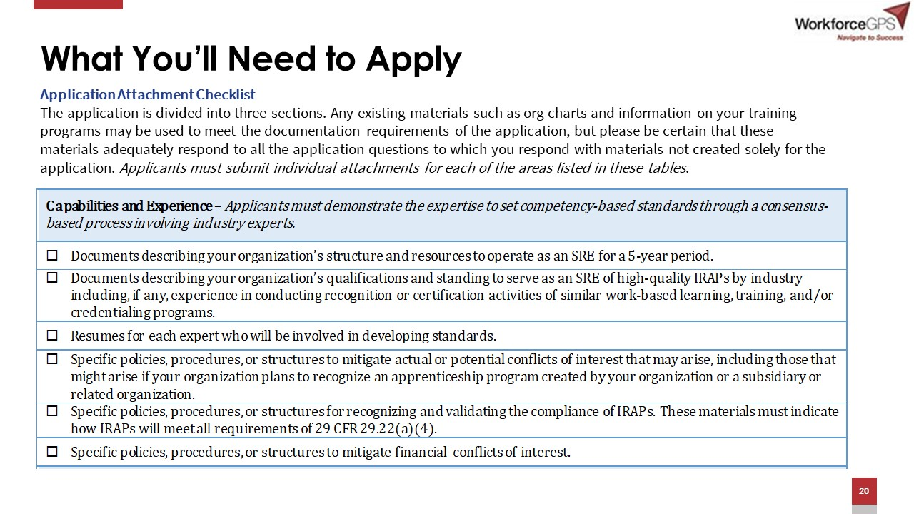
What You’ll Need to Apply
Application Attachment Checklist
The application is divided into three sections. Any existing materials such as org charts and information on your training programs may be used to meet the documentation requirements of the application, but please be certain that these materials adequately respond to all the application questions to which you respond with materials not created solely for the application. Applicants must submit individual attachments for each of the areas listed in these tables.

Slide 21
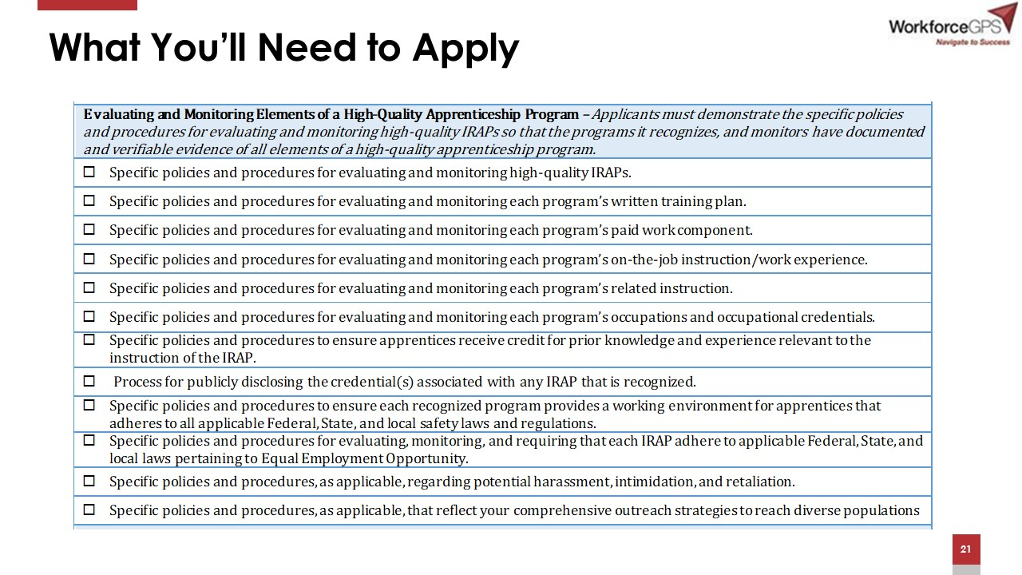
What You’ll Need to Apply

Slide 22
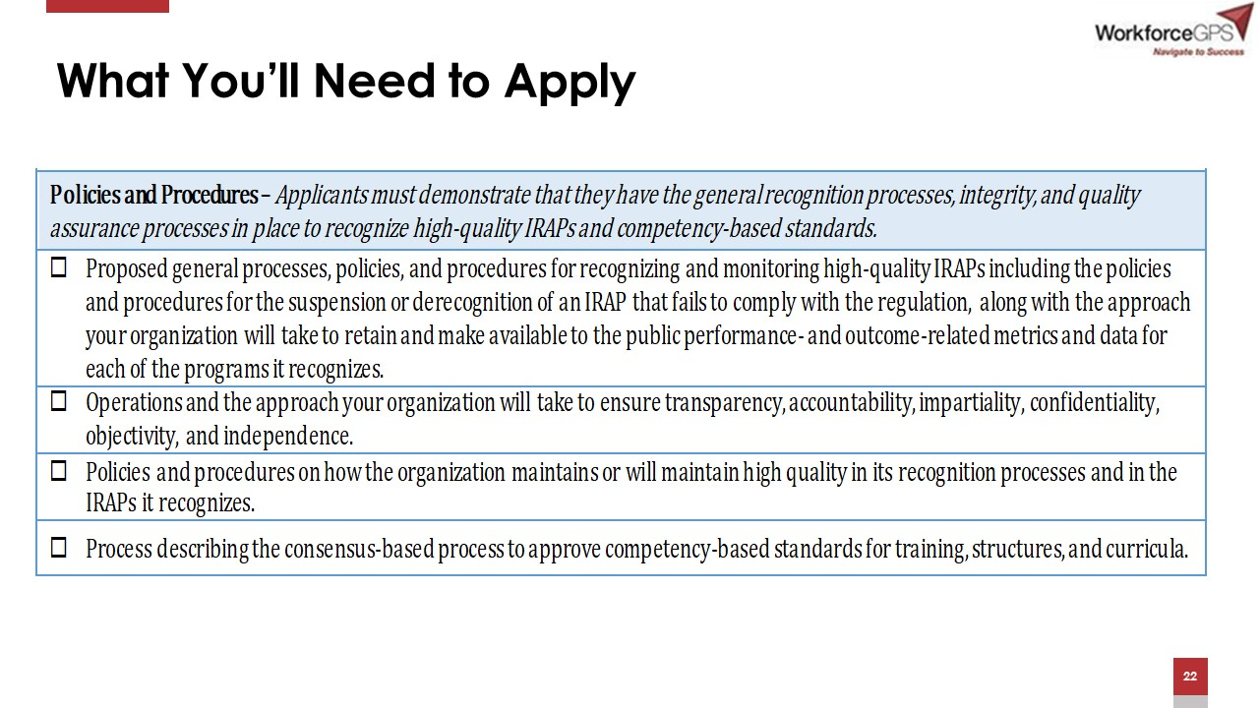
What You’ll Need to Apply

Slide 23
The Application Process
Applications can be submitted starting on May 11, 2020, which is the date the application portal launches. The portal will be open 24/7/365, except for scheduled maintenance. However, DOL will review applications, in batches, on a quarterly basis.
Based upon the information submitted, the Administrator will determine whether the applicant is qualified to be recognized as an SRE of IRAPs under 29 CFR 29 subpart B. DOL’s Office of Apprenticeship will notify the applicant.
Applicants can expect to receive a determination within approximately 90 days after the end of each quarterly review cycle.
An SRE will be recognized for 5 years, and must reapply at least 6 months before the date that its current recognition is set to expire if it seeks re-recognition.

Slide 24
If your application is denied …
The Office of Apprenticeship will provide a denial of recognition with the reason(s) for denial. The notice will tell the applicant what it needs to do differently before resubmitting its application. The notice will also explain that a request for administrative review must comply with the service requirements contained in 29 CFR part 18.
An entity that has been denied may request administrative review within 30 calendar days of receipt of the notice.
The Administrator will refer any requests for administrative review to the Office of Administrative Law Judges to be addressed in accordance with § 29.29.

Slide 25

SRE Derecognition
Once recognized, the Administrator may suspend an SRE for 45 calendar days and may initiate review of an SRE if it receives information indicating that:
The SRE is not in substantial compliance with this subpart; or
The SRE is no longer capable of continuing as an SRE.

Slide 26
Next Steps For Potential SREs
Organizations interested in serving as SREs will be able to submit their applications online once the Final Rule goes into effect on May 11, 2020.
To prepare, those interested in becoming SREs can:
  Become familiar with the Final Rule.
  Begin to develop the plans of action, structures, and key partnerships that will form the basis for a successful SRE application.
  Review the approved application mockup until the application portal is launched.
  Monitor DOL’s IRAP website for up-to-date information and additional webinars.
  Contact DOL with any technical assistance questions at https://www.apprenticeship.gov/help/contact-us.

Slide 27

Next Steps For Potential IRAP Sponsors
Assess your workforce needs, consider how this new flexibility in apprenticeship could offer the right talent development solution, and develop a program.
Familiarize yourself with the DOL standards for high-quality IRAPs.
Identify trusted national industry leaders in your industry sector, and encourage them to apply for recognition as an SRE.
Monitor DOL’s IRAP website for up-to-date information about recognized SREs.

Slide 28
IRAP Resources
To learn more about IRAPs and SREs: Visit our website at https://www.apprenticeship.gov/industry-recognized-apprenticeship-program to review the IRAP Final Rule and resources to become familiar with IRAPs and the roles and responsibilities of SREs. Resources include:
    IRAP Press Release
    IRAP Factsheet
    IRAP Factsheet for Prospective SREs
    IRAP Factsheet for Prospective IRAP Sponsors
    IRAP FAQs
    RAPs vs IRAPs comparison chart
    Office of Apprenticeship Staff: https://www.apprenticeship.gov/help/contact-us
    DOL Hotline (1-877-872-5627)
  Sign up for our Apprenticeship Newsletter to receive the latest apprenticeship-related news from the USDOL.

Slide 29
Are you interested in becoming an SRE?
Lets hear from you!
Here are a few polling questions:
Did you find this webinar helpful?
Are you interested in becoming an IRAP Sponsor ?

Slide 30

Office of Apprenticeship

