Slide 1
Read Before You Proceed: Instructions for Use & Legal Compliance
Legal Accessibility Requirements: 508 Compliance
Only use tables when standard content delivery is insufficient, and never merge table cells.
Do not use screenshots or images of text items. All text must be editable and not blur when the screen is zoomed in.
Avoid using “Smart Art” or the “Design Ideas” tool.
Do not repurpose slide title boxes for any other use.
Do not use multiple spaces, empty paragraphs, or strings of tabs to visually adjust your content, as every such repeated character must then be manually stripped from all slides before posting. Instead:
Use soft returns to bump content to the next line in lieu of spaces (Shift + Enter)
Manage paragraph spacing and tabs in the “Paragraph” panel.
Every image or visual element used must either have alternative “alt” text applied or be marked as “decorative”.
Alt text translates visual information into verbal information, which is read aloud in screen readers, while items marked “decorative” are skipped.
This step is required to deliver the full message provided by any graphics.
The person who laid out the content should also provide that alternate information to ensure their message stays intact.
Learn about the new innovative features!
Please watch this webcast before using this template.
https://vimeo.com/370983870/2afa9e8306
(Ctrl + Click to open link)
Duration: 6 minutes

Slide 2
TAA Administrative Collection of States (TAAACS)
Initial Review of Results

Slide 3
Today’s Speaker / Today’s Moderator
Robert Hoekstra
Program Analyst, PMDR Technical Expert
Office of Trade Adjustment Assistance

Slide 4
Who is on the call?
What is your role?
Fiscal Staff
TAA Program Reporting Staff
TAA Staff
TRA Staff
DOL ETA Staff
Other
Please click on the most appropriate answer in the poll.

Slide 5
TAAACS Basics Recap

Slide 6
TAAACS Basics Recap
What is TAAACS?
Formal Collection (OMB No. 1205-0540)
165 Questions About State Organization and Practice around the TAA Program (Estimated 5 hours to complete)
Discrete data and categories
Provides help text
Mandatory under Section 239(c) of Title II, Chapter 2 of the Trade Act of 1974, as amended (19 USC § 2271 et seq.)

Slide 7
TAAACS Basics Recap
Purpose of TAA Administrative Collection of States (TAAACS)
Provide Baseline Information on State Organization
Collect State Practice
Context for technical assistance
Common practices
Outlier states
Prioritize Technical Assistance
Investigate Practices Related to Positive Program Metrics

Slide 8
TAAACS Overview
Topics
The Collection is Broken Down into Eight Topic Areas
State Organization
Eligibility Determinations and Participant Training Procedures
Integration
IT Systems and Reporting
Training for TAA Staff
Outreach
Job Search and Relocation
Barriers

Slide 9
TAAACS Basics Recap
Timeline
8-Week Collection Window
Collection Will Normally Run October through November
Allows for integration with annual reporting
Extensions May Be Requested
To Be Returned as an Excel Sheet to hoekstra.robert@dol.gov

Slide 10
TAAACS Results
Data based on FY 2020 TAAACS, TAADI results from the 12/31/2019 quarter, and the most recent four quarter PIRL data ending 12/31/2019 unless otherwise noted.

Slide 11
Population in 2018, Certified Workers 1/1/2018 – 9/30/2019

Slide 12
Population in 2018, Certified Workers 1/1/2018 – 9/30/2019

Slide 13
Population in 2018, Certified Workers 1/1/2018 – 9/30/2019

Slide 14
Population in 2018, Certified Workers 1/1/2018 – 9/30/2019

Slide 15
Population in 2018, Certified Workers 1/1/2018 – 9/30/2019

Slide 21
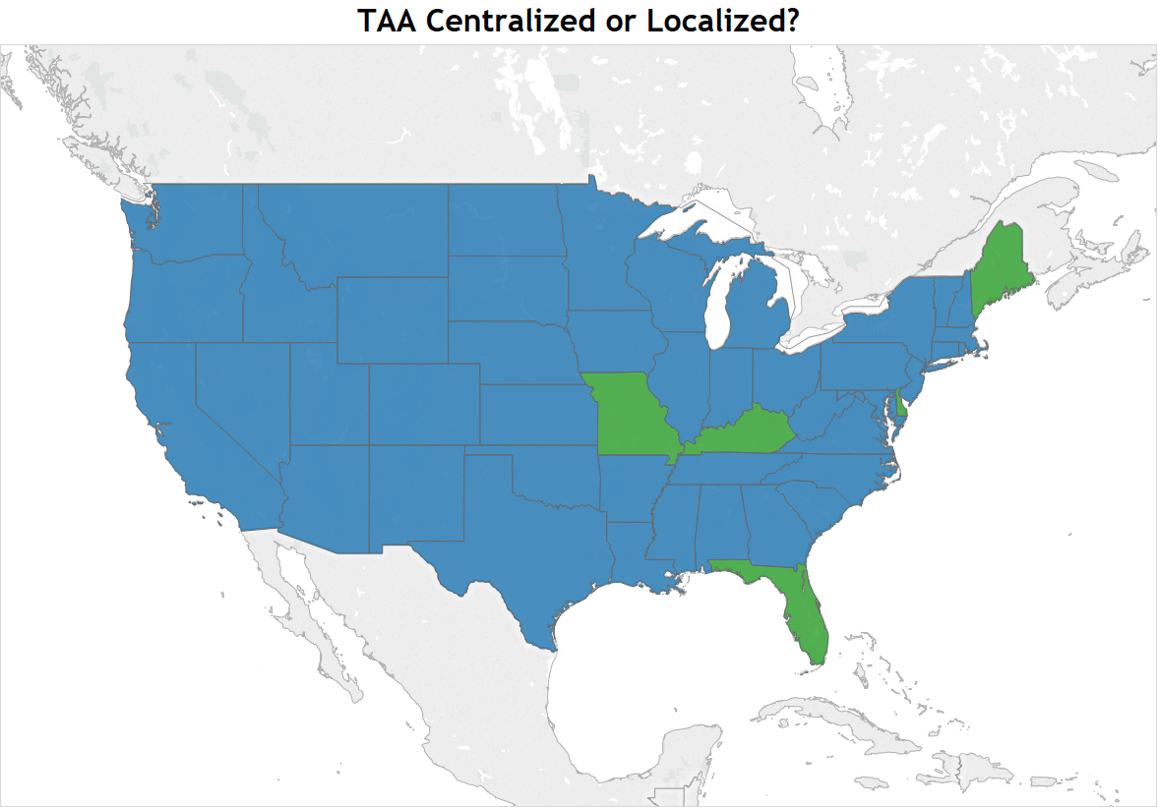
Blue indicates Centralized TAA Program
Green indicates Localized TAA Program

Slide 22
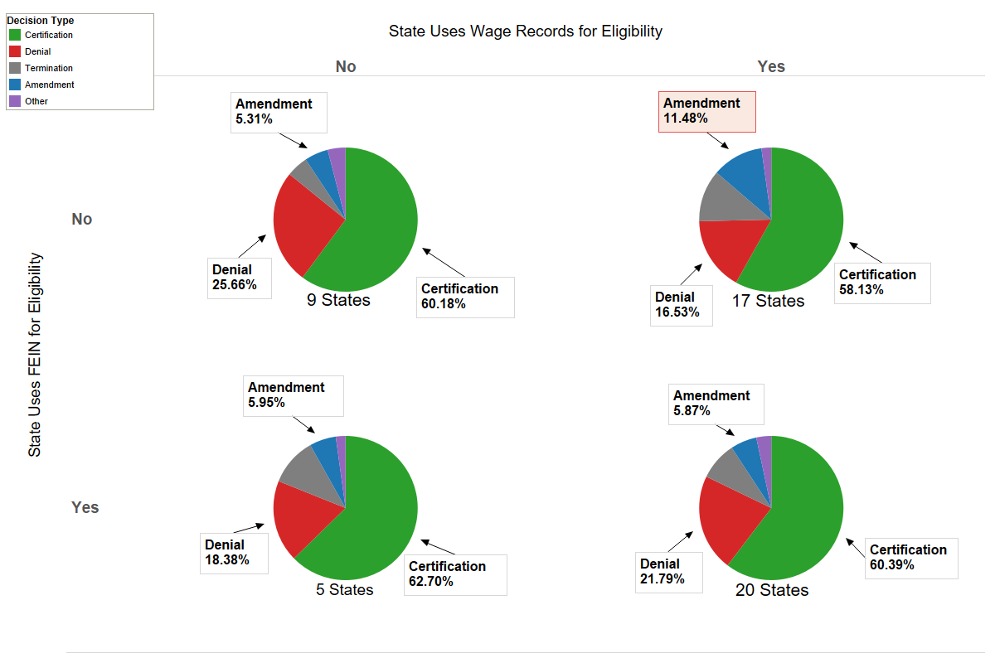
Based on Decisions rendered 10/1/2017 through 4/5/2020

Slide 24
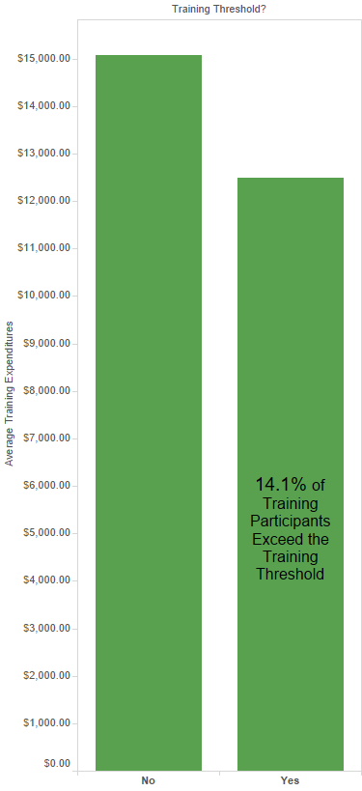

Slide 25
Integration Observations
States who have Rapid Response in the same department (37) as TAA average 85.6% vs. 74.2% on the TAADI measure
States that have Fiscal in the same department (33) have a TAADI training expenditures passage rate of 70% vs. 30% if they are not in the same department
Integration with VETS program is not related to higher veteran participant rates or better outcomes
Integration with Title 1 is associated with higher training rates and higher employment rates
Integration ratings of 2 and 4 (hedged ratings) typically have lower outcomes and training rates than states providing a clear rating of 1, 3, or 5

Slide 26
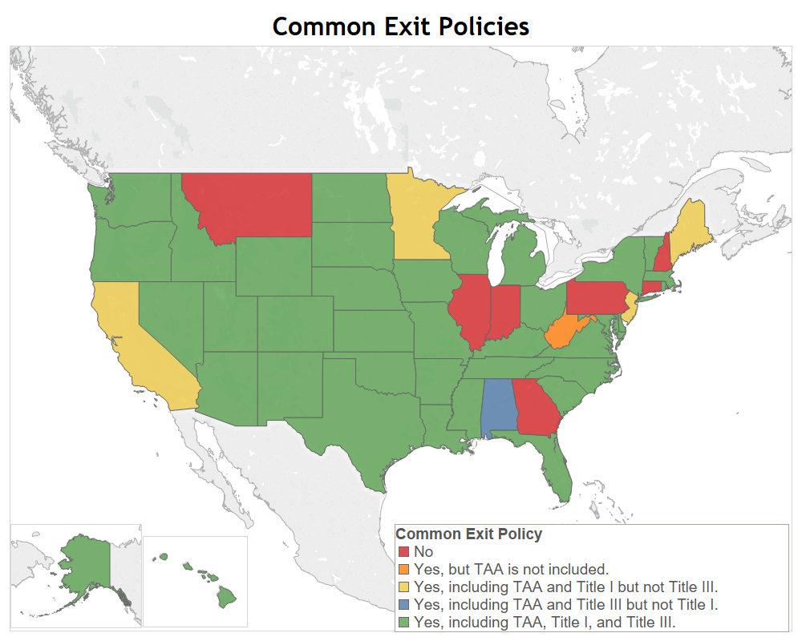
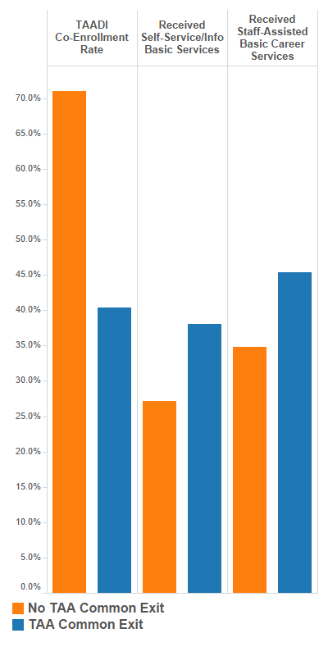

Slide 27
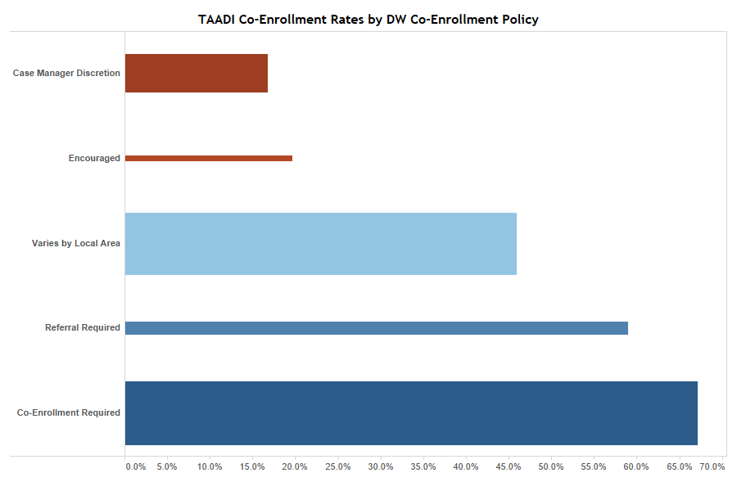

Slide 29
Training for TAA Staff Observations
Nearly every State has a handbook for TAA staff, but those who do not have substantially lower Q2 employment rates (62% vs. 77%)
All but 7 states hold conferences, but 1/3 of those who conduct conferences hold them less than annually
Webinars are highly leveraged and 30 states hold regular conference calls
States that do not conduct any regular conference calls or webinars have somewhat lower credentialing, training completion, and case management rates
Generally, training is important, but there is no clear benefit to one training over another

Slide 30
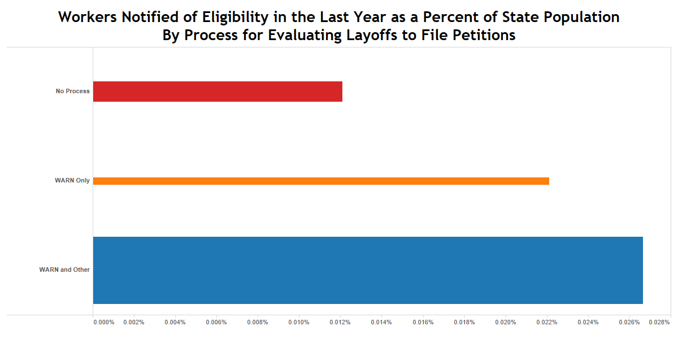

Slide 31
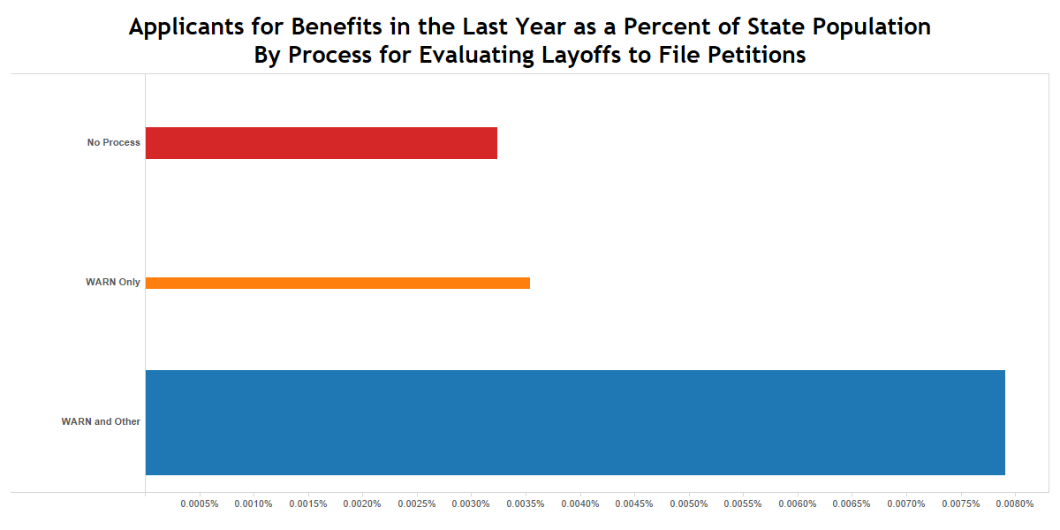

Slide 32
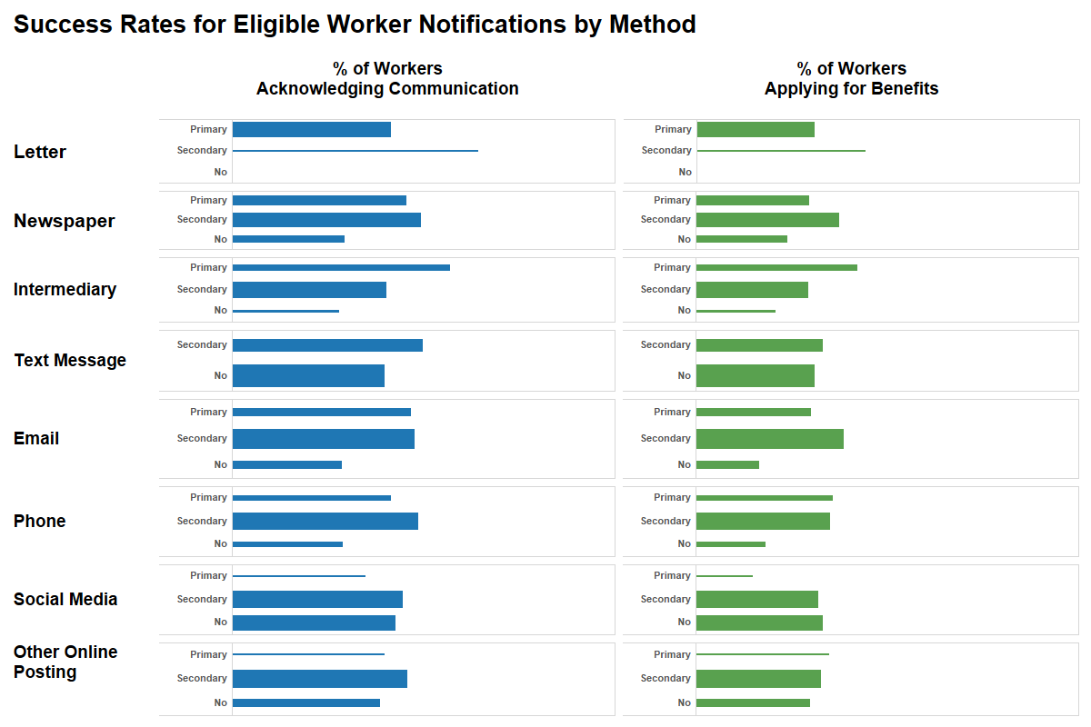

Slide 33
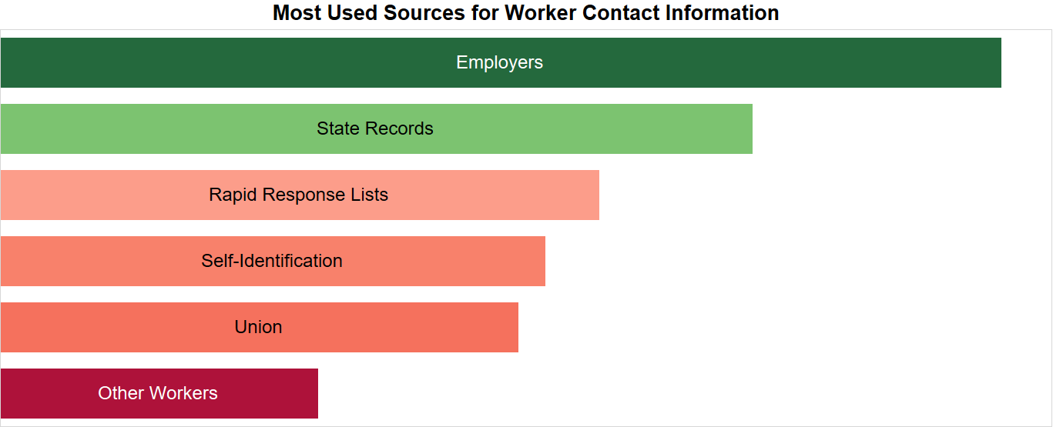

Slide 34
Job Search and Relocation Observations
Every state informs participants of job search and relocation benefits when participants start
36 states talk about these benefits at training completion and additionally at the case manager’s discretion
States that do not discuss these benefits at training completion have substantially lower utilization
40% of states have a specific follow-up time to discuss these benefits, which is associated with slightly lower utilization

Slide 35
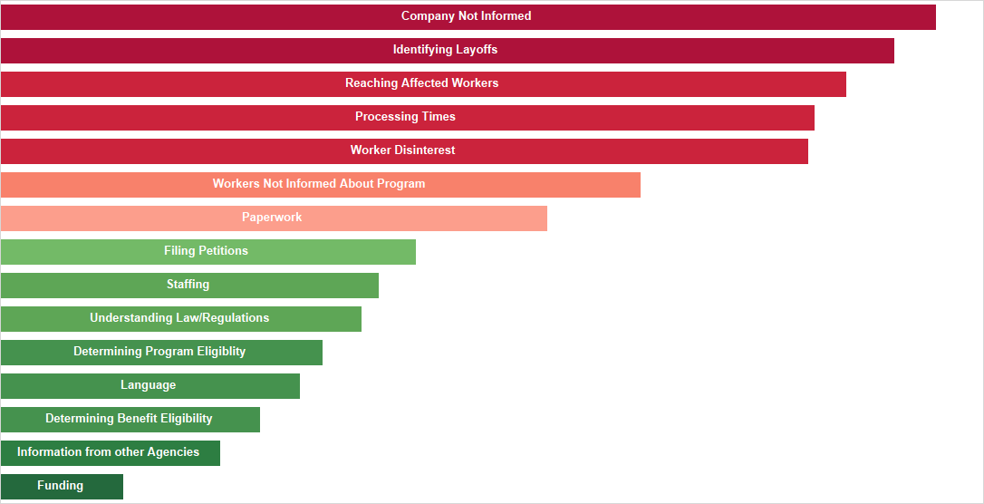

Slide 36
Any Questions?
Any other questions?

Slide 37
Closing Notes

Slide 38
Resources:
TAA Participant Reporting Page
Tons of information on participant reporting including TAADI resources
https://www.doleta.gov/tradeact/taa-data/participant-reporting/
Upcoming Webinars on our TAA Community Page
WorkforceGPS TAA community page lists upcoming webinars and events
https://taa.workforcegps.org/events

Slide 39
Contact Us
Robert Hoekstra
Program Analyst, Technical Expert PMDR
Office of Trade Adjustment Assistance
hoekstra.robert@dol.gov
202-693-3522

Slide 40
Thank You!
Need help? Email: support@workforceGPS.org

