Slide 1
Poll #1
How long have you worked in workforce development?
0-4 years
5-9 years
10+ years
Enter your response in the chat room.

Slide 2
WIOA Performance 101 Series – Part I
Introduction to Performance Accountability

Slide 3
Today’s Moderator
Christina Eckenroth
Workforce Analyst
U.S. Department of Labor
Employment and Training Administration

Slide 4
Today’s Presenters
Cesar Villanueva
Workforce Analyst
U.S. Department of Labor
Employment and Training Administration
Shelia F. Lewis
Workforce Analyst
U.S. Department of Labor
Employment and Training Administration

Slide 5
Today’s Objectives
1
Workforce Development: Background & Basics
2
Roadmap: From Law to Outcomes—WIOA Data Lifecycle
3
Overview: Performance Accountability
4
Important Terms in WIOA Performance Report

Slide 6
Workforce Development:
Background & Basics

Slide 7
History of Workforce Development
The New Deal (1933 - 1938)
Manpower Development and Training Act
(1962 - 1973)
Comprehensive Employment and Training Act (1973 - 1982)
Job Training Partnership Act (1982 - 1998)
Workforce Investment Act (1998 - 2014)
Workforce Innovation and Opportunity Act (2014 - Present)

Slide 8
Basics: Statute, Regulations, and Guidance
Statute:
WIOA Section 116 establishes performance accountability requirements for the six core WIOA programs
Regulations: WIOA- DOL only & WIOA Joint Final Rule
20 CFR 676, 677, and 678 (Adult, Dislocated Worker, Youth, and Wagner-Peyser)
Policy Guidance and Joint Issuances:
Guidance is issued by each of the Federal agencies. “Joint issuances” is the identical content coming out under each Federal partner’s vehicle, for consistency.

Slide 9
WIOA: WIOA Program Overview
WIOA Title I
Adult, Dislocated Worker, & Youth
WIOA Title II
Adult Education and Family Literacy Act (AEFLA) Programs (administered by Department of Education)
WIOA Title III
Wagner-Peyser Act Employment Services
WIOA Title IV
Vocational Rehabilitation Services (administered by Department of Education)
Six
Core
WIOA
Programs

Slide 10
Roadmap:
From Law to Outcomes—WIOA Data Lifecycle

Slide 11
Data…Data…Data…

Slide 12
Slide Title
WIOA
Legislation
PIRL
Performance Outcomes

Slide 13
Roadmap from Legislation to Outcomes
WIOA
Legislation (Law)
Regulations
CFR
Information Collection Request
(ICR)
Guidance
TEGLs & TENs
Technical Assistance
State Policies
Local Policies

Slide 14
Information Collection Requests – Reporting Instruments
PIRL
(Data Layout)
REPORTS
Specifications
(Formulas)
Reporting Instruments

Slide 15
Participant Individual Record Layout (PIRL)

Slide 16
WIOA Report Templates
ETA 9169
Annual Report
ETA 9173
Quarterly Report
ETA 9171
Eligible Training Provider
Annual
Narrative
Report


Slide 17
Report Specifications
Count of UNIQUE RECORDS from Employment Rate (Q2) DENOMINATOR where (EMPLOYED 2ND QUARTER AFTER EXIT QUARTER > 0 and < 9) divided by Count of UNIQUE RECORDS where (Funding Stream) and Date of Program Exit is within the report period and OTHER REASON FOR EXIT = 00

Slide 18
Data Collection Process
Services
Intake Forms
Case Management System
Data

Slide 19
How Data Gets to the Department of Labor
Department of Labor
WIPS
Workforce Integrated Performance System
Services
Intake Forms
MIS
Grantee Data
Services
Intake Forms
MIS
Grantee Data
Services
Intake Forms
MIS
Grantee Data

Slide 20
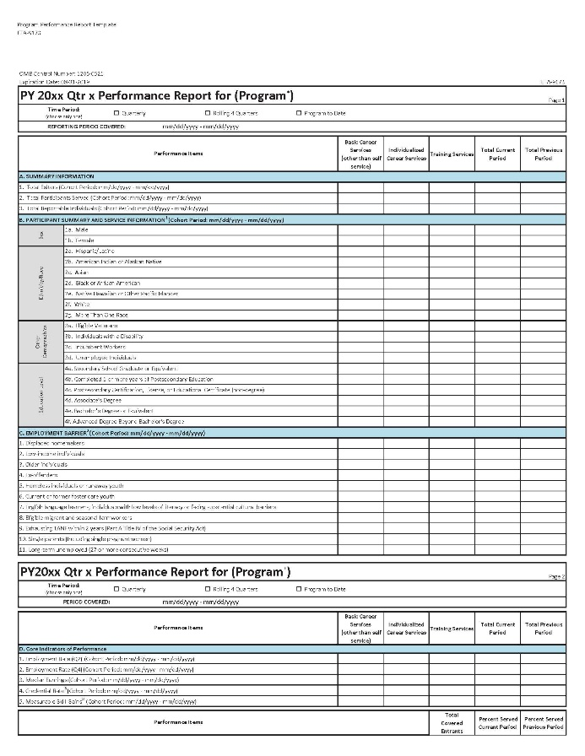
WIPS to Performance Reports
Department of Labor
WIPS
Workforce Integrated Performance System

Slide 21
Workforce Development Boards
Source: Quarterly Workforce System Report, PY 2018, Quarter 3

Slide 22
American Job Centers
Source: Quarterly Workforce System Report, PY 2018, Quarter 3

Slide 23
Poll #2
Now that you have heard a little about the background and organization of workforce development, tell us how you fit into that picture by indicating your primary role in the workforce development system?
Data/Reporting Analyst
State or Local Board Member
Case Manager
AJC Intake
Monitoring/Quality Assurance
AJC Supervisor/Director
Job Developer/Business Services Representative
Federal Staff
Other
Select all responses that apply.

Slide 24
Performance Outcomes

Slide 25
Slide Title
WIOA
Legislation
WIOA
Regulations
Information Collection Requests (ICRs)
PIRL
Report Templates

Participant Individual Record Layout (PIRL)
Reporting Instruments
Report Specifications
6 Indicators of Performance
Data Elements Collected
Intake Forms
Workforce Integrated Performance System (WIPS) Generates Reports
Management
Information System
Performance Outcomes
Grantees forward Data to DOL via WIPS

Slide 26
Overview:
Performance Accountability

Slide 27
What is Performance Accountability?
Reporting to Stakeholders
Continuous Improvement
Tracking Performance

Slide 28
Performance Accountability: Tracking Performance
High Quality Data
Timely
Standard
Consistent
Accurate
Reports
Outcomes
Accountability
Targets

Slide 29
What does data quality look like under WIOA?
ETA supports high quality data through:
Workforce Integrated Performance System (WIPS)
Participant Individual Record Layout (PIRL)
Federal and grantee data validation
Data analysis

Slide 30
Who is included in performance accountability?
Program Participants
Reportable individuals – engage with the workforce system on an initial level but, do not complete the requirements to become participants
So, when does someone seeking or using services become a “program participant?” And who are considered “reportable individuals?”

Slide 31
How are performance targets set?
WIOA implements a performance accountability system based on primary indicators. States and the Secretaries of Labor and Education negotiate levels of performance, which are adjusted at the end of program year, using a statistical adjustment model.

Slide 32
Vision of WIOA Performance Accountability
Alignment of Core Performance Indicators
Joint Accountability Across Six Core Programs
Title I: Adult, Dislocated Worker, and Youth
Title II: Adult Education
Title III: Wagner-Peyser Employment Services
Title IV: Vocational Rehabilitation
All core programs report on the same indicators, using the same definitions and data elements

Slide 33
WIOA Primary Indicators of Performance
Six Core Programs
Credential Attainment
Employment Rate
4th QTR After Exit
Employment Rate
2nd QTR After Exit
Median Earnings
Effectiveness in Serving Employers
Measurable Skill Gains

Slide 34
Primary Indicators of Performance
Percentage of participants who are in unsubsidized employment during the second quarter after exit from the program.
For Title I Youth: percentage of participants in education or training activities, or in unsubsidized employment during the second quarter after exit.
All participants in all core programs are included in this indicator regardless of employment/education status at program entry.
Employment Rate
2nd Qtr After Exit

Slide 35
Primary Indicators of Performance
Percentage of participants who are in unsubsidized employment during the fourth quarter after exit from the program.
For Title I Youth: percentage of participants in education or training activities, or in unsubsidized employment during the fourth quarter after exit.
All participants in all core programs are included in this indicator regardless of employment/education status at program entry.
Employment Rate
4th Qtr After Exit

Slide 36
Primary Indicators of Performance
The median earnings of participants who are in unsubsidized employment during the second quarter after exit from the program.
Median Earnings

Slide 37
Primary Indicators of Performance
Percentage of participants enrolled in education or training program who attain a recognized postsecondary credential or secondary school diploma within 1 year after program exit.
Only includes those who received training or education (excluding OJT or Customized Training) in denominator.
Credential Attainment

Slide 38
Primary Indicators of Performance
Percentage of program participants who are in an education or training program that leads to a recognized postsecondary credential or employment AND who are achieving measurable skills gains, defined as documented academic, technical, occupational, or other forms of progress, towards such a credential or employment.
Participants are included in the indicator regardless of how long they have participated in the program year.
Measurable Skill Gains

Slide 39
Primary Indicators of Performance
Statewide Measure: shared indicator across all core programs
Three Pilot Approaches:
Retention with the Same Employer
Repeat Business Customer
Employer Penetration Rate
Effectiveness in Serving Employers

Slide 40
Important Terms in WIOA Performance Reporting

Slide 41
Important Definitions:
Reportable Individual
A reportable individual is someone who:
Demonstrates intent to use program service
Only uses self-service
Receives information-only services
Provides identifying information
A student with a disability receiving only pre-employment transition services (VR-only)
Reportable individuals are reported, but do not count toward performance outcome measures.

Slide 42
Important Definitions:
Participant
A participant is someone who:
Meets the definition of a reportable individual
Has received one of the allowable services
Has satisfied all applicable programmatic requirements for the provision of services
Participants are counted in performance.

Slide 43
Important Definitions:
Period of Participation
A period of participation refers to:
The period of time beginning when an individual becomes a participant and ending on the participant’s date of exit from the program.
A new period of participation is counted each time a participant re-enters and exits the program- even if both exits occur during the same program year.
Periods of participation differ for Measurable Skill Gains.

Slide 44
Important Definitions:
Exit
Date of Exit is determined:
At the last date of service
After 90 days of no services have elapsed, and no future services are planned

Slide 45
Important Definitions:
DOL Only: Common Exit
Common exit occurs when a participant:
Is enrolled in multiple DOL-administered programs
Has not received services from any DOL-administered program to which the common exit policy applies for at least 90 days
No future services are planned, with the exception of self-service, information-only activities, or follow-up services
DOL allows for and encourages states to utilize a common exit, and envisions full implementation of a common exit across the DOL-administered programs within each State.

Slide 46
Knowledge Check #1
Let’s test your knowledge so far. Which of the following programs is NOT one of the six WIOA core programs?
Title I Youth
Dislocated Worker
Adult Education
National Dislocated Worker Grants
Vocational Rehabilitation
Enter the correct answer into the chat room.

Slide 47
Knowledge Check #2
A reportable individual is a person who receives a service beyond self-service or informational, and provides identifying information.
True
False
Enter the correct answer into the chat room.

Slide 48
Knowledge Check #3
Which of the following is NOT a WIOA indicator of performance?
Measurable Skill Gains
Average Earnings
Effectiveness in Serving Employers
Credential Attainment
Enter the correct answer into the chat room.

Slide 49
Resources:
DOLETA Resources:
WIOA Resources
https://www.dol.gov/agencies/eta/wioa
ETA Performance Resources
https://www.dol.gov/agencies/eta/Performance/resources
ETA Advisories
https://wdr.doleta.gov/directives/
WIOA Performance Reporting
https://www.dol.gov/agencies/eta/performance/reporting
WorkforceGPS Resources:
WIOA Implementation Training Resources
ion.workforcegps.org/FocusAreas
All About WIOA- Basic Training and TA
https://ion.workforcegps.org/resources/2017/08/31/15/45/All_WIOA_Basic_Training_TA

Slide 50
Create an account on WorkforceGPS
Here you will find curated communities of interest, useful webinars and other training resources, promising workforce development practices, and relevant evidence-based research.

Slide 51
Any Questions?
Enter your question in the chat room

Slide 52
Save the Date: Upcoming Technical Assistance Events
WIOA 101 Series continued
Part II – Performance Accountability Resources and
Their Use: A Guide for New State Grantees and Board Members
May 27, 2020

Slide 53
More Questions?
ETAPerforms@dol.gov

Slide 54
Thank You!
Need help? Email: Support@workforceGPS.org

