Slide 1


Read Before You Proceed:
Instructions for Use & Legal Compliance
Legal Accessibility Requirements: 508 Compliance
Only use tables when standard content delivery is insufficient, and never merge table cells.
Do not use screenshots or images of text items. All text must be editable and not blur when the screen is zoomed in.
Avoid using “Smart Art” or the “Design Ideas” tool.
Do not repurpose slide title boxes for any other use.
Do not use multiple spaces, empty paragraphs, or strings of tabs to visually adjust your content, as every such repeated character must then be manually stripped from all slides before posting. Instead:
  Use soft returns to bump content to the next line in lieu of spaces (Shift + Enter)
  Manage paragraph spacing and tabs in the “Paragraph” panel.
Every image or visual element used must either have alternative “alt” text applied or be marked as “decorative”.
  Alt text translates visual information into verbal information, which is read aloud in screen readers, while items marked “decorative” are skipped.
  This step is required to deliver the full message provided by any graphics.
  The person who laid out the content should also provide
  that alternate information to ensure their
  message stays intact.
Learn about the new innovative features!
Please watch this webcast
before using this template.
https://vimeo.com/370983870/2afa9e8306
(Ctrl + Click to open link)
Duration: 6 minutes

Slide 2
Where Are You?
Please enter your location in the chat window
  (lower left of screen)

Slide 3
Building a Construction Career Pathway

Slide 4

Today’s Moderator
Mark Smith
  Workforce Analyst
    U.S. Department of Labor
    Employment and Training Administration

Slide 5

Today’s Speaker
Rossie Cherry
  DOL YouthBuild Technical Assistance Coach

Slide 6


Today’s Speakers
Joanna James
  Executive Director
    Project REBUILD
Brian McMahon
  Deputy Director
    Operation Fresh Start

Slide 7
Today’s Objectives
Clearly define career pathways according to WIOA
Identify six elements for development of career pathways and how they can apply to YouthBuild Construction career pathways
Understand need for employer-driven competencies of construction career pathways for implementation at a YouthBuild program level
Identify promising practices for administrative planning, partnership development, and program implementation at the local YouthBuild level

Slide 8
Poll
How would you describe your level of engagement with building construction career pathways?
I’m just learning about construction career pathways.
I’m familiar with construction career pathways but am not currently planning or implementing a model.
My program is committed to a construction career pathways approach and is in the planning stages.
My program is currently implementing a construction career pathway.
Choose the best answer for your organization

Slide 9
What are Career Pathways?
According to the Workforce Innovation and Opportunity Act (WIOA), the term ‘‘career pathway’’ means a combination of rigorous, high-quality education, training, and other services that:
aligns with the skill needs of industries in the economy of the state or regional economy involved.
prepares an individual to be successful in any of a full range of secondary or postsecondary education options, including registered apprenticeships.
includes counseling to support an individual in achieving the individual’s education and career goals.

Slide 10
What are Career Pathways? (cont.)
includes, as appropriate, education offered concurrently with, and in the same context as, workforce preparation activities and training for a specific occupation or occupational cluster.
organizes education, training, and other services to meet the particular needs of an individual in a manner that accelerates the educational and career advancement of the individual to the extent practicable.
enables an individual to gain a secondary school diploma or its recognized equivalent, and at least one recognized postsecondary credential.
helps an individual enter or advance within a specific occupation or occupational cluster.

Slide 11

Career Pathways as value added to your YouthBuild Program
Career pathways programs make it easier for people to earn industry-recognized credentials through avenues that are more relevant.
Provides opportunities for more flexible education and training and to attain market identifiable skills that can transfer into work.
These comprehensive education and training programs are suited to meet the needs of working learners and non-traditional participants.
Career pathways programs are designed to serve a diverse group of learners including adults, youth, dislocated workers, veterans, individuals with a disability, public assistance recipients, new immigrants, English language learners, and justice-involved individuals.
Career pathways systems and programs have been defined in multiple ways. WIOA now codifies the essential elements of career pathways into law.

Slide 12
Construction as a Career Pathway – Why?
Building and Trades – Construction is one of the fastest-growing industries in the country.
Construction is projected to be a HIGH-DEMAND INDUSTRY over the next 5-10 years.
YouthBuild model has infrastructure (education, hands-on training, supportive services and career planning) and historical partners that are construction focused.
YouthBuild programs already use industry-recognized credentials established by industry to build off and there are many registered apprenticeship programs with which to align.
Entry points align with technical skill level of most youth completing a YouthBuild program.

Slide 13
U.S. Bureau of Labor Statistics – Employment by Major Industry Sector
Table 2.1 Employment by major industry sector
Industry Sector | Thousands of Jobs |  |  | Change |  | Percent Distribution |  |  | Compound Annual Rate of Change
 | 2008 | 2018 | 2028 | 2008 - 2018 | 2018 - 2028 | 2008 | 2018 | 2028 | 2008 - 2018 | 2018 - 2028
Total(1)(2) | 149,276.0 | 161,037.7 | 169,435.9 | 11,761.7 | 8,398.2 | 100.0 | 100.0 | 100.0 | 0.8 | 0.5
Nonagriculture wage and salary(3) | 137,991.0 | 149,803.7 | 157,662.0 | 11,812.7 | 7,858.3 | 92.4 | 93.0 | 93.1 | 0.8 | 0.5
Goods-producing, excluding agriculture | 21,277.9 | 20,661.3 | 20,872.7 | -616.6 | 211.4 | 14.3 | 12.8 | 12.3 | -0.3 | 0.1
Mining | 709.9 | 683.3 | 727.9 | -26.6 | 44.6 | 0.5 | 0.4 | 0.4 | -0.4 | 0.6
Construction | 7,162.5 | 7,289.3 | 8,096.8 | 126.8 | 807.5 | 4.8 | 4.5 | 4.8 | 0.2 | 1.1
Manufacturing | 13,405.5 | 12,688.7 | 12,048.0 | -716.8 | -640.7 | 9.0 | 7.9 | 7.1 | -0.5 | -0.5
Services-providing excluding special industries | 116,713.1 | 129,142.4 | 136,789.3 | 12,429.3 | 7,646.9 | 78.2 | 80.2 | 80.7 | 1.0 | 0.6
Utilities | 558.8 | 554.6 | 537.2 | -4.2 | -17.4 | 0.4 | 0.3 | 0.3 | -0.1 | -0.3
Wholesale trade | 5,875.0 | 5,852.5 | 5,754.0 | -22.5 | -98.5 | 3.9 | 3.6 | 3.4 | 0.0 | -0.2
Retail trade | 15,289.1 | 15,833.1 | 15,679.4 | 544.0 | -153.7 | 10.2 | 9.8 | 9.3 | 0.4 | -0.1
Transportation and warehousing | 4,513.6 | 5,419.1 | 5,741.4 | 905.5 | 322.3 | 3.0 | 3.4 | 3.4 | 1.8 | 0.6
Information | 2,983.8 | 2,828.1 | 2,833.7 | -155.7 | 5.6 | 2.0 | 1.8 | 1.7 | -0.5 | 0.0
Financial activities | 8,206.1 | 8,568.8 | 8,849.4 | 362.7 | 280.6 | 5.5 | 5.3 | 5.2 | 0.4 | 0.3
Professional and business services | 17,792.3 | 20,999.5 | 22,661.9 | 3,207.2 | 1,662.4 | 11.9 | 13.0 | 13.4 | 1.7 | 0.8
Educational services | 3,039.8 | 3,727.5 | 4,201.0 | 687.7 | 473.5 | 2.0 | 2.3 | 2.5 | 2.1 | 1.2
https://www.bls.gov/emp/tables/employment-by-major-industry-sector.htm

Slide 14
This graphic from the National Governors Association illustrates the linkages between sector partnerships and career pathways.

Slide 15
Sample of Construction Clusters
Boilermakers
General Construction Workers
Bricklayers and Stonemasons
Glaziers
Cabinetmakers
Heating and Cooling System Mechanics
Carpenters
Insulation Installers
Cement Masons
Landscapers and Grounds Keepers
Commercial Drivers
Line Installers and Repairers
Construction and Well Drillers
Painter
Construction Helpers
Paving Equipment Operators
Construction Managers
Pipelayers
Drywall Finishers
Plasterers
Drywall Installers
Plumbers and Pipefitters
Ironworkers
Electrician Helpers
Roof Bolters
Electricians
Roofers
Elevator Installers and Repairs
Sheet Metal Workers
Sprinkler Installers
Explosives Workers
Structural Metal Workers
Fence Builders
Tile Setters
Floor Sanding Machine Operators
Wallpaper Hangers

Slide 16
Six Key Elements of Career Pathways
Build Cross-Agency Partnerships and Clarify Roles
Identify Sector or Industry and Engage Employers
Design Education & Training Programs
Identify Funding Needs & Sources
Align Policies & Programs
Measure System Change & Performance

Slide 17
Six Elements of Career Pathways Development
Key Element One Components
Engage cross-agency partners and employers
Establish a shared vision, mission, and set of goals
Define the roles and responsibilities of all partners
Develop a work plan and/or Memorandum of Understanding for the partnership
Element One - Build cross-agency partnerships and clarify roles. Comprehensive career pathways systems require participation at many different levels.

Slide 18
Element One: Build Agency Partnerships and Clarify Roles
Key Agency Partners
Workforce Development Boards and American Job Centers (WIOA – Youth, disadvantaged workers)
Local building and trades councils (emphasize youth, female, and disadvantaged workers)
Local construction employers (review the entire construction cluster and various specialty trades)
HUD Section 3
Postsecondary - registered apprenticeship, community colleges, trade schools
Local education agency
Social services
Supportive services

Slide 19
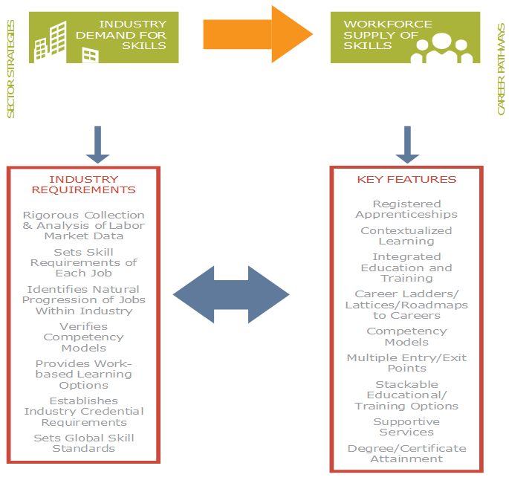
Complementary Approaches
to Workforce Development

Slide 20
Element One: Program Implementation
Joanna James
  Executive Director
    Project REBUILD
20

Slide 21

Element One: Build Cross-Agency Partnership and Clarify Roles
Understand the Definition of Partner
Very Defined Roles and Responsibilities
Review Plans and MOUs Regularly
In Summary – Create a partnership, NOT a placement
This Photo by Unknown author is licensed under CC BY.

Slide 22
Element One: Program Implementation
Brian McMahon
  Deputy Director
    Operation Fresh Start
22

Slide 23
Element One: Build Cross-Agency Partnership and Clarify Roles
Joined sub-committee within Construction Workforce Diversity Alliance (CWDA)
Partnered with Construction Training, Inc. (CTI) and joined Board of Directors
Developed relationships with local union apprenticeship coordinators
Engaged Findorff, a large regional construction firm, in an employment training partnership

Slide 24
Six Elements of Career Pathways Development
Key Element Two Components
Conduct labor market analysis to target high demand and growing industries.
Survey and engage key industry leaders from targeted industries and sector partnerships.
Clarify the role of employers in the development and operation of programs.
Identify existing training systems within industry as well as the natural progression and/or mobility (career ladders/lattices).
Identify the skill competencies and associated training needs.
Sustain and expand business partnerships.
Element Two - Identify industry sectors and engage employers. A career pathways system must be employer driven. This is the single most important transformational element of a career pathways system; employers are partners and co-investors in the system.

Slide 25
Labor Market Information
The intent of career pathways is to train participants for the skill needs of employers, so it is essential to select the industries that will benefit the local economy and provide employment at family sustaining wages.
What is the labor market information telling you about building and trades career opportunities in your area?

Slide 26
Effective Employer Engagement
Be specific with construction employers to identify what they really want youth to know in key areas:
Technical skills
Employability skills
Path to career advancement
Ask construction employers how they instruct their staff in key areas of competency and if they have any activities to reinforce these skills.
Ask construction employers to assist in developing curriculum content in addition to your HBI, MC3, NCCER, etc.
Ask construction employers how they sequence competencies. If they are doing project-related math, what do they teach first and why? What is the sequencing to ensure no gaps in conceptual learning?

Slide 27
Roles of Employers (and/or Other Stakeholders)
Does this career pathway align with the skill needs of industries in the state or regional economy involved?
Career pathways are intended to encourage and expand the number of participants, jobseekers, and workers who earn industry-recognized postsecondary credentials that correspond to the skill needs of employers in high-demand industry sectors. Therefore, career pathways programs should engage employers and other stakeholders in:
identifying the skills that are needed by high-demand employers.
determining how participants are deemed proficient in these skills.
identifying the credentials that employers value in making labor market decisions.
providing work-based learning opportunities for participants.
advising how to validate curricula and credentials.

Slide 28
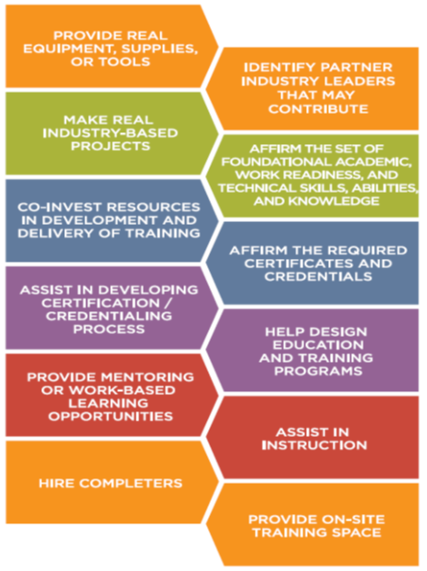
Role of Construction Employers in the Development and
Operation of Programs
Key employers will accept multiple roles and contribute in the development of career pathway elements such as:
enhancing/aligning current curriculum, content, and instruction on mastery of trade-related tools
developing work-based learning program with “internship descriptions,” time keeping, and assessments

Slide 29
Employer-Driven Competencies Embedded in All Aspects of Industry-Recognized Credential
Education/Academics – Example: a specialty trade employer would like to see math and vocabulary within material data safety sheets, writing about problem solving in that particular workplace, and science projects related to their needs
Leadership – work-based learning component where youth can “shadow” company project manager or other leadership staff as an intern learning the overall trade

Slide 30
Competency-Driven – Ask Questions
What are skill gaps in employer work demand that may need to be added to curriculum to increase local hiring for participants?
Example – employer has a few years of solar installation farm projects and would like program to add a module into their curriculum.
What are challenges employers identify within current workforce?
Employability Skills Framework – Example: What is youth relationship with construction employer supervisor? Will it be one based upon mentor/mentee (ideal)? How do you build relationship development between youth and employer into program?
Career One-Stop Competency Model – Example: Clearly define what professionalism within various building and trades work sites looks like for our youth

Slide 31
Element Two: Program Implementation
Joanna James
  Executive Director
    Project REBUILD
31

Slide 32
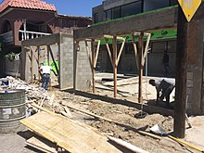
Element Two: Identify Sector or Industry and Engage Employers
Know your organization’s capacity to engage employers
Know your young people (before you spend time and energy creating partnerships)
Know employer needs and your capacity to meet those needs
In Summary: Be prepared, be realistic, and be knowledgeable

Slide 33
Element Two: Program Implementation
Brian McMahon
  Deputy Director
    Operation Fresh Start
33
33

Slide 34
Element Two: Identify Sector or Industry and Engage Employers
Developed OFS Grad Crew program, an advanced construction training platform
Apprenticeship readiness evaluation
Obtained BAS (Bureau of Apprenticeship Standards) Pre-Apprenticeship Training Provider certification
Communicated with employers and our regional Workforce Development Board about workforce needs

Slide 35
Six Elements of Career Pathways Development
Key Element Three Components
Education and training programs provide a clear sequence of education courses and credentials.
Combine with continuous and seamless support systems that prepare individuals, regardless of their skill levels at the point of entry, for postsecondary education, training, and employment.
Align skills and competencies with postsecondary education, registered apprenticeship, and other workforce training systems.
Your program design is encouraged not to be “business as usual” and requires “out of the box” thinking to best meet the needs of employers and learners.
Think of the how to best support the unique needs of targeted populations and what challenges youth may encounter that cause early exiting from career pathways programs.
Element Three - Design education and training programs; career pathways programs provide a clear sequence of education courses and credentials that meet the skill needs of high-demand industries.

Slide 36
Element Three - Design Education and Training Programs
Identify and engage education and training partners.
Identify target populations, entry points, and recruitment strategies.
Career pathways systems provide participants with multiple entry points to accommodate academic readiness and multiple exit points to permit on ramp and off ramp when necessary.
Review, develop, or modify competency models with employers and develop and validate career ladders/lattices.
Designing programs requires organizing competencies into a logical sequence of information and experiences by applying teaching methodologies. Develop or modify programs to ensure they meet industry-recognized and/or postsecondary credentials.

Slide 37
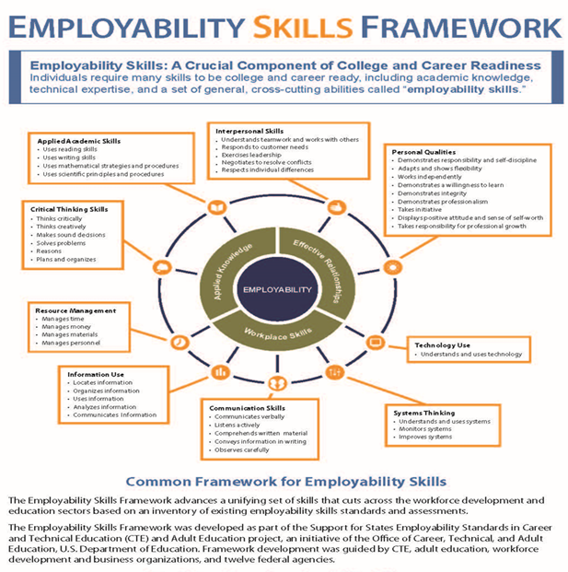
Http://cte.ed.gov/employabilityskills

Slide 38
Employability Skills Framework
Employability Skills Framework – identify with employers ways to embed and sequence skills within all program components.
Applied Knowledge:
Applied academic skills
Critical thinking skills
Workplace Skills:
Information use
Resource management
Communication skills
Systems thinking
Technology use
Effective Relationships:
Personal qualities
Interpersonal skills
The Leadership Development component within our programs should be heavily focused on building these skills in participants.

Slide 39
Element Three - Design Education and Training Programs
Research and promote work-based learning opportunities within construction and industry-related partners. What major construction projects are going on near your program site?
Develop integrated, accelerated, contextualized learning strategies. Work with key partners/employers to identify “how” they teach. What order do they teach specific concepts in (especially math and technical skills)?
Provide flexible delivery methods. Does the employer use technology and/or online instruction platforms? What is the classroom and hands-on ratio to ensure competency?
Provide career services, case management, and comprehensive supportive services. What building and trade apprenticeship schools are available for tours and/or demos?
Provide employment assistance and retention services. Is there a childcare partner that employer works with? Do they offer substance abuse counseling?

Slide 40
Element Three: Program Implementation
Joanna James
  Executive Director
    Project REBUILD
40

Slide 41
Element Three: Design Education & Training Program
Everything that you do
Progressive milestones and the bar of expectations rises
Consider other certifications
Skills-specific trainings
Think about your community partners
In Summary: Everything that you and your staff does should correlate to success in a career pathway and make sure that you're communicating that to your young people.

Slide 42
Element Three: Program Implementation
Brian McMahon
  Deputy Director
    Operation Fresh Start
42

Slide 43

Element Three: Design Education & Training Program
Educational alignment with project-based learning - supervisor and teacher communication
BAS Pre-Apprenticeship curriculum
DRIVE-OFS Driver License Program and partnership with 4 Lakes Driving School
This Photo by Unknown author is licensed under CC BY-SA.

Slide 44
Six Elements of Career Pathways Development
Key Element Four Components
Identify the costs associated with system and program development and operations.
Identify sources of funding available from partner agencies and related public and private resources and secure funding.
Develop long-term sustainability plan with state or local partners.
Element Four - Identify funding needs and sources.
Necessary resources are raised and/or leveraged to develop, operate, and sustain the career pathways system and programs.

Slide 45
Element Four: Program Implementation
Joanna James
  Executive Director
    Project REBUILD
45

Slide 46

Element Four: Identify Funding Needs & Sources
Will vary for each partner
Get creative
Don't forget your community partners
In Summary: Think of who has funding and how you can approach them about adding value and helping to prepare your young people for success.

Slide 47
Element Four: Program Implementation
Brian McMahon
  Deputy Director
    Operation Fresh Start
47

Slide 48

Element Four: Identify Funding Needs & Sources
WIOA
City, county, and local funding for DRIVE program
Grad Crew model can be a revenue generator

Slide 49
Six Elements of Career Pathways Development
Key Element Five Components
Identify state and local policies necessary to implement career pathways systems.
Identify and pursue needed reforms in state and local policy (if necessary).
Implement administrative policies and procedures to facilitate cross-agency collaboration.
Element Five - Align policies and programs.
State and local policies and administrative reforms have been revised to align with implementation of a career pathways system.

Slide 50
Element Five: Program Implementation
Joanna James
  Executive Director
    Project REBUILD

Slide 51

Element Five: Align Polices & Programs
Understand Employer Expectations
Your Policies

Slide 52
Element Five: Program Implementation
Brian McMahon
  Deputy Director
    Operation Fresh Start

Slide 53

Element Five: Align Polices & Programs
Implemented Accuplacer prep and testing requirement
Developed DRIVE program to address community need

Slide 54
Six Elements of Career Pathways Development
Key Element Six Components
Define desired system, program, and participant outcomes.
Identify the data needed to measure system, program, and participant outcomes.
Implement a process to collect, store, track, share, and analyze data.
Design and implement a plan for reporting system and program outcomes.
Element Six - Measure system change and performance.
Appropriate measures and evaluation methods are in place to support continuous improvement of the career pathways system.

Slide 55
Element Six: Program Implementation
Joanna James
  Executive Director
    Project REBUILD

Slide 56

Element Six: Measure System Change & Performance
Your plan for monitoring
Assessing progress
Intervention or course changes
In Summary: The young person is still your young person and your support does not stop

Slide 57
Element Six: Program Implementation
Brian McMahon
  Deputy Director
    Operation Fresh Start

Slide 58

Element Six: Measure System Change & Performance
Pre-Apprenticeship competencies
8-week participant one-on-one evaluations
Apprenticeship readiness evaluation
Retention, retention, retention - follow up with participants and employers

Slide 59
Ideas for Next Steps in Your Career Pathways Development Process

Slide 60
Ideas for Next Steps in Your Career Pathways Development Process
Planning
Curriculum and instruction
Technical skills implementation
Employer engagement
Youth engagement

Slide 61
Things to Consider - Planning
I. Assessing the construction program in your local/regional community for needs and partner participation – things to consider
  Program management and planning — A system of data collection and evaluation that supports continuous improvement resulting in high participant achievement.
  Curriculum — A written curriculum for each sequential course that integrates and balances classroom/lab instruction, work-based learning, leadership, and personal development.
(What needs to be added to current curriculum, whether you are using MC3, HBI PACT, NCCER, etc.)?

Slide 62
Things to Consider – Planning (cont.)
Instruction — Instructor qualifications and job descriptions. Classroom instruction aligned with the approved industry-recognized written curriculum.
Professional development — Certified teachers participating in ongoing, high-quality professional development activities.
Instructional facilities and equipment — Safe, clean, and appropriate facilities and equipment.
Employer engagement - CREATE AN ADVISORY COMMITTEE - Focus on the expertise of the members you invite.

Slide 63
Things to Consider - Curriculum and Instruction
II. Curriculum integration and sequencing
Career pathways programs have written curriculum requirements for each sequential course, balancing classroom/laboratory instruction, leadership, and personal development with employability competencies.
Some quality indicators of such programs include:
  Lesson plans and teaching calendars derived from the construction curriculum guide are used to direct the instructional process. Plan it all out, including the competencies listed in earlier diagrams.
  A variety of instructional methods are used to accommodate all learning styles.
  Effective classroom management techniques facilitate instruction.
  The instructor and the case management staff work cooperatively to provide assistance to youth transitioning to the workplace and/or postsecondary education.
  Construction-related work-based learning is integral to the curriculum and program objectives.

Slide 64
Things to Consider - Technical Skills Implementation
III. Technical skills, hands-on training, and work-based learning
Technical skills taught should center on key competencies in TRADE areas that meet employer needs.
All programs are designed to prepare participants for an apprenticeship, entry-level position in the field, or postsecondary education.
Teach entry-level skills for the major trades involved in residential construction such as carpentry, siding, interior trim, drywall hanging, roofing, and concrete work or other specialized skill areas to meet local/regional employer needs.
Provide participants with a working knowledge of relevant technology as well as necessary critical thinking and academic skills for pursuing apprenticeships or entry-level careers in residential and commercial construction.
Include major units of instruction for safety, blueprint reading, and specialty trades.

Slide 65
Things to Consider - Employer Engagement – Placement, Placement, and More Placement
Employer-driven approach leads to placements:
Seek specialty trades subcontractors who have high demand for workers
Design efficient construction work sites with employer-driven strategies for engagement with youth
Work-based learning opportunities with employers
Engage guest speakers for employability competencies
Supportive service needs – how to help mitigate potential challenges?
Follow-up plans – Can YouthBuild staff visit company work sites? Monthly meeting with employers to assess youth who are placed and areas to strengthen training for future placements

Slide 66
Things to Consider - Youth Engagement
Develop a clear and flexible plan of study
Identify internships (paid or unpaid)
Identify job/shadowing opportunities
Set plan to tour current construction projects and/or training facilities

Slide 67
Youth Engagement
List a sequence of learning:
Academic skills
Technical skills
Employability skills
Work-based learning
Supportive service needs
Other relevant areas
Develop a clear and flexible Plan of Study

Slide 68
Sample Plan of Study

Slide 69
What’s Next?

Slide 70

Assess your Construction Career Pathway
A strong construction career pathway:
aligns with the skill needs of industries in the economy of the state or regional economy involved.
prepares an individual to be successful in any of a full range of secondary or postsecondary education options, including apprenticeships.
includes counseling to support an individual in achieving the individual’s education career goals.
includes, as appropriate, education offered concurrently with and in the same context as workforce preparation activities and training for a specific occupation or occupational cluster.

Slide 71
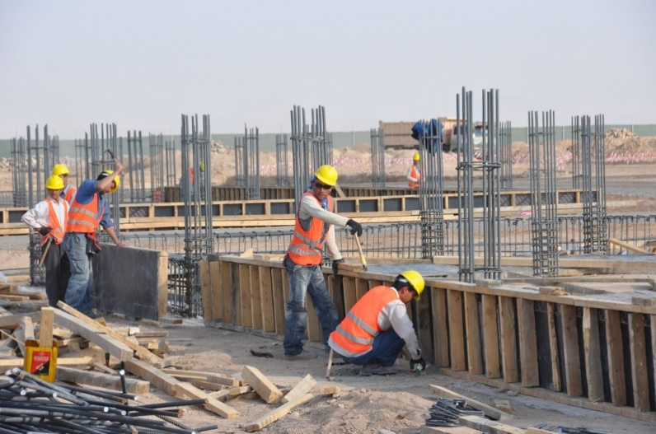
Assess your Construction Career Pathway (cont.)
organizes education, training, and other services to meet the particular needs of an individual in a manner that accelerates the educational and career advancement of the individual to the extent practicable.
enables an individual to attain a secondary school diploma or its recognized equivalent, and at least one recognized postsecondary credential.
helps an individual enter or advance within a specific occupation or occupational cluster.

Slide 72
Closing Thoughts
Be intentional and leave no stone unturned
Understand local labor market by construction cluster and specialty trades.
Understand needs of employers – get them back to the table.
Understand needs and challenges of youth we serve.
Revisit curriculum and see how to improve sequencing and integration.
Are supportive services consistent and addressing needs of employers and youth?
Are there any employers or agencies you think you need to strengthen gaps in service delivery?
Revisit your program’s career pathways plan and ensure that it meets WIOA standards and the six elements of career pathway development

Slide 73
Any Questions?
Place your questions in the text box.

Slide 74
Resources:
Career Pathways Toolkit
    https://youthbuild.workforcegps.org/resources/2016/10/26/09/44/Career_Pathways_Toolkit
Apprenticeship Guide for YouthBuild Programs
    https://youthbuild.workforcegps.org/resources/2014/08/21/10/06/dol-apprenticeship-guide-for-youthbuild-programs
Apprenticeship Resource Page
    https://youthbuild.workforcegps.org/resources/2019/10/28/13/11/Apprenticeship_Resource_Page
Implementing Building Trades Multi-Craft Core Curriculum
    https://youthbuild.workforcegps.org/resources/2017/06/08/13/06/Implementing-Building-Trades-Multi-Craft-Core-Curriculum
National Center for Construction Education and Research
    http://www.nccer.org/credentials-nationalregistry?mID=195
Home Builders Institute
    http://www.hbi.org/

Slide 75
Contact Us
Mark Smith
  Workforce Analyst
    U.S. Department of Labor
      smith.mark.w@dol.gov
        202.693.3597
Rossie Cherry
  DOL YouthBuild Technical Assistance Coach
      rcherry@avyyouthbuild.org
        661.317.8310

Slide 76
Contact Us
Joanna James
  Executive Director
    Project ReBUILD
      jjames@projectrebuild.org
        330.588.3205
Brian McMahon
  Deputy Director
    Operation Fresh Start
      bmcmahon@operationfreshstart.org
        608.444.4262

Slide 77
Thank You!
Please stay for a moment to complete a short survey.
Need help? Email: Support@workforceGPS.org

