Slide 1
ASE Grantee Participant Tracking & Case Management
May 14, 2020

Slide 2
Your Presenters
Andrea Hill
Program Analyst
Office of Apprenticeship, ASE Program Lead
Marcia Hampton
Supervisory Program Analyst
Office of Apprenticeship, Grants Team Lead
Gina Wells
ASE & SAE TA Project Director
Maher & Maher

Slide 3
Today’s Objectives
Review basic ASE participant data tracking requirements
Discuss the case management activities necessary to support participant tracking
Share examples of current state case management and data tracking approaches

Slide 4
ASE Participant
An ASE Program Participant is an individual
Who has satisfied all applicable programmatic requirements for the provision of services, including an eligibility determination and intake process;
AND became a Registered Apprentices after July 1, 2019 was not previously enrolled as a Registered Apprentice in the same industry;
AND is participating in a RAP as a Registered Apprentice;
AND who has received a training or supportive service funded with ASE funds.

Slide 5
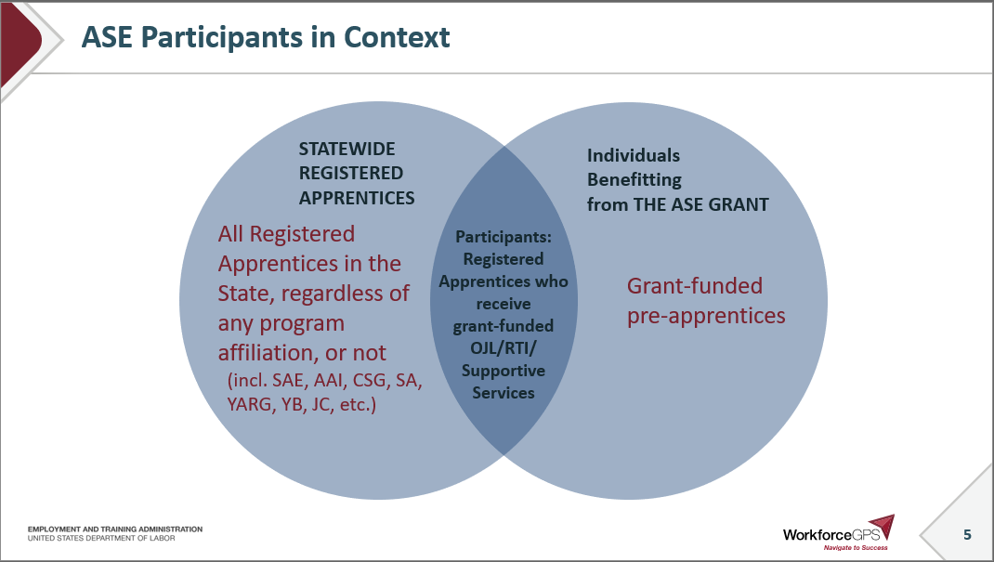
ASE Participants in Context
STATEWIDE
REGISTERED
APPRENTICES
Individuals
Benefitting
from THE ASE GRANT
All Registered Apprentices in the State, regardless of any program affiliation, or not
(incl. SAE, AAI, CSG, SA, YARG, YB, JC, etc.)
Participants: Registered Apprentices who receive grant-funded OJL/RTI/ Supportive Services
Grant-funded pre-apprentices

Slide 6
Who gets tracked under the grant?
Participants – reported in the QPR
Registered Apprentices who receive grant-funded OJL/RTI/Supportive Services
Pre-apprentices who receive grant-funded programming
Who does NOT get tracked under the grant
other registered apprentices
People who participate in only outreach and career exploration events

Slide 7
ASE Tracking Requirements
Data tracking requirements began July 1, 2019
Individual participant level data collected for all participants, at least each quarter from intake through exit
Personally Identifiable Information (PII)
Data elements for the interim reporting period provided in the fillable Excel form provided by the Office of Apprenticeship (OA)
PIRL elements
Were published by OMB for the 30-day comment period – once approved there are additional elements beyond just the ones which appear on the QPR which must be tracked
Further guidance coming as we begin the WIPS roll-out process

Slide 8
Data Collection Solutions
Collecting and Storing ASE Participant Data

Slide 9
Stage of Development Poll
Haven’t started it
Have determined what it will be, but waiting for PIRL to issue RFP/purchase order
Have a system in place and are just waiting to include the PIRL elements
What stage of development is your case-management system in?

Slide 10
Case Management: From Recruitment to Outcomes
Recruitment
Eligibility Determination/ Intake
Service Delivery
After Services End/Exit

Slide 11
Overview of Approaches
Off-the-shelf solutions
WIOA data system
Proprietary/customized solutions

Slide 12
Participant Tracking Systems
What approach are you using, or considering using, to track participant data for your ASE grant? Please share your specific system/solution in the chat!
Off-the-shelf solutions
WIOA data system
Proprietary/customized solutions
Excel spreadsheet
Other

Slide 13
Peer Solutions
Amy Beller
Registered Apprenticeship Program Coordinator, Iowa

Slide 14
Case Management Life-Cycle
Activities to Support Grant Management and Apprentice Success

Slide 15
Case Management: From Recruitment to Outcomes
Recruitment
Eligibility Determination/ Intake
Service Delivery
After Services End/Exit

Slide 16
Recruiting Participants
Recruitment Planning Considerations
Where will grant-funded apprentices come from? How will they learn about and become Registered Apprentices?
Which partners will work with them?
At what point will they be identified as participants in the grant?

Slide 17
Recruitment Resources
Outreach to Apprentices
Apprenticeship Outreach to Youth & Parents
Universal Outreach Tool
◻

Slide 18
Eligibility Determination and Enrollment
Enrollment Planning Considerations
How will you enroll new apprentices in grant funded services?
Who will enroll new participants and determine eligibility?
How will the entrance data be collected?
Where will that data be housed?
What agreements might you need to have with partners to collect this information

Slide 19
Coordinating Services to Apprentices
Considerations when planning an approach for services to apprentices:
What services will grant participants receive?
Who will deliver these services?
Will you connect with an existing partnership or create something new?
New partnership infrastructure – MOUs?
New database or case management system
How will services be provided?
When and how will service delivery be documented for reporting purposes?

Slide 20
Data Collection
Considerations when planning an approach collecting data participants:
Have you identified an approach of maintaining contact throughout participation and after?
Who is entering data? Are they fully trained on the importance of data collection and data definitions?

Slide 21
Data Entry
Which partners/staff will enter data as part of your participant tracking system?
ASE grant staff
State apprenticeship staff
Partner staff in the workforce system
Partner staff from the technical or community college system
Other (share in the chat)

Slide 22
Tips for Data Collection
Develop an electronic case management system.
Ensure all relevant partners and training participants understand why certain information is collected, where it is sent, and for what purpose.
Add disclaimer language and guidance during the enrollment process to help participants understand
Ensure all partners understand all data elements and how to enter data.
Add relevant dates to your participant enrollment/intake forms.

Slide 23
Any Questions?

Slide 24
TA Topics
What additional TA topics would be helpful to support your ASE participant tracking?
Strategies for capturing PII during times of social distancing
Aligning/connecting data sets
Understanding data elements
Other (share in the chat)

Slide 25
Update on Transition to WIPS
ICR Currently published by OMB hope to have approval by June
We will start BETA Testing in late June, early July and testing over by October
Anticipate roll-out of the QPR for all grantees for the quarter ending Dec. 31, reports due Feb. 14, 2021.

Slide 26
Next Steps
Continue to collected individual level data for all participants and report aggregate numbers in the QPR.
Collect data on Registered Apprentices in programs developed using grant funds and pre-apprentices served and report aggregate numbers in the QNR.
Get acquainted with the WIPS process.
Register at WorkforceGPS, and join the ASE Community and the Reporting community to get notified when new materials are posted.
Read the newsletter for timing updates.
Direct questions to your FPO.

Slide 27
Resources
www.Apprenticeship.gov
ASE Reporting Resources
WIPS System Overview Information
PIRL Reporting Online Resource

Slide 28
Contact Information
For all grant-related questions, contact your assigned FPO

Slide 29
Thank You!
Need help? Email: Support@workforceGPS.org

