Slide 1
Polling Question #1
What is your experience with Remote Monitoring?
I’m a pro at it! My organization has been doing it for years.
We just started monitoring our grantees remotely.
We are working on a strategy to conduct remote monitoring.
Remote what?!? I can’t wait to learn what remote monitoring is!

Slide 2
Polling Question #2
How does your organization use grantee Risk Assessments?
We have a well-defined list of risk indicators and the assessment informs our monitoring strategy.
We have a risk assessment, but it doesn’t really tell us much.
Who needs a risk assessment? Everyone just knows which grantees are at risk!

Slide 3
Remote Monitoring
ETA Grantee Webinar

Slide 4
Today’s Moderator
Leo Miller
Regional Administrator
U.S. Department of Labor
Regions 1 & 2

Slide 5
Today’s Speakers
O’Shell Howell
Division Chief
U.S. Department of Labor
Employment & Training Administration – Region 2
Darren Kroenke
Division Chief
U.S. Department of Labor
Employment & Training Administration – Region 5
Roseana Smith
Executive Assistant
U.S. Department of Labor
Employment & Training Administration – Regions 4 & 6

Slide 6
Grantee Practitioners
Terri Burgess Sandu
Director, Talent and Business Innovation
Lorain County Community College
Julie Sherman, MPP
Project Director, IMPACT Consortium
Chippewa Valley Technical College
Connie Wray
Associate Chief, Compliance & Policy
Indiana Department of Workforce Development

Slide 7
Today’s Objectives
Answer these questions.
What is remote monitoring?
When is (or isn’t) remote monitoring appropriate?
How is remote monitoring done?
Are there any tips for success?
Answer Questions

Slide 8
What is Remote Monitoring?
How is it different from on-site monitoring?

Slide 9
What is Remote Monitoring?
Management and administration of the grant
Quality of the program and/or services
Program Compliance
Achievement of grant goals and performance
Evaluate
Review
Determine
Ensure
When you have limited monitoring staff or ability to travel
By identifying risk areas so future on-site monitoring is more targeted
Alternative to…
Preparation for…

Slide 10
So What’s the Difference?
On-Site Review
Remote
Video/telephone interviews
In-person interviews
Review materials on-site
Observe activities/services
Hard copy documents
Limited time on-site
Ad hoc time with grantee staff
Only focused on review
Review materials electronically
Focus on Documents
Securing PII
Flexibility to span several weeks
Schedule time with grantee staff
Option for multiple assignments

Slide 11
When is (or isn’t) Remote Monitoring Appropriate?

Slide 12
When is Remote Monitoring Appropriate? (2)
Review on a Case-by-Case Basis…look at the following:
Risk Analysis
Monitoring History
Project Complexity
Other Considerations

Slide 13
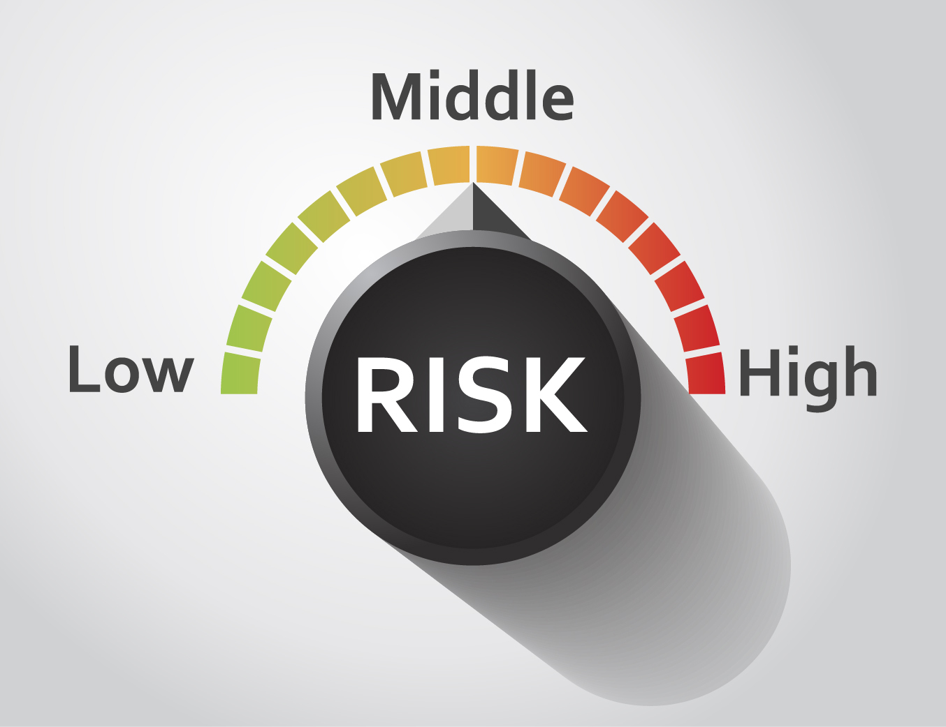
Risk Analysis
What are the risk factors?
Risk Assessment? Is the grantee Low, Medium, High-Risk or At-Risk?
OIG or other Investigations?
Grant Status?
Is there Fraud, Waste, or Abuse?

Slide 14
Monitoring History
Has the grantee been monitored before?
If yes, were there significant prior monitoring findings or areas of concern?

Slide 15
Grant/Project Complexity
What is the scale? Is it national, regional or local?
What is the number of subrecipients, contractors, and partners?
What type of grant is it? Is it a capacity-building or direct service project?
What about Performance and Expenditures? Are they on track?

Slide 16
Other Considerations
Availability of Staff, Participants, and other Stakeholders
Access to Documentation
Scheduling Flexibility

Slide 17
What are the Benefits and Limitations of Remote Monitoring?
BENEFITS
LIMITATIONS
Can be completed with lower expense
Can be completed relatively quickly to respond to an urgent issue
Limits some methods of inquiry and verification
More rigid/discrete scope
Depending on the system – some documentation may be unavailable for virtual review

Slide 18
How is Remote Monitoring Conducted?

Slide 19
Break Down Remote Monitoring…
Pre-Work
Conduct Remote-Monitoring
Post-Monitoring & Next Steps

Slide 20
Pre-Work
After identifying the need for remote monitoring…the pre-work and prep should be done prior to the remote monitoring.
Define the Scope
Collect Source Documentation
Request Documents
Identify Methods for Reviewing Source Documentation
Develop Agenda for the Review
Entrance/Exit Meetings
Individual Interview Schedules
Strategies for Protecting PII

Slide 21
Define the Scope (Pre-work)
Based on the Risk Analysis, what will be included in the scope of this review?
Will it review all program and fiscal aspects of the grant?
Planning call with grantee where you discuss the agenda, materials, and logistics.
Send announcement and request for materials prior to the review. Note that the pre-work is very similar to an on-site monitoring review.

Slide 22
Collect Source Documentation (Pre-Work)
Request materials in electronic format or have access to system to pull files and materials.
If you can’t pull the files directly from the system, use another tool to share materials (e.g. email, Dropbox, Max.gov, or other online platform).
Only request what is needed for the review.
Remind grantee to remove PII if they are sending files directly.
Send announcement/request for materials weeks before the review starts.
Receive and start reviewing materials 2-3 weeks in advance of the review.

Slide 23
Develop Agenda for Monitoring Review (Pre-Work)
Include Scope, Timeline, and Objectives
Schedule interviews/discussions with key grantee and subrecipient staff (relevant to the review)
Make sure there is sufficient time for interviews and follow-up questions
Communicate agenda and scope with grantee and subrecipients

Slide 24
Strategies for Protecting PII (Pre-Work)
Make sure to think about what type of PII might be on files
If you have access to the case management system – can you pull the information for the review easily?
If you must email files for review, can the PII be redacted? Or can the information be password protected?

Slide 25
Conduct Remote Monitoring
Logistics
Video/Phone Calls
Screen-Sharing (if possible)
Follow Agenda
Scheduled Interview & Check-Ins
File/Documentation Review
Take Notes and Follow-up
Possible Issues/Findings
Areas of Concern
Promising Practices

Slide 26
Logistics – Setup & Tools
Test technology BEFORE review
Schedule/organize interviews
Have a checklist/structure for interviews
Organize files for review and/or sharing

Slide 27
Follow Agenda/Schedule
Stick to the agenda/schedule
Conduct interviews and meetings on time
Conduct any file review follow-up questions during interviews and discussions with staff

Slide 28
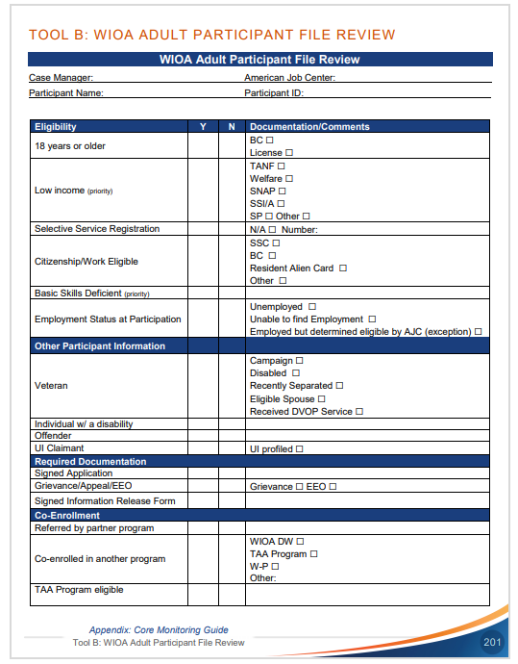
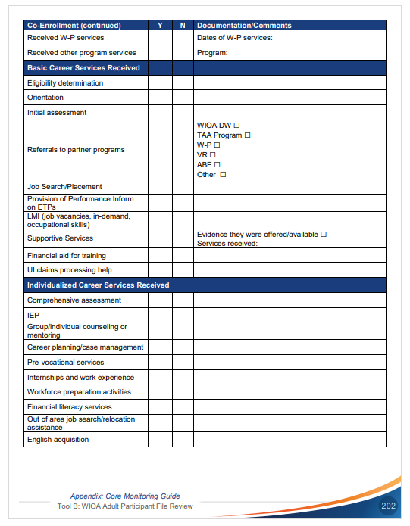
File/Documentation Review…TIPS
Prepare files for review
Review program-related guidance
Use a guide/checklist when reviewing files. Checklist should guide you to review the relevant areas of the file (e.g. Eligibility Documentation, case notes, labor market information, service delivery documents, assessments provided, outcomes information or credential, etc.)

Slide 29
Follow-up File Review with Questions
Don’t Make Assumptions
Ask some clarifying questions after reviewing files and finding missing pieces.
It is possible that the information is there, but not obvious – asking questions keeps the dialog going with the grantee/subgrantee.

Slide 30
Post-Monitoring and Next Steps
Issue Report
Resolve Compliance Issues
Provide Technical Assistance

Slide 31
Issue Report
The report is like the report issued after an on-site visit. It includes:
Summary of the review
Description of any finding or key compliance issue (along with citation)
Description of any areas of concern (may not be a finding now, but could result in one)
Description of any promising practices

Slide 32
Resolve Compliance Issues
Need process and tool to track each issue​ (e.g. excel spreadsheet that outlines grantee/subrecipient, issue, date report was issued, response received, notes re: progress made, etc.​)
May need to provide grantee or subrecipient technical assistance to resolve any compliance issues
Grantee must stick with the issue through to resolution​

Slide 33
Provide Technical Assistance
May need to provide technical assistance to grantee or subrecipient to resolve any compliance issues and resolve any areas of concern.
Technical Assistance can take many forms, including:
Advice & Guidance (in writing and through conversations)
Training (group or individual)

Slide 34
Experience from the Field
Terri Burgess Sandu
Director, Talent and Business Innovation
Lorain County Community College
Julie Sherman, MPP
Project Director, IMPACT Consortium
Chippewa Valley Technical College
Connie Wray
Associate Chief, Compliance & Policy
Indiana Department of Workforce Development

Slide 35
Tips for Success
Key Takeaways

Slide 36
Tips for Success & Key Takeaways
Fiscal and Program Monitoring can be done remotely.
Work Efficiently – when an on-site visit is not an option due to travel restrictions or timelines.
Target Risk Areas – narrow down issues, target compliance issues or technical assistance.
Compliance with Federal and State Monitoring Requirements – when on-site monitoring is not feasible, remote monitoring may meet the monitoring requirements of Federal/State grants.
Written Notification MUST Be Issued – like on-site monitoring, you need documentation that summarizes the review, details any findings, and requires corrective action.

Slide 37
Resources
ETA’s Core Monitoring Guide
Grants Application and Management Community of Practice
State Monitoring & Oversight Resources (see next page)
Examples of State Monitoring Tools
Including monitoring policies and procedures, risk assessment tools, desk monitoring guides, monitoring analysis tools, monitoring schedules and guidance, new monitoring staff onboarding and training plans, templates for scheduling, promising practices, templates, and other tools.

Slide 38
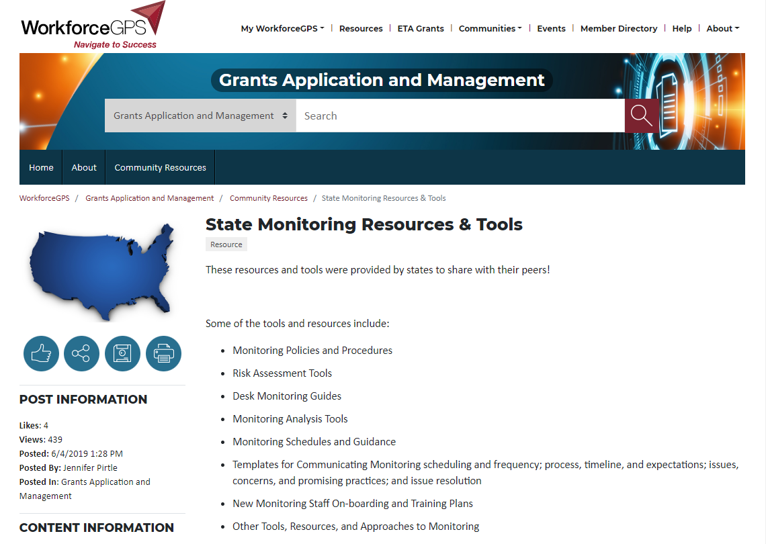
State Monitoring & Oversight Resources on WorkforceGPS
The State Monitoring Resources & Tools Resource on WorkforceGPS provides resources including:
monitoring policies and procedures
risk assessment tools
desk monitoring guides
monitoring analysis tools
monitoring schedules and guidance
new monitoring staff onboarding and training plans
templates for scheduling
promising practices
templates
If you would like to submit additional Monitoring Tools and Resources, please send the content to support@workforcegps.org and mention the Monitoring Resources on the Grants Application and Management Community of Practice.

Slide 39
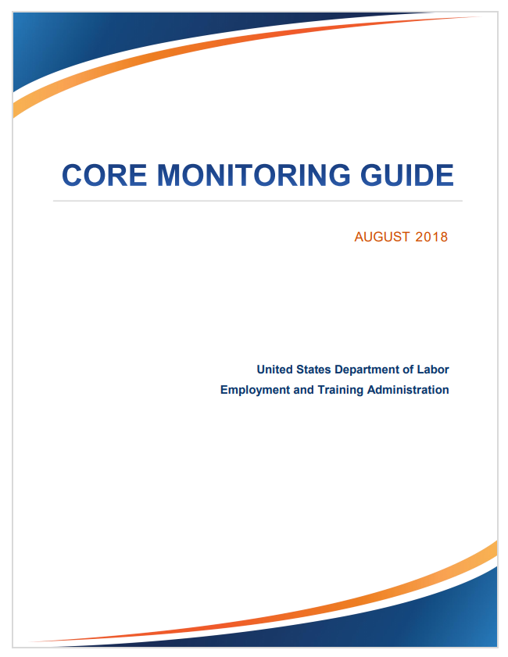
ETA’s Core Monitoring Guide
Resource D: Documentation Request Samples & Data Analysis (several grant programs)
Resource E: Analysis for On-Site Monitoring
Resource H: Monitoring Finding Template
Tools B-D: WIOA Participant File Review checklists (Adult, Dislocated Worker, and Youth)
Tool E: Budget Comparison Tool
Tool J: Subrecipient Monitoring Reports Worksheet
Tool S: Risk Assessment Worksheet
Tool T: Summary of Results/Reviewer Notes

Slide 40
Any Questions?
Please type your questions in the chat

Slide 41
Thank You!
Need help? Email: Support@workforceGPS.org

