Slide 1
Workforce Opportunity for Rural Communities (WORC) Initiative Round 2
Potential Applicant Webinar

Slide 2
Today’s Moderator
Robert Kight
  Division Chief, Office of Workforce Investment, US Department of Labor/ Employment and Training Administration
Notes:
Laura will introduce ROBERT

Slide 3
Today’s Objectives
Provide high-level overview of the WORC FOA in advance of technical assistance sessions
Provide information to help you understand the concepts and major elements of the FOA
Answer your questions where we can (because these grants are competitive there will be many questions we cannot legally answer)
Notes:
Robert welcomes attendees:
ROBERT: Today we’ll cover, from a fairly high-level, the major elements of the funding opportunity announcement for the second round of the Workforce Opportunities for Rural Communities (or WORC) grant initiative
We are providing this webinar in conjunction with other technical assistance sessions to support potential applicants developed by the Appalachian Regional Commission and the Delta Regional Authority, our partners in the WORC Initiative
We will also answer questions that you may have during this webinar, but because this is an open grant competition there are many questions we are prohibited from answering; however, we will do our best to answer as many of your questions as possible.

Slide 4
Your Presenters
Emela Halilovic
  Program Analyst-Workforce & Education
  Appalachian Regional Commission
Aury Kangelos
  Program Manager
  Delta Regional Authority
Lynn Fraga
  Grant Officer
  US Department of Labor/ ETA
Notes:
ROBERT
Before we move on I’d like to introduce the presenters from whom you’ll be hearing throughout today’s event:
Robert introduces presenters

Slide 5
Background
ARC and DRA Descriptions, Grant Overview, Congressional Requirement and the Vision for WORC
Notes:
ROBERT
We will start today with some background on the initiative, including why we created this grant opportunity and what we hope it will achieve. But first let’s learn a bit about the Appalachian Regional Commission and the Delta Regional Authority, our partners on this program.
ROBERT tosses to EMELA

Slide 6
Appalachian Regional Commission
(ARC)
The Appalachian Regional Commission (ARC) is a regional economic development agency that represents a partnership of federal, state, and local government. Established by an act of Congress in 1965, ARC is composed of the governors of the 13 Appalachian states and a federal co-chair, who is appointed by the president. Local participation is provided through multi-county local development districts. ARC invests in activities that address the five goals identified in the strategic plan:
Goal 1: Economic Opportunities
Invest in entrepreneurial and business development strategies that strengthen Appalachia's economy.
Goal 2: Ready Workforce
Increase the education, knowledge, skills, and health of residents to work and succeed in Appalachia.
Goal 3: Critical Infrastructure
Invest in critical infrastructure—especially broadband; transportation, including the Appalachian Development Highway System; and water/wastewater systems.
Goal 4: Natural and Cultural Assets
Strengthen Appalachia's community and economic development potential by leveraging the Region's natural and cultural heritage assets.
Goal 5: Leadership and Community Capacity
Build the capacity and skills of current and next-generation leaders and organizations to innovate, collaborate, and advance community and economic development.
Notes:
ROBERT hands to EMELA
EMELA presents.

Slide 7

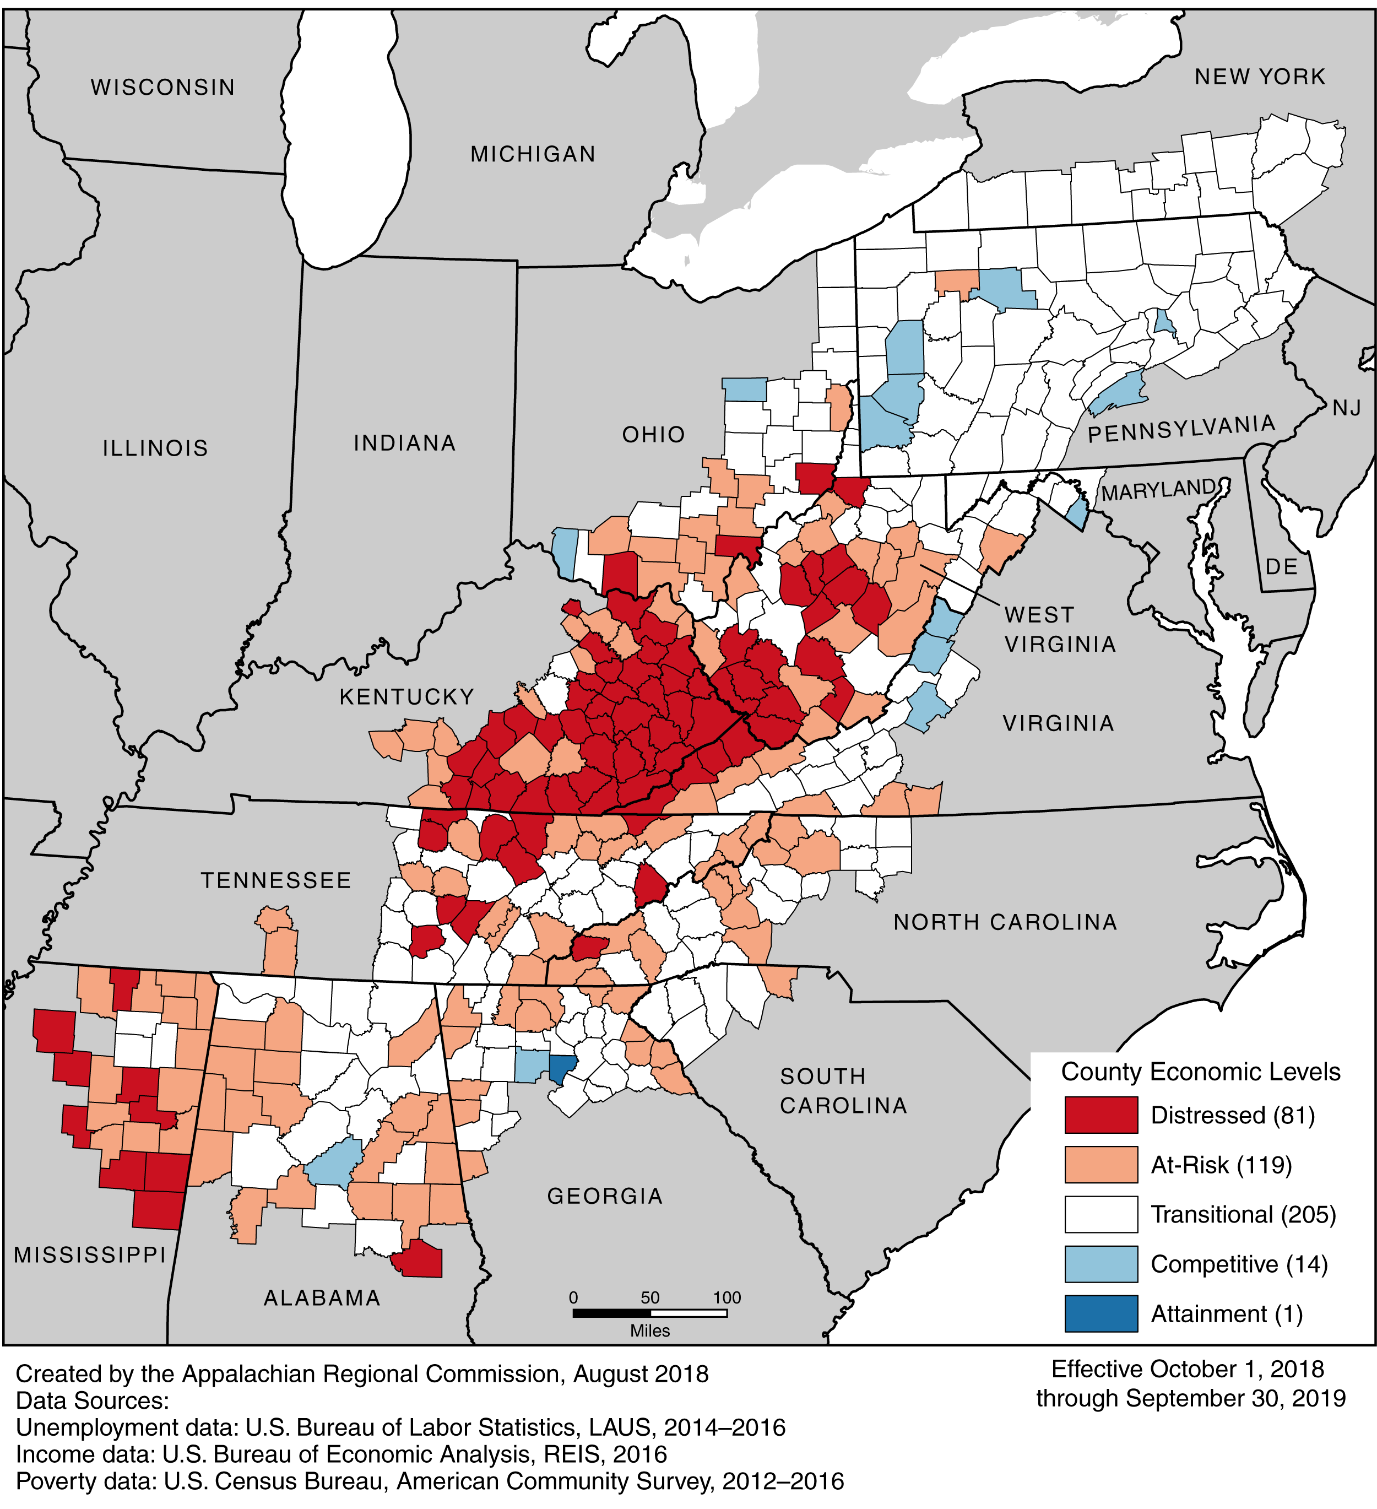
420 ARC Counties
Notes:
EMELA

Slide 8
Delta Regional Authority (DRA)
The Delta Regional Authority (DRA) is a regional economic development agency that represents a partnership of federal, state, and local government. Established by an act of Congress in 2000, DRA is composed of the governors of the 8 Delta states and a federal co-chair, who is appointed by the president. Local participation is provided through multi-county local development districts. DRA invests in activities that address the three goals identified in the strategic plan:
Goal 1: Improved Workforce Competitiveness
Advance the productivity and economic competitiveness of the Delta workforce.
Goal 2: Strengthened Infrastructure
Strengthen the Delta’s physical, digital, and capital connections to the global economy.
Goal 3: Increased Community Capacity
Facilitate local capacity building within Delta communities, organizations, businesses, and individuals.
Notes:
EMELA turns it over to AURY.
AURY presents

Slide 9
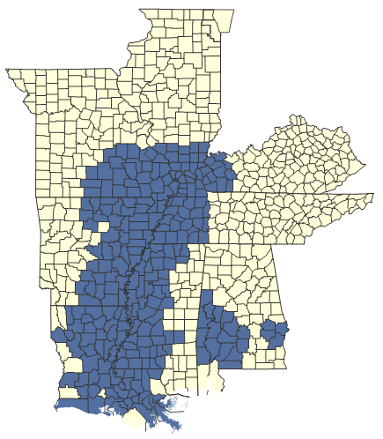
The Delta Region
252 counties and parishes
Mississippi Delta and Alabama Black Belt Regions
4 Investment Priorities
  Transportation Infrastructure
  Basic Public Infrastructure
  Business Development – emphasis on entrepreneurship
  Workforce Development
www.dra.gov
Notes:
AURY

Slide 10
What is the WORC Initiative?
Workforce Opportunity for Rural Communities Initiative
WORC is a partnership between the Employment & Training Administration (ETA), the Appalachian Regional Commission (ARC) and the Delta Regional Authority (DRA)
Grant awards for eligible entities serving participants who live and work in the Appalachian and Delta regions
Notes:
AURY turns it back to ROBERT
ROBERT
Thank you, Aury and Emela.
As we have mentioned, the WORC Initiative is a partnership between the Employment & Training Administration, ARC and DRA.
The WORC Initiative provides grant funds to enable impacted communities to develop local and regional workforce development solutions aligned with existing economic development strategies and community partnerships to promote new, sustainable job opportunities and long-term economic vitality
To support an American economy that provides opportunity for all, workers must have skills that align with the needs of businesses and must be readily able to adapt as business needs evolve
While there are many potentially eligible applicant organizations, all WORC grants must serve participants who reside in the Appalachian or Delta regions

Slide 11
What is the WORC Initiative?
This is the 2nd round of the WORC Initiative
The 2019 the Department of Defense and Labor, Health and Human Services and Education Appropriations Act 2019 and the Continuing Appropriations Act 2019 reserved funding to promote economic recovery across the Appalachian and Delta regions
These regions have been particularly hard hit by industrial downsizing and closures, and this funding is designed to target these areas
The WORC grants therefore are designed to address the workforce and economic development challenges facing communities in these regions
Notes:
ROBERT
This is the 2nd round of WORC grants offered by ETA in partnership with ARC and DRA.
Because the Appalachian and Delta regions have been particularly hard hit by industrial downsizing and closures and continue to face economic and employment challenges, Congress included language in the 2019 Appropriations for the Department of Labor reserving funding to create a grant program that aims to bring economic and workforce success to these underserved areas.

Slide 12
What is the Goal of the WORC Initiative?
The goal of this grant opportunity is to create economic prosperity and gainful employment opportunities for eligible residents in impacted ARC and DRA regions, enabling them to remain and thrive in these communities.
Successful applicants must demonstrate coordinated economic development and workforce strategies in the ARC and DRA regions and help the regions achieve long-term economic success.
Notes:
ROBERT:
The WORC grants aim to achieve a specific and important goal, which we expect applications will aim to address:
to create economic prosperity and gainful employment opportunities for eligible residents in impacted ARC and DRA regions, enabling them to remain and thrive in these communities
WORC grants must demonstrate that, and how, your proposed project aligns workforce and economic development strategies for short-term positive outcomes and long-term economic success for residents, businesses and communities in the areas covered by your proposed project

Slide 13
Grant Objectives
Implement innovative, sustainable service delivery strategies to address economic and workforce-related impacts
Provide or facilitate the provision of new or enhanced training, job placement and support activities to the following eligible participants including those affected by substance use disorder (e.g., opioids, stimulants, cocaine, and other substances), who reside in ARC and DRA regions
Align and integrate workforce development activities with existing state, regional, or community economic development strategies
Develop and expand partnerships, including industry partnerships that build and sustain capacity, maximize available resources, and establish community-based approaches for addressing workforce challenges and industry needs; and,
Provide or facilitate delivery of support services to assist employers and industry in meeting workforce challenges and industry needs
Notes:
Robert:
To achieve the goal of the WORC Initiative, successful applications will propose projects that clearly address all of the following Objectives:
Objective 1: Implement innovative, sustainable service delivery strategies to address economic and workforce-related impacts within each of the regions;
Objective 2: Provide or facilitate the provision of new or enhanced training, job placement and support activities to the following eligible participants: dislocated workers (including displaced homemakers), new entrants in the workforce, and incumbent workers, (including those affected by substance use disorder (e.g., opioids, stimulants, cocaine, and other substances)) who reside in ARC and DRA regions;
Objective 3: Align and integrate workforce development activities with existing state, regional, or community economic development strategies;
Objective 4: Develop and expand partnerships, including industry partnerships that build and sustain capacity, maximize available resources, and establish community-based approaches for addressing workforce challenges and industry needs in the ARC and DRA regions; and,
Objective 5: Provide or facilitate delivery of support services to assist employers and industry in meeting workforce challenges and industry needs in the ARC and DRA regions.

Slide 14
FOA Overview
Eligibility, Grant Activities, Alignment and Impact, Addressing SUD, and Role of Employers
Notes:
ROBERT: OK, so that’s a brief overview of the WORC initiative. Now let’s turn to a discussion of what the FOA lays out with regard to the grants themselves—including with regard to eligibility, grant activities, and more. For this we’ll hear from Emela and Aury. Emela’s first up: Emela?
ROBERT turns it over to EMELA

Slide 15
Eligibility: Applicants
Wide range of entities eligible to apply, as described in the FOA
However, regardless of type of organization, or where an organization is located, services MUST be delivered only to eligible participants who live and work in the Appalachian or Delta regions
Notes:
EMELA
The FOA lists the entities eligible to apply.
Because this is a competitive grant program, we cannot make determinations as to whether your organization is eligible prior to your submitting an application. If you believe your organization is eligible you should submit an application, and a determination will be made after the closing date.
Please note—your organization may be located anywhere in the US, but ALL services must be provided to eligible participants who live and work in the Appalachian and Delta regions. Your application must demonstrate that you commit to this requirement.

Slide 16
Eligibility: Participants
Three types of eligible participants
  Dislocated workers (as defined in WIOA sec 3(15))
  Incumbent workers (individuals who are currently working)
  New entrants to the workforce
    We define new entrants as those who have never worked before or who have been out of the workforce for a long enough time to make it as if they are entering the workforce for the first time
    But applicants have some discretion on determining eligibility for new entrants as appropriate
Notes:
AURY
Dislocated workers (as defined in WIOA sec 3(15))
Incumbent workers (individuals who are currently working)
New entrants to the workforce
Applicants have discretion on defining the term “new entrants” more specifically, to include a wide range of individuals, such as those receiving public assistance, high school dropouts, high school or postsecondary students, individuals enrolled in adult basic and other education programs, individuals with disabilities, veterans, Indian and Native Americans, and individuals with Limited English Proficiency

Slide 17
Additional Considerations: Eligibility
Applicants are encouraged to develop plans to serve individuals who reside in economically distressed counties and parishes
In addition, applicants are encouraged to serve individuals affected by substance use disorder
Notes:
EMELA
While grants may serve any parts of the Appalachian and Delta regions, applicants are encouraged to develop plans to serve individuals who reside in economically distressed counties and parishes
In addition, applicants are encouraged to serve individuals affected by substance use disorder—we’ll cover this in more detail shortly.

Slide 18
Strategic Alignment & Grant Impact
Applicants must ensure that planned activities will achieve outcomes that are aligned with existing local or regional economic development and other strategic plans
Applicants must also demonstrate that their plan aligns with at least one element of the relevant ARC or DRA state plan
Applicants must demonstrate that their plan aligns with the relevant WIOA State Plan
And applicants must demonstrate that their plan specifically addresses the current or future workforce needs of at least two local employers
You will be expected to demonstrate how your project will achieve positive outcomes in the short- and medium terms
But most importantly you will be expected to demonstrate long-term economic and workforce benefits to the communities served in the grant
Notes:
AURY
Applicants must ensure that planned activities will achieve outcomes that are aligned with existing local or regional economic development and other strategic plans
Applicants must also demonstrate that their plan aligns with at least one element of the relevant ARC or DRA state plan
And finally, applicants must demonstrate that their plan aligns with the relevant WIOA State Plan
The FOA provides information oh how you can find each of the relevant plans
And applicants must demonstrate that their plan specifically addresses the current or future workforce needs of at least two local employers
You will be expected to demonstrate how your project will achieve positive outcomes in the short- and medium terms
But most importantly you will be expected to demonstrate long-term economic and workforce benefits to the communities served in the grant

Slide 19
What does “alignment” with economic development mean?
As mentioned, a key element of the WORC Initiative is the alignment of proposed activities with existing plans
  We expect that these grants will help economic transformation that is sustainable and leads to opportunity for workers and businesses
You will be expected to present a coherent strategy that aligns the strategies proposed with existing, demonstrated needs of employers and with the broader economic development strategies in the community
We encourage applicants to truly embed this alignment into their applications, make it fully part of the concept, not simply addressing it in one section
Notes:
EMELA
As Aury mentioned, there are 4 plans with which you must demonstrate alignment in your proposal: we are looking for long-term economic transformation that is sustainable over the long-term
You will be expected to present a coherent strategy that truly aligns the strategies proposed with existing, demonstrated needs of employers and with the broader economic development strategies in the community—we recommend that this alignment is integrated into your full application and is not only addressed in passing in one section
Think about how all aspects of your project will help achieve the goals of the broader economic development or strategic plans

Slide 20
Grant Activities
These grants are designed to be flexible and promote innovative solutions to specific challenges
Allowable activities in the following categories
  Delivering training or other workforce-related services
  Developing other “Innovative” approaches to meet specific challenges
  Providing a wide range of support services to participants
  Serving and Partnering with Employers
  Equipment Purchase and Facility Renovations
Notes:
AURY
These grants are designed to be flexible and promote innovative solutions to specific challenges, and therefore have a wide range of allowable activities
The FOA discusses allowable activities in the following categories; we won’t get into the details on these but the FOA provides more context for you, and we recommend you read these sections carefully as you design your proposed project:
Delivering training or other workforce-related services
Developing other “Innovative” approaches to meet specific challenges
Providing a wide range of support services to participants
Serving and Partnering with Employers
Equipment Purchase and Facility Renovations

Slide 21
Addressing SUD Impacts
Applicants proposing to specifically address the workforce impacts of substance use disorder are encouraged to consider the following when framing the project:
  Projects that address the substance misuse crisis should focus on creating a recovery ecosystem that will lead to workforce re-entry
  The recovery ecosystem is a complex linkage of multiple sectors designed to help individuals in recovery access the support services and training they need to maintain recovery and successfully obtain sustainable employment.
  Initiate or expand programs designed to eliminate or reduce the harm to the workforce and economic growth of the region that results from substance misuse; attract and retain relevant health care services, businesses, and workers.
Notes:
EMELA
One of the priorities for the WORC Initiative is to provide services to individuals struggling with Substance Use Disorder
Applicants proposing to specifically address the workforce impacts of substance use disorder are encouraged to consider the following when framing the project:
Projects that address the substance misuse crisis should focus on creating a recovery ecosystem that will lead to workforce re-entry, including support for the post-treatment to employment continuum, which could support the training of recovery professionals, recovery-focused job training programs, as well as initiatives designed to coordinate, or link, recovery services and training that support the reintegration into the workforce of eligible SUD affected individuals.
The recovery ecosystem is a complex linkage of multiple sectors, including but not limited to recovery communities, peer support, health, human services, faith communities, criminal justice, public safety, housing, transportation, education, and employers, designed to help individuals in recovery access the support services and training they need to maintain recovery and successfully obtain sustainable employment.
Initiate or expand programs designed to eliminate or reduce the harm to the workforce and economic growth of the region that results from substance misuse; attract and retain relevant health care services, businesses, and workers.

Slide 22
Employers: Demonstrating Need vs Partners
Two roles for employers/industry in the WORC grants:
Demonstrating Workforce Needs: To ensure that your project is addressing specific workforce needs of local employers, you must include letters attesting to this from TWO employers
Employers as Partners in the Grant: Applicants must also demonstrate collaboration with a strong and diverse community-wide coalition that must include engagement with at least two employers/industry partners
Employer or industry partnerships increase the likelihood of establishing work-based learning programs and ensure that training and workforce development efforts are relevant to the needs of the employer community.
Employers provide valuable insight into the development of innovative training approaches, as well as leadership in aligning/enhancing existing strategic plans for the economic diversification and development of the region or community.
Notes:
AURY
We want to provide a bit more information with regard to the role of employers in the WORC grants. Employers play 2 roles in this grant initiative:
Demonstrating Workforce Needs: To ensure that your project is addressing specific workforce needs of local employers, you must include letters attesting to this from TWO employers
Employers as Partners in the Grant: Applicants must also demonstrate collaboration with a strong and diverse community-wide coalition that must include engagement with at least two employers/industry partners
Employer or industry partnerships increase the likelihood of establishing work-based learning programs and ensure that training and workforce development efforts are relevant to and evolve along with the needs of the employer community.
Employers provide valuable insight into the development of innovative training approaches, as well as leadership in aligning/enhancing existing, strategic plans for the economic diversification and development of the region or community.
Applicants should include information in their application about how they will access the leadership and support of the employer community.

Slide 23
Grant Performance
Notes:
AURY turns it back over to ROBERT
ROBERT: Thanks, Aury and Emela!
We turn now to a brief discussion of the performance requirements of the WORC Initiative.

Slide 24
Grant Performance
Grant proposals must indicate the performance metrics that you will collect and share as part of the project
Proposals must demonstrate how these measures are reflective of the project goals and the regional strategy
Reporting on the grant will include a quarterly narrative description to provide an update on progress toward grant goals
Notes:
ROBERT: part of the review and scoring of your application will be focused on the outputs and outcomes of your grant. We recognize that these grants may take many shapes and approaches, and have different measures of success.
Applicants must indicate in their application the performance measures they will collect and share as part of their proposed project. Performance elements may consist of metrics or data that the organization already collects.
The application must also demonstrate how these measures are reflective of the overall goals for the project and for the regional strategy.
The WORC grants will submit a quarterly report consisting of narrative descriptions, according to a template that will be provided.
In addition, there is a unique data collection requirement we will discuss on the next slide.

Slide 25
Performance Outcomes Data
WORC grants partner with the workforce system to report employment outcomes
Grantees will be required to provide state or local workforce agencies with the necessary information to register those participants who receive employment-related services described in section III.C.4(b) or classroom training
These participants can then be registered in the Wagner-Peyser Employment Service where they can access additional services as appropriate
ETA will provide further technical assistance post-award on this process
Notes:
ROBERT:
ETA is also interested in learning the employment outcomes from WORC projects through the existing metrics for the workforce system.
Applicants should be aware that once awarded, WORC grants will partner with the workforce system in the local or state government to report these outcomes.
Grantees will be required to provide state or local workforce agencies with the necessary information to register those participants who receive employment-related services or classroom training as described in the FOA.
These participants can then be registered in the Wagner-Peyser Employment Service where they can access additional services as appropriate.
The Department will provide technical assistance to grantees post-award on this process.

Slide 26
Application Requirements
Details and Deadlines
Notes:
ROBERT:
Let’s turn now to a discussion of the application requirements, deadline, and process. To do that, I’ll introduce Lynn Fraga, who is the grant officer in ETA for the WORC program.
Lynn, take it away.

Slide 27

Application Deadline
July 29, 2020, @ 4:00:00 p.m. Eastern Time
Hardcopy submissions by mail, hand delivery, or overnight delivery WILL NOT BE ACCEPTED
Notes:
LYNN:

Slide 28

Funding Opportunity Announcement – Read Carefully
The Funding Opportunity Announcement (FOA) postings:
  Grants.gov:
  https://www.grants.gov/web/grants/view-opportunity.html?oppld=315986
  ETA website:
  https://www.doleta.gov/grants/find_grants.cfm
  ARC website: https://www.arc.gov/index.asp
  DRA website: https://dra.gov/
  .
Notes:
Lynn

Slide 29

Application Screening Requirements
Use the checklist in Section 3.C.1 of the FOA to ensure your application package is complete:
  On-time application
  Applicant eligibility
  Electronic files are readable/not corrupt
  Funding requests between $150,000 and $1.5 million
  Current registration with Systems Award Management (SAM)
  Current Dun and Bradstreet (DUNS) number on the SF-424
Notes:
LYNN

Slide 30
Application Screening Requirements, contd.
Application Components:
  SF-424, Application for Federal Assistance
  Project Budget (Section 4.b.2)
    SF-424A
    Budget Narrative
  Applicant Designation (Specify ARC or DRA Service Area in separate attachment, including map)
  Your choice: Project Narrative OR the Optional Proposal Summary (Attachment A), with applicable attachments
Notes:
Section 4 of the FOA –

Slide 31
Option 1: Project Narrative
What is the Project Narrative?
A comprehensive description of the proposed project, demonstrating applicant’s ability to implement in accordance with the provisions of the FOA
Limited to 10 double-spaced single-sided 8.5 x11 inch pages with Times New Roman 12 point font and 1 inch margins
Notes:
LYNN

Slide 32
Option 1: Project Narrative -- Required Framework
Project Narrative must be organized using the following subheadings provided in the FOA, all of which are reviewed against the scoring criteria provided in Section 5A.
  Statement of Need and Strategic Alignment
  Project Description (Project Design and Project Partnerships
  Project Results and Sustainability
  Organizational, Administrative, and Fiscal Capacity
  Budget and Budget Narrative
Notes:
LYNN

Slide 33
Option 1: Project Narrative -- Attachments
Project Narrative must also contain requested attachments. Their omission may result in loss of points during application scoring:
  Project Abstract;
  Project Timeline;
  Two letters of engagement from employer/industry partners;
  Key staff resumes and job descriptions; and,
  Financial System Assessment Information.
DON’T FORGET TO ATTACH THE ARC/DRA DESIGNATION – screenout results from omission.
Notes:
LYNN

Slide 34
Option 2: Proposal Summary (Attachment A)
Use of the Proposal Summary is optional.
Proposal Summary may be submitted in lieu of the Project Narrative and some of the requested attachments, referenced in Section IV.B.4 of the FOA.
Attachments to include with Proposal Summary:
  Applicant declaration of ARC/DRA designation, including map of proposed service area (omission results in application screenout);
  Required letters from at least two employer/industry partners; and,
  Financial Assessment Form, IRS Form 990, or most recent audit report.
Notes:
LYNN:
Will you want to update this slide in any way?

Slide 35
Application Review and Award
Technical merit review panels evaluate applications against the selection criteria found in Section 5A of the FOA.
Approximately $29.2 million available
Awards range from $150,000 to $1,500,000
Total grants awarded dependent upon the number of applications received and funding amounts requested
Awards announced on or before 9/30/2020
Notes:
LYNN

Slide 36
Applicant Support
If you have questions during the grant writing process, submit them per the FOA to mcenery.jenifer@dol.gov
Please note that we can only answer questions related to the application process or to help clarify the requirements of the FOA. Grant staff cannot discuss the content of your application, or provide any other support as you develop the application.
Notes:
Lynn

Slide 37
Applicant Support & Technical Assistance
Technical Assistance Events
Notes:
ROBERT:
Thank you Lynn. Before we get to the Q+A portion of today’s webinar, let’s hear a bit about the technical assistance that ARC and DRA are providing to prospective applicants.
Emela?

Slide 38
Technical Assistance Workshops
ARC and DRA have delivered or are planning virtual technical assistance sessions for potential applicants
Information and registration information is available at:
  ARC: FOA/Application Webinar Series May 28-June 8: https://www.arc.gov/news/article.asp?ARTICLE_ID=694
  DRA: Recorded Applicant Technical Assistance Sessions: https://dra.gov/initiatives/strengthening-the-delta-workforce/2020-resources/
Notes:
ROBERT tosses to Emela
Emela first, for ARC schedule/plans
Aury 2nd, for DRA schedule/plans
AURY tosses back to Robert

Slide 39
Any Questions?
Add guidance for how to answer questions here.
  (If more info is needed as a parenthetical, add here. If not needed, delete this block.)
Notes:
Robert thanks presenters, and begins Q+A portion of the event.

Slide 40
Thank You!
Need help? Email: Support@workforceGPS.org

