Slide 1
Read Before You Proceed: Instructions for Use & Legal Compliance
Legal Accessibility Requirements: 508 Compliance
Only use tables when standard content delivery is insufficient, and never merge table cells.
Do not use screenshots or images of text items. All text must be editable and not blur when the screen is zoomed in.
Avoid using “Smart Art” or the “Design Ideas” tool.
Do not repurpose slide title boxes for any other use.
Do not use multiple spaces, empty paragraphs, or strings of tabs to visually adjust your content, as every such repeated character must then be manually stripped from all slides before posting. Instead:
Use soft returns to bump content to the next line in lieu of spaces (Shift + Enter)
Manage paragraph spacing and tabs in the “Paragraph” panel.
Every image or visual element used must either have alternative “alt” text applied or be marked as “decorative.”
Alt text translates visual information into verbal information, which is read aloud in screen readers, while items marked “decorative” are skipped.
This step is required to deliver the full message provided by any graphics.
The person who laid out the content should also provide that alternate information to ensure their message stays intact.
Learn about the new innovative features!
Please watch this webcast before using this template.
https://vimeo.com/370983870/2afa9e8306
(Ctrl + Click to open link)
Duration: 6 minutes

Slide 2
Where Are You?
Please enter your location in the chat window
(lower left of screen)

Slide 3
What is your Role?
Select the option that best describes your role in the H-1B Scaling Apprenticeship grant.
Authorized Representative
Program Director/Manager
IT/Data Manager or Staff
Sub-Awardee
Training Partner
Employer Partner
Other Grant Team Member (case manager, job developer or employment specialist, college grants officer, etc.) – type into chat
Please select only one.

Slide 4
H-1B Scaling Apprenticeship: Implementing Grants in Times of Virtual Learning and Workspaces
Presented By:
Office of Workforce Investment, Division of Strategic Investments

Slide 5
Today’s Moderator
Zodie Makonnen
Grant Lead - Scaling Apprenticeship Through Sector-Based Strategies
Division of Strategic Investments
Employment and Training Administration
Cheryl Martin
Program Manager
Division of Strategic Investments
Employment and Training Administration

Slide 6
Today’s Facilitator
Chris Spence
Scaling Apprenticeship Technical Assistance Coach & Subject Matter Expert
Manhattan Strategy Group

Slide 7
Today’s Agenda
Guidance from the Employment and Training Administration (ETA) regarding the COVID-19 crisis
Panelist Introductions
Scaling Apprenticeship (SA) grantees share their experience
What has been the impact of social distancing and stay-at-home orders on your grant?
How has social distancing affected employer engagement?
How have you changed your student engagement methods, including the provision of student services and/or recruitment of future students?
Do you have tips or advice for how your peers can best prepare for the future?
Q&A

Slide 8
Before we get started…..
The Employment and Training Administration (ETA) has developed a series of technical assistance resources and frequently asked questions (FAQs) to address grants management questions related to Coronavirus (COVID-19)
FAQs can be found at https://www.dol.gov/agencies/eta/coronavirus
Technical Assistance resources are available at https://www.workforcegps.org/resources/2020/03/18/23/35/Coronavirus-COVID-19-Resources
Submit your questions to ScalingApprenticeship@dol.gov
_
_
_
_
_

Slide 9
Today’s Objectives
Showcase the experiences of SA grantees
Share SA grantee strategies and emerging practices with special attention to virtual learning and workspaces
Help SA grantees gain knowledge of:
Delivering their program
Employer engagement
Providing student services and/or recruitment of future students
Preparing for the future

Slide 10
Today’s Panelists
Audrey Webb
Project Director
Alabama Community College System

Slide 11
Overview of the Alabama Community College System Grant
Advanced Manufacturing Focus
Specializes in three apprenticeship options:
Quick-start pre-apprenticeships that lead to Manufacturing Skill Standards Council certifications and prepare individuals for in-depth apprenticeships or entry-level employment;
Alabama Advanced Manufacturing Apprenticeship Programs (ALAMAPs), which are short-term apprenticeships embedded in a traditional career and technical education program; and
Federation for Advanced Manufacturing Education (FAME) apprenticeships, which are 21-month long Advanced Manufacturing Technician programs that lead to an Associate’s degree.

Slide 12
Today’s Panelists
Aaron Burdette
Faculty Lead
University of Cincinnati

Slide 13
Overview of the University of Cincinnati Grant
IT Focus
The NEXT apprenticeship project:
Incorporates multiple education pathways with experiential learning components to provide industry certifications from the Cisco and IBM Skills Academy; and
Includes robust pathways aimed at enabling unemployment and underemployed of minority populations.

Slide 14
Today’s Panelists
Dave Cofer
Project Manager, Employer Engagement and Experiential Learning
Columbus State Community College

Slide 15
Overview of the Columbus State Community College Grant
IT Focus
The Flexible Learning Expressway for Technology (FLEXTech) program offers two tracks for apprentices:
An emerging workforce apprenticeship track that combines college curriculum and part-time paid employment in five semesters; and
An incumbent apprenticeship track that offers stackable credentials in data analytics, cyber security and software development.

Slide 16
Today’s Panelists
Amy Mackenroth
Senior Managing Director
Dallas County Community College District

Slide 17
Overview of the Dallas County Community College District Grant
Health Care Focus:
Registered Apprenticeships
Industry-Recognized Apprenticeship Programs (IRAP)
The “You’re Hired” project provides competency-based clinical and non-clinical apprenticeships for major hospital systems
Key Partners:
The American Hospital Association (AHA)
US DOL VETS to emphasize apprenticeships for transitioning service members
The Department of Defense Force Education and Training

Slide 18
Poll Question for Audience
Which area of your grant activities has been most affected by social distancing measures?
Training delivery
Employer engagement
Student engagement
Apprentice placement
Grant management (e.g., managing subgrantees, data reporting)
Please select only one.

Slide 19
What has been the impact of social distancing and stay-at-home orders on your program delivery?

Slide 20
Dallas County Community College District
Active apprenticeship programs were not affected beyond online learning
Continued placement of apprentices – Patient Care Technician (PCT), Certified Nursing Assistant (CNA)
Exclusive online instruction by both employers and the District
Proctored exams at testing centers have been delayed
Exploration of new health care occupations – Biomedical 3D Printing Technician, Nurse Informaticist, Hospital Facility Emergency Preparedness Manager, etc.
Scaling process – managing multiple priorities and harnessing the strengths of diverse teams and organizations

Slide 21
Alabama Community College System
Responded quickly by engaging students and employers immediately upon mandated health orders
Conducted preparations to ensure student accessibility to curriculum as well as lines of support to assist students with transition to online instruction and continuation of OJT
Program delivery shifted to online curriculum and virtual lab programs
Outreach, recruitment and enrollment of students shifted to online and virtual events to ensure next cohorts are ready based on adjusted timelines

Slide 22
Columbus State Community College
Shifted Employer Engagement from In-Person to Virtual
“Normal” process called for speed-dating inspired networking event to precede in-person interviews; converted event to virtual delivery; 70+ people involved in 2-hour virtual networking event (rotations, student lounges, etc.)
Maintained Operational Excellence
Need for additional means for each student to “introduce” themselves; modified resume books to include 60-second elevator pitches (links to videos embedded with each resume)
Extended Grace Periods for Students
Shift to virtual learning was a monumental task for everyone involved, including our students; ensured grace extended when appropriate (e.g., deadline forgiveness, additional reviews, etc.)

Slide 23
University of Cincinnati
Developed innovative ways for apprentices to gain professional skills and working experience
Online courses, boot campus and certificates to learn new skills and earn industry recognized credentials from the University or from one of our partners
Opportunities to work on real-world projects and earn money
Developed a technology bootcamp for people in our community laid off or furloughed due to the COVID-19 pandemic
Provided employer support remotely
Delivered training using remote curriculum

Slide 24
Poll Question for Audience
What virtual platform are you primarily using to connect to your team and project clients (employers and students)?
Zoom
Microsoft Teams
Skype
Google Hangouts
Slack
Other – type in box.
None
Please select all that apply.

Slide 25
How has social distancing affected employer engagement?

Slide 26
University of Cincinnati
Developed pathways for employers to work with students on short-term projects
Created Virtual Innovation Studio
Developed opportunities with employer partners to use student software skills
Created pathways for employers to recruit students remotely
Provided resources to employers through webinars and presentations
Created “Distanced by Design” Television Show
Maintain relationships in a virtual setting as communication is key

Slide 27
Alabama Community College System
Most industry partners, including automotive manufacturers and their suppliers, were shut down for two to three weeks
One employer requested assistance to provide work activities for the students while plant was shut down
Colleges developed and provided relevant simulated workplace activities and mentorship for those students
Developed procedures on new equipment installations as well as troubleshooting guides for equipment which the students could work on remotely

Slide 28
Columbus State Community College
Employment engagement strategies are based on three principles:
Leveraging prescribed processes and communications
“Normal” processes include anticipated points of interaction; fully leverage while avoiding new and unanticipated outreach
Ensuring mutual benefit
Shared resources related to on-boarding new employees in a virtual environment
Exhibiting flexibility
Employer demand may not align with current timelines; when clouds lift be ready to respond (ready, set, sprint) even if it requires standing-up supplemental processes unique to individual employers

Slide 29
Dallas County Community College District
Agile response to keep pace… at different paces
AHA – key partner – focused on patient care and immediate demands of their association members (building field hospitals, hotel hospitals, etc.)
Local placement of apprentices has continued

Slide 30
How have you changed your student engagement methods, the provision of student services and/or recruitment of future students?

Slide 31
Poll Question for Audience
What learning platforms are you using to deliver instruction?
Canvas
Blackboard
Moodle
Google Classroom
Bright Space
Other – type in box.
None
Select as many as apply.

Slide 32
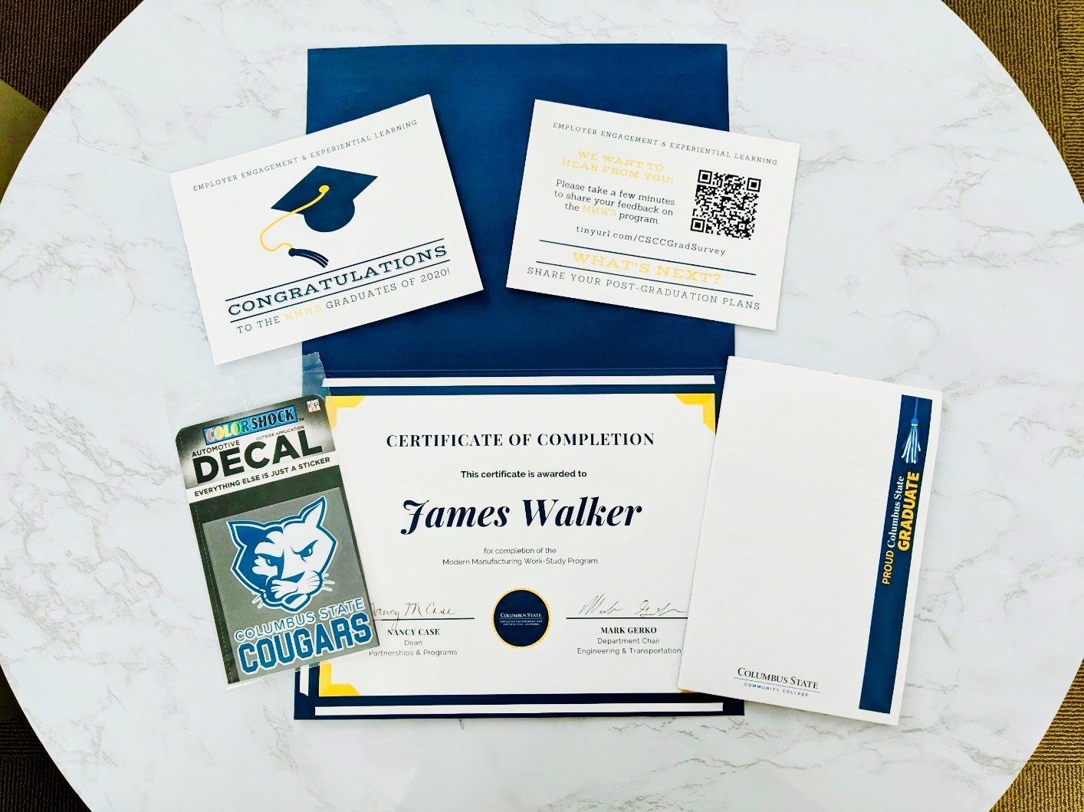
Columbus State Community College
Adopted “Alternative” Modalities / Replicated “Normal” Processes
Virtual Information Sessions
Congratulatory Grad Packs
Created packet that could be mailed
Educator Packs
Virtual Summer Orientation
Created a 5-hour virtual orientation
Grad Pack

Slide 33
Alabama Community College System
Working diligently with our students using online services such as Zoom, Microsoft Teams and email
Holding recruiting activities, interviews and end-of-semester presentations virtually
Holding virtual meetings to help students with financial aid and scholarships

Slide 34
University of Cincinnati
Partnered with industry recognized credential providers and software companies to increase upskilling and micro-credential trainings online
Provided community-based technical training for laid off or furloughed workers to explore careers in technology and find new work opportunities
Provided Chromebooks for students who do not have computers at home
Delivered virtual project-based OJT for apprentices with both industry and not-for-profit partners (e.g., student design challenges, virtual hackathons, micro internships, etc.)

Slide 35
Dallas County Community College District
Provided technology to students (laptops and hot spots)
Local staff engages more frequently with students
Hospitals intend to continue recruiting on the same schedule

Slide 36
Do you have tips or advice for how your peers can best prepare for the future?

Slide 37
Alabama Community College System
Think outside the box while maintaining the integrity of programs and ensuring students continue to receive quality training and education that leads to gainful employment/career pathway
Work on developing innovative strategies to recruit students through virtual solutions and social media and work closely with secondary partners to determine creative ways to engage with their students

Slide 38
Columbus State Community College
Have a clear sense for your process “non-negotiables” and pursue new and innovative means of achieving desired outcomes
Jettison thoughts of “We’ve always done it this way” or “That’s not how we do it”
Embrace a culture of innovation, continuously eliciting customer feedback and leveraging feedback as source of process enhancements
Anticipate change by continuously engaging employers/industry. Practitioners should not to be blind-sided by the next “big thing”
Take a position of offense and continuously bring recommendations and enhancements to employer partners/other stakeholders for review and consideration

Slide 39
University of Cincinnati
Embrace flexibility (e.g., reduced OJT hours, new ways of supporting employers and apprentices, changes to calendars, changes in supportive services)
Create opportunities for remote placements and alternatives to OJT
Continue to engage students and employee partners while acknowledging new realities
Prepare to offer as much training as possible in online settings to provide maximum flexibility over the coming months

Slide 40
Dallas County Community College District
Develop a framework for IRAP creation and delivery
Alignment of internal and program rules and regulations
Alignment of the team with the strategic objectives of the grant
Build relationships with key partners and across the board

Slide 41
Any Questions?

Slide 42
Contact Information
ScalingApprenticeship@dol.gov

Slide 43
Thank you!

