Slide 1
Beyond the Dollars: Sustainability in TechHire Programs

Slide 2
Where Are You?
Please enter your location in the chat window
(lower left of screen)

Slide 3
Today’s Speaker / Today’s Moderator
Ayreen Cadwallader
Workforce Analyst
U.S. Department of Labor
Employment and Training Administration

Slide 4
Today’s Speakers
Christian LaGarde
Consultant
Maher & Maher
Matthew A. Poland
Senior Program Manager
JFF

Slide 5
Agenda
Introductions and Poll
How to Think About Sustainability
Designing a Planning Process
Core Sustainability Elements
Organizational Infrastructure and Sustaining Capacity
Partnerships and Networks
Funding and Resource Analysis
Stakeholder Outreach and Telling Your Story
Funding Analysis Tool Demo
Q + A

Slide 6
Today’s Objectives
Learn how to design a sustainability planning process
Review five core elements of sustainability
Discover new tools available for sustainability planning
Learn how to use the Funding Analysis Tool

Slide 7
Poll Question 1
What are your organization’s biggest concerns with sustainability?
Ensuring organizational capacity in the long-term.
Maintaining partner relationships
Securing adequate funding
Preparing for the future of work
Something else…(type in the chat)
Select your top two concerns

Slide 8
How to Think About Sustainability
Designing a Planning Process

Slide 9
A Holistic Approach
Sustainability is more than funding…
It includes planning for:
Infrastructure and capacity,
Partnerships and networks,
Funding and resources,
Stakeholder outreach and telling your story, and
Preparing for the future of work.

Slide 10
The Planning Process
Plan
Evaluate
Sustain
Execute

Slide 11
The Planning Process
Who Should Be Involved?
Internal staff members: program managers, development or fiscal staffers, and organizational leaders (e.g. deans, vice presidents, executive directors), as well as instructors, and program and resource specialists, etc.
External partners: employer partners, workforce development boards, community colleges, community-based organizations, intermediary organizations, local and regional government agencies, and other workforce and education partners

Slide 12
The Planning Process
Overarching Guiding Questions:
What specifically worked well? What did not?
What is the value proposition for sustaining our programming and the associated partnerships?
Where can elements be integrated and/or incorporated into existing programs and/or roles?
How do our innovations and the program elements that we want to sustain connect and/or align with state, regional, and local strategic sustainability planning?
How might the industries we work within change?
What feedback do we have from our industry employer partners that may help with sustainability planning?
Given our discussion, what do we want to sustain?
What mechanisms will we use to sustain our work?

Slide 13
An Online Resource - PSAT
The Program Sustainability Assessment Tool (PSAT) is an online tool used to rate your program’s sustainability efforts.
Created by Washington University in St. Louis, the online tool will generate a report based on the information that you submit to help determine where your program should focus its sustainability efforts. The tool is available online for up to 12 users or can be downloaded free of charge.

Slide 14
Core Sustainability Elements

Slide 15
Core Sustainability Elements
Organizational Structure and Sustainability Capacity
Partnerships and Networks
Funding and Resource Analysis
Stakeholder Outreach and Telling Your Story
Preparing for the Future of Work

Slide 16
Organizational Infrastructure and Sustaining Capacity
Does your organization possess the necessary infrastructure and staffing to accomplish the goals of the program?
Is there a succession plan in place for your program staff? Are employees’ responsibilities and details of how the program is delivered documented thoroughly?
What role(s) do partners play, and what is their capacity to help the program achieve its sustainability goals?
What gaps exist in the capacity of the program to meet its goals? How can they be addressed?
Is there an intermediary organization involved, or could there be? What role(s) does it (or would it) play to help achieve the desired outcomes?

Slide 17
Organizational Infrastructure and Sustaining Capacity
How Do We Work Together: Building the Capacity of Your Partnership, by the Education Development Center
Quick Guide to Intermediary Practice, by the Intermediary Network
“Capacity Building for Nonprofits,” by the National Council of Nonprofits

Slide 18
Partnerships and Networks
Which organizations make up your current mix of partners? Do they all meet your needs and share your goals?
Who are your “employer champions”? How can you harness their strengths and expertise for sustainability?
What is the level of commitment among your partners? Does it need to be deepened or formalized?
How are you continually assessing the effectiveness of your partnerships to ensure that all needs and goals are met?
What other stakeholders and networks are your organization and partners connected to, and how can they be leveraged?
What specific role will partners play in supporting sustainability?

Slide 19
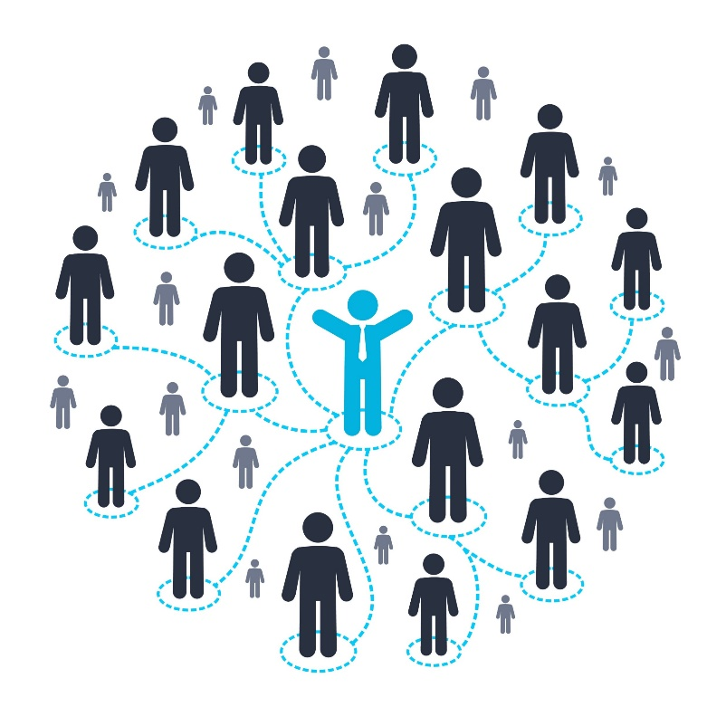
Partnerships and Networks
Career Pathways Toolkit: An Enhanced Guide and Workbook for System Development, by the U.S. Department of Labor
Creating Postsecondary Partnerships That Work: A Guide from YouthBuild USA
“When Commitment Leads to Transformative Change: How Partnerships Pave the Road to Careers,” by JFF and the U.S. Department of Labor
“Community Auditing – Asset and Resource Mapping to Maximize Capacity,” by the Innovation and Opportunity Network

Slide 20
Funding and Resource Analysis
How can your model/structure/program be organized by priority, service, and individual associated costs?
What financial resources are needed to continue the programming in the next six months to a year? In the next two to three years?
What federal, state, local, and private program resources are available for funding? What are the requirements and/or restrictions for these sources?
What clarification on your funding sources do you need? Who may provide answers?
Where do you need to fill gaps in funding, and how can this inform your fundraising efforts?

Slide 21
Funding and Resource Analysis
“Ten Nonprofit Funding Models,” Stanford Social Innovation Review, Spring 2009
What Matters: Investing in Results to Build Strong, Vibrant Communities, by the Nonprofit Finance Fund and the Federal Reserve Bank of San Francisco
“Grant Research Tools,” by the National Council of Nonprofits
The Funding Analysis Tool

Slide 22
Stakeholder Outreach and Telling Your Story
Who are your target audiences? How might they change going forward and what are the best ways to reach them?
What state and regional funders and potential partners do you want to make aware of your program?
What message do you want to convey to your target audiences? What is the story of your work?
Will your participant outreach strategies need to change because of your sustainability plans?
What forms of communication are you currently using, and which ones have been the most effective? How can you make use of this information?
How will you know if your outreach and marketing strategies are effective? What metrics will you use?

Slide 23
Stakeholder Outreach and Telling Your Story
“Communications Toolkit,” by Cause Communications
“StoryTelling Network,” by SkillsCommons
Maximizing the Power of Social Media, by JFF and the U.S. Department of Labor
“Elevate Advanced Manufacturing,” by Elevate Iowa

Slide 24
Preparing for the Future of Work
What technologies are impacting the H1-B industries that you are training people for? How should you adjust your training to reflect likely changes in occupations in those industries?
How do your training program(s) help participants develop employability skills?
Are there opportunities to work with employers in your target sectors to better understand how their jobs and associated skill sets may change in the next year or two?
What guidance can you solicit from your industry partners about how their jobs and skill needs are changing now and will change in the future?
Are there programs or services that are at high risk of becoming obsolete because of changes in the economy?
How can you make your programs more resilient to change?

Slide 25
Preparing for the Future of Work
The Future of Work in America: People and Places, Today and Tomorrow, by McKinsey and Company
The Future of Work: How Might New Technologies Affect H-1B Industries and Occupations? by the U.S. Department of Labor
New World of Work
Developing Future Talent: How We Can Prepare for the Future of Work and Business, by JFF

Slide 26
Sustainability Action Plan

Slide 27
Sustainability Action Plan
Sustainability Building Blocks | Key Action Steps | Person(s) Responsible | Time Frame
Organizational Structure and Sustainability Capacity
Partnerships and Networks
Funding and Resource Analysis
Stakeholder Outreach and Telling Your Story
Preparing for the Future of Work

Slide 28
Poll Question 2
How complex is your organization’s financial picture?
Very complex – multiple programs and multiple funding sources
Somewhat complex – more than one program and/or funding source
Not sure / don’t know
Fairly simple – only one program and/or funding source
Very simple – one program and one primary funding source
Select one

Slide 29
Funding Analysis Tool Demo

Slide 30
Any Questions?

Slide 31
Contact Us
Ayreen Cadwallader
TechHire Grants Program Lead / Workforce Analyst
Organization
techhire@dol.gov
Christian LaGarde
Consultant
Maher & Maher
clagarde@mahernet.com
Matthew A. Poland
Senior Program Manager
JFF
mpoland@JFF.org

Slide 32
Thank You!
Need help? Email: Support@workforceGPS.org

