Slide 1
SAE Sustainability Webinar

Slide 2
Today’s Objectives
Define “sustainability.”
Identify key members of a Sustainability Planning Team.
Discuss the key components of a Sustainability Work Plan.
Describe four tasks of the Sustainability Planning Team:
Program Assessment
Succession Planning
Building and Maintaining Partnerships
Funding Stability

Slide 3
Today’s Speakers
Gabrielle Aponte Henkel
Program Analyst
Employment and Training Administration, Office of Apprenticeship
Gina Wells
ASE & SAE TA Project Director
Maher & Maher

Slide 4
Where Are You?
Please enter your location in the chat window.
(lower left of screen)

Slide 5
Introduction

Slide 6
What is Sustainability?
Maintaining the impact of programs and innovations after grant-funding has ended
Continuing grant efforts with new funding sources
The goal is not to maintain the program as it currently exists; but to maintain elements that are critical to its impact.

Slide 7
Sustainability Planning vs. Transitional Planning
Sustainability Planning
Transitional Planning
The goal of sustainability planning is to identify SAE-funded apprenticeship expansion activities that should be maintained when grant funding has ended.
The goal of transitional planning is to prepare new and existing staff to carry out tasks that support the momentum of those efforts and close out the grant.
!
Transitional planning is necessary if you anticipate grant-funded staff may leave the project in the final months of the grant.

Slide 8
Key Elements of Sustainability
There are four important areas of sustainability planning. Each element will be explored in this webinar.
Program Assessment
Succession Planning
Building and Maintaining Partnerships
Funding Stability

Slide 9
Getting Started

Slide 10
Form a Sustainability Planning Team
External Members
Internal Members
Staff of funded projects and critical partners (e.g. workforce boards, community colleges and other RTI providers, other intermediaries)
Regional Apprenticeship Representatives
State agency partners and other state leadership
State Apprenticeship Director and ATRs and the State Apprenticeship Council (if applicable)
SAE Project Managers
SAE project staff

Slide 11
Sustainability Work Plans
A Sustainability Work Plan will help you develop plans to sustain activities for your program.
It should provide the following information:
Description of the apprenticeship activity created or funded through SAE
Mechanism/strategy to sustain the activity
Resources needed
Action steps required
Person who will lead the activity
Completion date
Registered Apprenticeship Activity
Mechanism/Strategy for Sustaining the Activity | Action Steps Required | Resources Needed | Person in the Lead | Completion Date

Slide 12
Sample Sustainability Work Plan
Registered Apprenticeship Activity
Employer Outreach and Accelerator Events
Mechanism/Strategy for Sustaining the Activity | Action Steps Required | Resources Needed | Person in the Lead | Completion Date
Add apprenticeship specific component to other employer engagement meetings/events - possibly for education and training providers | Identify a partner willing to host events. Determine focus of events (industry sector, etc.) and timing. Plan logistics. Identify and invite employers. Invite existing partners to share apprenticeship experiences. | Partner facility and staff time | Jane Smith, SAE Grant Lead | August 2020

Slide 13
Team Task #1: Program Assessment

Slide 14
Review Grant Outcomes
Determine impactful aspects of your SAE-funded apprenticeship expansion activities that should be sustained.
Identify promising practices and protocols that were implemented with grant funding and contributed to successful outcomes.
Define lessons learned along the way.

Slide 15
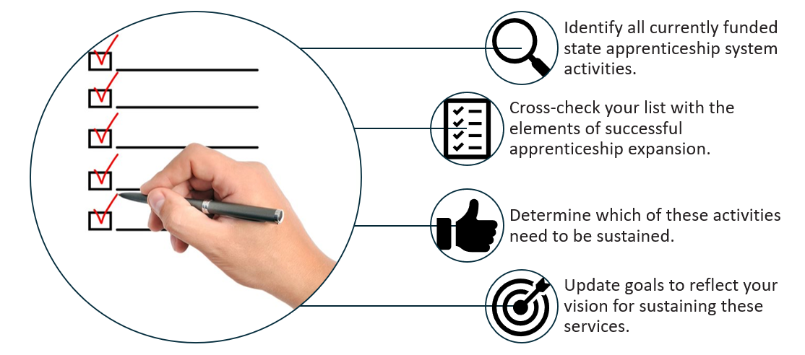
Review State Apprenticeship System Activities

Slide 16
Apprenticeship Program Activities: Consider Current Alignment with Needs
Identify all currently funded services to apprentices and sponsors.
Review labor market statistics for current industry needs.
Determine if elements of funded services should be modified to meet these needs.
Determine what should be sustained through an economic transition.
Update goals to reflect your vision for sustaining these services.

Slide 17
Polling Question
How have you presented SAE program success?
(Select all that apply.)
Written descriptions
Charts and/or graphs
Storytelling narratives
Pictures and/or images

Slide 18
Use Data and Storytelling to Demonstrate Success
Data illustrates ROI and presents a case for sustainability.
Data can identify unintended positive outcomes of your funded activities, or “ripple effects.”
When demonstrating success, identify activities that appear to be impactful, but require supporting data.
Use storytelling and best practices.
Use qualitative and quantitative data to demonstrate the success of program innovations.

Slide 19
Examples of Quantitative and Qualitative Data
Quantitative Data
Qualitative Data
Participant outcomes from the Quarterly Performance Report (i.e., completions, employment)
Data on deliverables
Sponsor feedback
Apprentice/Pre-Apprentice feedback
Partner feedback (i.e., workforce system staff, intermediaries, etc.)

Slide 20
Using Storytelling Effectively
Use stories tailored to key audiences. Include photos and videos when sharing these stories.
Before developing your story, identify your audience and the message you want to deliver.
Focus on the people involved and have a relatable main character.
Include details of where and when the story happened.
Have a clear moral and reason that is relatable to your audience.

Slide 21
Using Storytelling Effectively (2)
Clearly identify what your character wants to do or how they want to change.
Let your characters speak for themselves by using direct quotes.
Keep it short to keep your audience engaged.
Use a hook for your opener.
Make the audience wonder about what happens next.

Slide 22
Using Storytelling Effectively (3)
Stir emotion.
Use language that is relatable to your audience.
Include interesting details while not overwhelming the audience.
Describe the scene and let the listener picture themselves in the story.
Include a moment of truth that reflects what was achieved or learned.
When presenting to potential partners, be sure to share your success stories!

Slide 23
Identify Mechanisms for Sustaining Program Successes
Consider how you will sustain/scale activities based on evidence of success.
Identify mechanisms or strategies that will help you sustain activities.
Examples include:
Create a new policy.
Implement new protocols.
Build it into professional development.
Support it within the budget.
Codify the partnership through a memorandum of understanding (MOU).
Advocate for statewide policy.
Identify additional funding.
Engage new stakeholders to take on critical roles.

Slide 24
Discussion Question
What have been your most impactful SAE activities? How are you sustaining them?
What activities have served their purpose and will be winding down at the end of your SAE grant?

Slide 25
Team Task #2: Succession Planning

Slide 26
Implement Shared Leadership
What is Shared Leadership?
An emerging practice that prepares employees for advancement
Improves team performance and increases staff retention
Maximizes staff potential by providing staff with opportunities to lead each other
Cultivates leaders who uphold the organizations mission, vision, and values

Slide 27
Create Digital Resources
Include all key documents related to the project, including the following:
Proposal
Project plan
Detailed policies and procedure manual
Display data using pivot tables and charts to present outcomes.
Use a template to record mechanisms for sustaining activities.
Activities to Sustain | Mechanism(s) for Sustaining Activities
Provide a description: | Provide a description:

Slide 28
Team Task #3: Building and Maintaining Partnerships

Slide 29
Conduct a Partner or Stakeholder Analysis
Analyze systems-level statewide partnerships, policy, communication, outreach, etc., and review program-level work (pre-apprenticeship and apprenticeship).
Determine whether your partners have an interest in sustaining the benefits of the project and are willing to be part of the planning process.
Create a stakeholder management plan based on this analysis.

Slide 30
Meet with Apprenticeship Sponsors
Determine whether support for OJL/OJT provided by SAE is still relevant to their needs.

Slide 31
Identify and Engage Additional Organizations and Individuals
Identify who is not involved in grant activities but will be impacted by SAE changes.
Determine how they can contribute to or benefit from your work.
Engage them in your apprenticeship expansion work and give them a specific role or task.

Slide 32
Discussion Question
What are you planning to do to assess partner needs as your SAE grant winds down?

Slide 33
Team Task #4: Funding Stability

Slide 34
Develop a Funding Plan
Address the long-term needs of your apprenticeship expansion efforts
Adjust your plan to trends in economic cycles and include diverse funding sources
Identify additional funds needed and ROI on grant funds used.

Slide 35
Identify Additional Sources of Funding Support
Consider local & state government funding, industry funding, and support from foundations.
Restructure existing staff roles.
Restructure grant activities so costs are covered by different sources.
Develop a “braided funding” strategy to combine funding sources.

Slide 36
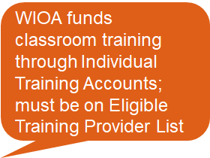
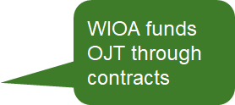
WIOA Funds Can Support Registered Apprenticeship
Business
Involvement
❷
❶
National
Occupational
Credential
Related
Instruction
❺
❸
Rewards
for Skill
Gains
Structured
On-the-Job
Training
❹

Slide 37
How WIOA and Registered Apprenticeship Can Work Together
Referrals of qualified job seekers to apprenticeship programs
Training resources for eligible participants to become an apprentice through:
Individual Training Accounts (ITAs) with RA programs
On-the-Job Training with RA sponsors (WIOA can offset some costs to employers for training)
Pre-Apprenticeships
Supportive Services, while in training

Slide 38
WIOA Support for Pre-Apprenticeship
For Youth
Part of Work Experience, which has 20% expenditure requirement (OJT also part of work experience)
Can support 75% out-of-school youth requirement
For Adults
Can be considered short-term pre-vocational training
Can also be a training service

Slide 39
Leveraging Other Federal Funding
The Federal Resources Playbook for Registered Apprenticeship explains how to use funding from six agencies:
U.S. Department of Education: Federal Student Aid Funds, Title IV Student Aid including Pell Grants and Federal Work Study
U.S. Department of Labor: Federal Workforce Development Funds, including Workforce Investment Act and Workforce Innovation and Opportunity Act
U.S. Department of Veterans Affairs: GI Bill® and Veterans Affairs Educational Assistance
U.S. Department of Agriculture: Supplemental Nutrition Assistance Program Education and Training Funds
U.S. Department of Transportation: Federal Highway Administration On-the-Job Training and Supportive Services Program
U.S. Department of Housing and Urban Development: Section 3 Covered Housing and Urban Development Financial Assistance Programs
https://www.doleta.gov/oa/federalresources/playbook.pdf

Slide 40
Discussion Question
As you work to build sustainable apprenticeship expansion efforts in your state, what funding sources are you bringing to the table?

Slide 41
Summary
The process of creating a sustainability work plan is not linear.
Begin the process early and continuously review the progress of activities.
Pay attention to new opportunities for sustaining activities.

Slide 42
Communicating Your Plan and Next Steps
Identify who should be engaged.
Secure the support of senior leadership.
Use lessons learned from SAE to enhance future state apprenticeship expansion goals and activities.

Slide 43
Any Questions?

Slide 44
Contact Information
For grant related questions, contact your assigned FPO.

Slide 45
Thank You!
Need help? Email: Support@workforceGPS.org

