Slide 1
Poll Question #1
Let’s get to know who is on the call today. Using the poll, select the role that you play in your H-1B Closing the Skills Gap grant.
Authorized Representative
Program Director/Manager
IT Data Manager/Staff
Training Partner
Employer Partner
Service Provider
Other (case manager, job developer, or employment specialist)
Choose the answer that best reflects you (or your organization)

Slide 2
Where Are You?
Enter your location in the chat window below

Slide 3
H-1B Performance Reporting Orientation 2.0
For Apprenticeships: Closing the skills gap
Grantees

Slide 4

Today’s Moderator
Ayreen Cadwallader
  Workforce Analyst / Grant Program Lead
  U.S. Department of Labor/Employment and Training Administration

Slide 5


Today’s Speakers
Kevin Mauro
  Performance Lead / Closing the Skills Gap
    High Impact Partners
Gregory Scheib
  Workforce Analyst
  U.S. Department of Labor/Employment and Training Administration

Slide 6
Today’s Objectives / Agenda
Provide an introduction to Workforce Integrated Performance System (WIPS)
Provide an overview of the H-1B PIRL Data Elements
Describe the format and structure of a data file, creation of a CSV file, and describe ongoing case management processes
Describe how to generate a Quarterly Performance Report (QPR) Form
Present an overview of the Quarterly Narrative Report
Provide an overview of the performance reporting guidance
Discuss next steps/action items for July – September 2020

Slide 7
Accessing and Reporting in WIPS

Slide 8
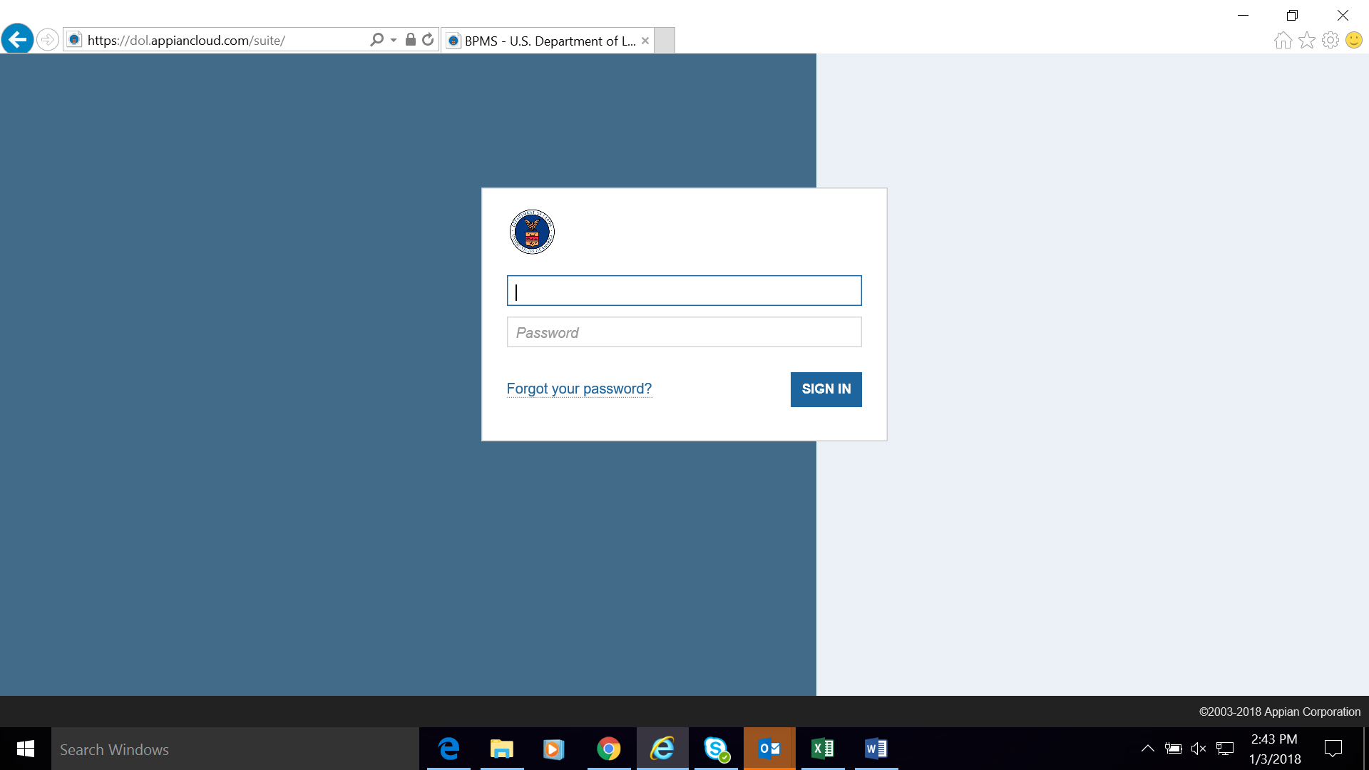
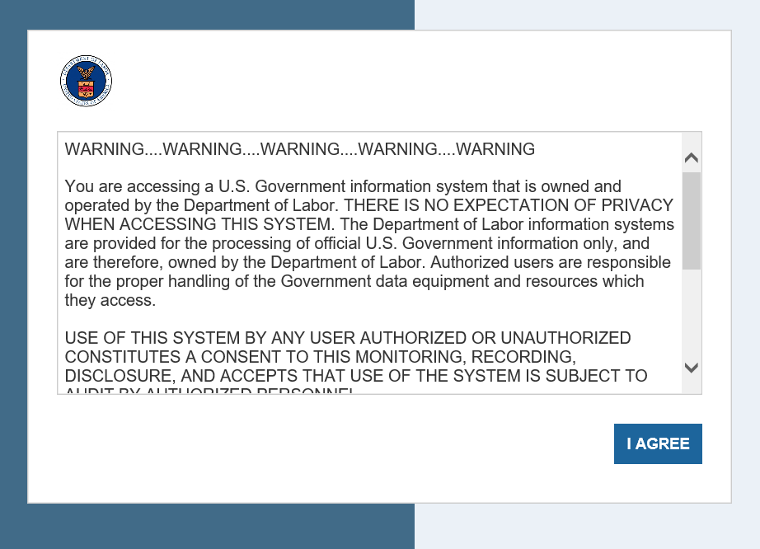
WIPS Access
Username and Passwords
The ONLY way to access WIPS is with a WIPS-generated username and password.
Both username and password are sent via email to the Grant’s Authorized Representative from the following email address: admin@dol.appiancloud.com.

Slide 9
WIPS Access
Reset Password in WIPS
Select the Reset Your Password link on the WIPS login screen. Then enter your email address in the Username field and select Request Password Reset.
You will receive an email with a temporary password that you will have to change the next time you log in. Your new password must be at least eight (8) characters and have at least one (1) of each of the following:
  Uppercase letter
  Special character
  Lower case letter
  Number
AFTER CHANGING YOUR PASSWORD, YOU MUST LOG OUT AND LOG IN AGAIN.

Slide 10
Change Authorized Representative
Any Authorized Representative change needs to go through the grant modification process, assisted by your FPO.
  The modification, signed by the Grant Officer, is the formal approval of the Authorized Representative change.
  Please note that after submitting the request to your FPO, it could take 1-2 weeks for the modification to be signed by the Grant Officer and transmitted to you.

Slide 11
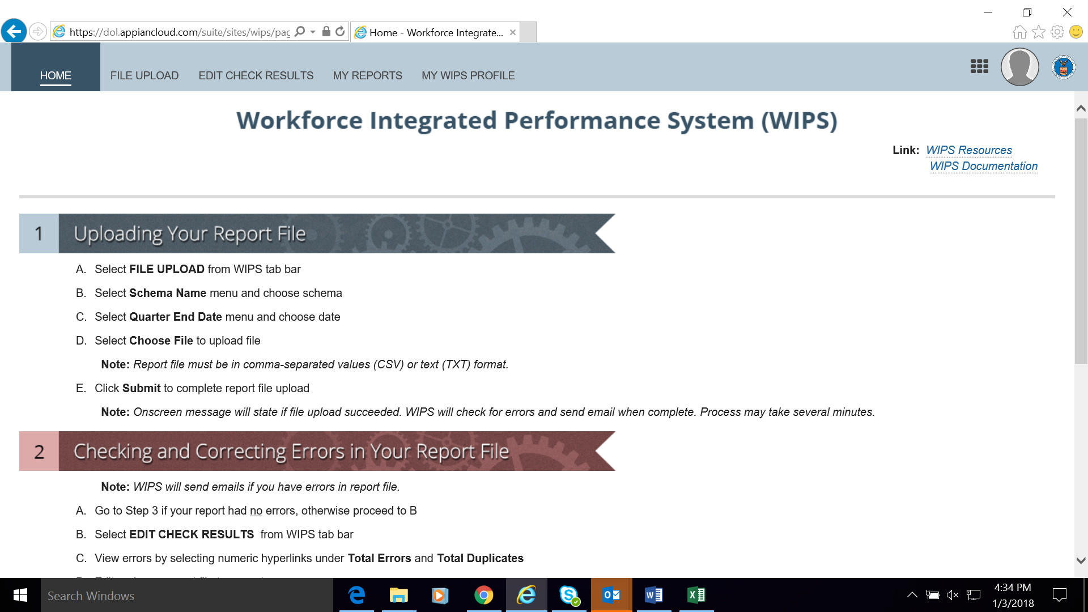
H-1B WIPS Homepage (first tab)
Once the username and password is entered, the WIPS homepage will display.
Instructions for “Uploading your QPR File” and “Checking and Correcting Errors in Your QPR” will be listed below on the homepage.

Slide 12
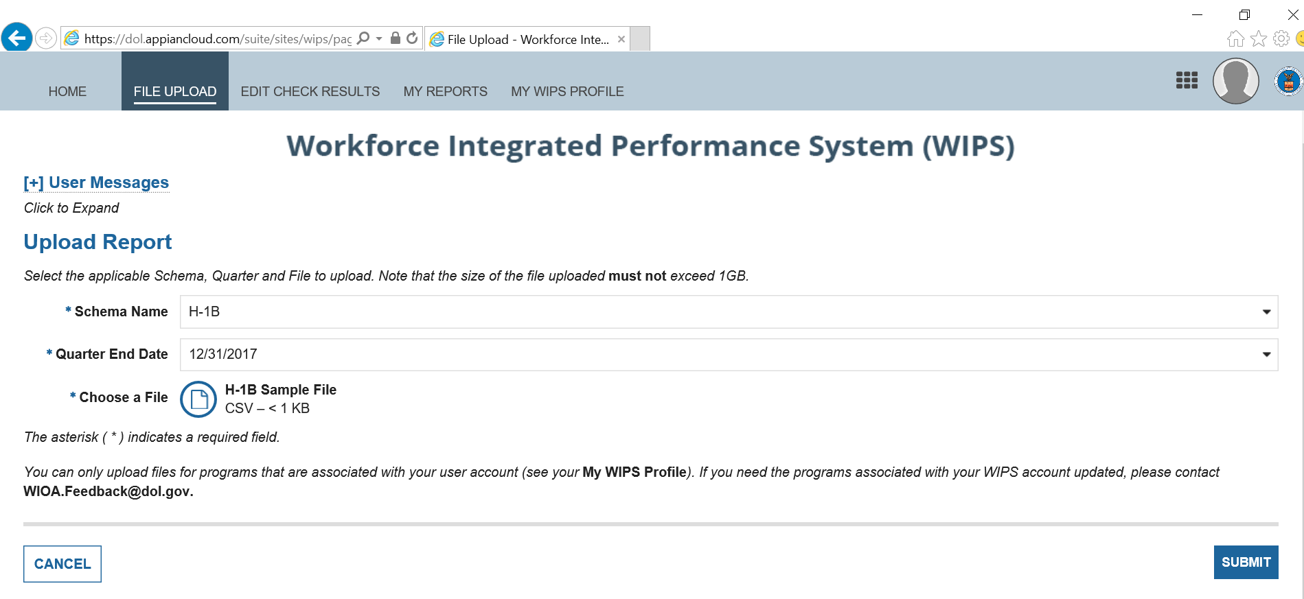
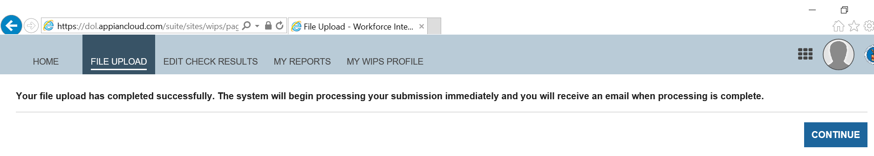
File Upload (Second Tab)
Uploading Your QPR File
Select FILE UPLOAD from WIPS tab bar.
Select Program Name menu and choose program.
Select Quarter End Date menu and choose program.
Select Choose File to upload file.
Click Submit to complete report file upload.
File Upload (Successful Upload Notice)

Slide 13
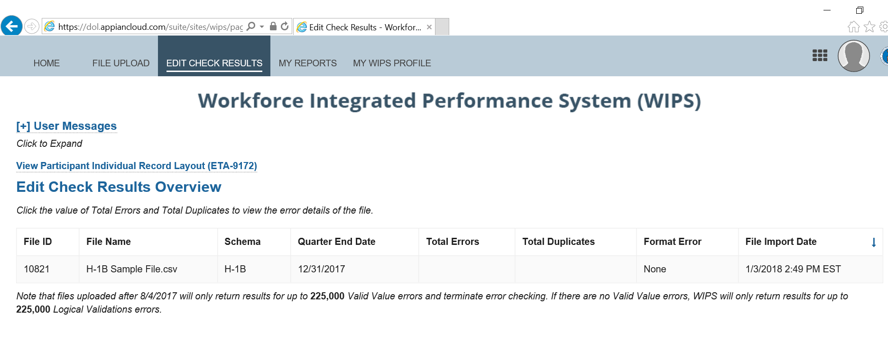
Edit Check Results (Third Tab)
Checking and Correcting Errors in Your Data File
Forgo if your report had no errors.
Select EDIT CHECK RESULTS from WIPS tab Bar
View errors by selecting numeric hyperlinks under
Total Errors and Total Duplicates
Edit and save CSV file to correct Errors
Return to Upload your CSV File

Slide 14
Knowledge Check!
Which of the following is not a task that WIPS can help grantees perform within the system?
Resetting a password
Checking whether errors in a data file exist
Correcting errors in a data file
Generating a QPR

Slide 15
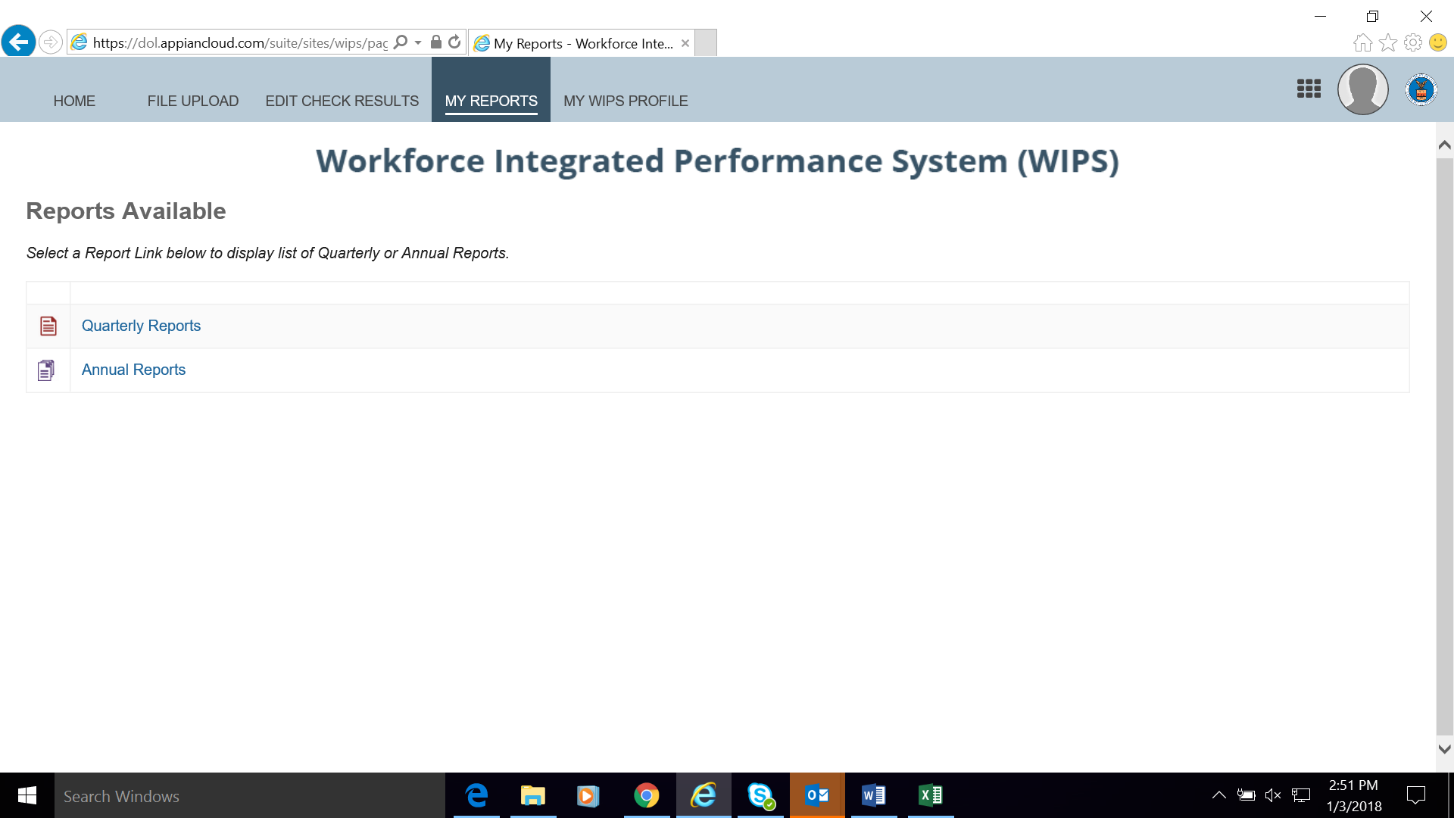
Reviewing Your Uploaded QPR (Fourth Tab)
Select QUARTERLY REPORTS from WIPS tab bar
Find recent report uploaded under Current Quarter section
Open report by clicking hyperlink under Status and Current Quarter(s) section
Confirm accuracy of QPR Information
Contact the Closing the Skills Gap mailbox if you find discrepancies with your outcomes that you don’t understand
Certify the QPR

Slide 16
WIPS Tips
Make arrangements with your Authorized Representative for access.
Determine your strategy for how you will receive and validate participant data from your partners.
Start the submission process early!

Slide 17
Any Questions?
Enter your questions in the chat window (lower left of the screen)

Slide 18
H-1B Closing the Skills Gap PIRL Data Elements
What is the Amended ETA-9172 DOL PIRL?
Tracking and Reporting Participants Using H-1B PIRL Data Elements
Guidance on Reporting PIRL Data Elements for CSG Grantees

Slide 19
What is PIRL?
Participant Individual Record Layout (PIRL)
  Contains all of the required individual data elements and code values that should be tracked and reported for each grant
  H-1B grants use a subset (89) of all DOL PIRL data elements
  Rollout of data elements occurred in phases, but PIRL is now complete for H-1B grantees
Tab 2
Amended ETA-9712 DOL PIRL for H-1B CSG Grants

Slide 20
Summary of H-1B Schema in WIPS Reflected in the Amended PIRL ETA-9172
Tab 1 (ETA-9172 DOL-Amended PIRL)
Tab 2 (H-1B Only PIRL)
Tab 4 (H-1B Valid Values)
Tab 5 (H-1B Duplicate Rules)
Tab 6 (H-1B Logic Rules)
Tab 7 (H-1B QPR Aggregation Rules)

Slide 21
PIRL Data Elements Validation Rules
Valid Values Rules (Tab 4)
  Ensure the amount and type of data reported in each field meets the technical requirements
  Example: Minimum or maximum number of characters
Duplicate Errors (Tab 5)
  Ensure participants are not being counted more than once
  Example: Cross-checks duplicate SSNs with dates of entry

Slide 22
PIRL Data Elements Validation Rules
H-1B Logic Rules (Tab 6)
  Ensure data reported for one participant entered is logically consistent according to the definitions of the data elements
  Example: There cannot be a date for “program completion” entered if no date has been reported for “began training”
Aggregation Rules (Tab 7)
  Calculations WIPS uses to aggregate participant data for the QPR
  Example: C1 (Unemployed Individuals) counts participants who have the appropriate code value for employment status at entry of “underemployed” and who also have a date reported for “program entry”

Slide 23
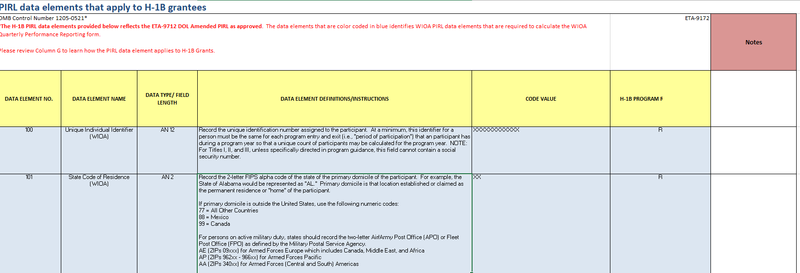
What Makes a Data Element?
Data Element Number
Data Element Name
Data Type/Length
Data Element Definition and Instructions
Code Values

Slide 24
Creating a Data File
Data File Format and Technical Requirements
Case Management

Slide 25
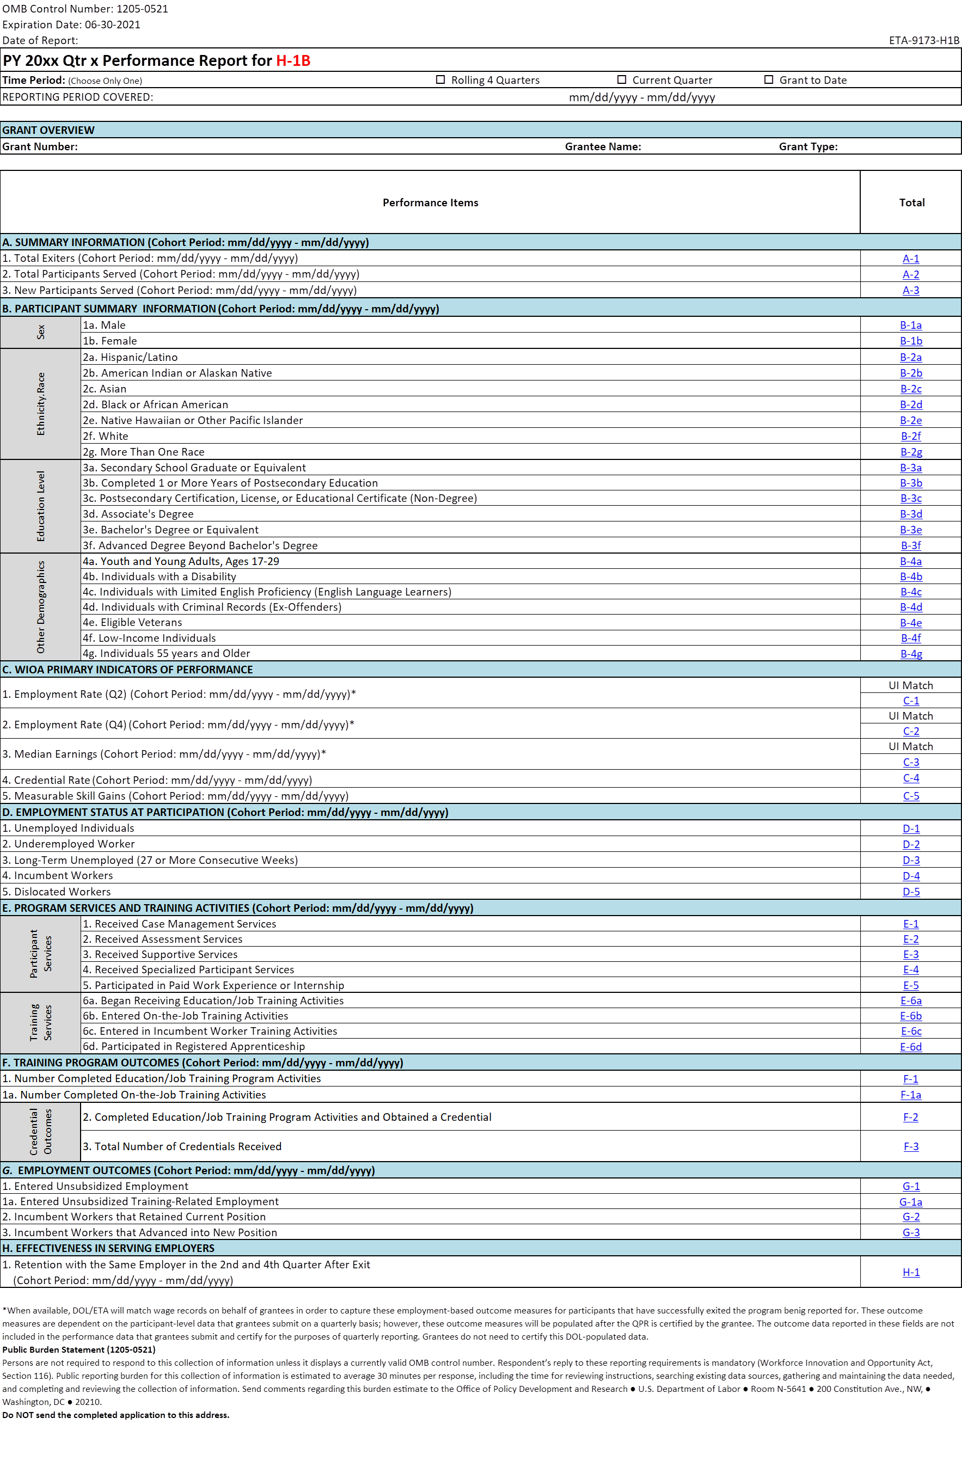
From a Data File to a QPR
WIPS generates a QPR of aggregate data and grantee certifies it
Grantee’s QPR data can be used to assess progress on the targets
Pre-award: Grantees submitted real-time aggregate performance targets on participants (Webinar 1.0 Review)
Post Qtr 2: Grantee develops a data file on participants using PIRL data elements
(Webinar 1.0 Review)
Grantee uploads participant data file to WIPS and resolves file errors
100000000001 | MA | SARAP11 |  |  | 1 | 1 | 0
100000000002 | FL | SAUAP22 |  |  | 2 | 1 | 1
100000000003 | CA | SAPRE33 |  |  | 9 | 0 | 9
100000000004 | AZ | SANONE4 |  |  | 2 | 9 | 1

Slide 26
What is a Data File?
Grantees will upload a data file that includes 89 Participant Individual Record Layout (PIRL) data elements.
PIRL data elements are the required pieces of information that must be reported for each participant served in your program.
The data file includes code values for each PIRL data element for each participant.

Slide 27
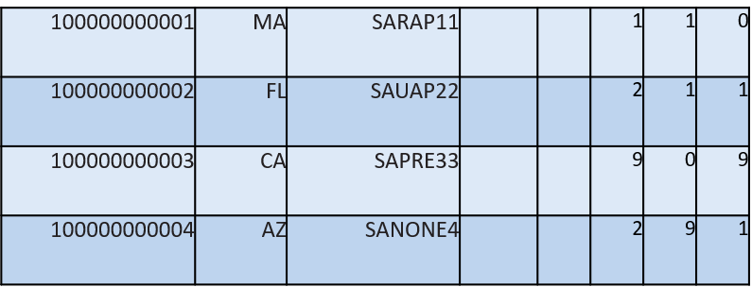
ETA-9172 DOL PIRL for Closing the Skills Gap Grantees
Grantees will upload a data file that includes 89 PIRL data elements.
The data file includes code values for each PIRL data element that must be entered for each participant served in your program.
Each ROW represents one participant
Each COLUMN represents each data elements code value per participant

Slide 28
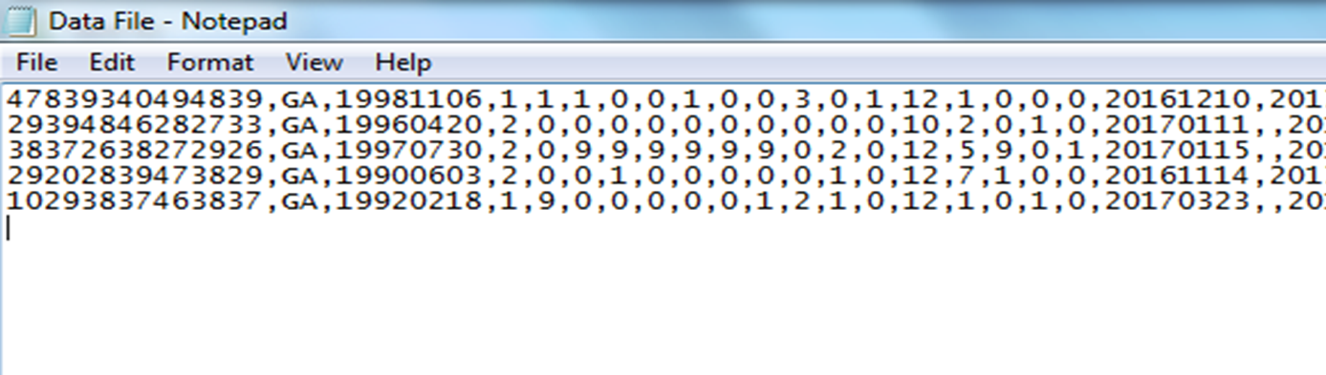
Sample Case Management and CSV Data File
Sample Case Management and CSV Data File
Hyperlink

Slide 29
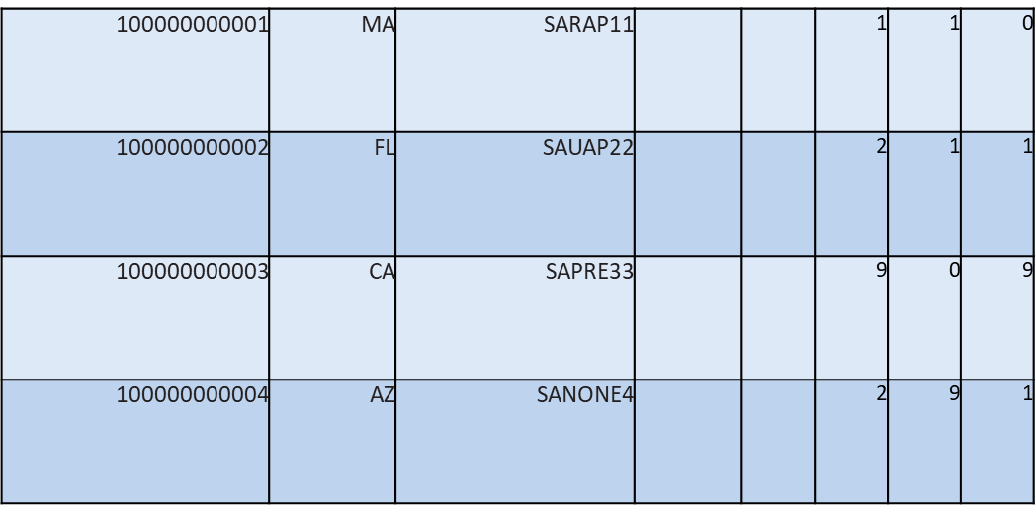
Data File Format
Each ROW
represents
one participant record
COLUMNS represent code values for data elements on each participant

Slide 30
Data File Technical Requirements
File must be in CSV format in only one file for your grant as a whole
File must include every data element as a data field entry
Participant records must have a corresponding code value for each data element
Cannot contain:
  Participant names
  Data element headers
  Additional rows
  Blank entries when code values are required
  Null values instead of a blank or a space
Note that in some cases, leaving the data field blank is an option if the data element does not apply to the participant. Spaces are counted as a code value.

Slide 31
Tips & Tricks: Tracking Participant Level Data
Develop an electronic case management system that can be transferable between training providers
Ensure all data elements are reviewed and definitions are understood
Ensure participants and training providers understand why certain information is collected
Add relevant dates to the enrollment form
Do not leave records containing PII open and unattended

Slide 32
Poll Question #2
What systems are you using to track and report your grant’s participant level data?
Existing MIS system
Third-Party Vendor
Excel Spreadsheet
Access Database
Other
Choose the answer that best reflects you (or your organization)

Slide 33
Data Validation and Resolving Data File Errors
Steps for Data Validation
Common Data File Errors

Slide 34
Steps for Data Validation
STEP ONE: Formatting Check Errors
Verify that the format of data file is correct
Appears under format errors hyperlink in WIPS
STEP TWO: Valid Values Errors
Verify that the code values entered match with the options available
Appears under total errors hyperlink in WIPS

Slide 35
Steps for Data Validation
STEP THREE: Duplicate Errors
Verifies that duplicative participant records are not in the uploaded file
Appears under duplicate errors hyperlink
STEP FOUR: Logic Rule Errors
Validation check related to the rules assigned to each code value for all data elements to verify internal logic of participant records
Appears under total errors hyperlink
Steps three and four are run at same time

Slide 36
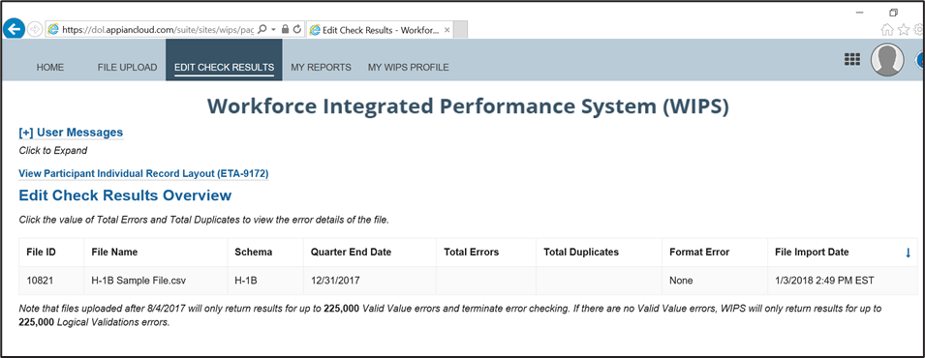
Edit Check Results (Third Tab)
Checking and Correcting Errors in Your Data File
Forgo if your report had no errors.
Select EDIT CHECK RESULTS from WIPS tab Bar
View errors by selecting numeric hyperlinks under
Total Errors and Total Duplicates
Edit and save CSV file to correct Errors
Return to Upload your CSV File

Slide 37
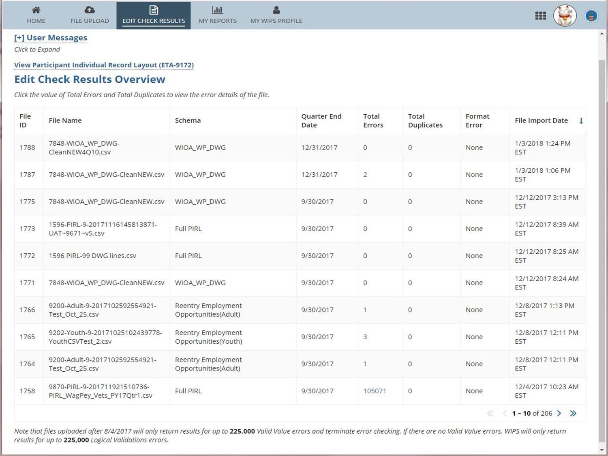

Slide 38
Data Validation Error Report Resolution
Consult error report
Identify error in data file
Verify accurate code value and consult logic rules and valid rules
Make corrections to data file
Re-submit data file for the next round of your data validation process

Slide 39

Common Format and Valid Value Errors
Data File Structure
Code values in between commas or a null value
  A space in between commas could be an error! A value that contains a space for a null value could be an error!
Do you have headings and data element numbers in your data file?
This will result in a data file error!
PIRL code values that require # digits
  Example: PIRL 938 H-1B Grants requires 13 or 14 digits.
  Including only 10 digits will result in an error!
Dates in the correct format
  Format must be 19771110.
  November 10, 1977 or “10111977” will result in an error!

Slide 40
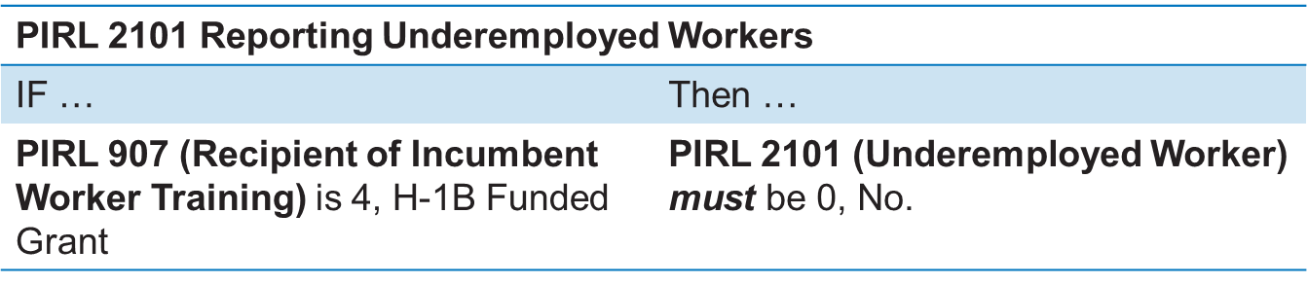
Logic Validation Rule Samples
Logic Validation Rules
  Rely on a variety of PIRL data elements to verify your data

Slide 41
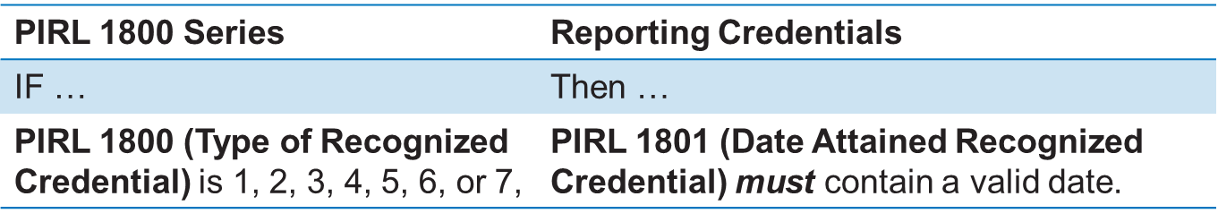
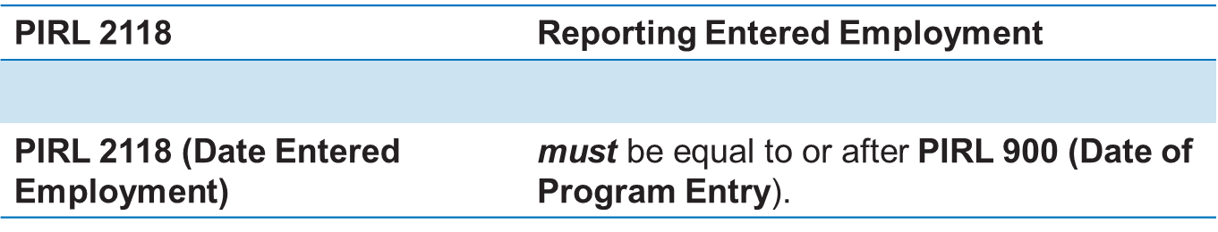
Logic Validation Rule Samples

Slide 42
Knowledge Check!
Which of the following is an example of a logic validation rule error?
A participant has a date of program entry that comes after a date of program exit
A participant ID number and date of entry are duplicated in the data file
A two-digit number has been entered in a field that requires a date
An extra space was added to a field

Slide 43
Any Questions?
Enter your questions in the chat window (lower left of screen)

Slide 44
Quarterly Performance Report (QPR) Form
How a QPR is Generated in WIPS
QPR Aggregation Rules

Slide 45
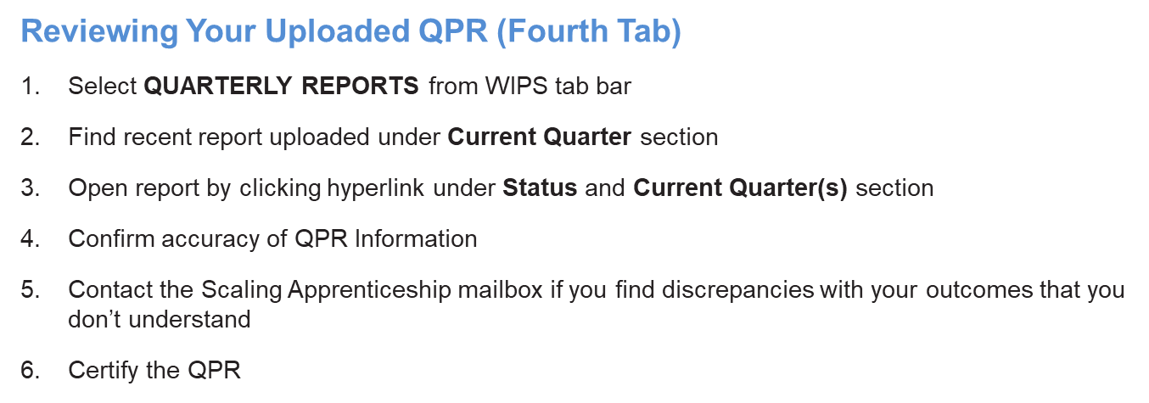

Slide 46
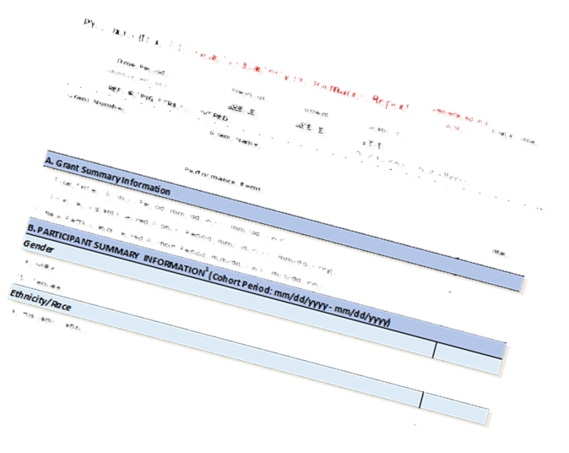



H-1B QPR Aggregation Rules
Overview of Aggregation Rules
  Business rules to aggregate performance data into H-1B Real-time Outcome Measures
  Total Participants Served, Began and Completed Training, including types of services, types of training, and credential and employment outcomes
  Ensure H-1B aggregation rules are applied to grantee’s internal systems for calculating H-1B Outcome Measures
Grantee Database System
CSV Data File Upload in WIPS
QPR Generated

Slide 47
Any Questions
Enter your questions in the chat window (lower left of the screen)

Slide 48
Quarterly Narrative Report Overview
Including: Special Instructions for Closing the Skills Gap Grantees on Reporting Program Outputs

Slide 49
Joint Quarterly Narrative Performance Report (ETA-9179)
H-1B grantees are required to submit a quarterly narrative report using the approved Joint Quarterly Narrative Performance Report (ETA-9179) for the quarter ending June 30, 2020 (and beyond)
The QNR is a qualitative summary of grant activities that occurred during the reporting quarter
Grantees will enter information in entry fields directly in WIPS
Grantees will submit and certify directly in WIPS

Slide 50
Joint Quarterly Narrative Performance Report (ETA-9179)

Slide 51
Joint Quarterly Narrative Performance Report (ETA-9179)

Slide 52
Note About QNR Attachments
Examples of Attachments
  Full QNR Document (to extend past 2000-character section limit)
  Flyers
  Graphs and Charts
  News Stories

Slide 53
Reminder: Section B Outcome Reporting in QNR
Closing the Skills Gap grantees were required to provide targets on three output measures related to expanding apprenticeship [Section B – B1, B2, B3]
These are not participant outcomes, but program outcomes so are not reported in your data file
These output measures should be reported in Section XI.A of the QNR

Slide 54
Reporting Output Measures for Closing the Skills Gap Grantees
Closing the Skills Gap grantees were required to provide targets in the Statement of Work on three output measures related to apprenticeship
[FOA Section B.2.i]
  1) Total number of all newly created apprenticeship programs, including newly created Registered Apprenticeship Programs.
  2) Total number of existing apprenticeship programs, including Registered Apprenticeship Programs, that are expanded, (e.g., new industries, occupations or service areas, or increased number of apprentices registered).
  3) Total number of employers engaged (i.e., those employers that adopt apprenticeship programs as a result of your grant project).
These output measures should be reported in Section XI.A of the QNR

Slide 55
Suggested Format for Reporting
Closing the Skills Gap Output Measures
Expanding Apprenticeship Output | Cumulative – To Date Amount | Grant Target
1) Total number of all newly created apprenticeship programs, including newly created Registered Apprenticeship Programs.
2) Total number of existing apprenticeship programs, including Registered Apprenticeship Programs, that are expanded, (e.g., new industries, occupations or service areas, or increased number of apprentices registered).
3) Total number of employers engaged (i.e., those employers that adopt apprenticeship programs as a result of your grant project).

Slide 56
Knowledge Check!
The output measures for Closing the Skills Gap grantees should be reported:
By email to my FPO
In Section XI.A. in my QNR each quarter
Only for the quarter ending June 30, 2020
What are output measures?

Slide 57
Any Questions?
Enter your questions in the chat window (lower left of screen)

Slide 58
Next Steps: Your Action Items
What should we do …

Slide 59
Quarter Ending
H-1B Reporting Reminders
June - August 2020
Next Steps for Grantees
  Review new performance reporting handbook (and other technical assistance materials—see next slide)
  Attend H-1B CSG Performance Reporting Office Hours
    Wednesday, July 29, 2020 from 2:00 pm – 3:00 pm EDT
    Thursday, August 6, 2020 from 1:00 pm – 2:00 pm EDT
    Thursday, August 13, 2020 from 3:00 pm – 4:00 pm EDT
  Submit and certify your grant’s QNR and data file in WIPS
    Don’t forget Section B
    Start early!
  Contact the Closing the Skills Gap mailbox (ClosingSkillsGap@dol.gov) for performance reporting technical assistance. Please make sure to cc your FPO.

Slide 60

Current Closing the Skills Gap Performance Resources
H-1B Grants Closing the Skills Gap Performance Reporting Handbook 2.0
DOL PIRL for CSG Grants
WIPS Tips, with helpful information on using the WIPS system to report your performance data; and WIPS QNR Upload Instructions
Sample case management file with 25 participants
Sample data file
Sample .csv file
CSG Performance Reporting Webinar 1.0 and 2.0
https://www.workforcegps.org/events/2020/06/08/13/50/Apprenticeships-Closing-the-Skills-Gap-Performance-Reporting-Orientation-2-0

Slide 61
Poll Question #3
How prepared are you to submit a CSV data file in WIPS??
Eeks! WIPS What?! We’re not ready!
Um…we’re still collecting participant data
Whew, we’re almost there! We have participant data in our MIS data base
Feeling great! We’re ready to upload a CSV data file in WIPS
Choose the answer that best reflects you (or your organization)

Slide 62
Thank You!

