Slide 1
Where Are You?
Please enter your location in the chat window
(lower left of screen)

Slide 2
What is your Role?
Select the option that best describes your role in the H-1B Scaling Apprenticeship grant.
Authorized Representative
Program Director/Manager
IT/Data Manager or Staff
Sub-Awardee
Training Partner
Employer Partner
Other Grant Team Member (case manager, job developer or employment specialist, college grants officer, etc.) – type into chat
Please select only one.

Slide 3
Strategies and Opportunities for Braiding Funds: Yielding Greater Flexibility and Impact
Presented By:
Office of Workforce Investment, Division of Strategic Investments

Slide 4
Today’s Moderator
Zodie Makonnen
Grant Lead - Scaling Apprenticeship Through Sector-Based Strategies
Division of Strategic Investments
Employment and Training Administration

Slide 5
Today’s Speakers
Lisa Rice
Technical Assistance Coach
Manhattan Strategy Group

Slide 6
Today’s Speakers
Christine Gillespie, Ed.D
Executive Director/Division of Continuing Education and Workforce
Bergen Community College (NJ)

Slide 7
Today’s Speakers
Marci Murphy
President
CareerSource Brevard (FL)

Slide 8
Today’s Speakers
Dug Jones, JD
Program Manager of Tech Quest Apprenticeship
Clark University (MA)

Slide 9
Today’s Objectives
Foundational knowledge of why braiding funds is vital to sustainability
The types of funds available to pursue
How to pursue specific types of funding
Real-life examples from practitioners
Answers to questions and knowledge of where to go with future questions

Slide 10
Foundational Knowledge of Braiding Funds
Why sustainability is important

Slide 11
Poll Question for Audience
Where have you received additional grant funds from?
Federal funding
State funding
Local funding
Private funding
Have not received other funds
Select as many as apply.

Slide 12
Definitions
Braided Funding: Pools multiple funding streams toward one purpose while separately tracking and reporting on each source of funding.
Blended Funding: Combines, or “co-mingles,” multiple funding streams for one purpose without continuing to differentiate or track individual sources.
Both types of funding are intended to promote the effective use of government funds by leveraging money being spent on separate programs serving similar populations.
Multiple funding sources requires a higher level of communication and coordination to track funding requirements (i.e., wages, employer of record).

Slide 13
Benefits of Braiding Funds
Greater ability to meet customer needs
Increased flexibility to achieve defined outcomes
Increased ability to focus more on program goals
Greater stakeholder collaboration, coordination of services and comprehensive project management
Greater likelihood of continuing services past grant funding
Improved customer experience and value
More creative service delivery options
Reduced duplication and achieves efficiencies

Slide 14
Reality of Braided Funding
It must benefit all partners, but not always financially
It works best if you have a narrow, specific goal in mind
Some organizations are better positioned to receive funding while others are better positioned to give funding
This is a long-term strategy; you can go slowly

Slide 15
Types of Funding Available to Pursue

Slide 16
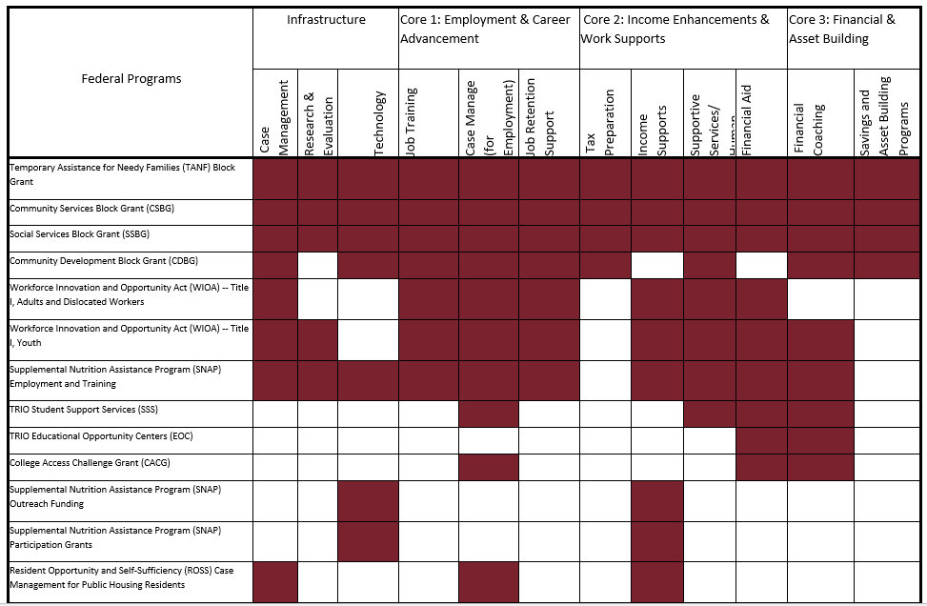
Federal Funding Streams At-A-Glance The Annie E. Casey Foundation – Federal Funding Integrated Service Delivery: A Toolkit

Slide 17
DOL or State-Funded Grants for Apprenticeship
How can SA grantees work with other grantees in your state or industry to expand apprenticeships?
Create a working group of all the federal and state-funded apprenticeship grantees in your state
Connect to your state’s apprenticeship point of contact if you have not already - https://www.doleta.gov/oa/contactlist.cfm
DOL appropriated funds can only be used for RAPs but nevertheless, there may be opportunities for collaboration, sector-building, or co-enrollment
See Scaling Apprenticeship FAQs for co-enrollment guidance

Slide 18
WIOA Funding
What services could WIOA provide to support apprenticeship programs and/or apprentices?
Recruiting qualified candidates (especially targeted populations)
Training and technical assistance for employers
(e.g., on accommodations, workplace access)
Cost of classroom instruction (tuition, books, supplies)
Disaster Funding:
Disaster
Layoffs/Major Dislocations
National Health Emergency
https://www.dol.gov/agencies/eta/dislocated-workers/grants/disaster

Slide 19
Vocational Rehabilitation (VR) Funding
What can Vocational Rehabilitation Funding do to help with apprenticeships?
Services to assist students with disabilities make the transition from secondary school to post‐secondary education programs and competitive integrated employment
Help employers with job site assessments and accommodations
Job coaching
Transportation
Education and training costs

Slide 20
Foundation Funding
Foundation and Application Details
Item | Foundation Details
Foundation Name:
Foundation Mission and Priorities:
Letter of Intent Due Date:
Other Requirements (if applicable):
Components of Application: | Abstract Project overview Funding requirements Other:
Application Due Date:
Internal Team Planning
Team Members | Roles and Responsibilities | Internal Due Dates | Additional Notes

Slide 21
Other Resources to Check Out
Employer/industry contributions
Wages
Equipment
Training Costs
Salaries of Mentors
Paid Release Time
Funding for a Teacher or Project Coordinator
Bank community giving contributions

Slide 22
A Few Things to Think About

Slide 23
Things to Think About as You Pursue Other Resources
All funding partners need to have a resource-opportunity mindset
Customers are shared’ and served by a network of resources and services
Partners jointly look for how to increase the program and customer outcomes
Creating success stories that showcase new ways of providing services

Slide 24
Guiding Philosophy
Focus on customers’ needs and outcomes and results drive the investment of diverse program/funding stream resources
Vs. programs/funding streams as the primary front-end drivers of service design and service delivery
Front office: Customer needs and outcomes
Back office: Funding customer services
Multiple programs/funding streams are tapped as appropriate to create the most effective service “portfolio” for customers

Slide 25
Questions to Consider When Pursuing Braided Funding
What is the scope of the project and what do I want to achieve?
Who are my potential partners?
What level of funding (or other resources) do I need?
What challenges might we face in implementing braided funding?
Funding requirements, reporting, communication between stakeholders
How likely is it that partners will remain with the project after grant funding?

Slide 26
Success Factors
Partner leaders have shared goals and strategies – Contribution versus attribution!
Clear purpose
Engage businesses
Demand-driven strategy
Evidence-based decision making
Ensure stability
Communicate, communicate, communicate

Slide 27
Hearing from the Experts: Real Life Examples

Slide 28
Where is the Money?
Christine Gillespie, Ed.D
Executive Director/Division of Continuing Education and Workforce
Bergen Community College (NJ)

Slide 29
Actual (and Potential) Funding Streams
Federal Funds
State Funds
Local Funds
Private Funds

Slide 30
Federal Funds
U.S. Department of Labor – H-1B Scaling Apprenticeship Grants
HealthWorks - $12M
CareerAdvance USA
U.S. Department of Veterans Affairs
GI Bill
Transition and Post Secondary Programs for Students with Intellectual Disabilities (TIPSID)

Slide 31
Filling the Gap
Match (35%) - $4.2M (cash)
Where did we find the money?

Slide 32
State Funds
Are they a federal “pass thru”?
NJ Department of Labor and Workforce Development
$1.68M cash
Division of Vocational Rehabilitation

Slide 33
Local Funds
Are they a federal “pass thru”? Are they a state “pass thru”?
Workforce Development Board
WIOA – ITA/OJT
Extended Benefits
Institutional
TIPSID (Turning Point Program)
School Districts
Libraries Systems
ESL/HSE

Slide 34
Private Funds
Employers are your best (and most influential) partners!
$2.52M cash

Slide 35
FEDERAL FUNDS
Grants
Dept. of Education
Dept. of Labor
Veterans Admin.
Environmental Protection Agency
GI Bill
STATE FUNDS
(Are they a federal pass thru?)
Grants
Dept. of Education
Dept. of Labor
Veterans Admin.
Div. Voc. Rehab.
Corrections
LOCAL FUNDS
(Are they a federal pass thru? Are they a state pass thru?)
Workforce Dev. Board
WIOA
On the Job Training
Institutional
School Districts
Libraries Systems
1 + 1 + 1
PRIVATE FUNDS (Cash and In Kind)
Foundations ** Industry Associations ** NGOs ** Employers-$2.52M ** Food Pantries ** Dress for Success

Slide 36
Funding Streams
Federal
State
Local
Private
CASH AND MATCH
vs.
IN-KIND AND LEVERAGED

Slide 37
Continuously Braiding Funds
Marci Murphy
President
CareerSource Brevard (FL)

Slide 38
Types of Braided Funds Accessed
There are infinite pathways funds can be braided together. Creative thinking can get you there!
WIOA Formula Funds
WIOA Governor’s reserve, state set-aside, and disaster funding
Foundation funding
Non-WIOA federal and state funds

Slide 39
Braided Funding Examples
Three Funding Streams Braided Together
Pre-apprenticeship for Skilled Trades with Adult Education
Aeroflex pre-apprenticeship grant
Four Funding Streams Braided Together
AARP 50+ Foundation Grant
Health Care Sector

Slide 40
7 Tips to Finding and Being Awarded Grants/Funds
Research
Grant writing
Partnerships
Developing relationships and trust
Being proactive
Scope Fit
Extensions and Modifications

Slide 41
Braiding for Tech Quest Apprenticeship
Dug Jones
Program Manager of Tech Quest Apprenticeship
Clark University (MA)

Slide 42
Tech Quest Apprenticeship Expansion Consortium Grant (TQA)
TQA was designed to enhance programs and initiatives already in place
Local Workforce Development Boards (LWDB) and communities are being encouraged to look beyond traditional workforce funding
Partners are encouraged to explore co-enrollment opportunities with WIOA, TANF, SNAP, VA and other funds to support moving people through a continuum from career exploration into pre-apprenticeship and apprenticeship with support services to ensure successful completion.

Slide 43
How Did We Do It?
Developed partnership agreements with partner LWDBs throughout the nation during the grant proposal stage and have been enhanced after award
Meeting with LWDB partners to discuss use of formula funding or special grants to leverage participant outcomes
Supporting 11 LWDBs and Business Services with apprenticeship overviews, assessment of opportunities, collaborations and discussions to identify strategic opportunities to grow with a focus on sustainability
LWDBs and partners will be meeting regularly to share what is working and what is being pursued and developed

Slide 44
Getting the Required Match
Amount of match - $4,201,720
Funds Consist of :
Incumbent Worker Salaries during Training - $576,000 (Employer paid wages)
Apprenticeship OJT match from employers with more than 50 employees - $702,720 (Employer portion of OJT costs)
Public Consulting Group (PCG) leveraging work-based learning platform that tracks participants in work-based learning with 11 workforce boards - $2,431,000 (Private sector in-kind donation)
Consultant from PCG - $180,000

Slide 45
What We Have Learned So Far
Process starting now as COVID-19 caused a slight delay
Start with getting people would like to see without any barriers and then scale back to what can be done now and incrementally

Slide 46
Example
John/Joan Q. Public walks into an AJC (American Job Center) in one of our partner regions and then, once qualified, starts the apprenticeship.
X Amount of his/her related instruction is paid for by WIOA training (ITA- Individual Training Account) or equivalent funds, and the employer hosting the apprentice receives OJT (On the Job Training) reimbursement for X% of the salary for up to X months.
The WBD paying this out then receives reimbursement from the grant for a portion of the funding they spent.

Slide 47
Tips
Assessing what is currently in place is a good way to start.
Look for connections, identify what can be leveraged. Many times this leads to collaborative opportunities to apply for new funding.
Successful responses to funding opportunities are dependent on impactful partnerships and results.
Start small and build.

Slide 48
Any Questions?
Type Your Questions Into Chat

Slide 49
Resources:
USDOL Apprenticeship Site
Apprenticeship.gov
USDOL Apprenticeship Toolkit
https://www.apprenticeship.gov/sites/default/files/apprenticeship_toolkit.pdf
WorkforceGPS Apprenticeship Community of Practice
https://apprenticeship.workforcegps.org/
Workforce Innovation and Opportunity Act
https://www.dol.gov/agencies/eta/wioa/
Disaster Funds
https://www.dol.gov/agencies/eta/dislocated-workers/grants/disaster
Innovation and Opportunity Network
https://ion.workforcegps.org/
Federal Grants
Set topical alerts
Grants.gov

Slide 50
Resources:
Candid
Formerly GuideStar – see listing of foundations
https://candid.org/?fcref=lr
Foundation Directory Online
Under Candid, but free at some Libraries
https://fconline.foundationcenter.org/fdo-search/search/?collection=grantmakers&activity=quicksearch&_new_search=1&support_strategy=UR05&subject_area=SN020302%2CSB03&quicksearch=apprenticeships&view_all=1&accepts_appl=true
Google Search
Bank Community Giving – gives you banks that make charitable donations you can apply for
Annual Register of Grant Support
Comes out Annually and available at Library. Gives you over 3,000 grant giving organizations.
National Collaborative on Workforce and Disability
Blending and Braiding Funds and Resources: the Intermediary as Facilitator
http://www.ncwd-youth.info/wp-content/uploads/2016/08/Blending-and-Braiding-Funds-and-Resources-Intermediary.pdf

Slide 51
Resources
Arch stone Foundation
Workforce Development – Specific to Healthcare
https://archstone.org/what-we-fund/funding-priorities/workforce-development/
Ira W. DeCamp Foundation
Workforce Development
http://fdnweb.org/decamp/workforce-development/
Annie E. Casey Foundation
Federal Funding for Integrated Service Delivery: A Toolkit
https://www.clasp.org/sites/default/files/public/resources-and-publications/publication-1/CWF_ALL.pdf

Slide 52
Thank You!
ScalingApprenticeship@DOL.gov

