Slide 1
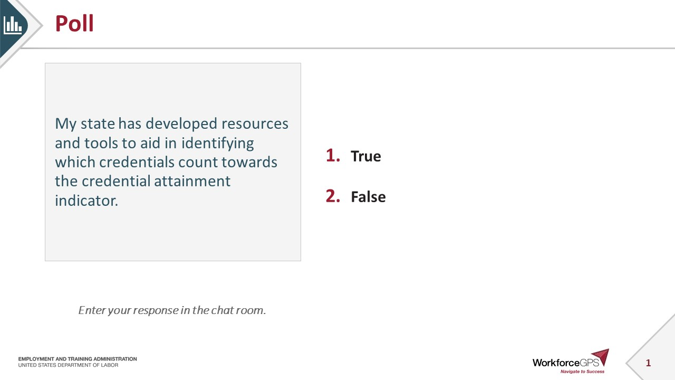
Poll
My state has developed resources and tools to aid in identifying which credentials count towards the credential attainment indicator.
True
False
  Enter your response in the chat room.

Slide 2
Credential Attainment - Introduction to New Tools

Slide 3

Today’s Moderator
Shelia F. Lewis
  Workforce Analyst
    U.S. Department of Labor, Employment and Training Administration

Slide 4


Today’s Speakers
Christina Eckenroth
  Workforce Analyst
    U. S. Department of Labor, Employment and Training Administration
Kellen Grode
  Workforce Analyst
    U. S. Department of Labor, Employment and Training Administration

Slide 5



Today’s Speakers
Gregory Scheib
  Workforce Analyst
    U.S. Department of Labor, Employment and Training Administration
Pam Frugoli
  Senior Workforce Analyst
    U.S. Department of Labor, Employment and Training Administration
Nick Moore
  Coordinator
    Alabama’s Office of Education and Workforce Transformation

Slide 6

Today’s Objectives
Background – State Cohort on Credential Attainment
Demonstration – Credential Attainment Decision Tree Tool;
How and When Grantees Might Use This Tool;
Practical Application – Credential Attainment Cohort Capstone and State Plans; and
Key Takeaways

Slide 7
Credential Attainment Decision Tree Tool

Slide 8



Background
Credential Attainment Cohort

Slide 9

Background
Credential Attainment Cohort
Purpose
Purpose
Purpose
Features
Features
Features
Location
Location
Location

Slide 10
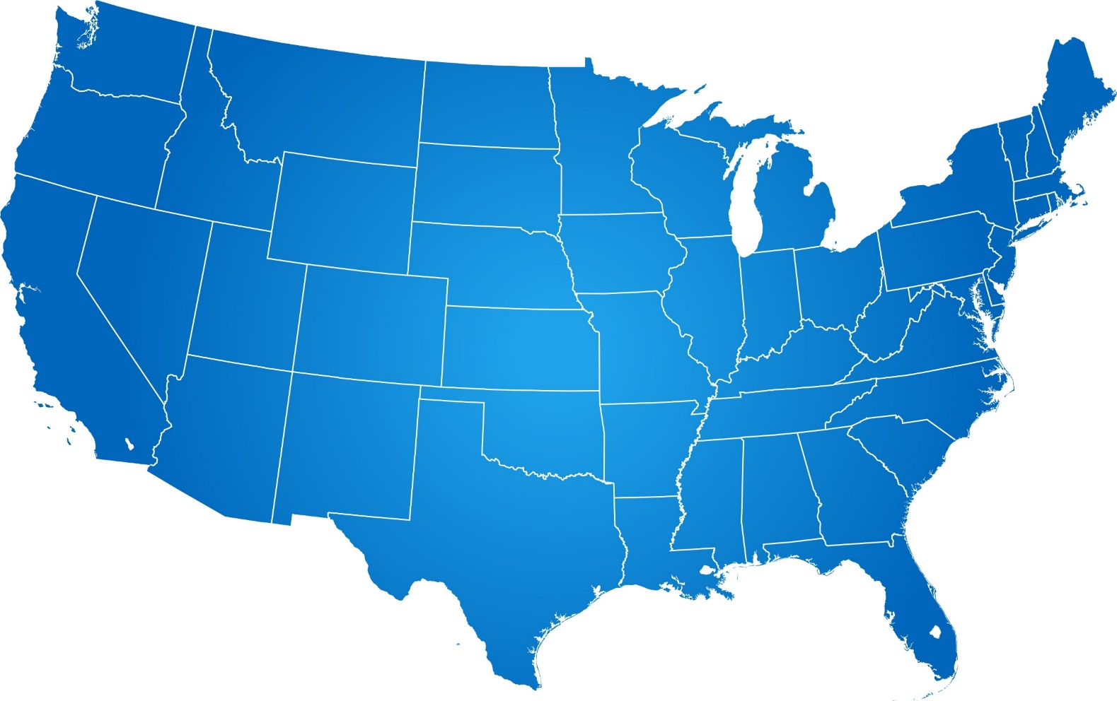
Credential Attainment Cohort States
Alabama
Massachusetts
Michigan
Minnesota
Missouri
Ohio
Pennsylvania
Utah
Vermont
9
4
2
3
7
6
8
5
1

Slide 11
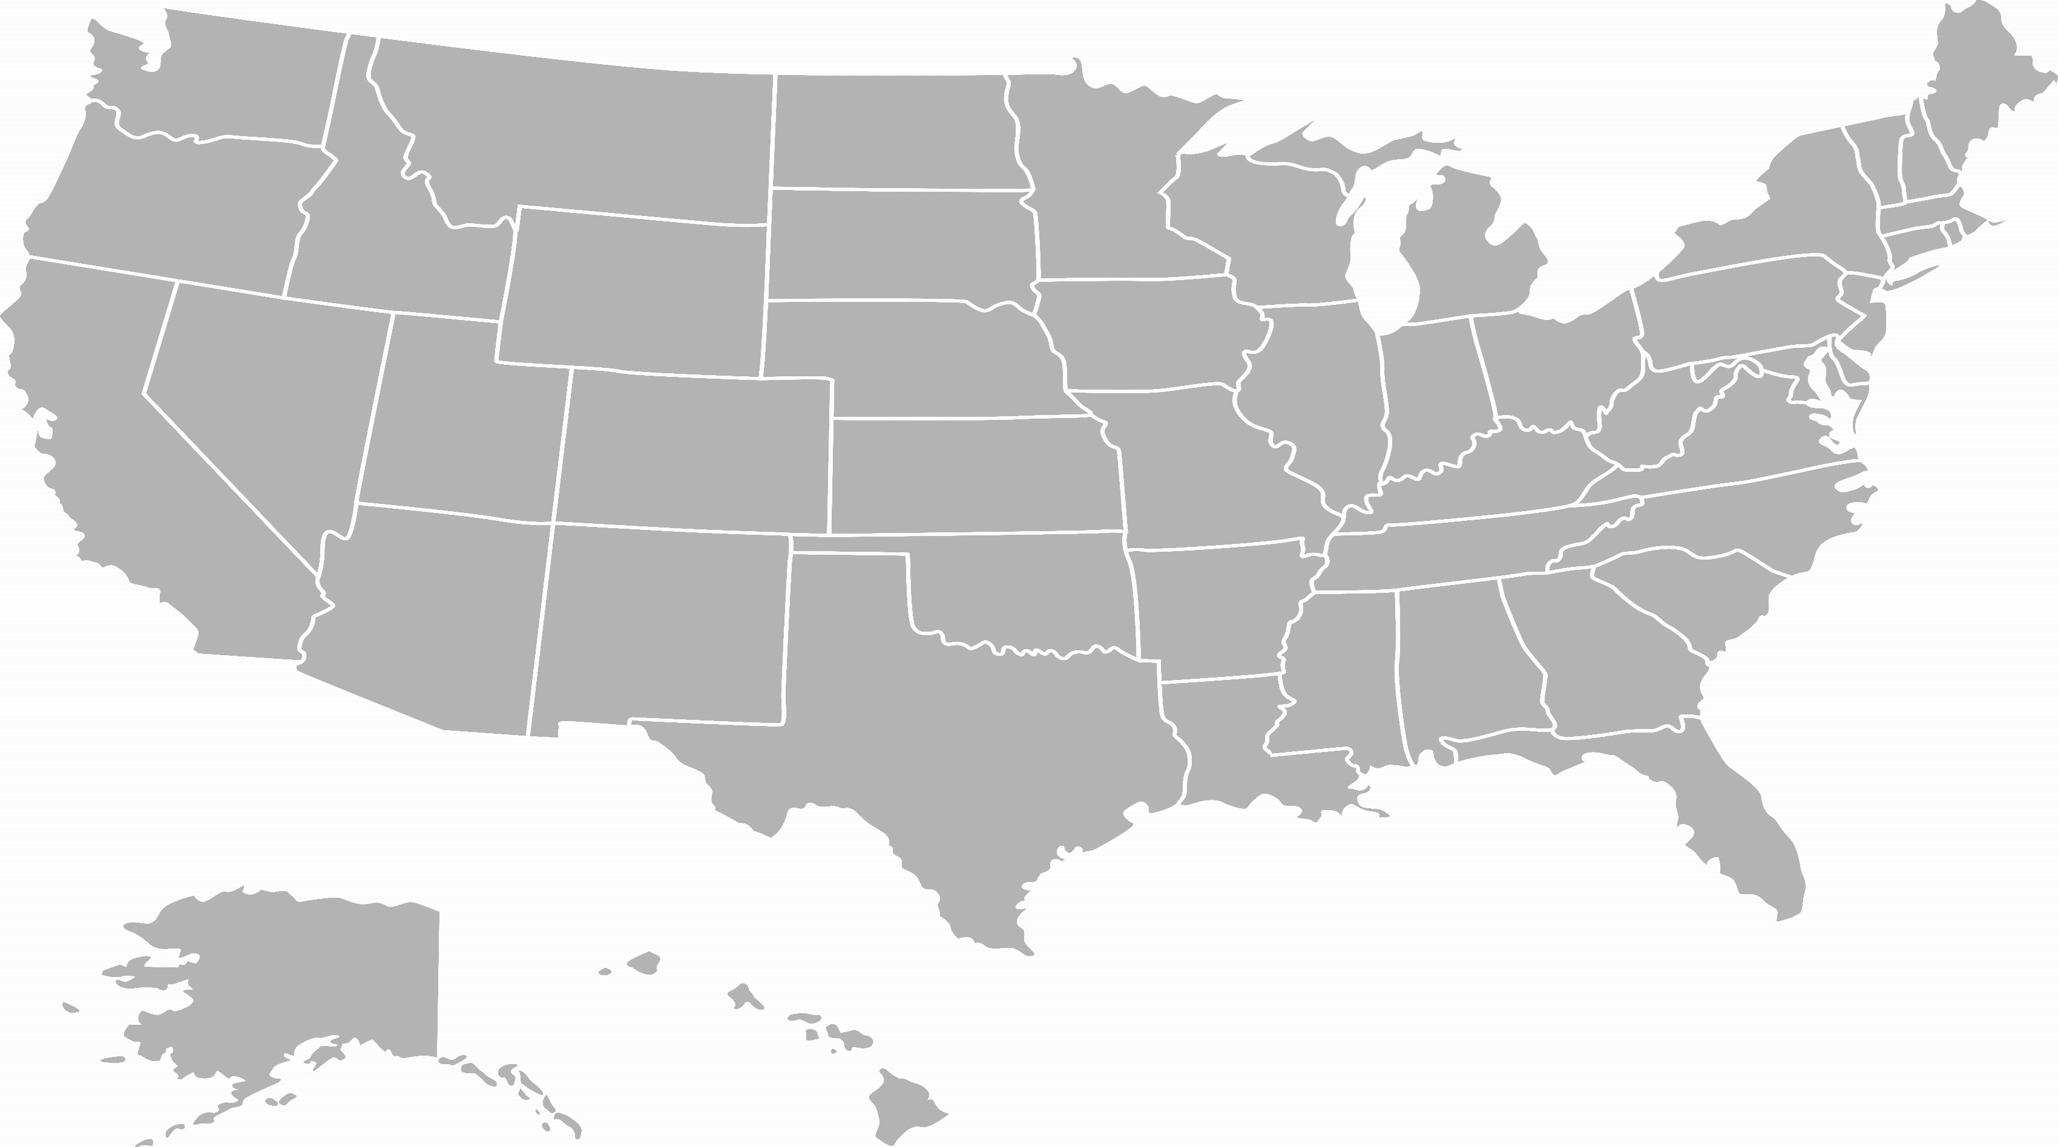
Purpose: State Specific & System-wide
State Action Plans Address State Specific Goals and Challenges
Capstone Product Provides a Tool for the System

Slide 12
Features
Collaboration with Education
Leverages Existing Technical Assistance Materials www.WINTAC.org
Title I, Title II applications
A suite of tools!
WIOA Credential Attainment Decision Tree Tool Narrative Guide
Credential Attainment Decision Tree Interactive Tool
Federal Joint Guidance
DOL Training and Employment Guidance Notice (TEN) 25-19 (published June 8, 2020)
Primarily for Title I
Title II: Integrated Education and Training (IET)
Postsecondary

Slide 13
Location – Narrative Guide, Tool, Capstone, State Action Plans
Get the basics! Be familiar with the performance indicators
Narrative Guide, Interactive Tool, Resources Link here: https://performancereporting.workforcegps.org/resources/2017/12/18/18/43/Credential-Attainment-Resource-Page
Learn more about the Cohort
Credential attainment cohort, the Capstone, and read the State Action plans here: https://performancereporting.workforcegps.org/resources/2020/06/25/13/53/Performance-Reporting-Cohorts
TEGL 10-16, Change 1
TEN 25-19
Access resources and tools
TEGL 14-18
https://wdr.doleta.gov/directives/

Slide 14
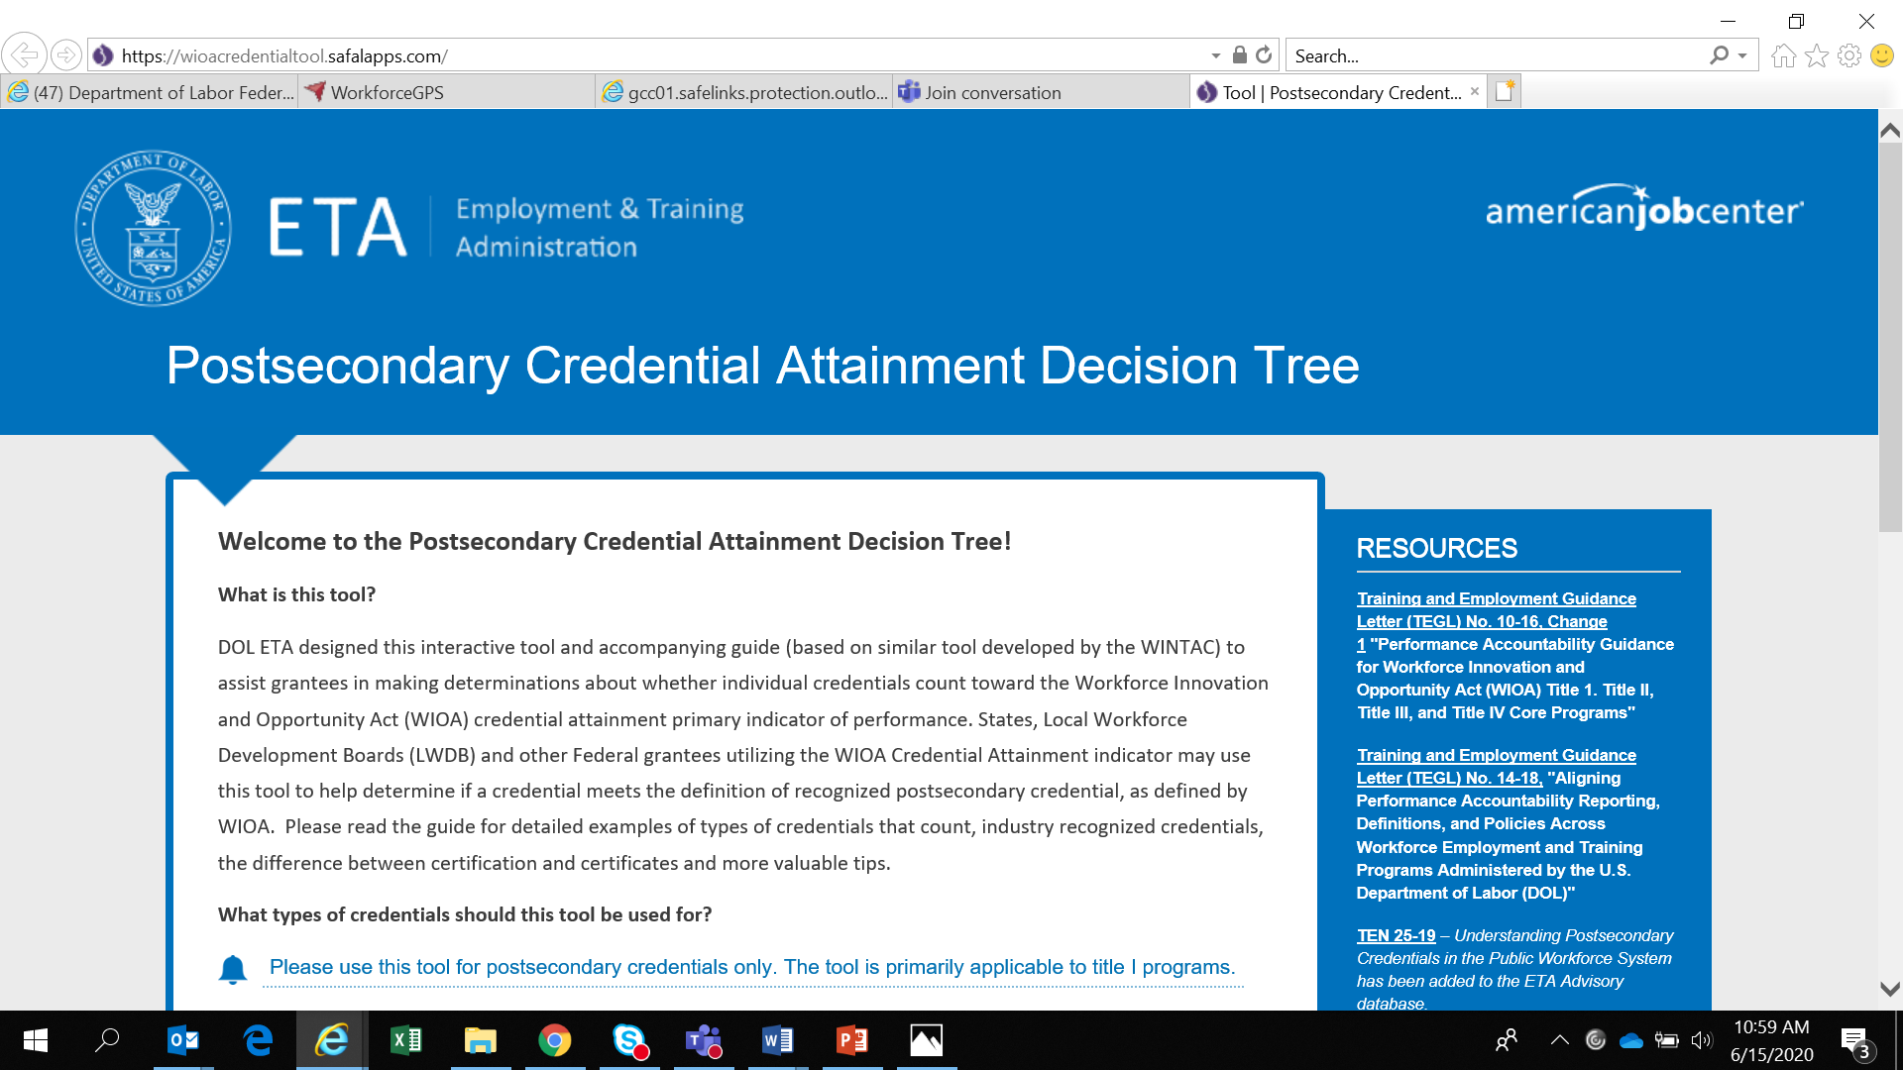
Walkthrough – Credential Attainment Decision Tree Tool
https://wioacredentialtool.safalapps.com/

Slide 15
Credential
Attainment
Cohort – A Practical Application

Slide 16

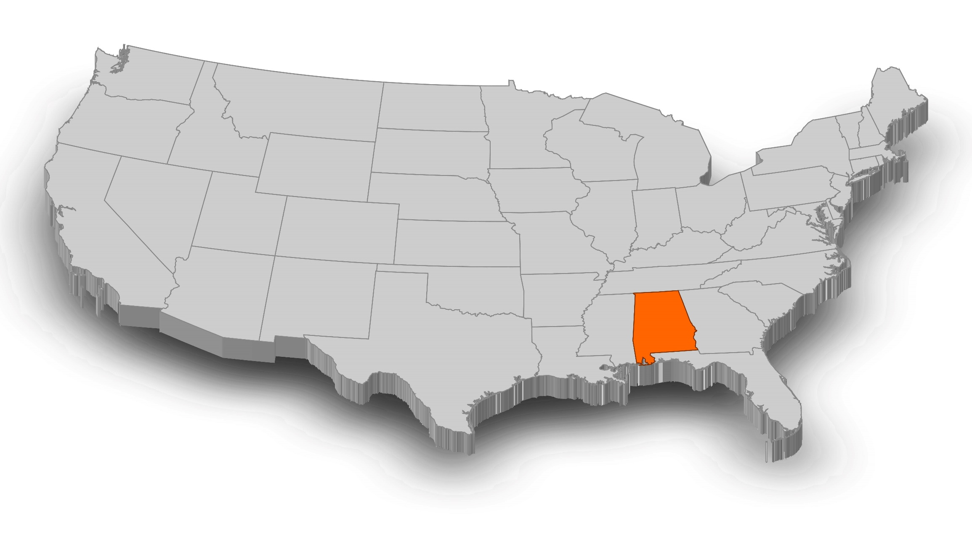
The Alabama Committee on Credentialing and Career Pathways

Slide 17

Mission One: Developing the Lists of In-Demand Occupations
The 2020 lists of in-demand occupations were approved at the December 18, 2019 ACCCP kickoff.

Slide 18
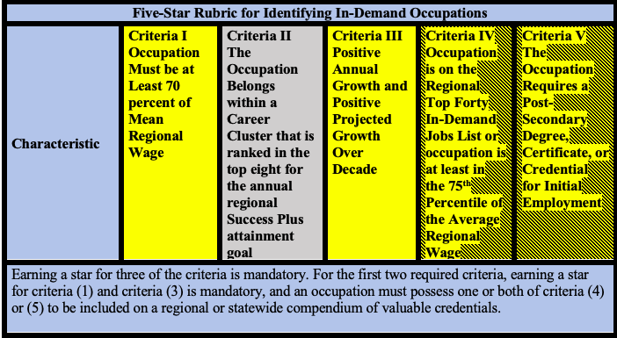
Five-Star Rubric for Identifying In-Demand Occupations

Slide 19

Mission Two: Survey of Employer Competencies, Competency Models, and Career Pathways
Between May 18 and May 27, 2020, the TACs should meet virtually to discuss the survey and to develop any recommended changes. Survey amendment requests are due on May 27, 2020 at 5pm.
The Survey of Employer Competencies will be conducted statewide between June 15 and June 26, 2020.
The TACs will receive the survey results before June 29, 2020.

Slide 20
Developing the Compendium of Valuable Credentials
1 July 2020 and 31 Aug. 2020
Each TAC will accept credential applications for review between July 1, 2020 and August 31, 2020.
31 Aug. 2020
Each TAC will compile its recommended lists of regional and statewide compendia of valuable credentials and submit it to the ACCCP by August 31, 2020.
16 Sep. 2020
The ACCCP will approve each TAC’s compendia of valuable credentials by September 16, 2020.
16 Sep. 2020
The first final regional and statewide compendia of valuable credentials will become effective on September 16, 2020.

Slide 21
Credential Checklist

Slide 22
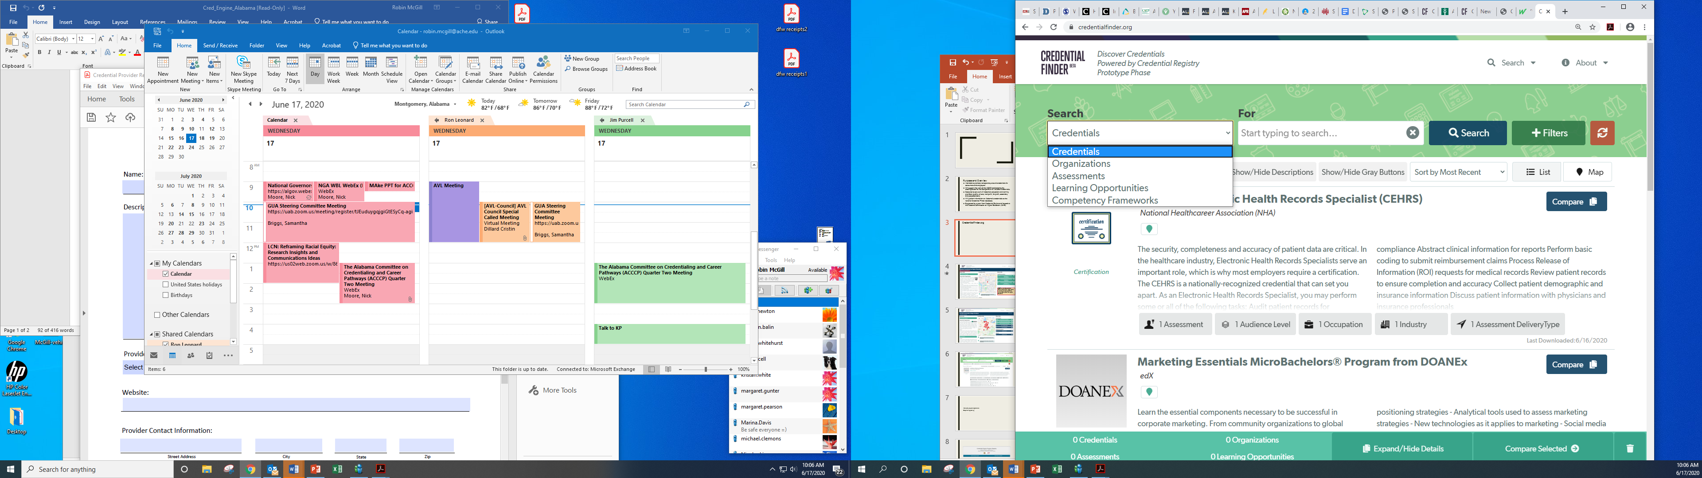

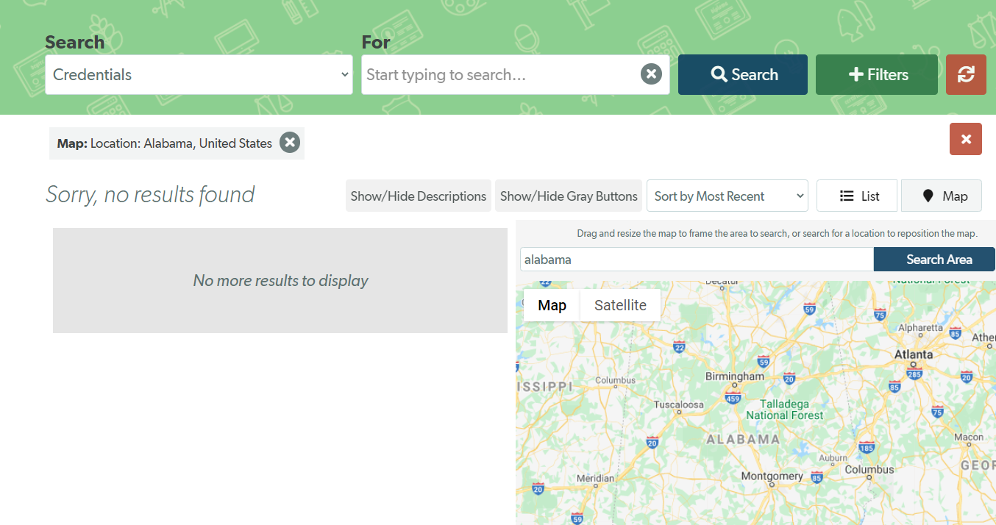
Currently, Alabama does not have any credentials in the CredentialFinder.org registry.

Slide 23
Knowledge Check
The Credential Attainment Decision Tree Tool will definitively tell you whether or not a credential counts towards the credential attainment indicator?
True
False
Enter your answer in the chat room.

Slide 24


Recap

Slide 25
Credential Attainment Toolkit
Toolkit
Guidance (TEGLs, TENS)
Credential Attainment Resource Page
State Action Plans
Peer Resources
Decision Tree Tool
Cohort Capstone
E-Learning Module
Other Resources (e.g., Credential Engine)

Slide 26

Conclusion
Begin with Guidance (TEGL 10-16, change 1, TEGL 14-18, TEN 25-19)
No Master Credential List!
Use Your Entire Tool Kit
No One tool is the End-all
State-Specific
Consider a State Action Plan
Be Consistent Within Your State
Work-Readiness and Work Safety certificates - Do NOT Count

Slide 27
Any Questions?
Please type your questions in the chat room.

Slide 28
Resources:
Credential Attainment Resource Page
  Serves as a landing page for technical assistance related directly to credentials and credential attainment indicator.
    https://performancereporting.workforcegps.org/resources/2017/12/18/18/43/Credential-Attainment-Resource-PageName of Reference Item
State Cohort on Credential Attainment
  Serves as a landing page for the State Cohort on Credential Attainment, which is a collaboration between ETA, OCTAE, and RSA, comprised of nine state teams of cross-agency participants who joined forces in the development of solutions to specific issues related to the WIOA credential attainment indicator.
    https://performancereporting.workforcegps.org/resources/2020/06/25/13/53/Performance-Reporting-Cohortswww.resource-link-here.com

Slide 29
New/Coming Attractions:
e-Learning Module: WIOA Performance Accountability Cycle
  This e-Learning module walks through the basic elements of the negotiations process and is intended for state and local workforce boards, administrators, and policy and operations staff.
  https://performancereporting.workforcegps.org/resources/2020/06/16/13/50/WIOA-Performance-Accountability-Cycle-e-Learning-Module
    Released June 16, 2020
Release of PIRL Reporting Online Resource 3.0
  ETA designed the PIRL Reporting Online Resource to support grantees in successfully understanding, preparing, and submitting the DOL-only PIRL. This latest release includes the following new topics: common PIRL data elements; program-specific PIRL data elements; uploading performance reports through the Workforce Integrated Performance System (WIPS); WIPS edit checks; and a full set of resource links. This new release also includes a video walking through the process of uploading performance reports with WIPS!
    Released June 12, 2020

Slide 30
New/Coming Attractions:
Webinar: TEN 25-19 Understanding Post Secondary Credentials in the Public Workforce System (published June 8, 2020)
  This event will highlight the information published in the newly released TEN on credential attainment intended to assist the public workforce system in better understanding the key elements of credentials and identifying credentials that help individuals acquire and leverage the skills needed for quality in-demand jobs that meet the needs of the business community.
  https://wdr.doleta.gov/directives/corr_doc.cfm?DOCN=5953
    Event Date – TBD
TEGL 23-19: Guidance for Validating Required Performance Data Submitted by Grant Recipients of DOL Workforce Programs (published June 18, 2020)
  This guidance provides guidelines to DOL grant recipients to use in developing procedures for ensuring the data submitted for performance reporting are valid and reliable.
  https://wdr.doleta.gov/directives/corr_doc.cfm?docn=9155
    Event Date – July 29, 2020, 1:00 – 2:00 PM ET

Slide 31
Contact Us
      Email – ETAPerforms@DOL.Gov

Slide 32

Need help? Email: Support@workforceGPS.org

