Slide 1
U.S. Department of Labor
Employment and Training Administration
Northeast States Peer Meeting – June 25, 2020
“A Presentation on Mental Health Strategies”
by
Dr. Unique Morris-Hughes, Director
District of Columbia Department of Employment Services

Slide 2
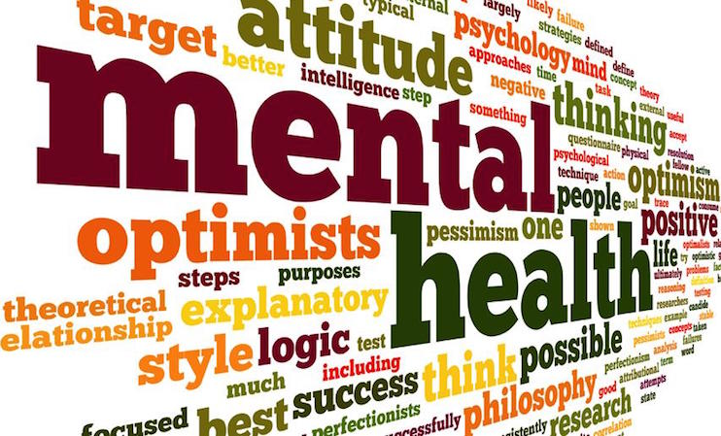

Slide 3
MENTAL HEALTH vs MENTAL ILLNESS
Mental health and mental illness are increasingly used interchangeably as if they mean the same thing, but they are not.
Mental health is the foundation for emotions, thinking, communication, learning and self-esteem. Mental health is also key to relationships (personal and professional) and emotional well-being.
The Mayo Clinic defines mental illness, also referred to mental health disorders, as a wide range of mental health conditions – disorders that affect your mood, thinking and behavior.

Slide 4
MENTAL HEALTH BY THE NUMBERS
According to the Centers for Disease Control and Prevention (CDC), mental health disorders are among the most burdensome health concerns in the United States. Nearly 1 in 5 U.S. adults aged 18 or older (44.7 million people) reported some form of mental illness in 2016. In addition, 71% of adults reported at least one symptom of stress, such as a headache or feeling overwhelmed or anxious.

Slide 5
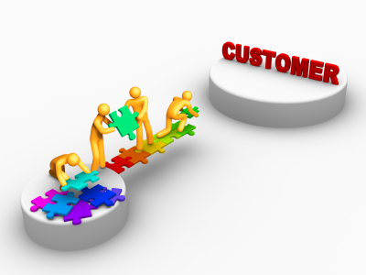
CONNECTING OUR CUSTOMERS
The District and our American Job Centers (AJCs) have established partnerships and co-locating agreements with several key mental health service partners including:
The Department of Behavioral Health (DBH)
The Department of Disability Services (DDS)
The Department of Health (DOH)
The Department of Human Services (DHS)
Through these partnerships, we are able to offer both onsite and referral services to agencies ensuring resources are coordinated and to avoid duplication of effort and expenditures.

Slide 6
CONNECTNG OUR CUSTOMERS
The District has developed a universal referral process which includes a commitment of all AJC partners to implement processes for the referral of customers to services provided on-site at the AJCs and at other locations.
The referral process between the AJCs and partners include:
• Ensuring that intake and referral processes are customer-centered and provided by staff trained in customer service.
• Describing how customer referrals are made electronically, through traditional correspondence, verbally, or through other means determined in cooperation with partners and operators.
• Detailing how each AJC partner will provide a direct link or access to other AJC partner staff who can provide meaningful information or service, through the use of co-location, cross training of AJC staff, or real-time technology (two-way communication and interaction with AJC partners that results in services needed by the customer).

Slide 7
CONNECTING OUR CUSTOMERS
Through our referral process and with the use of WIOA supportive services funding, DOES works with the Department of Behavioral Health (DBH) to ensure that all customers in need have access to high quality mental health services.
Our partnership with DBH allows DOES to utilize this certified provider list, connecting our customers to services including:
Diagnostic Assessment
Medication
Counseling and Community Support
Quality Substance Abuse Prevention

Slide 8
CONNECTING OUR CUSTOMERS
Through our Division of State Initiatives (DSI) reentry and job training ecosystem we offer intensive mental health services to customers to ensure they are able to effectively re-enter the workforce.
DSI serves nearly 1,200 residents annually. Those seeking services present with a multitude of challenges including: previous incarceration, short/long term mental health instability, substance abuse, housing insecurity, familial dysfunction, domestic violence experiences, educational deficiencies, and other barriers impacting their lives on a day-to-day basis.

Slide 9
CONNECTING OUR CUSTOMERS
Through our partnership with the Department of Behavioral Health (DBH), DSI participants have on-site access to a qualified practitioner (Licensed Independent Clinical Social Worker or Licensed Professional Counselor) who is able to counsel participants and resolve routine and non-routine issues.
Services include:
Comprehensive behavioral health assessments using Patient Health Questionnaire—PHQ-9, Generalized Anxiety Disorder Scale—GAD 7, CAGE and CAGE-AID, Domestic Violence Screener
Participant counseling sessions—individual
Assessment of participants presenting with behavioral health crises to determine follow up action required-- including de-escalation, assessing suicidality, and the need for mobile crisis intervention
Referrals to existing DBH service providers for follow up assistance
Establishing new referrals to DBH providers for those not already connected
DSI staff training on assisting participants with mental health challenges

Slide 10
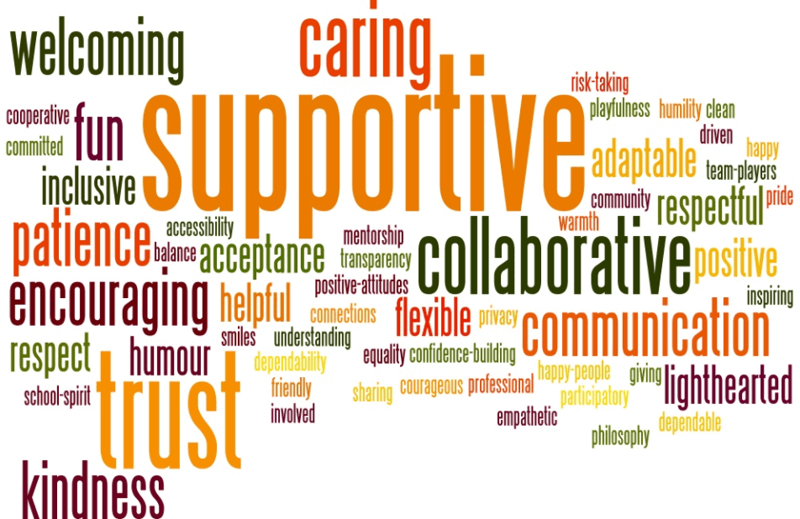
“Improving the health and well-being of our employees…offers a ”win-win” all around. Employees benefit from better support for their health. Companies benefit from less absence and improved productivity. And society benefits from improved public health.” –Steve Flanagan, Chief Executive, The Fremantle Trust

