Slide 1
Poll Question
We have some data validation strategies in place
Yes, we have efforts in place
Somewhat, we have a few in place
Not yet, we are working on it
Insert your response in the chat room.

Slide 2
Overview: Validating Required Performance Data Submitted by DOL Grantees

Slide 3
Today’s Moderator
Cesar Villanueva
Workforce Analyst
U. S. Department of Labor
Employment and Training Administration

Slide 4
Today’s Speakers
Toquir Ahmed
Workforce Analyst
U. S. Department of Labor
Employment and Training Administration
Christina Eckenroth
Workforce Analyst
U. S. Department of Labor
Employment and Training Administration
Robert Hoekstra
Program Analyst
U. S. Department of Labor
Employment and Training Administration

Slide 5
Today’s Objectives
Overview
Key Points
Questions

Slide 6
Data Validation Guidance
DOL-Specific Guidance

Slide 7
Overview – Data Validation Guidance/DOL-Specific Guidance
WIOA section 116(d)(5)
TEGL 7-18
ETA
OCTAE
RSA
TEGL 23-19
DOL-Specific Guidance
DOL Grantees Only

Slide 8
Key Points

Slide 9
Key Points - General Info
Based on TEGL 7-18: Guidance for Validating Jointly Required Performance Data Submitted under the Workforce Innovation and Opportunity Act (WIOA) (December 19, 2018)
Addresses specifics for title I, III, and DOL programs
Encouraged for many programs

Slide 10
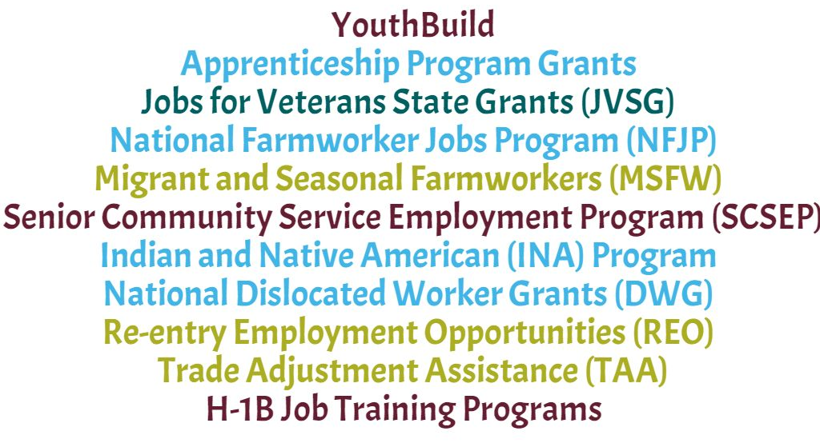
Key Points - Programs

Slide 11
Key Points - Purpose of Data Validation
To verify that the performance data reported by States to the Departments are valid, accurate, reliable, and comparable across programs.
To identify anomalies in the data and resolve issues that may cause inaccurate reporting.
To outline source documentation required for common data elements.
To improve program performance accountability through the results of data validation efforts.

Slide 12
Key Points – DV Procedure Requirements: Core & TAA
Written procedures
Monitoring protocols, consistent with 2 CFR 200.328
Documentation
Regular assessments of the effectiveness of the data validation process

Slide 13
Key Points – Program-Specific Instructions
Attachment I: Program Specific Instructions
Attachment II: Source Documentation for WIOA Core/Non-Core Programs
Attachment III: References
_
_
Where do I find my program instructions?
_

Slide 14
Attachment I: Program Specific Instructions

Slide 15
Key Points – Attachment II: Source Documentation

Slide 16
Source Documentation Example Employed in the 1st Quarter after Exit
R^{DEV} = Required for Data Element Validation

Slide 17
Source Documentation Example Employed in the 1st Quarter after Exit
The grant recipient may choose any of the source documents listed, as appropriate.

Slide 18
Source Documentation Example Employed in the 1st Quarter after Exit
Program specific parameters may apply in some cases.

Slide 19
Key Points – Reporting Requirements
WIOA Core Programs
Annual Report Narrative
Program Specific

Slide 20
Key Points - Monitoring
Federal reviews may include:
Data validation policies/processes/procedures;
Verifying staff are being trained, and if any corrective action is needed or implemented;
Reviewing files and source documentation;
Reviewing data validation results;
Analyzing data integrity reports generated by DOL
Reviews may result in findings or requirements for corrective action

Slide 21
Attachment III: References
TEGL 10-16, Change 1: Performance Accountability Guidance for Workforce Innovation and Opportunity Act (WIOA) Title I, Title II, Title III, and Title IV Core Programs (August 23, 2017)
TEGL 14-18: Aligning Performance Accountability Reporting, Definitions, and Policies Across Workforce Employment and Training Programs Administered by the U.S. Department of Labor (DOL) (March 25, 2019)
TEGL 7-18: Guidance for Validating Jointly Required Performance Data Submitted under the Workforce Innovation and Opportunity Act (WIOA) (December 19, 2018)

Slide 22
Save the Date:
Webinar – Data Integrity Technical Assistance Tool: Quarterly Report Analysis for WIOA Titles I and III
Learn about the Employment and Training Administration’s Quarterly Report Analysis tool for WIOA Titles I and III to support state level data validation processes.
Tuesday, August 18, 2020, 1:00 PM – 2:00 PM ET

Slide 23
Any Questions?
Please type your question in the chat room, or press *6 to unmute your phone line.

Slide 24
Contact Us
ETAPerforms@dol.gov

Slide 25
Thank You!
Need help? Email: Support@workforceGPS.org
_

