Slide 1
Where Are You?
Please enter your location in the chat window
(lower left of screen)
Please tell us where you’re listening in from! Also, are any of you in “virtual groups” listening in together?

Slide 2
WIOA YOUTH LISTENING SESSION
Youth Voice: How Workforce Development Programming Best Supports Me!

Slide 3
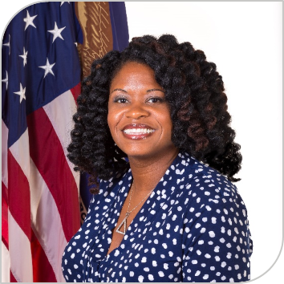
Today’s Moderator
Maisha Meminger
Manpower Analyst
Division of Youth Services
Employment & Training Administration
U.S. Department of Labor

Slide 4
Today’s Speakers (Panel 1)
Analis Nitta
Hawaii
Hector Ruiz
Texas
Laycie Gwynn
South Carolina
Allen Holmes (AJ)
Minnesota
Tyreke Mitchell
Rhode Island

Slide 5
Today’s Speakers (Panel 2)
Abigail Gauna
Colorado
Ryan McCrary
Delaware
Tyson Ristau
Washington
Gloria Stanford
Ohio

Slide 6
Today’s Objectives
Provide youth an opportunity to discuss their experiences in DOL-funded youth programs.
Identify any technical assistance needs that would benefit staff in providing successful employment and training opportunities.
Experiences of youth currently engaged in or have successfully completed a program
How programs are making an impact in the lives of the youth

Slide 7
Introduction
What are we learning from Youth?

Slide 8
Youth Listening Session
PANEL 1
QUESTIONS

Slide 9
Youth Listening Session
Panel 1 Questions
Tell us who you are, where you’re from, and describe yourself in five words or less?

Slide 10
Youth Listening Session
Panel 1 Questions
How did you learn about and become involved with your local WIOA youth program?
How long have you been in the program?
If you’re still in the program, if you’ve completed/graduated from the program?

Slide 11
Youth Listening Session
Panel 1 Questions
Can you tell us about your overall experience in the program? What do you like the most about the program?

Slide 12
Youth Listening Session
Panel 1 Questions
What is different now during COVID? How has programming changed? Are there changes that were made due to COVID that you would suggest keeping in place permanently?

Slide 13
Youth Listening Session
Panel 1 Questions
If you were the director of a youth program like the one you’re engaged/or were engaged in, what would be the most important things you want to do and why?

Slide 14
Youth Listening Session
Panel 1 Questions
Is there anything else you would like to share with us….

Slide 15
Youth Listening Session
PANEL 2
QUESTIONS

Slide 16
Youth Listening Session
Panel 2 Questions
Tell us who you are, where you’re from, and describe yourself in five words or less?

Slide 17
Youth Listening Session
Panel 2 Questions
How did you learn about and become involved with your local WIOA youth program?
How long have you been in the program?
If you’re still in the program, if you’ve completed/graduated from the program?

Slide 18
Youth Listening Session
Panel 2 Questions
Can you tell us about your overall experience in the program? What do you like the most about the program?

Slide 19
Youth Listening Session
Panel 2 Questions
What are your ideas about how programs can engage young adults in decisions around programming and services?

Slide 20
Youth Listening Session
Panel 2 Questions
What have you learned while in the program that you found to be most useful to you now and in the future?

Slide 21
Youth Listening Session
Panel 2 Questions
Is there anything else you would like to share with us….

Slide 22
Contact Us
Employment and Training Administration’s
Division of Youth Services
youth.services@dol.gov
Become a member of Youth Connections Community
youth.workforcegps.org
_
_

Slide 23
Thank You!
Thank you for all the work you do on behalf of our nation’s most vulnerable youth!
Need help? Email: Support@workforceGPS.org
_

