Slide 1
Where Are You?
Please enter your location in the chat window
(lower left of screen)

Slide 2
Building Partnerships with State Monitor Advocates to Increase Access to Care for Ag Worker Families

Slide 3
Today’s Moderator
Timmy Dudley
Workforce Analyst
U.S. Department of Labor, Employment and Training Administration

Slide 4
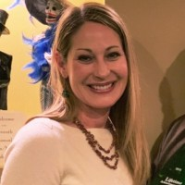
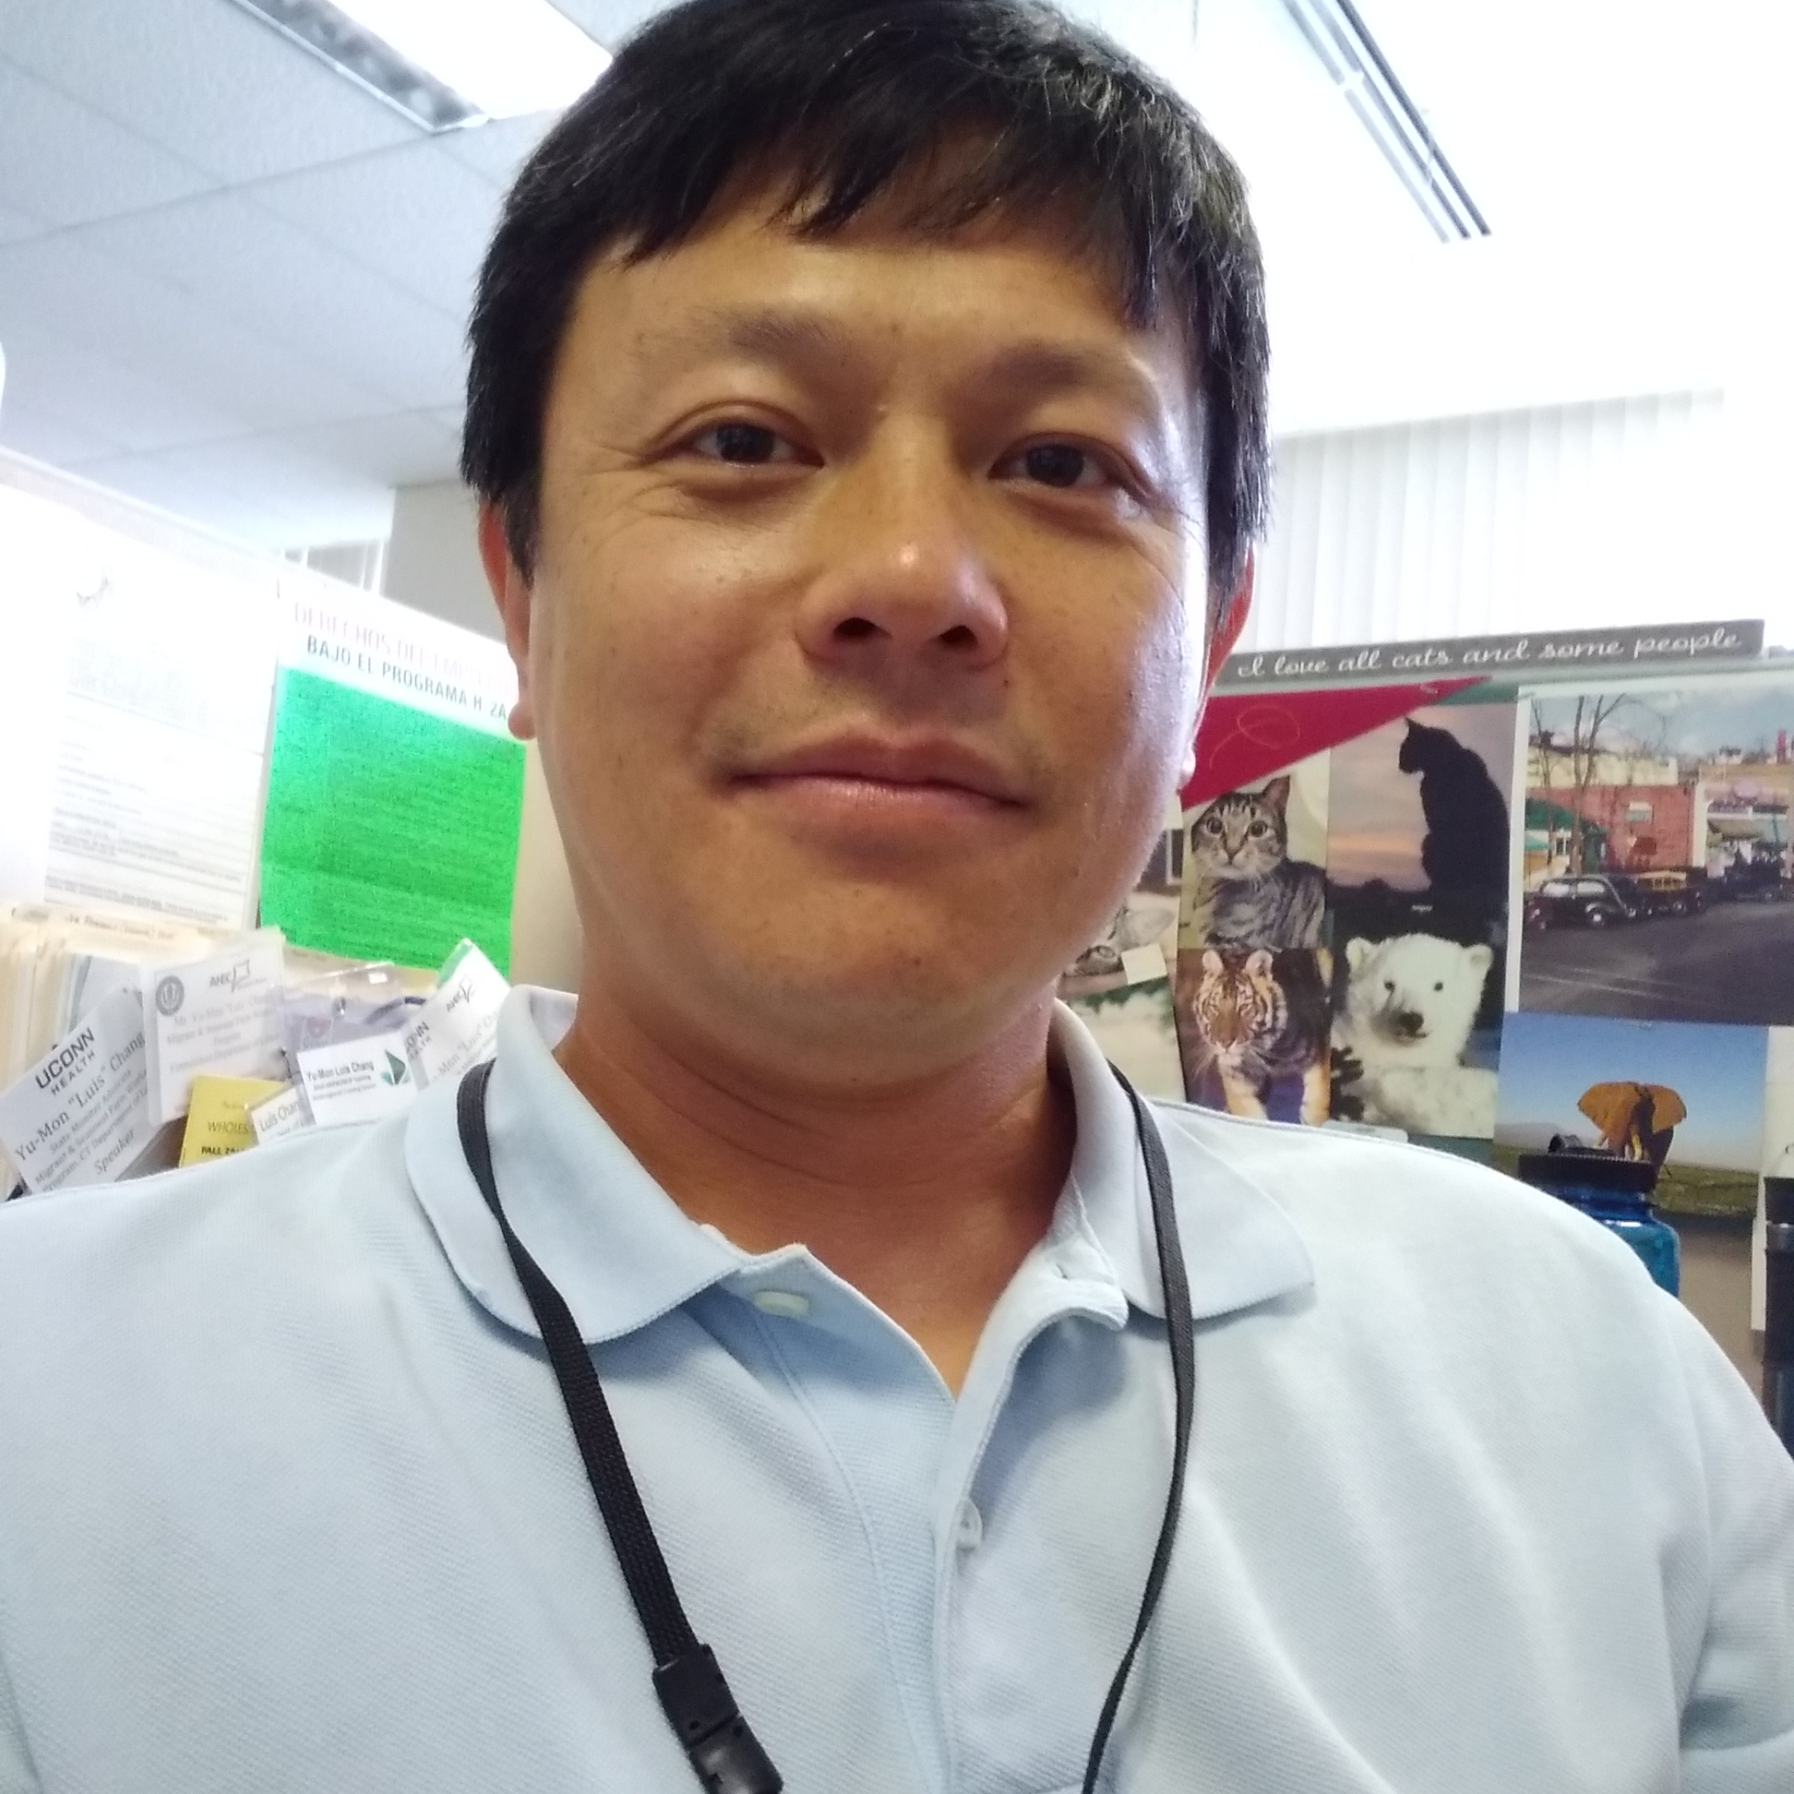
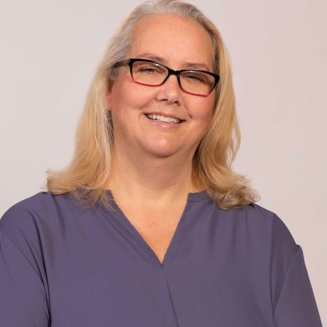
Today’s Speakers
Amy Shepherd, MPH
Director Connecticut River Valley Farmworker Health Program
Massachusetts League of Community Health Centers
Mary Ellen McIntyre
Senior Vice President,
Compliance & Special Populations
Massachusetts League of Community Health Centers
Yu-Mon Luis Chang
State Monitor Advocate
Connecticut Department of Labor
Kasey Harding ​
Director of the Center for Key Populations ​
Community Health Center, Inc.

Slide 5
Today’s Objectives
Participants will learn about :
Successful partnerships between health centers and their State Monitor Advocates and how their relationships were established, evolved, and achieved success in increasing access to quality healthcare for MSAWs in Connecticut and Massachusetts
Enhancing and increasing access to healthcare for farmworkers through collaboration with partners, including the case study of COVID-19 outbreak
Accessing tools/resources available through Ag Worker Access Campaign

Slide 6
Journey of a State Monitor Advocate

Slide 7
Journey of the Connecticut State Monitor Advocate
As a State Monitor Advocate, I am committed to understanding the needs of farmworkers.
Identify what type of support and services are needed
Reach out to others by cold calling/emailing/meeting/networking other agencies and stakeholders
Communicate with community partners to clarify roles and what services are available
Available Partner | Initial Contact
UConn Farmworker Clinics and the Connecticut River Valley Farmworker Health Program. (CRVFHP) | CRVFHP Director provides on-site visit to UConn Farmworker Clinic at farm.

Slide 8
Polling Question
Which type of services can an State Monitor Advocate offer? (hint it can be more than one)
Providing information to workers regarding labor laws.
Assisting a worker in making a medical appointment and arranging transportation.
Advising a worker on healthcare or medical condition.

Slide 9
Any Questions?

Slide 10
Migrant Voucher Program

Slide 11
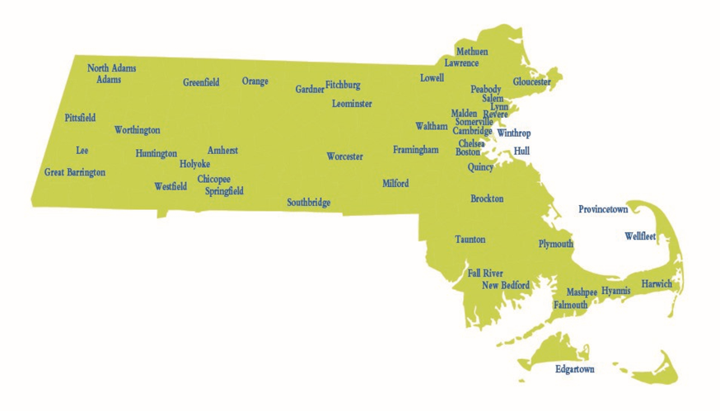
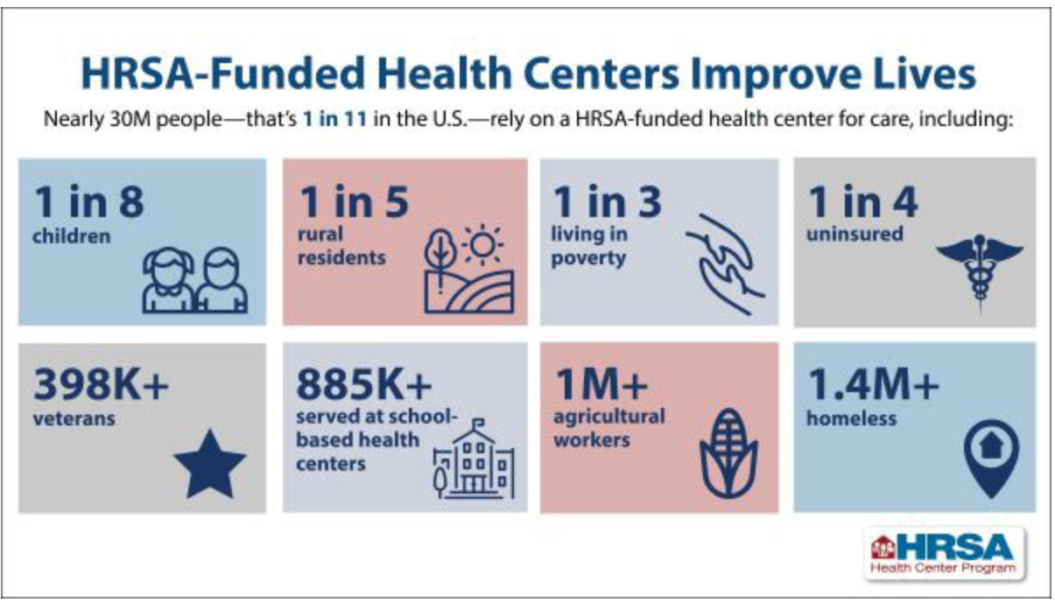
Massachusetts League of Community Health Centers
Primary Care Association for Massachusetts (PCAs & health centers in every state)
Founded in 1972 to support and represent health centers:
Information and Advocacy
Training and Education / Technical Assistance
Workforce Development
Site and Service Development
Clinical Quality Initiatives
Emergency Preparedness
Health IT Development
Connecticut River Valley Farmworker Health Program
Membership is a mix of Federally Qualified Health Centers (aka Section 330 e, g, h, i) & Hospital-Licensed Health Centers
52 Community Health Center organizations, including the CRVFHP
300+ sites reflect medical, dental, behavioral health, school-based and social services; provide patient-centered, culturally competent, high quality care
1,046,000 total patients (MA population: 6.7 million) = 1 in 7 residents
5.0 million total patient visits

Slide 12
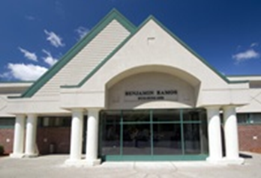
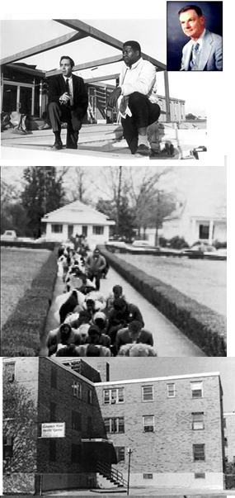
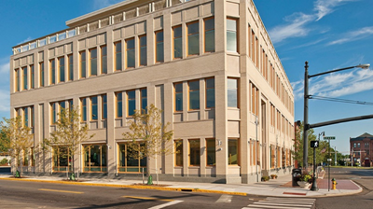
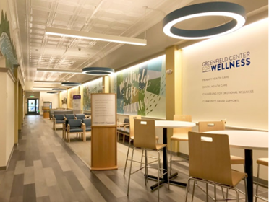
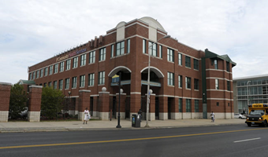
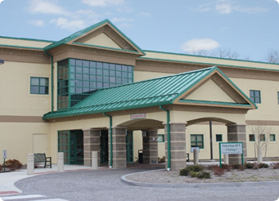
Massachusetts League of Community Health Centers
Brief History of Health Centers...
H. Jack Geiger and Count Gibson
Apartheid South Africa (mid-1940s)
US Civil Rights Movement / Freedom Summer (1950s-1960s)
War on Poverty (1960s)
“Demonstration funding” through federal Office of Economic Opportunity (not HEW)
Urban site: Dorchester, MA established in 1965
Rural site: Mound Bayou, MS established in 1966
“The poor get sicker and the sick get poorer” – H.J.G.
Neighborhood store-front clinics
Available to all (no “Barriers to Access”)
“Health Care is a Right”
https://www.jacobinmag.com/2017/05/good-doctors-out-in-the-rural-review-freedom-summer
Migrant Health Act - Signed into law in 1962 by President John F. Kennedy; established the authorization for delivery of primary and supplemental health services to migrant farmworkers.

Slide 13
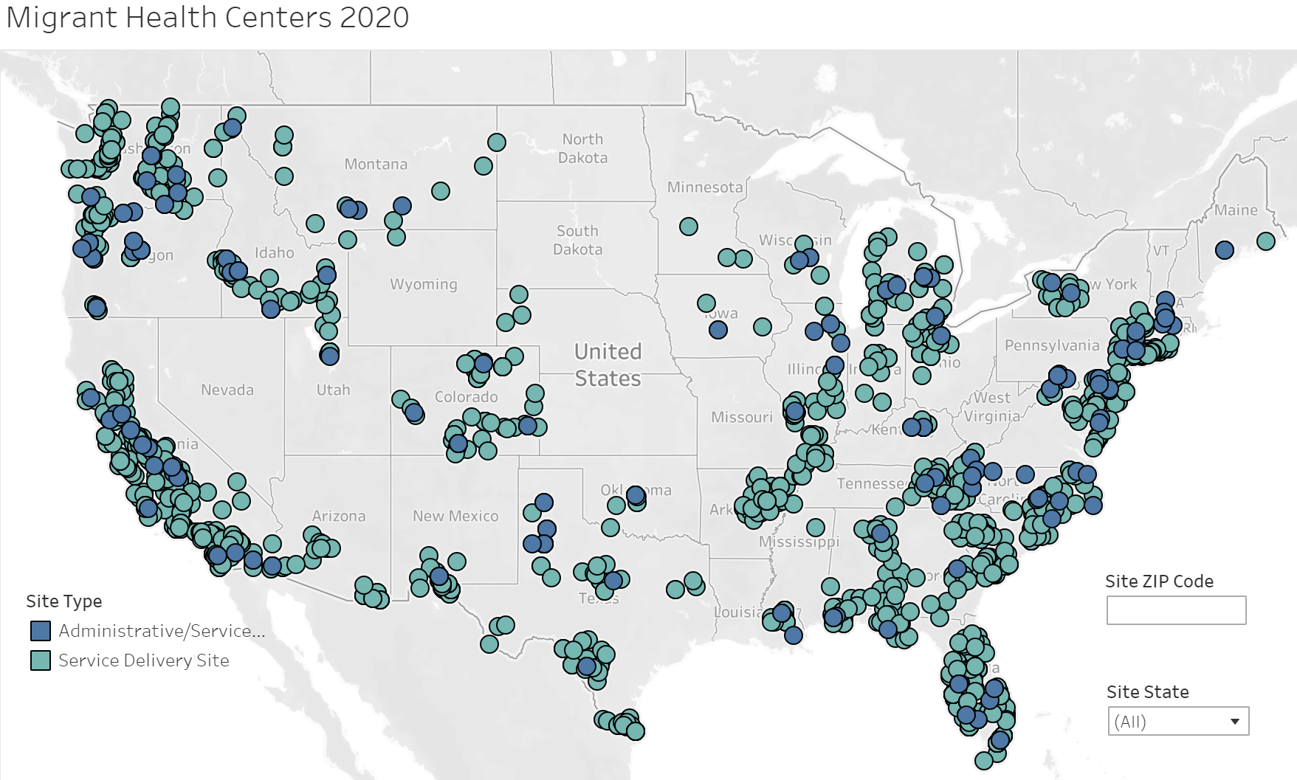
Migrant Health Centers

Slide 14
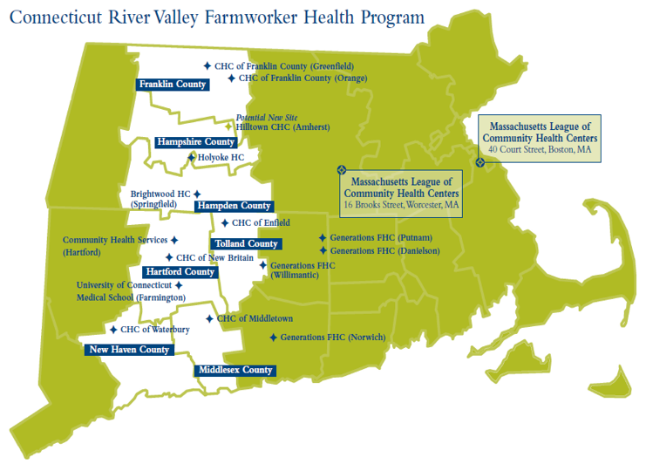
Connecticut River Valley Farmworker Health Program
Our Mission: To improve access to quality community-based primary care and other health-related services for the migratory and seasonal agricultural worker populations in the Connecticut River Valley.

Slide 15
CRVFHP & Partners
Established in 1997
Federally-funded, two-state 330g Migrant Voucher Program operating out of the Massachusetts League of Community Health Centers ("The League"), which is a primary care association
Funded by U.S. DH&HS / HRSA / Bureau of Primary Health Care
Private Donation Fund
Contracted service model with Community Health Centers (“Partner Agencies”) in Massachusetts & Connecticut
Primary care services
Enabling /outreach services
Collaborative relationship with UConn Medical School
Advisory Council *
* Governance Requirement

Slide 16
CRVFHP & Partners
Advisory Council - Special Committee of the League's (CRVFHP) Board of Directors; compliance requirement
Purpose is to advise the League on CRVFHP programmatic activities and directions; ensure that the CRVFHP reaches eligible agricultural workers effectively, delivers culturally appropriate and high-quality health care services to them, and contributes to the improved health of the agricultural worker populations in the CRV
Comprised of representatives of agencies providing legal, housing, educational or other non-health care services to agricultural workers, grower representatives / employers and representatives of the CT and MA Departments of Public Health; includes State Monitor Advocates as essential contributors
Meets quarterly

Slide 17
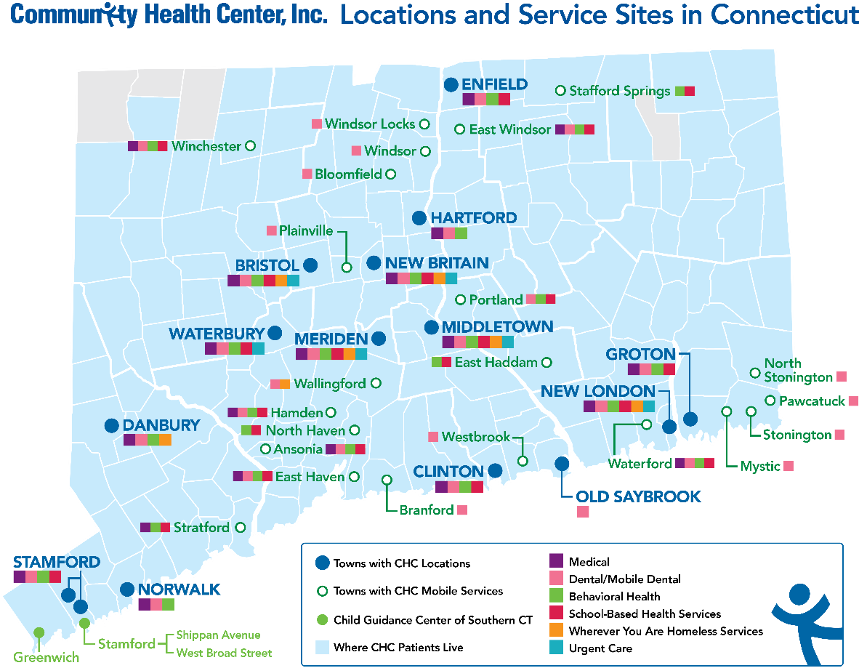
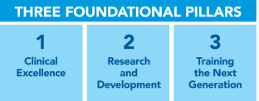
Federally Qualified Health Centers (FQHCs)
Nation’s largest safety net setting
Located in designated high need communities
Caring for 24 million patients annually
93% served are below 200% poverty and 35% uninsured
CHC Profile
Founding year: 1972
Primary care hubs: 14; 204 sites
Staff: 1,000
Patients/year: 100,000
Specialties: onsite psychiatry, podiatry, chiropractic
Specialty access by e-Consult to 15 specialists
Elements of Model
Fully Integrated teams and data
Integration of key populations into primary care
Data driven performance
“Wherever You Are” approach
Weitzman Institute
QI experts; national coaches
Project ECHO®— special populations
Formal research and R&D
Clinical workforce development
2019

Slide 18
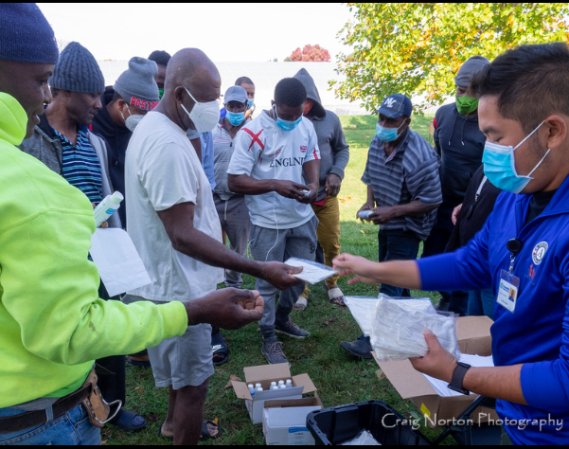
Community Health Center, Inc.
Connecticut River Valley
Farm Worker Health Program
Our CHC Team
Joelle Isidor – Outreach/Engagement
Marisol Velez – Outreach/Engagement
Jeannie McIntosh, APRN – Provider
Marlene Edelstein, APRN – Provider
Alicia Petit – Irizarry, LPN – Nurse
Bernie Delgado, RN – Nurse Supervisor
Doug Janssen – Logistics Coordinator

Slide 19
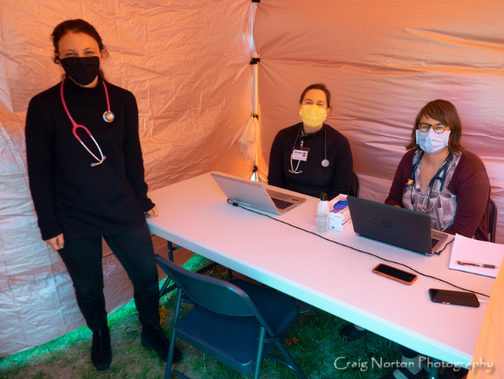
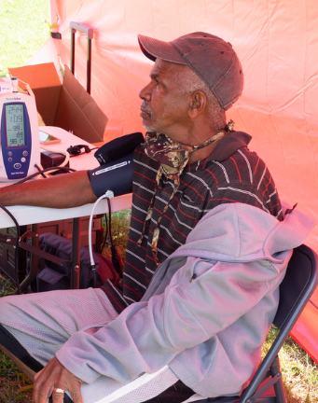
COMMUNITY CLINICS
Monthly Field Medical Clinics During Growing Season
CHC Site Clinic in Off Season
Monthly Free Dental Clinics
Most Common Diagnosis
Hypertension
Chronic Pain/Injury
Dermatitis
Respiratory Issues
Dental/Oral Issues

Slide 20
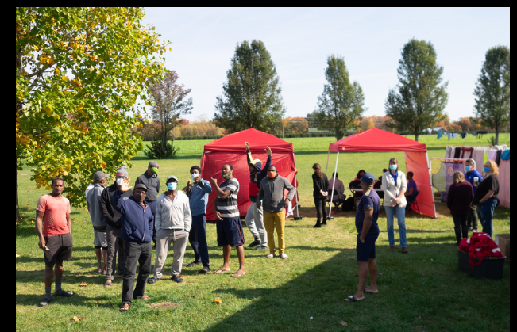
How COVID-19 Impacted Health Services
Telehealth Visits and Phone Screenings
Monthly
Outdoor Medical Clinics
Covid Testing and Education
Home Monitoring Equipment
Challenges from Covid
Lack of Dental Appointments
Lack of access to specialist
Travel/Visa Issues
Testing/Vaccine Hesitancy
Cultural Humility in Covid

Slide 21
COVID-19 Farmworker Outbreak Case Study

Slide 22
Farm Outbreak Timeline
CHC conducts pop up event on farm.
91 Covid tests conducted beginning at 10am.
Delivered PPE, cleaning supplies and education.
33 Covid + tests
Received from Quest.
Clinical guidance provided to growers for isolation and quarantine.
Positive and Negative Covid results delivered in person at farm.
Delivered food, PPE, education, consultation and contact info.
Farm worker identified as Covid + and moved to isolation
DPH receives required documentation of outbreak.
August 13, 2020
August 14, 2020
August 19, 2020
August 20, 2020
Worker who tested positive was a patient of CHS. Their agency was not able to do Covid testing in the community at the time so reached out to CHC.
CHC/CHS work collaboratively at the farm to outreach and educate farmers and conduct testing.
CRVFHP brings supplies and helps staff event.
SMA provides support and guidance.
CHC/CHS provide continued support to growers for isolation, quarantine and symptom monitoring.
SMA communicates regularly with consulate and healthcare providers and works with growers for resource allocation.
Worked collaboratively with Jamaican Consulate, CTRVFHP, CHC/CHS and SMA to provide resources to growers and farmers.

Slide 23
Farm Timeline Continued
33 Covid tests are received from Quest.
All are negative
Covid +
Individuals from 8/14 are
screened and assessed once more.
None ever become symptomatic.
Farm outbreak is
declared over.
Growers are instructed that they can resume congregate living on 9/9/2020
Follow up testing event and medical consultation clinic held.
No positive cases identified.
33 individuals not previously tested are given Covid test.
August 24, 2020
September 3, 2020
August 20, 2020
Town Sheriff brought in to investigate, DPH begins making calls to growers and workers. Created stress and distrust.
August 25, 2020
August 30, 2020
Growers are applauded by all involved for timely response, compassion for workers and ultimate containment of outbreak.
DPH/local politicians alert press and Governor mentions outbreak during daily press conference.
CHC/CHS work to maintain trust of growers and workers and to protect worker status.
SMA works to protect healthcare rights of workers.
Jamaican Consulate, SMA work with CHC/CHS to ensure resolution of current outbreak and provide resources for future outbreaks.
SMA provides guidance for growers and workers as press and politicians draw negative attention to farm.

Slide 24
Farm Timeline Continued - Challenges
Coordinating communication between DPH, local health officials, Governor’s office and healthcare agencies while protecting the privacy and relationships with the farms.
Providing up to date information to growers who are historically hard to reach.
Reaching workers with results was virtually impossible and had to be done in person.
Responding appropriately to patients with technology issues for follow up.
Staffing last minute events.
Maintaining trust between all partner agencies and growers/workers.
Boosting morale during high stress times in the midst of Covid-19 Pandemic when resources were minimal.

Slide 25
Farm Timeline Continued - Lessons Learned
Protecting the relationships with growers and community partners needs to come first whenever possible.
Collaboration with SMA and Consulate needs to be a priority for success.
DPH does not always have the most up to date information or resources.
Growers and farmers were capable, efficient, thoughtful and grateful as they handled the outbreak exceptionally well.
On-going communication with the growers created a trust.
Bringing in important collaborators like CRVFHP staff, CHS partners and DOL supporters was important in protecting our patients.
Flexibility in all areas was a must!

Slide 26
Increasing access to healthcare services
Applying lessons learned. Achievements resulting from Outbreak:
State agencies have a better understanding of the unique needs of migratory and seasonal agricultural workers in the Connecticut River Valley.
New COVID-19 response partnerships: CRVFHP, CHC, Inc., Community Health Services, Generations Family Health Center, Department of Agriculture, DOL, DPH (local & state), University of Connecticut Health
Partnering to increasing access to:
COVID-19 testing & vaccine
Primary care services
Dissemination of health education
Referrals

Slide 27
Any Questions?

Slide 28
Contact Us
Mary Ellen McIntyre
Senior Vice President, Compliance & Special Populations
Massachusetts League of Community Health Centers
memcintyre@massleague.org
(617) 988-2255
Amy Shepherd, MPH
Director, Connecticut River Valley Farmworker Health Program
Massachusetts League of Community Health Centers
ashehperd@massleauge.org
(617) 988-2317

Slide 29
Contact Us
Kasey Harding
Director of the Center for Key Populations
Community Health Center, Inc.
hardink@chc1.com
(860) 301-1090
Joelle Isidor
Program Manager
Community Health Center, Inc.
isidorj@chc1.com
(860) 398-2250
Marwan Haddad, MD
Medical Director of the Center for Key Populations
Community Health Center, Inc.
haddadm@chc1.com
(203) 980-6248

Slide 30
Resources: Find a Health Center
https://findahealthcenter.hrsa.gov/

Slide 31
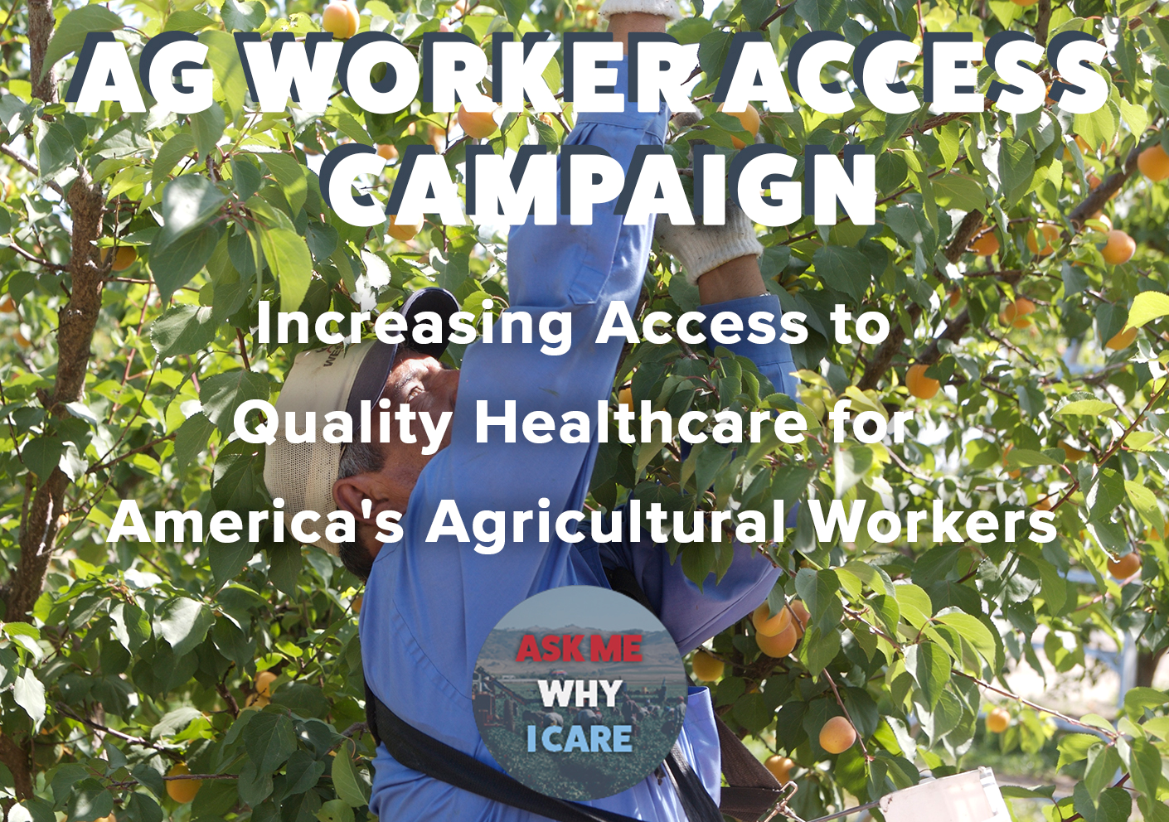
www.ncfh.org/ag-worker-access.html

Slide 32
Check out the Agricultural Connection Community!
The Agricultural Connection Community provides a collection of workforce information and technical assistance resources that support career services and training for migrant and seasonal farmworkers (MSFWs). The featured content area is the perfect area to start learning about the National Farmworker Jobs Program (NFJP) and the Monitor Advocate System (MAS) as well as promising practices, success stories, and special topic resources and training related to the MSFW population. We hope you will join our community (click below) and receive updates on new resources to the site!
https://farmworker.workforcegps.org/

Slide 33
Any Questions?

Slide 34
Thank You!
Need help? Email: Support@workforceGPS.org

