Slide 1
Assessing and Developing the Soft Skills of Today’s Workforce
June 22, 2021 1-2:30PM EDT

Slide 2
Today’s Moderator
Pam Frugoli
Workforce Analyst
USDOL Employment & Training Administration

Slide 3
Opening Poll 1
Do you currently use a tool to assess the soft skills of jobseekers you serve?
Yes
No
I’m not sure

Slide 4
Opening Poll 2
What question are you most looking forward to having answered in today’s webinar?
Why are soft skills important?
What tools are available to assess and develop soft skills?
How do organizations implement these tools?
Where can I learn more?

Slide 5
Agenda
Welcome
Background
Success Stories: Soft Skill Assessment and Development Tool Implementation
GPS Education Partners
State of Arizona
Alamo Colleges
Washington Greene County Job Training Agency
Panel Discussion and Q&A
Next Steps

Slide 6
Today’s Speakers
Amanda Daniels
Curriculum and Instructional Design Manager,
GPS Education Partners
Luke Dowden
Chief Online Learning Officer and Associate Vice Chancellor of Academic Success,
Alamo Colleges District
Andy Ridley
Workforce Program Manager,
State of Arizona
Terri Cooley-Taylor
EARN Program Supervisor,
Washington Greene County Job Training Agency, Inc.

Slide 7
Background – Soft Skills
Different terms for the same skills
These skills continue to grow in importance
Essential skills
21st century skills
Employability skills
Human skills
And many more!
Employer demand
Automation and artificial intelligence
Human advantage

Slide 8
Background – Soft Skills Frameworks
Department of Education has reviewed 28 Employability Skills Frameworks

Slide 9
Background – Building Blocks Competency Model
Competency Model Clearinghouse features 28 industry models
The first three tiers of each model cover traditional soft skills
Personal Effectiveness Competencies
Academic Competencies
Workplace Competencies
We may know what skills are important, but there is still a struggle to assess and develop the skills in jobseekers

Slide 10
Questions for the Nationwide Workforce System
How do we assess if the people we are serving have these important skills?
How can we help them develop these skills to make them more successful job candidates?

Slide 11
Background – ETA Environmental Scan
In 2020, ETA conducted an environmental scan of soft skill assessment and learning tools
Focused on tools with:
A postsecondary and/or workforce development user base
Alignment with the Building Blocks Model
Inclusion of both assessment and learning capabilities
Today’s webinar features success stories from four different organizations around the country

Slide 12
Polling Question 3
In your role, do you/have you supported youth with developing soft skills?
Yes
No
Answer the poll on the screen.

Slide 13
Success Story: GPS Education Partners
Amanda Daniels
Curriculum and Instructional Design Manager, GPS Education Partners

Slide 14
GPS Education Partners
Audience:
High school students ages 16 – 18
Clients*:
200 students
50 school districts
70 businesses
Geography:
Wisconsin
Illinois
Minnesota
Ohio
California
*Approximate numbers served annually based on end of 2020-2021 fiscal year

Slide 15
GPS Education Partners
GPSEd Personal Development Program
Why:
"Find us someone who will show up and be positive and we will train on the technical skills."
What:
In depth examination of 6 national and 2 Wisconsin soft skills certifications
Conversations with business parterners
Tiered and progressive training program

Slide 16
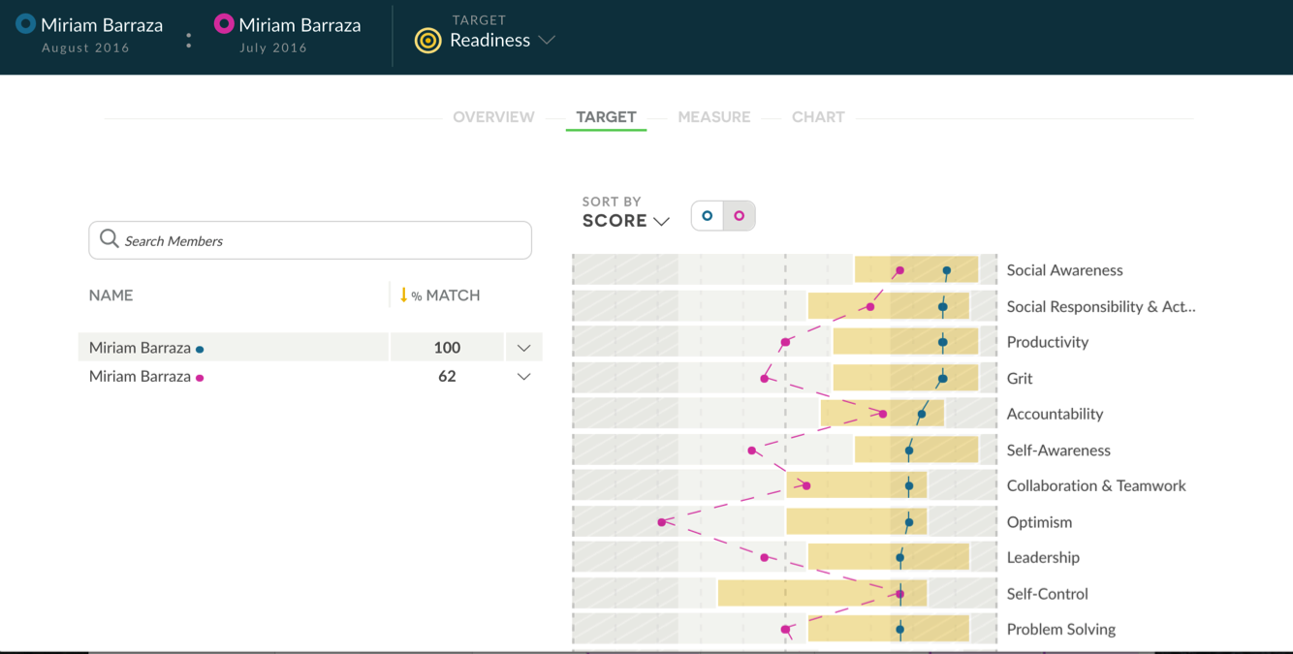
GPS Education Partners
PAIRIN Essential Skills Tools
PAIRIN Pro – data/admin
PAIRIN Personal – user tools
Personal, Social, Professional, and Entrepreneurial Skills
102 skills available for assessment
Customize skills into specific targets
Why PAIRIN?
Most comprehensive skills and tools

Slide 17
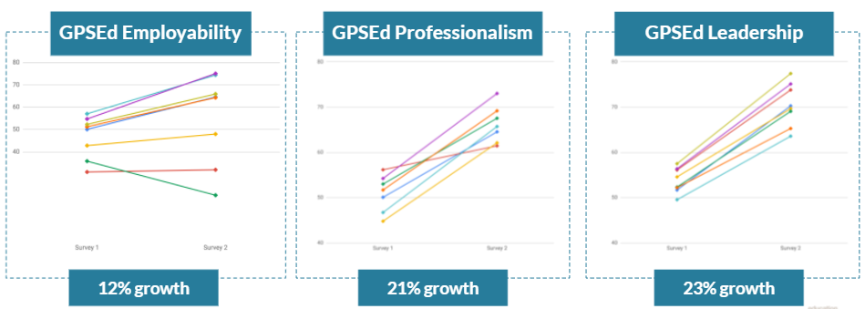
GPS Education Partners
Coaching young adults toward professional success
Assessment tools pinpoint focus areas
Curriculum and coaching tools support individualized growth

Slide 18
GPS Education Partners
Start with a vision for what you want to achieve
Create tools that facilitate business support of client growth
Embrace continuous improvement
Tips for Success

Slide 19
Polling Question 4
Workforce
Commerce
Education
All of the above – and more
What agencies can partner when implementing soft skill assessment programs?
Answer the poll on the screen.

Slide 20
Success Story: State of Arizona
Andy Ridley
Program Manager
Office of Economic Opportunity

Slide 21
Arizona Commerce Authority
Economic Development
Office of Economic Opportunity
Labor Analytics

Slide 22
Governor’s Goal - Bridge the Skills Gap

Slide 23
Breakthrough Project Across State Agencies
-Soft Skills Incorporated in Career Readiness-
Partners:
Commerce Authority, Office of Economic Opportunity, Department of Education, ARIZONA@WORK, Workforce Arizona Council, Department of Administration, Department of Economic Security, Governor’s Office
3 years of research through labor strategy labs across varied employment sectors
Supporting research across the country:
University of Michigan, Forbes, Harvard University, LinkedIn, Boston College, Deloitte

Slide 24
Unique 2-Pinned Approach to Validate Career Readiness
Traditional Method
Assessments of Foundational Workplace Academic Skills
Arizona Method
Assessments of Foundational Workplace Academic Skills
Additional Soft Skills Assessment

Slide 25
Arizona’s Desired Platform Features
Career contextualized to simulate on-the-job experiences and application
Spanish option
Online assessment
Flexible partner integration

Slide 26
Arizona selected WIN Learning
Key differentiators:
Customized approach
Listened throughout development as a partner
Continuous development with changing demands
Offers both online instruction/development or offline in-person instruction/mentoring
Alignment with Arizona Department of Education’s
Career and College Readiness Professional Skills Standards
Adult Education Standards

Slide 27
Arizona Career Readiness Mandatory Professional Skills Assessment
Professional Skills Sub-Topics
Collaboration and Teamwork
Effective Communication
Critical Thinking and Problem Solving
Conveying Professionalism - attitude, punctuality, integrity, organization

Slide 28
Arizona Career Readiness Professional Skills Online Format
Format
Progress Measures
Pretests
Learning content, videos, interactive checks for understanding
Posttests
eBadges
Hours on task
Reports - downloadable to Excel

Slide 29
Arizona Career Readiness Professional Skills Offline Format
Hundreds of pages of content
Workplace scenario instruction
Self assessments
Formative assessments
Posttests

Slide 30
Arizona Career Readiness Professional Skills Assessment
Exclusively online
Instant results on dashboard and administrator reports
Instant certificate
Governor’s signature
Seal of Arizona
Scores
Unique certificate serial number to authenticate

Slide 31
Arizona Career Readiness Professional Skills
Current Implementation Arenas:
One-Stop Career Development Centers
Non-Profit Employment Assistance
High Schools
Colleges
Corrections
Employers
Unemployment
‘Return Stronger’ COVID Emergence Campaign
Self-Enrollment
Social Media / Word-of-Mouth
Community Education and Adult Education
Apprenticeships
Credentialing / Certification Programs

Slide 32
State of Arizona
Tips for Success
Research the employers - determine what they deem important
Consult with implementation partners to hone in on best approach
Determine priorities for key content, delivery features, and what will reach a broad base

Slide 33
Polling Question 5
What is your familiarity with digital badges?
I’m an expert!
I’m familiar but want to learn more.
I’ve heard the term but couldn’t define it.
A digital WHAT?
Answer the poll on the screen.

Slide 34
Success Story: Alamo Colleges District
Luke Dowden, Ed.D.
Chief Online Learning Officer and Associate Vice Chancellor of Academic Success Alamo Colleges District

Slide 35
Alamo Colleges District | San Antonio, Texas
5 community colleges
San Antonio College
St. Philip’s College
Palo Alto College
Northwest Vista College
Northeast Lakeview College
8 regional & neighborhood centers

Slide 36
STUDENT PROFILE
100,000 Students Served Annually
64% Hispanic
9% African-American
22% White
3% Asian
4% Other
28.3% Under-Resourced
Students
48.7% Economically Disadvantaged
60% Female
40% Male
70% Rely on Financial Aid & Scholarships
32% Full-Time
68% Part-Time
60% Housing Insecure
48% Food Insecure

Slide 37
What is a Digital Badge?
Type of digital credentials that people earn by demonstrating a skill
Consist of an image and metadata
Aligned with Open Badges 2.0 standards
Sharable on social media platforms

Slide 38
Scaling Marketable Skills Attainment
Mission
To empower students for success by awarding verified digital badges that articulate in-demand marketable skills to employers. Digital badges increase social mobility and position students for greater competitiveness in the job market.
Guiding Principles
Competency-Based
Marketable Skills
Credentialed faculty members and trainers

Slide 39
Alamo Colleges and Education Design Lab
Integrate the Education Design Lab’s 21st Century Skills Framework

Slide 40
Surfacing Marketable Skills in the Curriculum
Course+ Badge
10-week online professional development that trains faculty to integrate a marketable skills badge into a credit-bearing course
$1,000 stipend funded by the Participatory Budget Grant
Education Design Lab 21st Century Skills Micro-credentials
Completers receive a Badge Specialist Digital Credential
Faculty complete an application and are nominated by their Vice President for Academic Success
4 cohorts

Slide 41
Preparing Faculty: Badge Credentials
Badge Coach - to prepare faculty to facilitate a badge course and/or a badge integrated in an academic course
Badge Specialist - to train a faculty member to integrate a marketable skills badge into an academic course

Slide 42
Expanding Offerings: Stand Alone Marketable Skills
Most In-Demand Skills for High Demand, High Wage Occupations
Free Pilot
Marketable Skills Direct to Community
Badge Coach Facilitated
Marketable Skills Digital Badge

Slide 43
Providing Evidence for Employers
What does an employer see when a student links to a badge on Alamo.badgr.com?
Badge Name
Competency Description
Sub-competencies Demonstrated
EMSI and related skills

Slide 44
Tracking Outcomes
88 marketable skills badges awarded in Fall 2020
Critical Thinking (NVC, PAC, SPC)
Intercultural Fluency (NVC)
Oral Communication (SAC)
167 marketable skills badges awarded in Spring 2021
Empathy (NVC, SAC)
Critical Thinking (NVC, PAC)
Creative Problem-Solving (PAC)
Oral Communication (SPC, SAC)
Collaboration (SPC)
Resilience/Initiative (NVC)
54 Faculty Badge Specialists (2020-21)
32 Badge Coaches (2020-21)

Slide 45
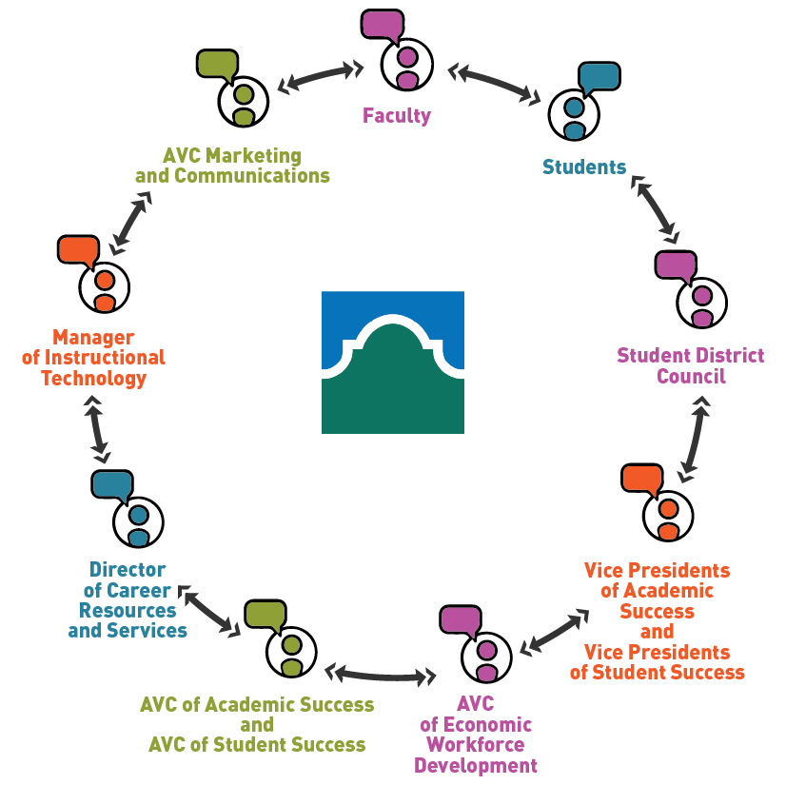
Partnering Internally Across the Alamo Colleges
{
Internal Partners
Partial List

Slide 46
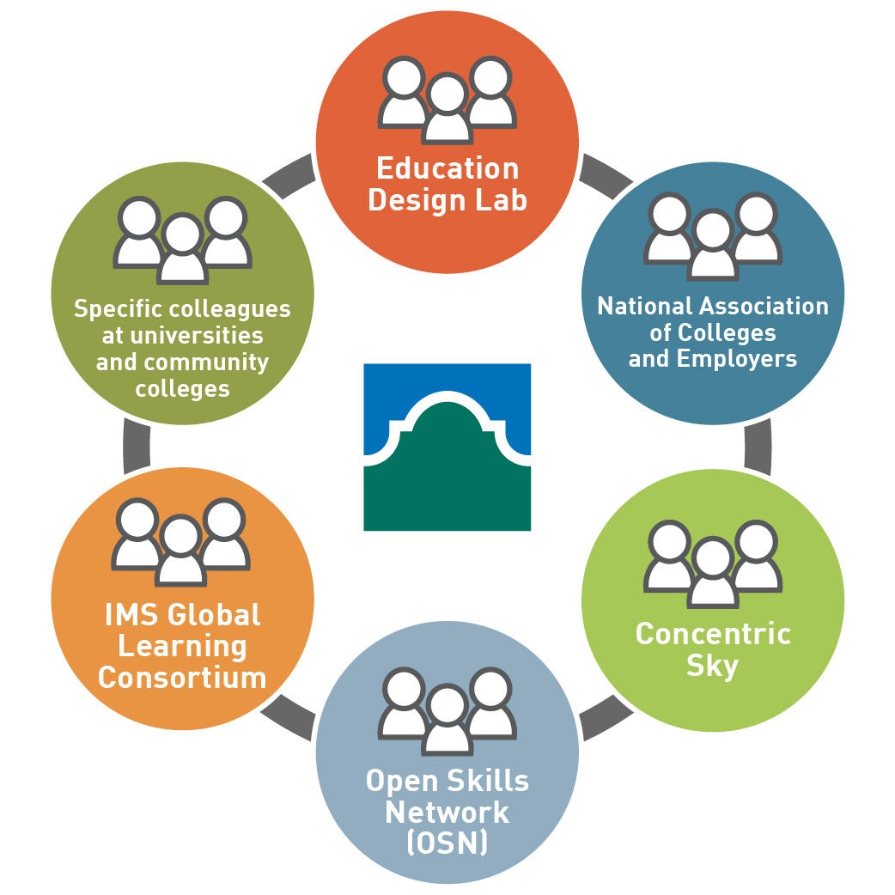
Collaborating Externally
{
External
Collaborators

Slide 47
Education Design Lab’s Platform Offering: vsbl
Virtual. Stackable. Bits of learning.
vsbl is a platform for the delivery of Education Design Lab’s suite of eight 21st Century Skills digital micro-credentials.
The micro-credentials are facilitator-led experiences.
Facilitator training is available for purchase.
Learners can earn a digital badge upon successful demonstration of four sub-competencies.
Each micro-credential is designed for approximately 15 hours of learner engagement

Slide 48
Alamo Colleges District: Success Strategies for Delivering Marketable Skills Badges
Insider Tips for Sustainable Success
Buy it, Build, or Partner
Resource the effort
Use Radical Innovation Process (RIP) to discover, incubate, and accelerate your own innovations
Create good examples and share them
Prepare for scale
Invest in technology that is affordable and interoperable
Survey worker learners and employer partners
Use what is learned to elevate and continue your work
Keep designing for your learner

Slide 49
Polling Question 6
As we “return to normal” after COVID-19, will your organization continue its virtual service offerings?
Yes
No
I’m not sure
N/A
Answer the poll on the screen.

Slide 50
Success Story: Washington Greene County Job Training Agency
Terri Cooley-Taylor
EARN Program Supervisor

Slide 51
Washington Greene County Job Training Agency Background
Southwest Corner PA
Employment & Training Program
Transitional Assistance for Needy Families (TANF)
Purchased Conover Online in 2015 – employer driven job market
Increase Program Participants Employability
Provide tool that assesses, trains, and develops soft skills

Slide 52
Washington Greene County Job Training Agency and Conover
Conover Online
Research-based assessment and training system for the soft skills needed in the workplace
Skill Building & Social/Emotional Development
Workplace Readiness program focuses on 3 areas:
Job Readiness, Job Seeking, and Job Keeping Competencies

Slide 53
Conover Workplace Readiness Competencies
Job Readiness
Attitude
Communication
Planning & Organizing
Critical Thinking
Interpersonal/Social Skills
Teamwork
Professionalism
Media Rules
Job Seeking
Job Search
Resumes
Job Application
Preparing for an Interview
Interviewing
After the Interview
Job Keeping
Getting off on the Right Foot
Getting Along in the Workplace
Performance Reviews

Slide 57
Washington Greene County Job Training Agency and Conover
Pre-COVID19 – Hybrid Model
Clients worked individually on weaknesses.
Then in Job Club as a group, instructor would review all the topics for soft skill & emotional intelligence enhancement.
Post-COVID19 – Virtual Only
Seamless transition to all virtual model.
Clients worked at home around their children’s school schedules.
Clients able to log in anytime of day to maintain program participation.
Client feedback tells us it is working.
Reaching Yearly Performance Benchmarks

Slide 58
Washington Greene County Job Training Agency
Tips for Success
Reports
Easily Track Participants Participation - Date/Time Stamp when participant Logs-In and Logs-Out of Conover Online.
Easily Track Goal Achievements- Conover Online shows the current progress participant is making on completing modules
Customer Service
Chat Feature on website- immediate response
Staff Trainings
Pre-Recorded Resources, Staff Webinars, Customized Trainings

Slide 59
Questions
Amanda Daniels
Curriculum and Instructional Design Manager,
GPS Education Partners
Andy Ridley
Workforce Program Manager,
State of Arizona
Luke Dowden
Chief Online Learning Officer and Associate Vice Chancellor of Academic Success,
Alamo Colleges District
Terri Cooley-Taylor
EARN Program Supervisor,
Washington Greene County Job Training Agency, Inc.

Slide 60
Next Steps
Check out the U.S. Department of Labor Building Blocks Model and Industry Competency Models
Consider your own criteria
Conduct your own research on soft skills tools
Get help from experts

Slide 61
Next Steps: Consider your criteria
When choosing between tools, you might consider:
Who is the target audience for the tool?
Do I see organizations like mine listed as clients/case studies?
What skills are assessed?
Does the tool assess the same skills I want my users to develop?
What is the cost?
Does the tool offer flexible pricing models? Can my organization afford this?
Are there add-on features available?
What other assessments or products can be bundled?
Who should I be partnering with to implement the tool?
Are there any organizations or agencies I can leverage during this process?

Slide 62
Next Steps: Research soft skill assessment tools
National College Transition Network (NCTN) has launched a curated collection of resources to teach and assess soft skills
Free and subscription-based resources available
Searchable by audience, cost, format, type of resource (curriculum, badging, assessment, framework) or keyword/skill.
Description of content, key takeaways, and links for every resource
Check out the Personal & Workplace Success Skills Library:
Personal and Workplace Success Skills | Skills for Employability (worlded.org)

Slide 63
Next Steps: Get help from experts
NCTN is seeking organizations to develop case studies to include in the PWSS Library.
Participants will:
Receive free technical assistance from Library staff to help you select resource(s) that fits your customers’ and program goals.
Implement the resource for 2-4 months following a plan you develop with staff (e.g. in coaching, skill training, job readiness workshops)
Participate in an interview for a case study write-up to be posted in the Library.
Receive a $2,500 stipend.
Learn more and fill out the interest form:
https://skills.worlded.org/participate-in-a-case-study/

Slide 64
Thank you!
This project has been funded either wholly or in part with Federal funds from the Department of Labor, Employment & Training Administration under Contract Number DOL-ETA-17-A-0001 Task Order Number 1630DC-18-F-00006. The contents of this publication do not necessarily reflect the views or policies of the Department of Labor, nor does mention of trade names, commercial products, or organizations imply endorsement of same by the U.S; Government.

