Slide 1
Workforce Innovation
and Opportunity Act:
An Introduction to Key Provisions

Slide 2
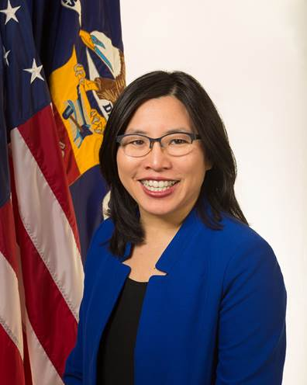
Presented by Portia Wu,
Assistant Secretary
Portia Wu
Assistant Secretary
Employment and Training Administration
U.S. Department of Labor
Have a question or comment about WIOA? Email DOL.WIOA@dol.gov
Notes:
Presenter introduces her/himself and indicates that WIOA presentation introducing key provisions will cover the following topics:
Connecting the Jobs-Driven Agenda
Opportunities for Partnerships
How to get more Information and ask Questions

Slide 3
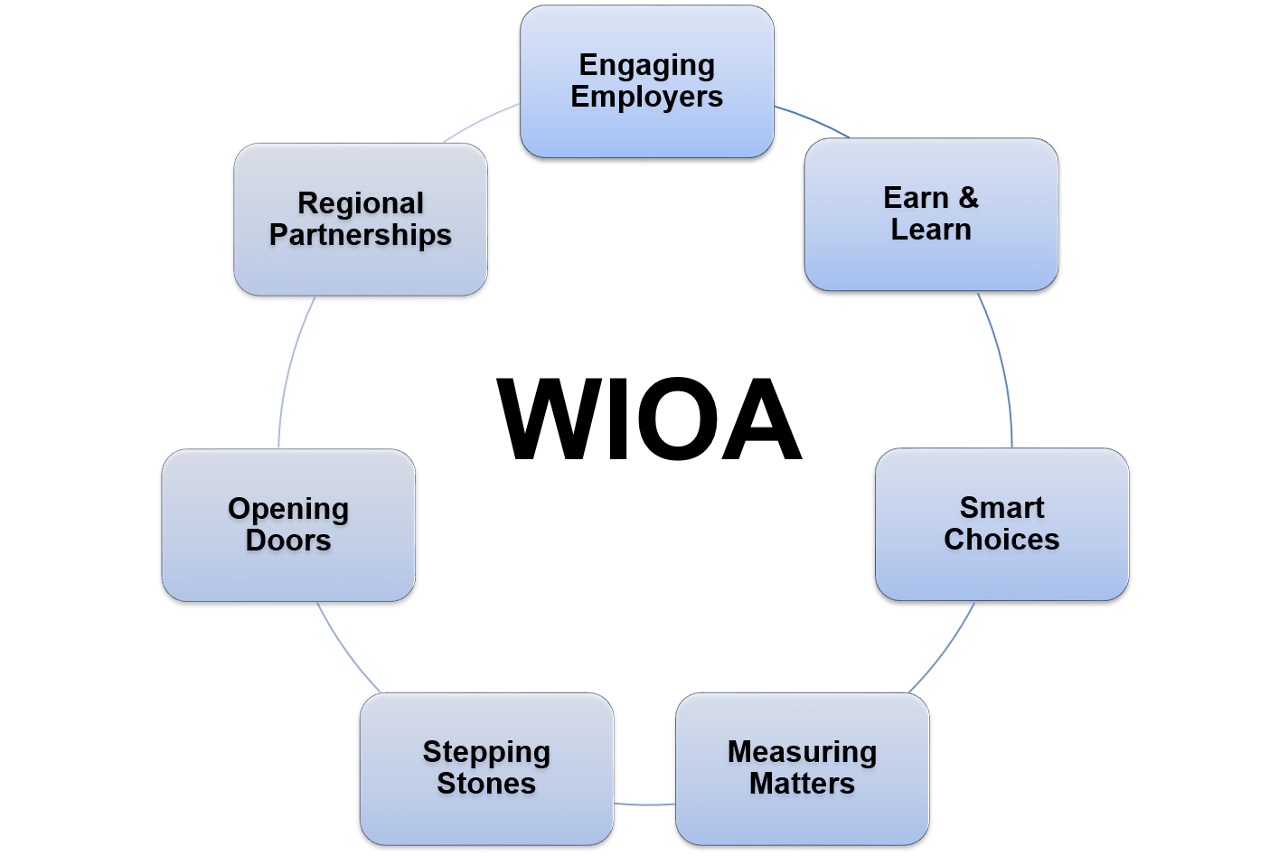
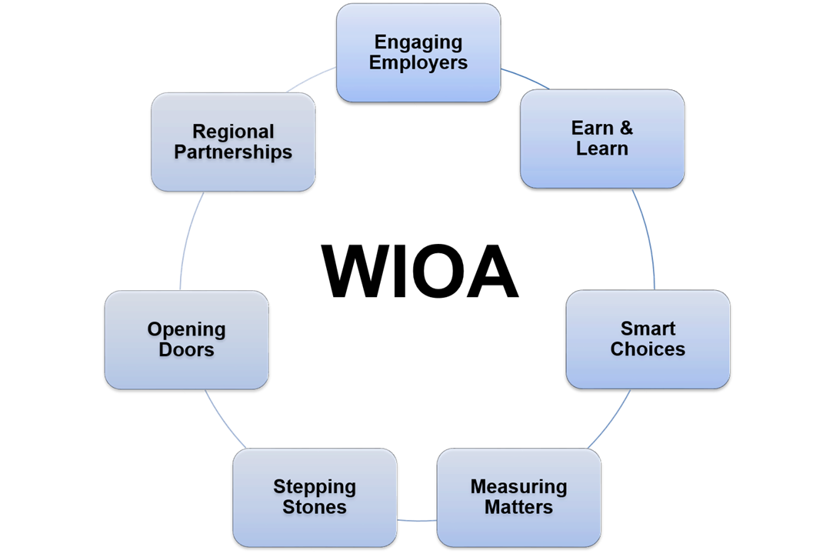
Connecting the Job-Driven
Agenda

Slide 4
Opportunities for Partnerships

Slide 5
Information and Questions
Department of Labor
WIOA resource page www.doleta.gov/WIOA
WIOA dedicated email DOL.WIOA@dol.gov
Department of Education
Office of Career, Technical, & Adult Education’s WIOA resource page www.ed.gov/AEFLA
Rehabilitation Services Administration’s WIOA resource page http://www2.ed.gov/about/offices/list/osers/rsa/wioa-reauthorization.html

