Slide 1
Our Journey Together: The WIOA Youth Program Technical Assistance (TA) Series Kick-off
October 23, 2017
Where We’ve Been, Where We Are Now and Where We’re Going!

Slide 3
Sara Hastings
Unit Chief /Division of Youth Services
DOL/ETA

Slide 4
Kick-off Our Journey Together TA Series
Remind ourselves where we’ve been and why we do this work
Learn about resources and TA plan ideas
Hear from you what your TA needs are and what your successes and challenges have been

Slide 5
Who do we have in the audience?
State workforce
Local workforce
State education
Local education
State human services
Local human services
Other partners

Slide 6
For how long have you been engaged in WIOA Youth work?
I just learned about WIOA within the last year.
I started in this work after WIOA became law.
I was here for the transition from WIA to WIOA.
WIA and WIOA?! Let me tell you about the JTPA days.

Slide 7
Where We’ve Been
WIOA over the last three years

Slide 8
Amanda Ahlstrand
Administrator / Office of Workforce Investment
DOL/ETA

Slide 9
The Progress of WIOA
WIOA was passed in July, 2014
WIOA provisions take effect July, 2015
Performance accountability and State Plans take effect – July, 2016
Final Rule published – August, 2016
Training and Employment Guidance Letters
Technical Assistance: Enough is Known for Action Series and WIOA Wednesdays

Slide 10
The Goals of WIOA
Increase the prosperity of workers and employers.
Reduce welfare dependency, increase economic self-sufficiency, meet employer needs, and enhance the productivity and competitiveness of the nation.
Promote improvement in the structure and delivery of services.
Increase access to education, training, and employment--particularly for people with barriers to employment.
Create a comprehensive, high-quality workforce development system by aligning workforce investment, education, and economic development.
Improve the quality and labor market relevance of workforce investment, education, and economic development efforts.

Slide 11
Sector Strategies

Slide 12
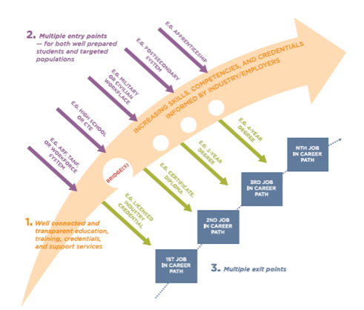
Career Pathways Operate At Many Levels

Slide 13
WIOA Vision for Youth
The DOL Only Final Rule Preamble outlines a clear vision for serving youth under WIOA:
WIOA aligns and coordinates service strategies across all youth-serving programs to help youth, particularly out-of-school youth, achieve educational and employment-related goals.
Across the system, continuous improvement is supported through evaluation, accountability, identification of best practices, and data driven decision making.

Slide 14
WIOA Youth Program Resources
Where to find them on youth.workforceGPS.org

Slide 16
https://youth.workforcegps.org/

Slide 17
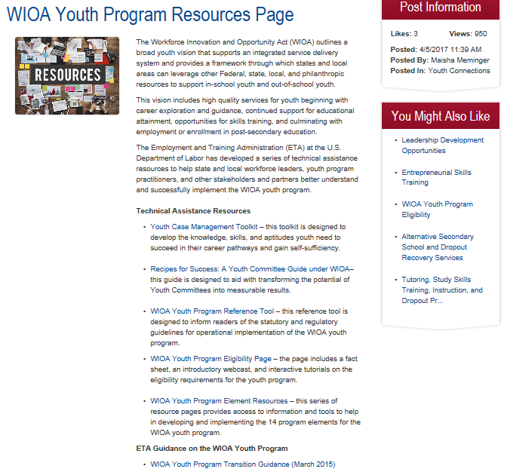

Slide 18
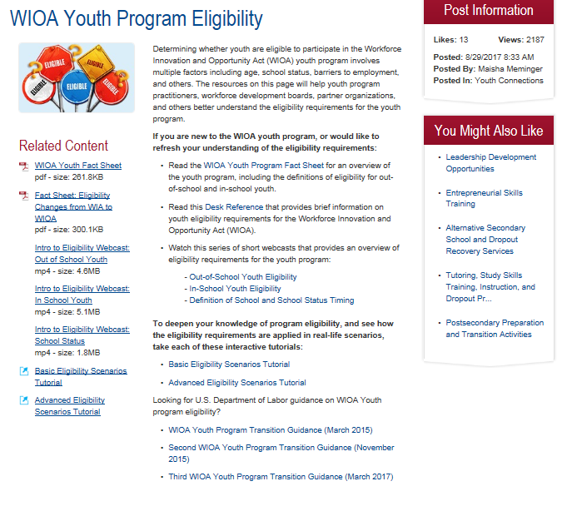

Slide 19
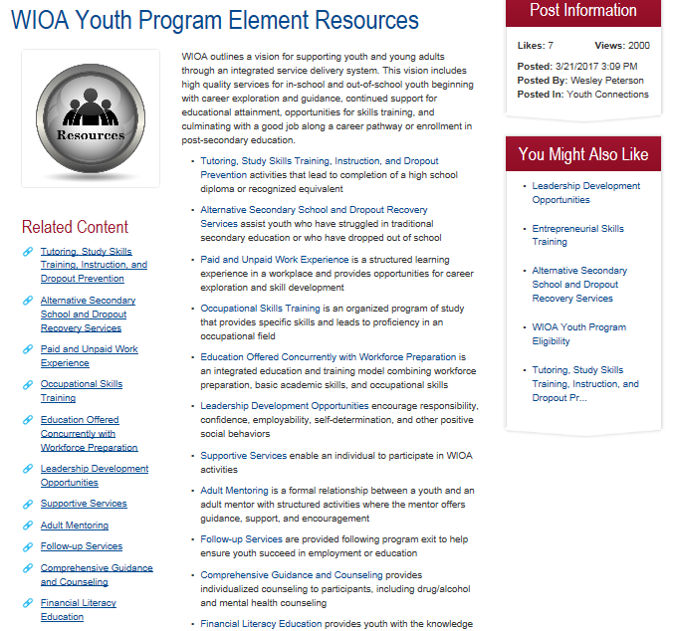

Slide 20
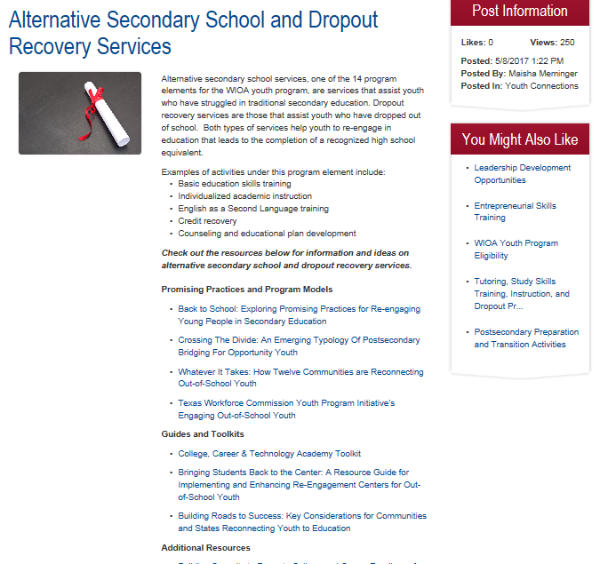

Slide 21
Where We Are Now
Implementation of the WIOA Youth Program

Slide 22
What makes a program a WIOA Youth Program?
Type your responses in the chat feature.

Slide 23
Priorities of WIOA Youth Program: OSY – Why the need?
Approx. 5 million out-of-school and out-of-work youth*
Cost:$51,340 per year and $939,700 over the course of a lifetime per disconnected youth **
WIOA Youth program in PY 2015 served over 156,000 youth with a budget of just under $830 million
Important that the public workforce systems sees itself as the system responsible for these youth.
*Measure of America and **The Economics of Investing in Opportunity Youth.

Slide 24
Priorities of WIOA Youth Program: OSY
Serving Out-of-School Youth - 75% minimum expenditure requirement

Slide 25
Priorities of WIOA Youth Program: OSY – How we’re doing.
Workforce system responded impressively to huge shift in focus to primarily serving OSY
In PY 2015, the nation spent 79.4% of local area youth funds on OSY, far exceeding the 75% in the first year of WIOA implementation.
Every state met the PY ‘15 transition goal of spending at least 50% of local area youth funds on OSY and increasing OSY expenditures by 10 percentage points.
So far in PY ‘16, 84.2% of local area youth funds have been expended on OSY – on track to exceed both the 75% requirement and PY ‘15 expenditures.

Slide 26
Priorities of WIOA Youth Program: Work Experience: Why the need?
Early work experience is critical for development
At least 2/3 of all jobs require at least some postsecondary education
Early exposure to work leads to increased earnings potential, provides youth an opportunity to develop soft skills and build networks and connection to the world of work.

Slide 27
Priorities of WIOA Youth Program: Work Experience
Providing Work Experiences - 20% minimum expenditure requirement

Slide 28
Priorities of WIOA Youth Program: Work Experience: How we’re doing
Workforce system responded to priority focus on work experience
For PY 2015, exactly 20% of local areas youth funds nationally were spent on work experience.
Met the 20% requirement despite work experience expenditures being a new financial reporting requirement and despite implementation of new ETA-9130 not until beginning of PY ‘16.
So far in PY 2016, 22.7% of local area youth expenditures have been spent on work experience.

Slide 29
What are allowable work experience expenditures?
Wages/stipends paid for participation in a work experience;
Participant work experience orientation sessions
Employer work experience orientation sessions
Staff time working with employers to ensure a successful work experience
All of the above

Slide 30
Allowable work experience expenditures include the following (TEGL 21-16)
Wages/stipends paid for participation in a work experience;
Staff time working to identify and develop a work experience opportunity, including staff time spent working with employers to identify and develop the work experience;
Staff time working with employers to ensure a successful work experience, including staff time spent managing the work experience;
Staff time spent evaluating the work experience;
Participant work experience orientation sessions;
Employer work experience orientation sessions;
Classroom training or the required academic education component directly related to the work experience;
Incentive payments directly tied to the completion of work experience; and
Employability skills/job readiness training to prepare youth for a work experience.

Slide 31
Where We’re Going – Together!
Technical Assistance for WIOA Youth program implementation and Successes and Challenges from the field

Slide 32
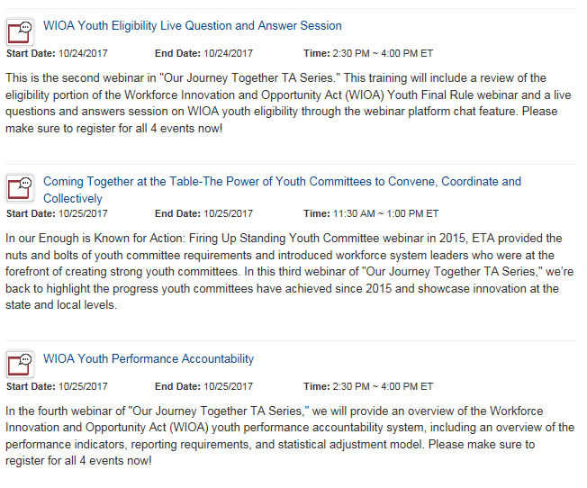
Our Journey Together TA Series
Two Day Kick-off Webinars

Slide 33
Our Journey Together TA Series Now–2018: Webinars, Resources & More!
Partnerships: WIOA Titles II and IV, Juvenile Justice, Child Welfare, TANF, Job Corps, SNAP E&T
Mentoring
Financial Literacy
Trauma-Informed Care
Summer Employment
Career Pathways
Entrepreneurship
Apprenticeship

Slide 34
What do you like? What are we missing from the TA Plan?
Let’s take a few minutes to get your feedback:
Affirm the topics you want to see
Provide us with topics you don’t see on the list.
Give specifics

Slide 35
Ways to Engage and Connect
DOL and your colleagues need to hear from you!

Slide 36
1st things 1st: Become a GPS member and use the Member Directory
Let’s take a few minutes to watch the video
https://www.workforcegps.org/resources/2017/02/14/16/39/WorkforceGPS_Member_Directory

Slide 37
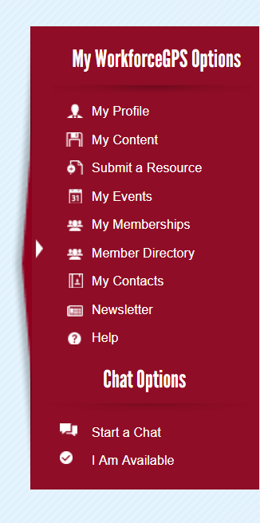
Ways to share your work
Send us your lessons learned and successful strategies to share with the field.
youth.services@dol.gov
You can also Submit a Resource on WorkforceGPS.

Slide 38
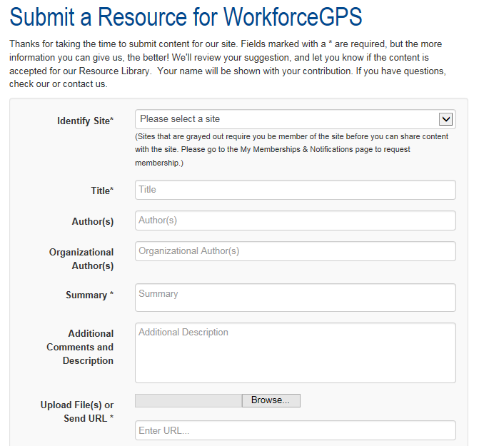

Slide 39
Discussion Threads

Slide 41
Sara Hastings
Unit Chief / Division of Youth Services
DOL/ETA
Hastings.sara@dol.gov
202.693.3599
Presenter Name
Title / Occupation
Organization
Email address
555.123.1234

