Slide 1
Coming Together at the Table
October 25, 2017
The Power of Youth Committees to Convene, Coordinate and Collectively Impact Youth Lives

Slide 3
LaSharn Youngblood
Moderator
Workforce Specialist
Division of Youth Services

Slide 4
Jinny Rietmann
Regional Youth Programs Coordinator
Workforce Development, Inc., Rochester, MN
Kimberly McCaffrey
Manager of Youth System
Philadelphia Works, Inc.
Philadelphia, PA

Slide 5
Jessica Ku Kim
Special Projects Development Manager
South Bay Workforce Investment Board, Inc., Hawthorne, CA
Gabriela Goetz “Gaby”
Youth Program Manager
South Bay One-Stop Business & Career Center, Hawthorne, CA

Slide 6
Objectives
Share with your peers about your WIOA youth implementation progress and how service delivery has changed;
Hear from youth committee leaders about the work underway and how they have overcome challenges to ensure their committee remains successful; and
Learn about tools and resources helpful for youth committees across the country.

Slide 7
What is your role in the Workforce System?
Youth Committee chair or member
Workforce System staff
Employer
Educational Provider
Youth Provider
Foundation
Community-Based Organization
Others

Slide 8
Does your local area have a youth committee?
Yes or No
Chat: Please let us know in the chat the name or location of your youth committee
If you have one, how long has it been operational?

Slide 9
Role of the Youth Committee
Provide information and assist with planning, operational, and other issues relating to the provision of services to youth

Slide 10
Youth Committees under WIOA
While WIOA eliminates the requirement for local boards to establish a youth council, the Department encourages local boards to establish:
“a standing committee to provide information and to assist with planning, operational, and other issues relating to the provision of services to youth, which shall include community-based organizations with a demonstrated record of success in serving eligible youth,” as permitted by Sec. 107(b)(4)(A)(ii) of WIOA.
WIOA permits a local board to designate an existing youth council as a youth standing committee if the youth council fulfills the requirements of a standing committee.
A local board may also choose not to establish a youth standing committee at all. If so, the local board is still responsible for conducting oversight of youth workforce investment activities

Slide 11
Final Regulations at 20 CFR 681.100
Who to include on a youth committee?
If a local board decides to form a standing youth committee the committee must include a member of the board, who chairs the committee, members of community based organizations with demonstrated record of success to serving eligible youth and other individuals with appropriate expertise and experience who are not local board members.

Slide 12
Guidance
ETA provides guidance highlighting the role youth committees can play in coordinating area wide youth services.
TEGL 8-15: Second Title 1 WIOA Youth Program Transition Guidance
TEGL 23-14: Workforce Innovation and Opportunity Act (WIOA) Youth Program Transition

Slide 13
What are critical activities for a Youth Committee
Create a formal working relationship with the board
Build community awareness and demonstrate leadership
Address key development, education and employment issues affecting youth
Facilitate coordination of youth activities in the community
Influence and leverage other community youth funds and services
Address specific needs of youth in the community
Engage and partner with the business community

Slide 14
Take Action
Assemble key players
Make the youth committee a decision-making body
Conduct asset mapping in each community
Forge linkages among member representatives who have special interest or expertise in youth policy
Organize a network of employers

Slide 15
Key Players In Action
Community-Based Partners—outreach to youth, link youth to learning, and community service, link youth to supportive services, connect youth to jobs with career potential
Employers—join the youth committee, form a network of employers, and make jobs accessible
Education officials—encourage flexible learning options, expand dropout prevention, connect with postsecondary system

Slide 16
Why did you keep your Youth Committee?
Philadelphia, Pennsylvania
Hawthorne, California
Southeast Minnesota

Slide 17
Kimberly McCaffrey, Manager of Youth System
Philadelphia, Pennsylvania

Slide 18
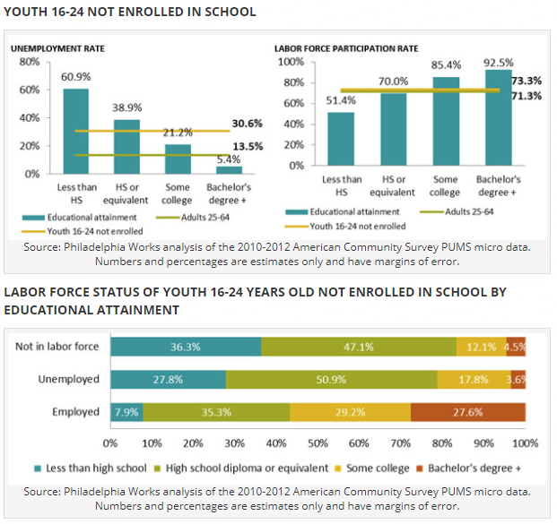
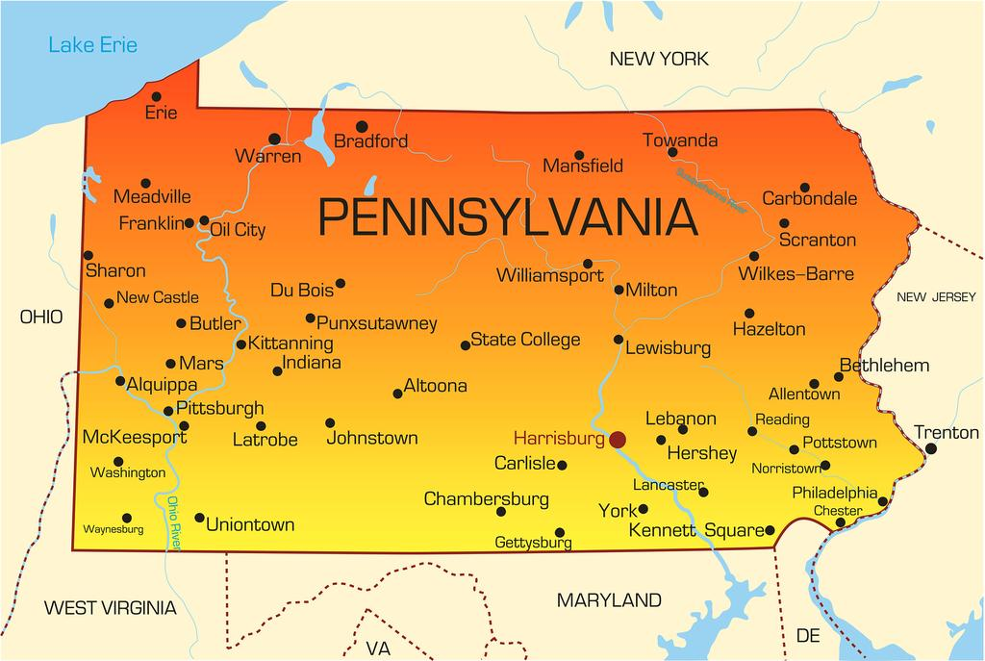
Philadelphia, PA
http://www.philaworks.org/workforce-information-works/workers-employment-barriers/

Slide 20
Youth Standing Committee History- Philadelphia
First convened as the WIA Youth Council
Restructured the committee role under Mayor Michael A. Nutter in 2008 to the Philadelphia Council for College and Career Success (PCCCS)
WIOA regulation encouraged Youth Councils but no longer required the component within local workforce areas
PA’s WIOA Combined State Plan required that all local workforce areas maintain youth standing committees
Recent transition in 2017 to the Youth Standing Committee of the Philadelphia Works Board

Slide 21
Why Establish a Youth Committee-Philadelphia
Effective process for the youth oversight responsibilities of the public workforce system that oversees WIOA and TANF funding
Allow for more efficient citywide coordination of education and youth workforce efforts
Visionary strategies to align and streamline efforts
Provides opportunity for a robust cross-sector collaboration of partners

Slide 22
Presented By:
Jessica Ku Kim, Special Projects Development Manager
Gaby Goetz, Youth Program Manager

Slide 23
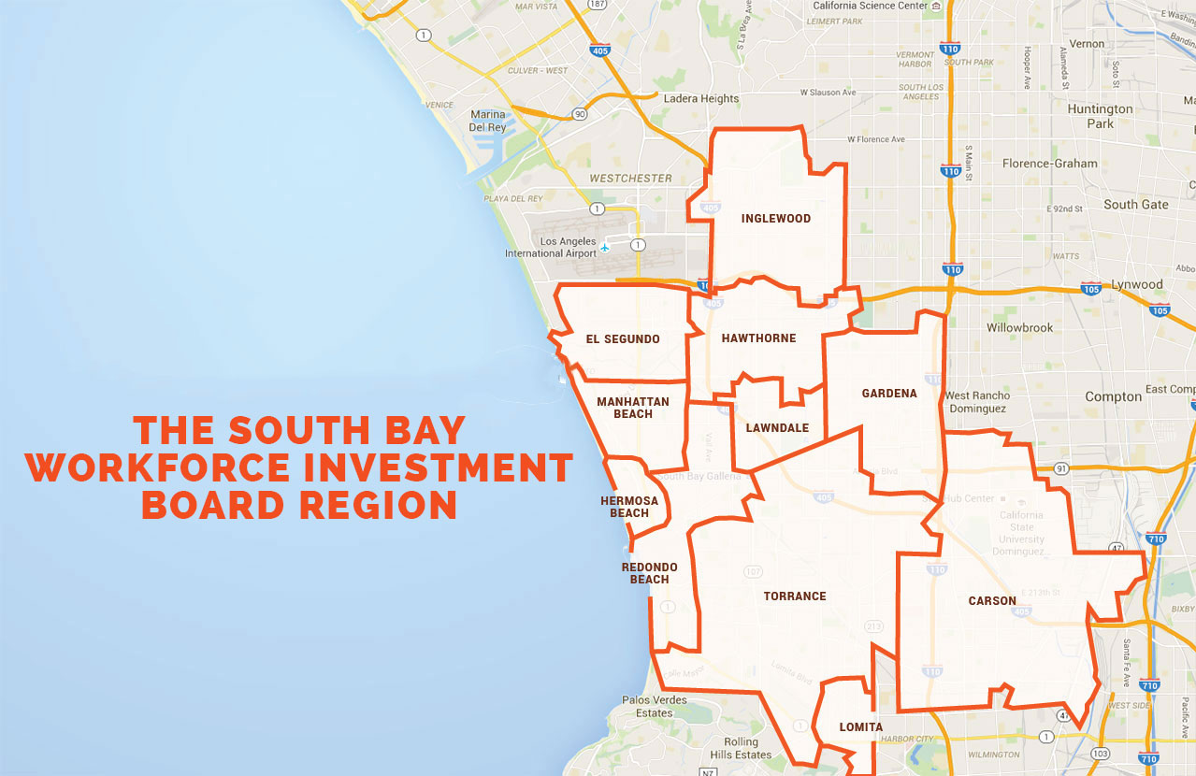

Slide 24
SBWIB Youth Stakeholders
10 School Districts
Others
Centinela Valley Union
El Segundo
Hawthorne
Inglewood
Lawndale
Lennox
Los Angeles
Redondo Beach
Torrance
Wiseburn
Southern CA Regional Occupational Center
South Bay Adult Education Consortium
YouthBuild
Community Colleges: El Camino, West Los Angeles, South West
CA State University, Dominguez Hills
Centinela Youth Services/Everychild Restorative Justice Center
Alternative Education Providers
Charter Schools
CBOs Serving Homeless Youth
CBOs Serving Justice Involved Youth
CBOs Serving Individuals with Disabilities

Slide 25
Transition to Youth Committees- SBWIB
We Wanted to Keep It
SBWIB’s robust Youth Council plays a vital role in responding to youth needs and building resources
They Said Yes!
Youth Council members themselves wanted to continue to meet and support youth services in the community.
The Youth Committee is a valued partnership in our community and the members, such as the Superintendents of our school districts and YouthBuild, appreciate being able to address disconnected youth needs and have resources made available to them.
Easy Policy Change for Us
Youth Committees required one non-Board member officially on the committee. Since we had many participating Council members who were not a Board member, the transition was not difficult.

Slide 26
Diversity Within the Region SBWIB
Socioeconomic Diversity
Affluent Beach Cities and Low-Income Neighborhoods
Different School District Needs
One school district is 84.5% English learners, foster youth, or eligible for free/reduced price meals
The neighboring school district is 15.3%
Racial Diversity
11 Cities = 11 sets of government officials and their priorities

Slide 27
Started with the Youth Council- SBWIB
WIA mandated the establishment of a Youth Council – a subgroup within each local board, appointed by the board, and in cooperation with the chief elected official for the local area
Membership was defined to include members with expertise, youth services, juvenile justice, local public housing authorities, Job Corps, etc.
Added: SBWIB decided that school district representatives would be a great addition though not required

Slide 28
SE Minnesota
Jinny Rietmann, Youth Programs Coordinator
Jeff Custer, Board Member and Youth Advisory Council Chair
Jerrianna Hansen, Youth Participant

Slide 29
SE MN Workforce Development, Inc.
Our Mission Our mission is to develop and advance the workforce of Southeast Minnesota.
Our Vision Our vision is to develop and advance the workforce of Southeast Minnesota by acting as:
A champion for workers
A convening agent bringing partners together to solve workforce problems
A change agent to promote and facilitate innovation and creative solutions
The agency accountable to the individuals, businesses and communities we serve, providing measurable change
Core Values We are a customer-focused, action-oriented team of professionals, dedicated to the principles of Respect, Integrity, Innovation, Education, and Community

Slide 30
SE MN Workforce Development Board

Slide 31
History of Youth Council- SE MN
Created even prior to WIA, to support “School to Work” initiatives, created “Campus Connection” programs at area colleges, and developed one of the first Alternative Learning Centers in our area – this subcommittee was formed to address the projects
Continued with WIOA legislation – WDB valued the committee and supported continuation
Advisory vs. Programming Deliverables

Slide 33
What are your most challenging issues with transitioning or establishing your youth committee, if any?
Please select all that apply…
Recruiting out-of-school youth
Developing program models
Fulfilling membership requirements
Finding and retaining appropriate members
Leveraging community resources
Engaging businesses
Finding enough organizations to deliver services, including work experiences
Identifying focus areas
Other (select and type into chat)

Slide 34
Youth Committee Challenges- Philadelphia
Provider input and engagement
Public versus business session
Scheduling/timeliness for Committee decisions (RFP approval, contract renewal, etc.)

Slide 35
Youth Committee Challenges - SBWIB
Youth member rotation
Out-of-school youth priority while maintaining in-school programs

Slide 36
Youth Committee Challenges- SE MN
Large geographic region (10 counties, 43 school districts)
Rural challenges – transportation, job availability, housing, and biases
Migrant workers and language barriers
Consistent board involvement

Slide 37
Chat: What are your youth committee’s strengths?
Please chat

Slide 38
Youth Committee Strengths - Philadelphia
Mix of partners at the table:
Comcast
Citizens Bank
Chamber of Commerce for Greater Philadelphia
City - Department of Commerce, Department of Human Services, and Managing Director’s Office
Community College of Philadelphia
Philadelphia Council AFL-CIO
Philadelphia Youth Network
School District of Philadelphia
United Way JOIN Collaborative
U.S. DOL-Job Corps

Slide 39
Youth Committee Strengths - Philadelphia
Efficient citywide coordination of education and youth workforce efforts
Intentional engagement in city collaboratives
Ability to ensure accountability, oversight and infuse innovation into the public workforce system
Knowledgeable of youth and young adult service delivery

Slide 40
Youth Committee Strengths - SBWIB
Full composition
Good meeting structure
Strong partnership approach

Slide 41
Youth Council Composition Includes all 11 Cities- SBWIB
Chambers of Commerce
Employers
Department of Rehabilitation
Unions/Apprenticeships
Superintendents
Probation Department
Behavioral Health Services
Police Departments
Job Corps
Parent
Student
Regional Occupational Center
Local Community College President
Employment Development Department
Housing Authority
Currently: 36 Members
Chair: Board Member

Slide 42
Meeting Structure Formula SBWIB
Youth Activity and Performance Report
Members evaluate our performance, ask questions, and make recommendations
Update on Youth Events, Projects, and Grants
Members receive up-to-date information about current resources available and can connect their resources or draw down resources from projects
Presidents/Superintendents Reports
Each President/Superintendent reports on their district to update the community, leverage their resources, and ask for support
Youth Presentation
We let the experts talk about their experience and make recommendations to all stakeholders present

Slide 43
SBWIB Partnership Approach
Let the Experts be the Experts
Important to have the variety of expertise needed to serve our region’s youth
Value the expertise each committee member brings and engage as much as possible
Let the youth and parent tell their youth stories
Provide the Resources
Needs identified should be met as soon as possible
Leverage resources and identify new resources to support the needs identified by the Committee
Leadership Needs to Have a Sense of Humor ☺

Slide 44
Youth Advisory Council Strengths- SE MN
Employer involvement
Engaged members
Youth involvement
Strong partnerships and leveraged resources

Slide 45
Chat: What are your employer engagement strategies?
Please share what your most effective practices are in the chat?

Slide 46
Employment Engagement Strategies- Philadelphia
Members of the Youth Committee
Ongoing City support for youth and young adults as a priority
Commitment to summer youth employment (WorkReady Summer)
Opportunities to engage at multiple levels: Career Exposure, Internship, On-the-Job Training, Placement, Industry Partnerships, etc.

Slide 47
Employment Engagement Strategies - SBWIB
We have local chambers, local unions which assist us in identifying business needs, which in turn help mold the programs for youth and young adults.
Ask “employer-centric” questions – pipeline development, baseline competencies, current investments in high school or college programs, etc.
Committee members are the business champions recruiting other businesses and sharing about the resources.
For example, Blueprint for Workplace Success was created in response to the Committee’s expressed needs.

Slide 48
Blueprint for Workplace Success SBWIB
BLUEPRINT I
BLUEPRINT II
Pre-Employment Training – Skills to Get a Job
30 Hour Training Program for Entry Level Workers
Has been widely used throughout California
Job Retention and Advancement – Skills to Retain a Job and Career Advancement
20 Hour Training Program for New and Incumbent Workers
Currently being administered throughout Los Angeles County

Slide 49
BLUEPRINT FOR WORKPLACE SUCCESS JOB FAIR
17th Annual Blueprint for Success Job Fair 2017 Results:
960 Students Attended
More than 80 Employers
235 Students Hired On-the-Spot
280 Students Invited Back for a Second Interview

Slide 50
Role of Employers – SE MN
Provide relevant, up-to-date feedback on hiring practices, training needs, employment needs, and future employment predictions
Provide essential information on needs of employers in our region
Help us to define future goals for youth programming
Participation in selection of tuition scholarships
Provide employment presentations
Mock interviewing and job shadowing/tours
First chance with employment opportunities
Give students opportunities for work-based learning, including work experiences, career pathways training, and internships
Presence at graduation ceremonies/commencements
Funding
Community Outreach/Marketing

Slide 51
Chat: Share your strategies for leveraging community resources?
Please share what your most effective practices are in the chat?

Slide 52
Leveraging Resources & Partner Connections - Philadelphia
Minimize/eliminate duplication of services
Streamline processes
Braid funding as allowable
Co-enrollment as needed by participants
Provide space for resource sharing
Communication across systems

Slide 53
Leveraging Resources - SBWIB
SBWIB has had long standing relationships with many Committee members.
Youth Committee members serve as the go to partners for our programs. We leverage their expertise. Let the experts be the experts!
Committee members have been instrumental with assisting us in developing Career Pathways and have served as partners for many of our programs such as:
Bridge-to-Work Manufacturing, Probation, Foster, and Construction
Career Pathways
South Bay Promise
YouthBuild
Aero- Flex Pre-Apprenticeship

Slide 54
An Innovative Employer-Centric Workforce Development Pipeline Program
Aero-Flex Partners

Slide 55
Increase Pipeline of Qualified Employees
Strategic and Seamless Industry and Education Engagement
Increased Work-Based Learning for All
Learn and Earn Opportunities
K-12
Training
Community College
University
Employed
Project Lead the Way MESA Clubs
Academies
STEM
Private Training Entity
America’s Job Centers of California
Career Technical Education
Advanced Manufac-turing
AA or AS Degree in Pursuit of Engineering Degree
Engineering Degrees
Master Degree and Doctorate Programs
New Hire
Incumbent Worker
Dislocated Worker

Slide 56
Strategies- SE MN How to leverage community resources and engage employers?
Identify and promote your VALUE
Be able to market your value to community employers and partners
Engage key stakeholders in decision making
Ask questions, value expert opinion, and make changes to programming as necessary
Develop Career Pathways with employers present from the beginning
Participation in youth events
Participate and present at youth graduation and celebration activities
Participate in youth scholarship program
Find the ‘Rock Stars’ in youth programming
Only engage board members who are passionate
Provide training
Invite employers to participate in youth development trainings or presentations on community resources/youth engagement opportunities

Slide 57
Leveraging Resources: SE Minnesota Youth Career Pathways
Minnesota Correctional Facility – Red Wing, Bridges to the Future
Rochester Bridges to Healthcare, Youthbuild, and Emerging Leaders Programs
Faribault and Northfield Bridges to the Future
Albert Lea Youth Apprenticeship Program

Slide 58
Emerging Leaders Road Map- SE MN

Slide 59
Bridges to Healthcare – SE MN (Olmsted County)

Slide 60
Albert Lea Apprenticeship Program (Freeborn County)- SE MN
Industry-developed skill standards
• Exposure to multiple aspects of an industry
• Skilled mentors train students
• Paid, on-the-job work experience Level 1: 450 work hours,
Level 2: 900 work hours (typically Junior and Senior year)
• Curriculum guidelines for all programs, with performance
evaluation of demonstrated competencies
• Related classroom training: industry-specific, safety, career
development and other related areas
• State-issued skill certificate
Employers:
Lou-Rich Industries, Trails Truck Center, Verne Eide Chevrolet, Interstate Molding and Manufacturing, Inc., Edwards Manufacturing Company, Buick/GMC

Slide 61
Strategies to improve service delivery for out-of-school youth?

Slide 62
Strategies to Improve OSY Service Delivery - Philadelphia
Transitioning to serving all OSY under the WIOA investment
Utilizing different models of service
Opportunity youth who have a credential
Opportunity youth who do not have a credential
Pre-apprenticeship programming
E³ Power Centers
Learning from Pilot programming

Slide 63
Improving Service Delivery Through Earn and Learn Models - SBWIB
Our committee prioritizes using the earn and learn model as much as possible.
The Committee also recognizes that our businesses are a significant customer and partner in developing career pathways for in-demand occupations.
In our region, SBWIB utilizes earn and learn models as a best practice in as many programs as possible. Here are a few examples:
Career Pathways:
SBWIB plays an active and significant role in coordinating work-based learning opportunities for our school districts by leveraging WIOA, CTE, and other special grants.
Bridge to Work Model:
SBWIB utilizes our Bridge to Work model in most of our youth services to provide paid work experience. Especially for our probation and foster youth, SBWIB partners with Department of Children and Family Services and the Probation Department to provide up to 400 hours of paid work experience for transitional foster youth.

Slide 64
Improving Service Delivery Through Earn and Learn Models - SBWIB
Pre-Apprenticeship and Apprenticeships:
SBWIB utilizes pre-apprenticeships and apprenticeship to equip our youth and adults with the training and support in their career pathway. SBWIB hosts orientations for pre-apprenticeship and apprenticeship opportunities in the construction industry every two weeks. Attendees are introduced to apprenticeship opportunities that are in-demand for the large-scale construction projects in the region.
SBWIB has created the Aero-Flex Pre-Apprenticeship for the Aerospace Industry and related Advanced Manufacturing occupations.
In addition, the Aero-Flex team is in the process of registering the Aero-Flex Apprenticeship – the first aerospace engineering apprenticeship in California and possibly in the United States. The apprenticeship should be registered through DAS and DOL by Spring 2018. Eight employers are leading the Aero-Flex Unilateral Apprenticeship Committee Team.

Slide 65
Improving Service Delivery Through Partners - SBWIB
Having organizations such as Youth Build, Job Corps, Probation Department, and other organizations have enhanced services for at-risk populations, including individuals with disabilities through:
Assistance in identifying out-of-school youth
Partnership for special programs
Enhanced wrap-around services for out-of-school individuals

Slide 66
Strategies to improve service delivery to OSY- SE MN
Identify gaps in service
Develop employer partnerships
Partner closely with school districts
Career Pathways programming

Slide 67
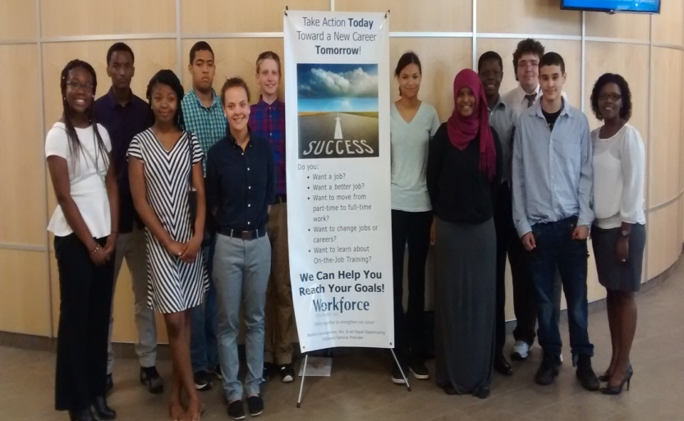
Success in serving OSY - SE MN
http://bbmedia.rochester.k12.mn.us/rits/District/HawthorneB2C.mp4
“The program really does provide a bridge to help you succeed. My navigator and professors are that bridge. Part of the problem at (my previous school) was that my personal life was in so much chaos that my grades were failing. I couldn’t separate my personal life and leave my problems at the door when completing school , work and going to class. I couldn’t concentrate. The best thing about this program is that our security is looked after in all aspects of our lives, not just school. This program bridged a path of success and sustainability for me and my family. I have learned that I am capable and I can do it! There will be no greater feeling than completing the program and framing my diploma. My daughter will see that I finished the program and I hope it will inspire her to do great things with her life.” – Youth Participant, Administrative Clinic Assistant Pathway

Slide 68
Lessons of Effective practices
There is no single model – “one size fits all”
Increase awareness of important youth issues
Establish effective connections with partner agencies.
Leverage resources from various funding streams and maximize their impact.
Set policy and become architects of comprehensive youth workforce development system
Engage family and youth in youth committee composition

Slide 69
Youth Committees Successes and Lessons Learned: Share your good work and advance the field! https://youth.workforcegps.org/discussions/Youth-Committees/2017/09/29/09/22/Coming-Together-at-the-Table
Enough is Known for Action: Firing Up Youth Standing Committees https://youth.workforcegps.org/resources/2017/09/18/13/20/Enough-is-Known-for-Action-Firing-Up-Youth-Standing-Committees
Youth Committee Resource Guide (Minnesota) https://mn.gov/deed/assets/youth-committee-guide_tcm1045-222605.pdf
Recipes for Success: A Youth Committee Guide under WIOA https://youth.workforcegps.org/resources/2017/04/05/11/08/YouthCommittee

Slide 70
Upcoming Topics in the Series
December 2017
Titles I & II
January 2018
Mentoring

Slide 71
Ways to Engage and Connect: DOL and your colleagues need to hear from you!
1st things 1st: Become a GPS member and use the Member Directory
Share your work
Submit a Resource on WorkforceGPS.
Send us your lessons learned and successful strategies to share with the field to youth.services@dol.gov
Participate in Discussion Threads
Youth Committees Successes and Lessons Learned: Share your good work and advance the field! https://youth.workforcegps.org/discussions/Youth-Committees/2017/09/29/09/22/Coming-Together-at-the-Table

Slide 72
Jinny Rietmann
Regional Youth Programs Coordinator
Workforce Development, Inc., Rochester, MN
JinnyRietmann@workforcedevelopmentinc.org
507-292-5165
Kimberly McCaffrey
Manager of Youth Services System
Philadelphia Works, Inc. Philadelphia, PA
KMcCaffrey@philaworks.org
215-557-2805
Jessica Ku Kim
Special Projects Development Manager
South Bay Workforce Investment Board, Inc., Hawthorne, CA
jkim@sbwib.org
310-970-7700
Gabriela Goetz “Gaby”
Youth Program Manager
South Bay One-Stop Business & Career Center, Hawthorne, CA
ggoetz@sbwib.org
310-680-3700

